Slide 1

Low β insertions
Cédric Hernalsteens
CERN

Slide 2
Insertions and low-beta optics
Insertions are interruptions of the “regular” lattice structure which would ideally extend through the arcs and straight sections as they are introduced to serve a variety of purposes
Longer straight sections in synchrotrons are required to host
  RF cavities
  Injection and extraction devices
  Internal beam dumps
  Collimation regions
  Wigglers
  The large detectors of physics experiments

Slide 3
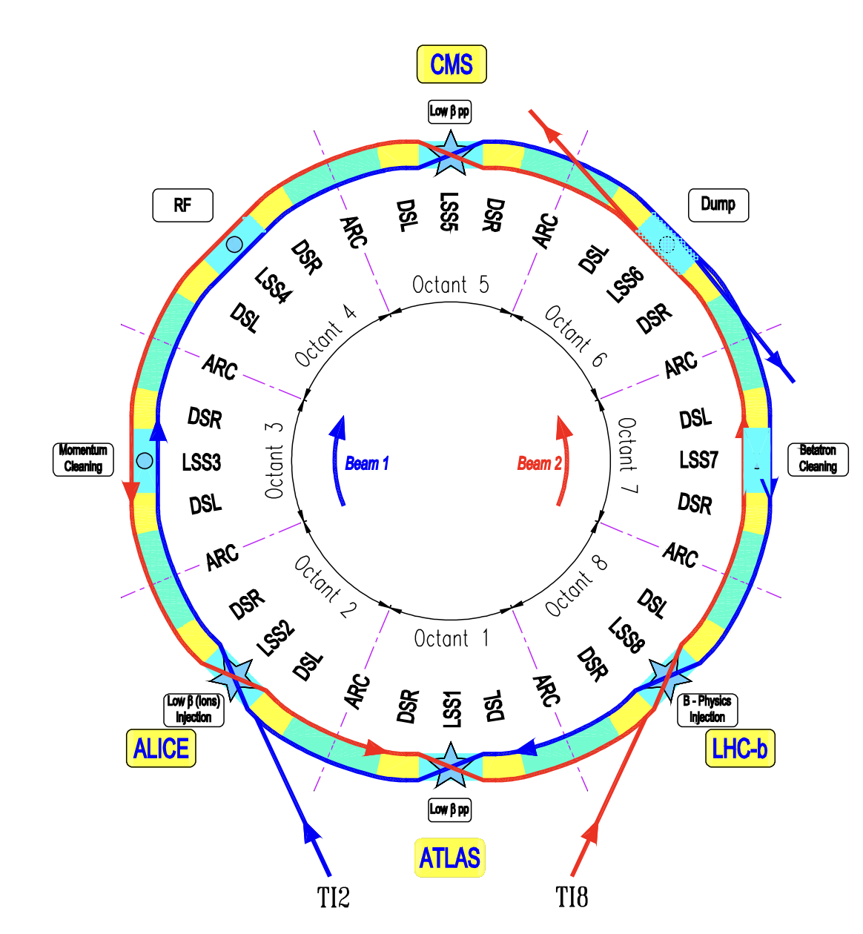
Insertions and low-beta optics
The LHC has 4 experimental insertions requiring low-beta optics and 4 additional insertions

Slide 4
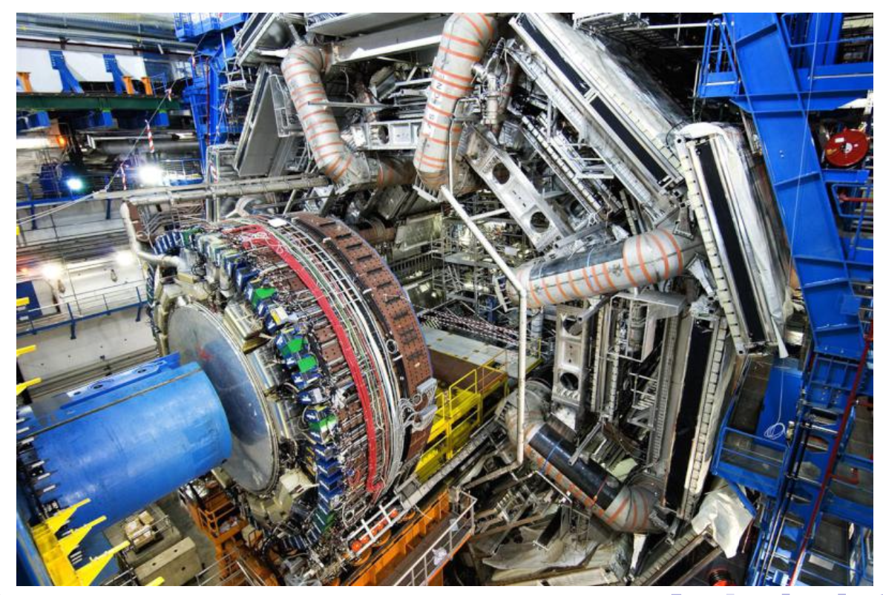
Low-beta insertions
Collider rings lattice: Arcs, Dispersion Suppressors, Long Straight Sections
Some of these long straight sections will host the detectors
Space constraints: requires a long drift space
Interruption of the regular lattice: symmetry and regularity of the optics will be broken
Other constraints?

Slide 5
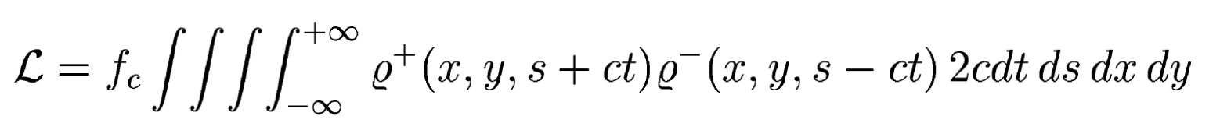
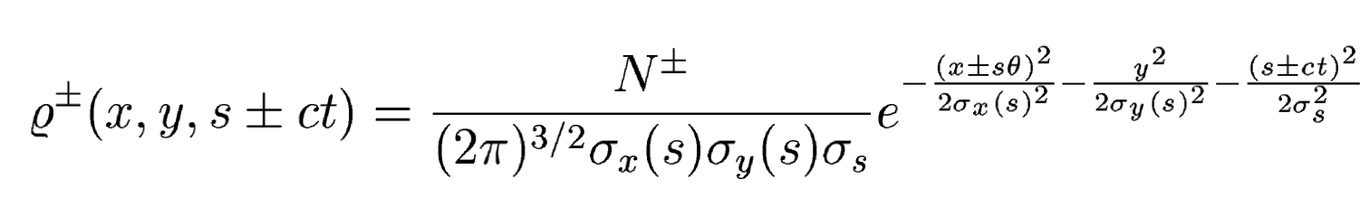
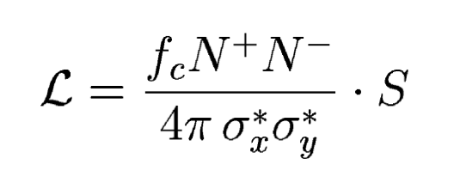
Low-beta insertions
Colliders performance is driven by the luminosity (collision rate
How can we increaes the luminosity of a collider ?
Low beta optics!
Transverse beam size (horizontal and vertical at the interaction point)

Slide 6
Drift spaces!
The description of the experimental insertion typically starts at the interaction point (IP) (where the beam collides) and proceeds towards the matching section, the dispersion suppressor and the arcs
The detector is located “around” the IP and represents our first constraint: it is essentially a drift space around the IP and pushes the first quadrupoles away from the IP
  The length of the drift space from the IP to the first quadrupole is refered to as L*
  How does the optics evolve in a pure drift space?

Slide 7
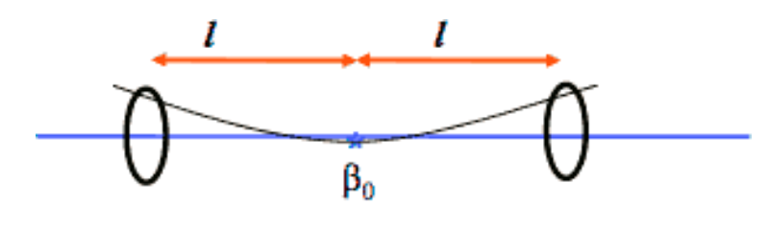
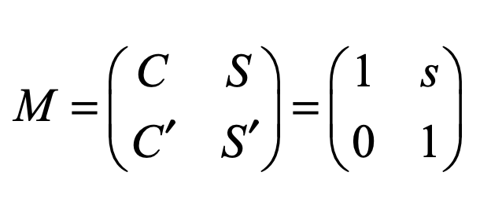
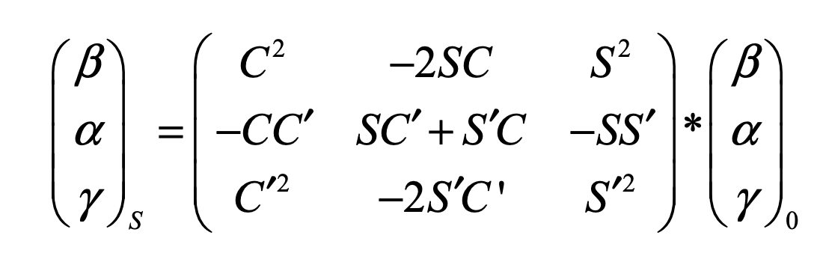
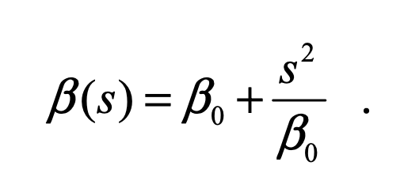
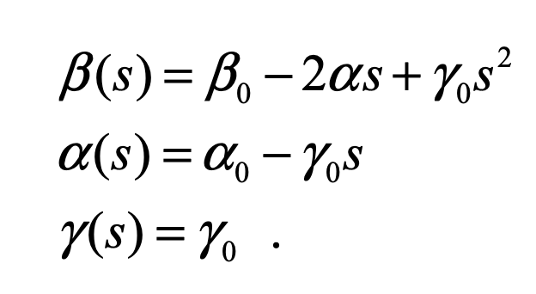
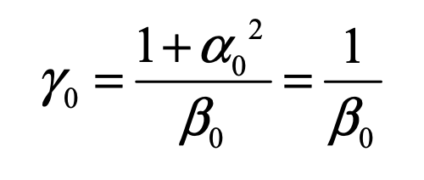
Drift spaces!
Transfer matrix for a drift
Beam waist
Propagation of the Twiss parameters

Slide 8
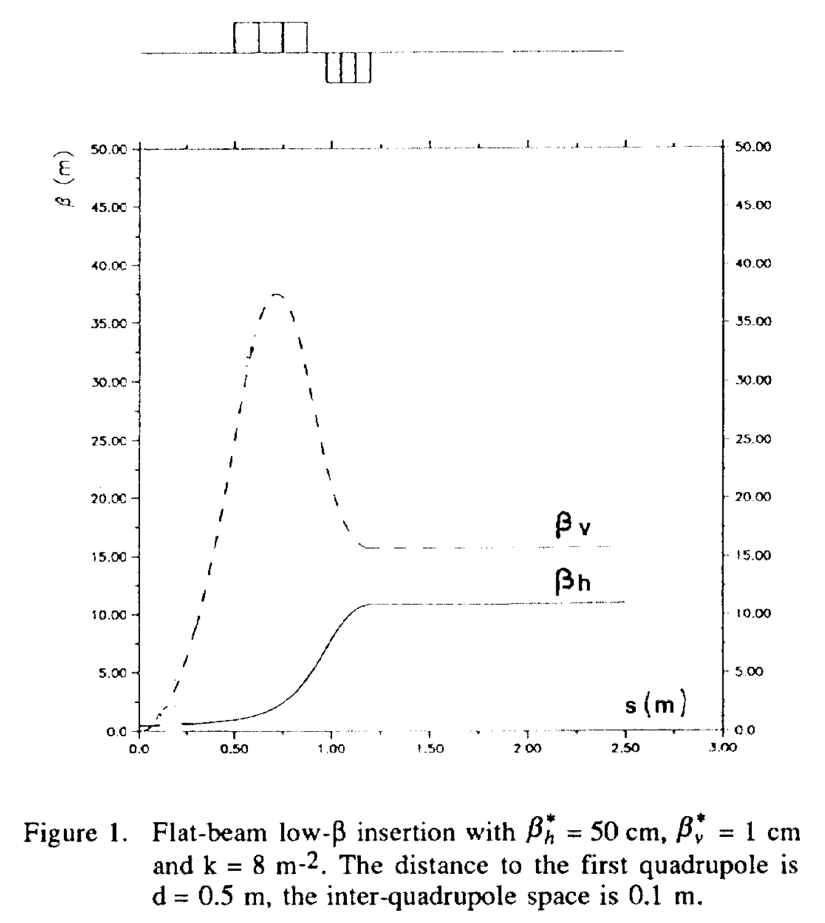
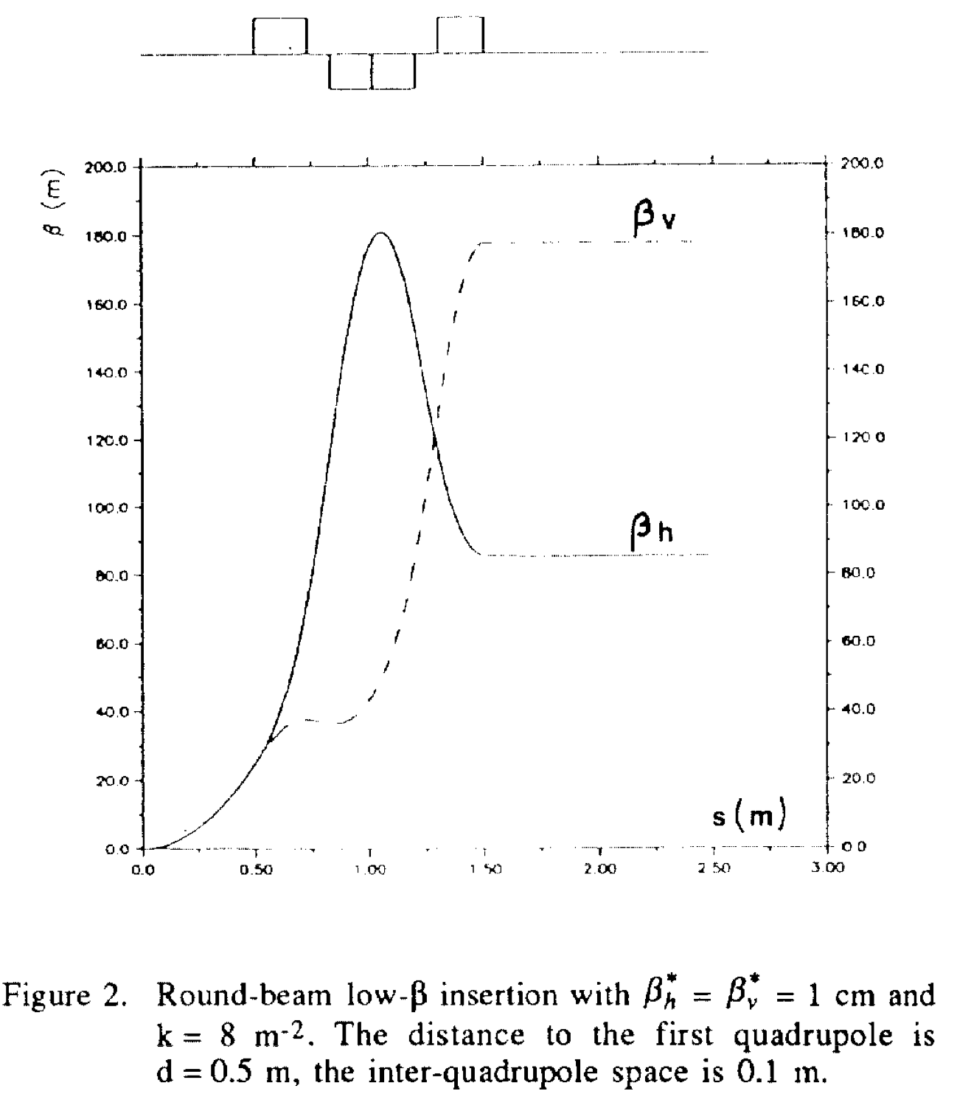
Possible layouts
L*
L*

Slide 9
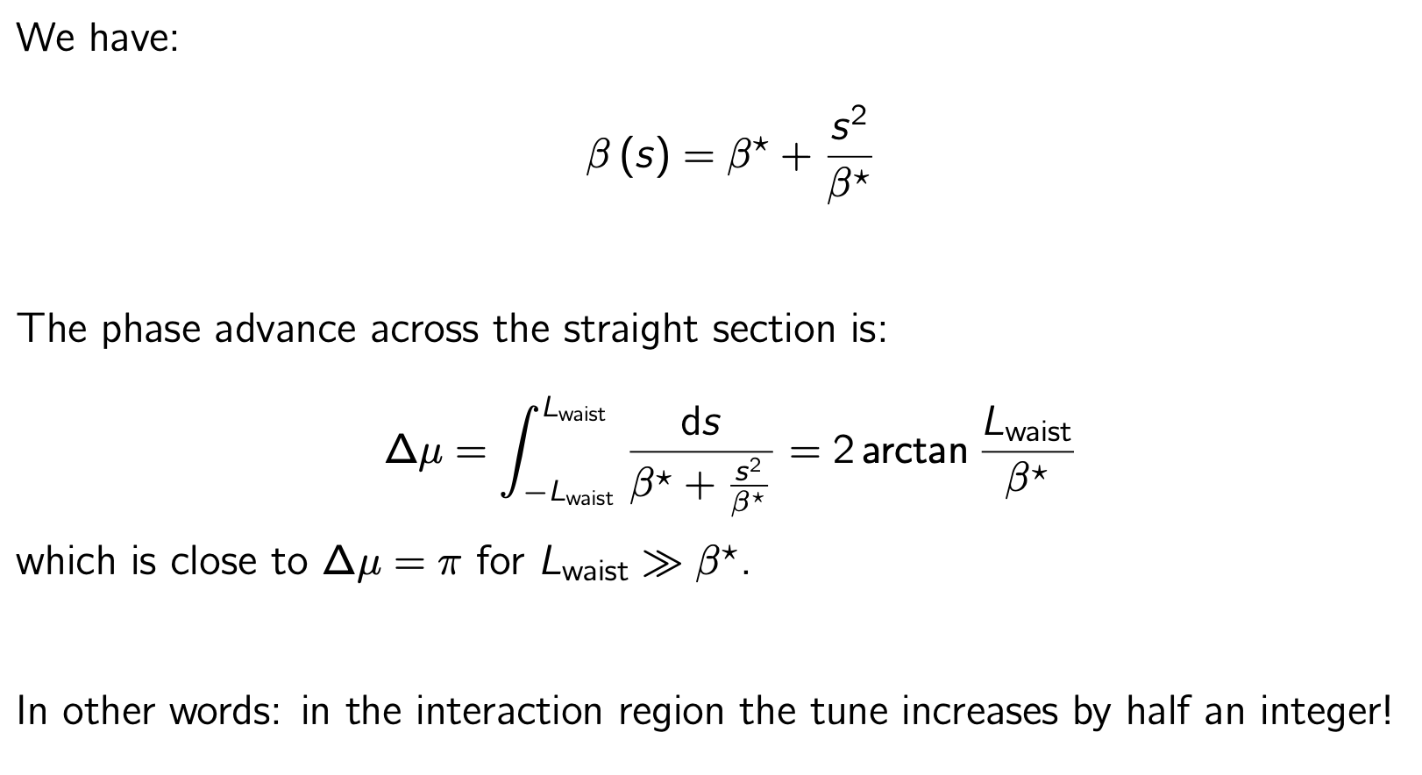
Phase advance in low-beta insertion

Slide 10
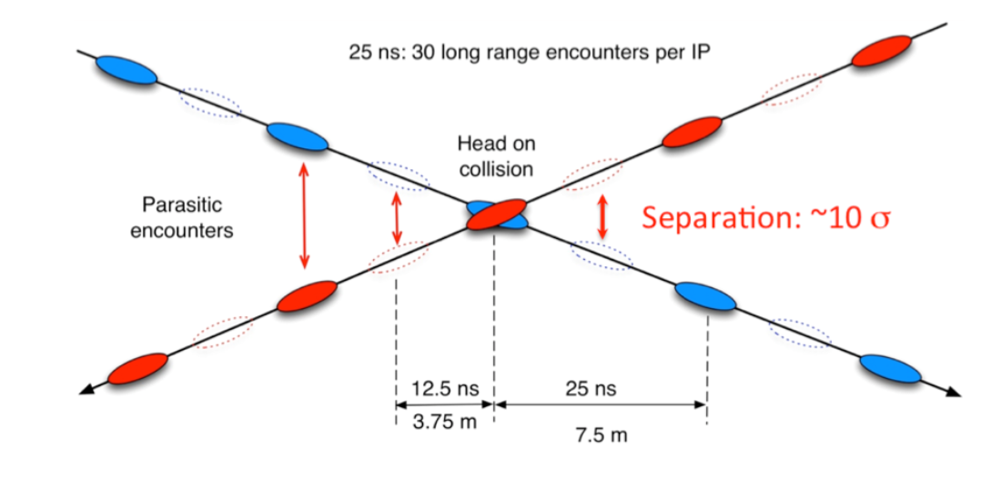
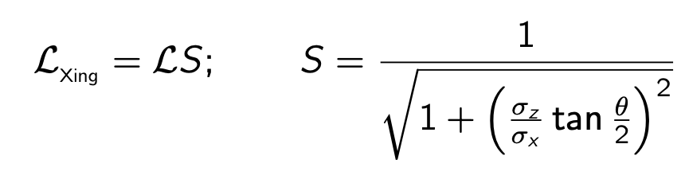
Crossing angle
The crossing bumps are created by dedicated dipole magnets
Increased crossing angle implies luminosity reduction!

Slide 11
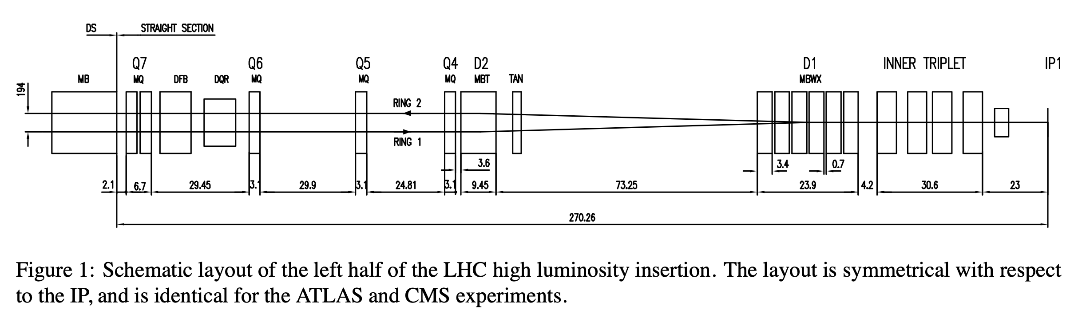
Beam separation
The two beams need to be separated ”quickly” to avoid additional long-range beam-beam encounters
In the case of high-energy e-p colliders this beam separation is an important source of synchrotron radiation, close to the detector

Slide 12
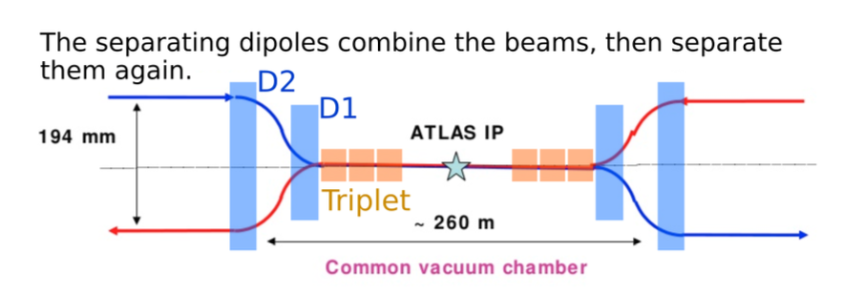
Beam separation
The two beams need to be separated ”quickly” to avoid additional long-range beam-beam encounters
In the case of high-energy e-p colliders this beam separation is an important source of synchrotron radiation, close to the detector

Slide 13
Beam recombination, crossing bumps and separation bumps ?!
Separation and recombination dipoles basically “send each beam to its own beam pipe”
However, in the common beam pipe the beams should not overlap, this created the need for the crossing angle bumps, generated by dedicated dipole magnets
What if the beams should not collide?
  Separation bumps are created by an additional set of dipoles!

Slide 14
Putting it together
  A drift space is reserved to house the particle detector
  The insertion is built (anti-)symmetrically around that drift space
  The collisions take place at the center of the drift space: the interaction point (IP)
  Beta is minimized at the IP, the beta value at the IP is called “beta*”
    This implies that alpha is zero at the IP!
  A quadrupole doublet or triplet is placed on each side of the IP, at a distance called “L*”
    Ideally L* should be minimized (why?) but experimental physicists fancy large detectors
    That doublet or triplet “intercepts” the highly diverging beams as close as possible to the IP so that the beam size remains “under control”
    Beta values at the triplet/doublet can reach very large values (kilometers!)
  Separation and recombination dipoles are added to the insertion
  Additional quadrupoles are used to match the mini-beta insertion to the rest of the lattice

Slide 15
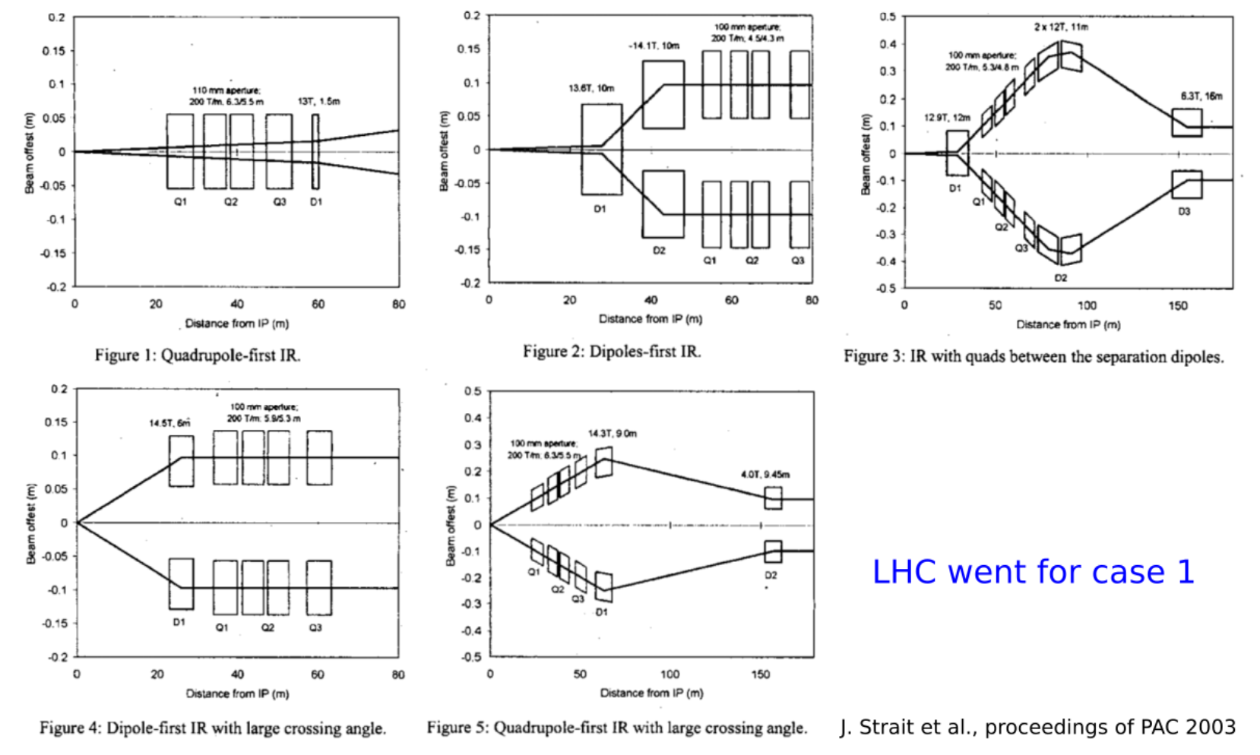
Putting it together

Slide 16
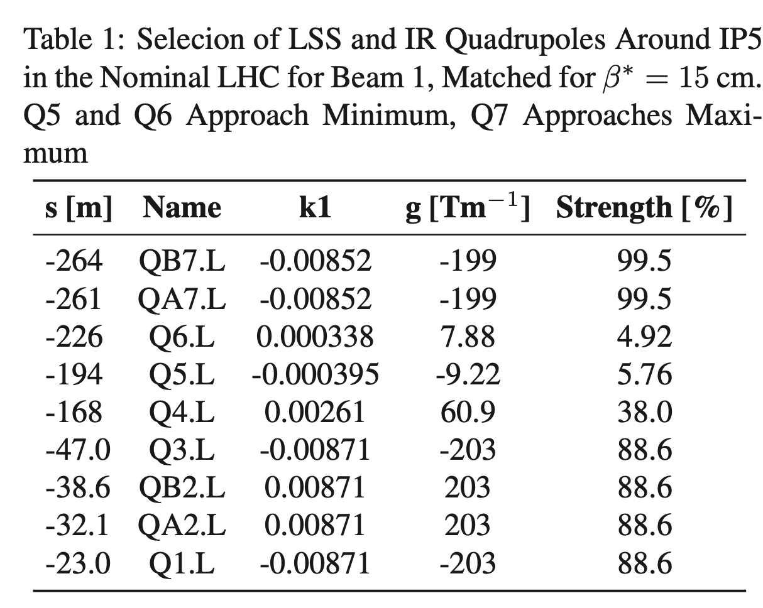
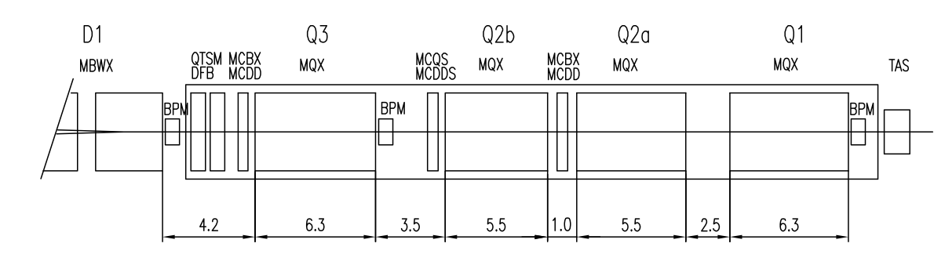
The LHC low-beta interaction regions

Slide 17
The LHC low-beta interaction regions
  Anything else or is it already complicated enough?
    Please implement all the constraints while at the same time remaining infinitely flexible so that we can implement all sorts of new ideas (and constraints) in a couple years!
    Chromaticity correction
    Corrections of higher-order errors and imperfections
    What about injection and ramp? Not only flat-top collision!
  What are the main limitations, why can’t we reach even smaller beta* values and thus gain in luminosity?
    The issue is beta max!

Slide 18
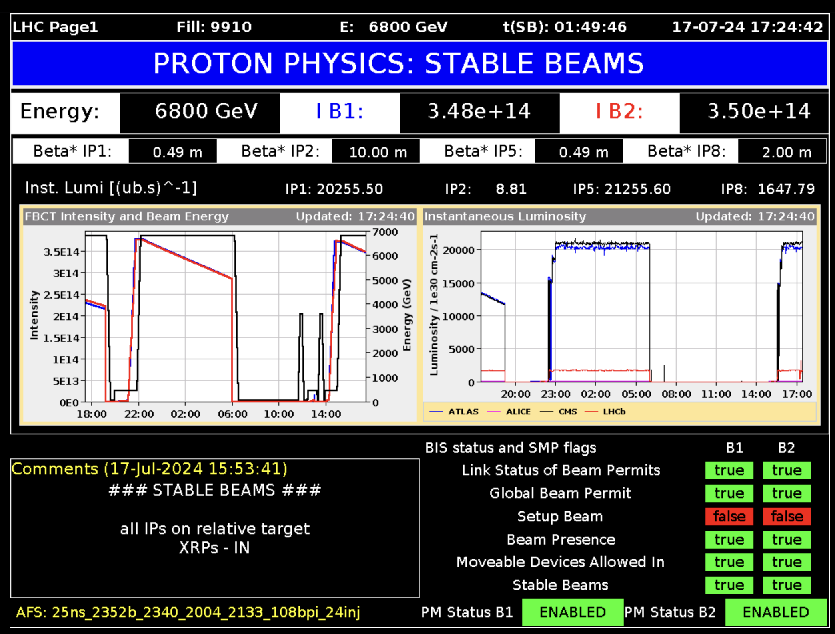

Slide 19
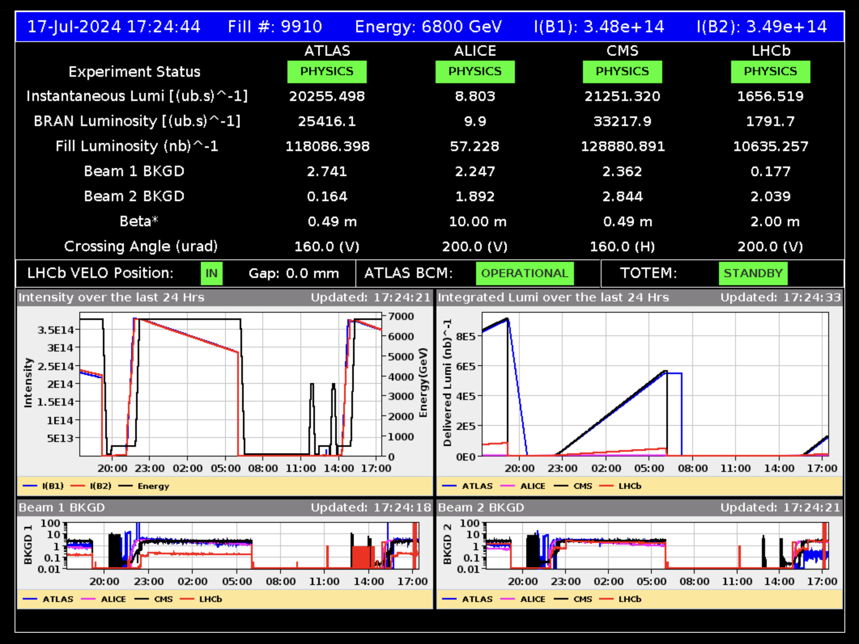

Slide 20
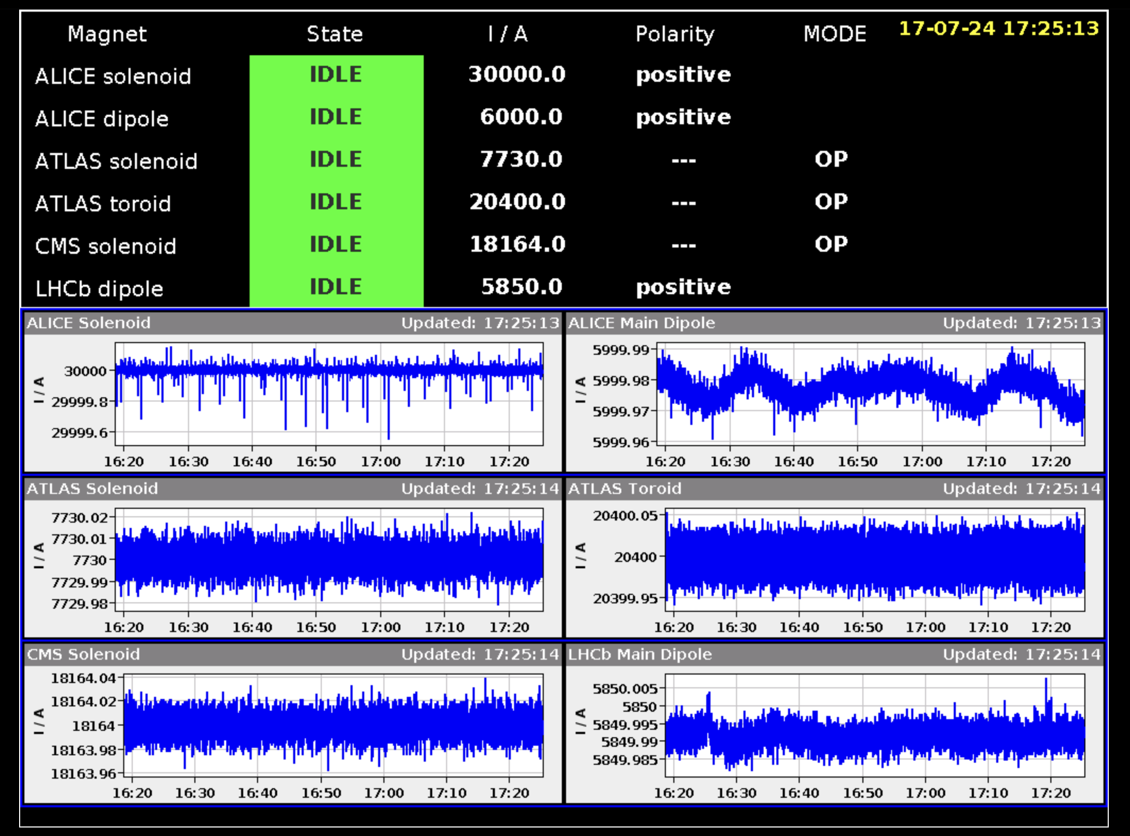

Slide 21
In practice
Calculate the optics of the dispersion suppressor, which should already be matched to the arc lattice
But start from the IP and pick your target beta*
Install a triplet or doublet and consider the constraints in term of gradient and aperture, “bring the beams under control”
Introduce additional quadrupoles to match towards the DS+Arc

