Slide 1


ALBA LLRF UPGRADES TO IMPROVE BEAM AVALIBYLITY
Emilio Morales
USPAS – Introduction to LLRF
Winter 2017. Rohnert Park, CA

Slide 2
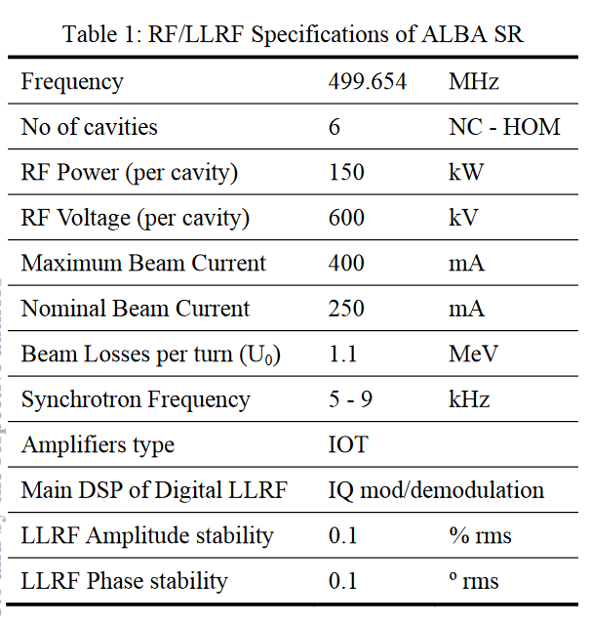
ALBA LLRF UPGRADES TO IMPROVE BEAM AVALIBYLITY
Introduction
Designed to provide up to 3.6MV and to restore 540kW.
RF interlocks: mainly due to internal arcs in RF amplifiers.
Auto-recovery process implemented. Recover the plant with circulating beam.
Observed: Disturbances induced to the beam due to RF trips may cause a partial o total beam dump.

Slide 3
CAVITY AUTORECOVERY WITH BEAM
RF Trip:
  Cavity absorbs power to the beam.
LLRF:
  Detune the cavity around 500kHz.
  Amplitude and Phase loops disabled.
  LLRF Drive to minimum.
Digital phase shifter.
Auto recovery process:
  Plunger move to previous position.
  Tunning Loop enable
  Amplitude and Phase loops enable.
  Power increase smoothly.

Slide 4
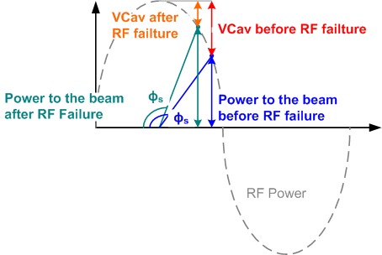
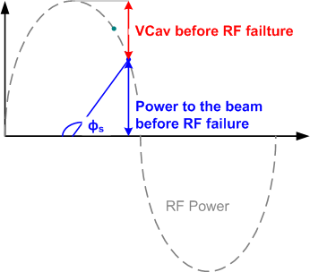
FEED-FORWARD LOOPS FOR RF TRIP COMPENSATION
Effects observed after RF Trip beam survival:
  Cavity voltage reduced. More power delivered to the beam.
  Sync. Phase start to decrease and oscillates.
  The higher beam current and/or low RF voltage, the higher amplitude.

Slide 5
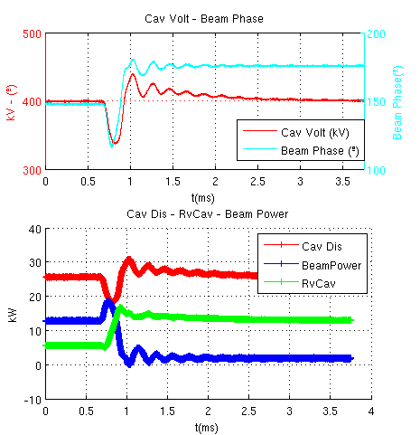
FEED-FORWARD LOOPS FOR RF TRIP COMPENSATION
Effects observed after RF Trip with partial beam lost:
  Cavity voltage reduced. Overshoot.
  Reverse power increase.
  Power delivered to the beam reduced.
Extracting power from to beam.
This extra power will be provided by the loop.

Slide 6
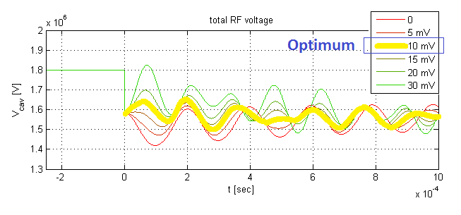
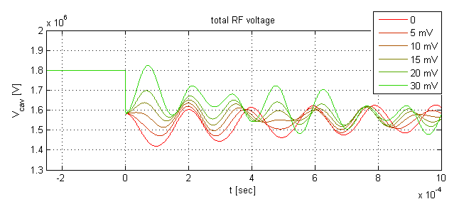
FEED-FORWARD LOOPS FOR RF TRIP COMPENSATION
Main Parameters:
  Plants informed in < 100 ns
  Increase the drive following sinusoidal signal, but with opposite phase.
  Transient of 3ms with exponential curve.
  FPGA limitations: Math. Operations limited. Linear decay implemented.
Simulations
  Interaction of the beam after RF trip with and w/o active compensation.
  Show that the it was not possible to completely remove the perturbation.

Slide 7
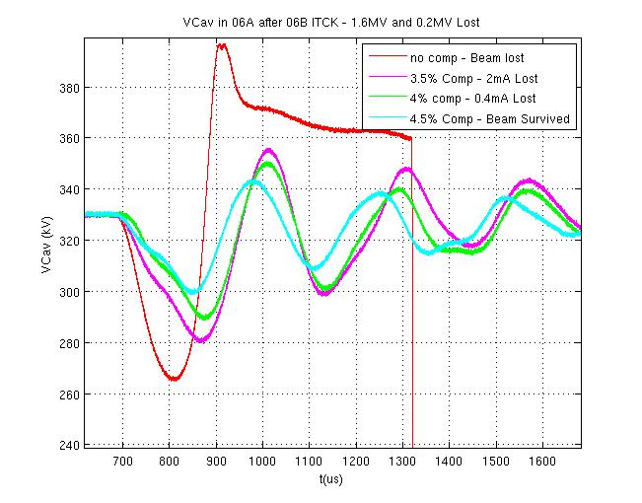
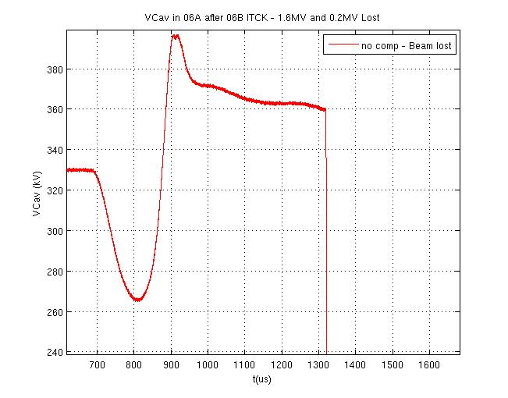
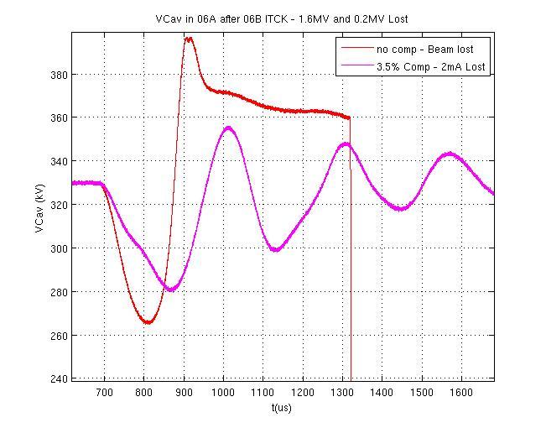
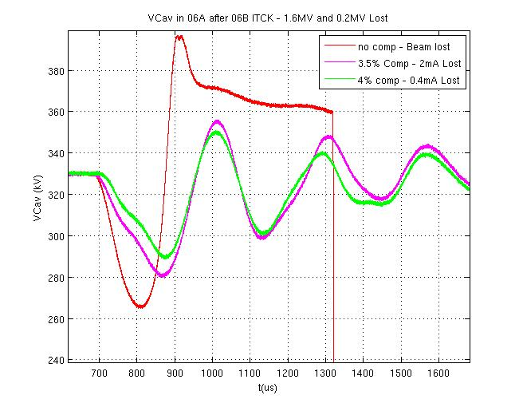
FEED-FORWARD LOOPS FOR RF TRIP COMPENSATION
Experimental results
  60mA, 1.5MV
  Fake interlock: 1.5MV → 1.2MV
  No compensation: Beam Lost
  Measure the ripples
  FF loop enabled.
  Fake interlock repeated. Amplitude of FF loop increased to cancel the beam lost.

Slide 8
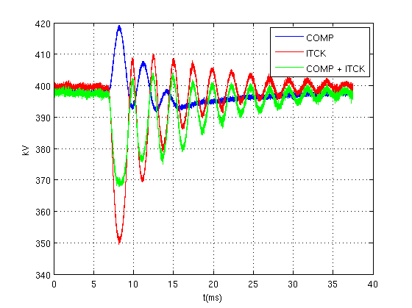
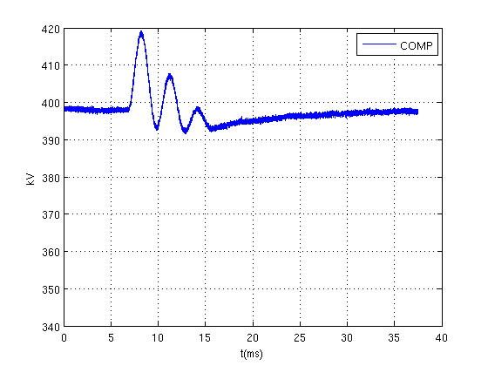
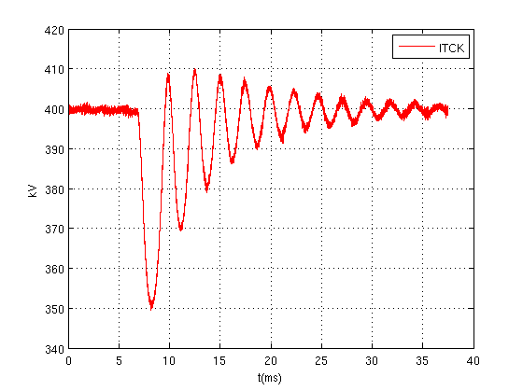
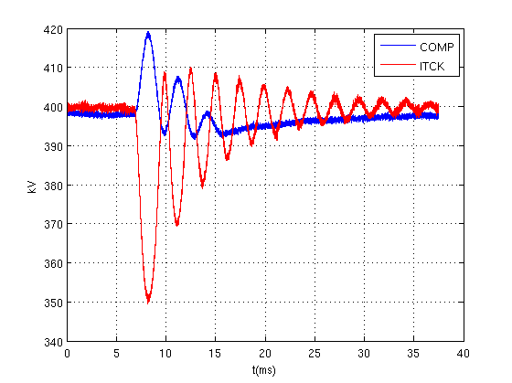
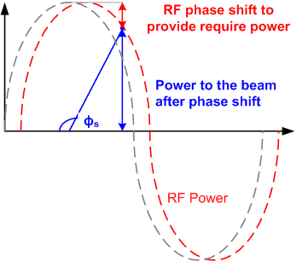
FEED-FORWARD LOOPS FOR RF TRIP COMPENSATION
Next steps:
  Amplitude modulation of LLRF drive to phase modulation.
  The main advantage: the output of the amplifier would remain constant.

Slide 9
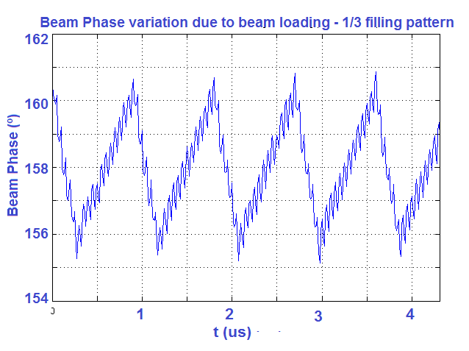
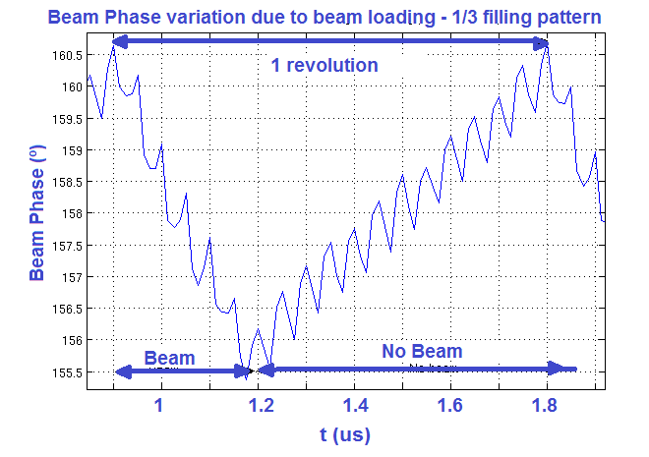
BEAM LOADING COMPENSATION
Feed-Forward loops to compensate bema loading effects.
Following the same approach for the RF Trip compensation, algorithm developed.

Slide 10
ALBA LLRF UPGRADES TO IMPROVE BEAM AVALIBYLITY
Emilio Morales
USPAS – Introduction to LLRF
Winter 2017. Rohnert Park, CA

