Slide 1
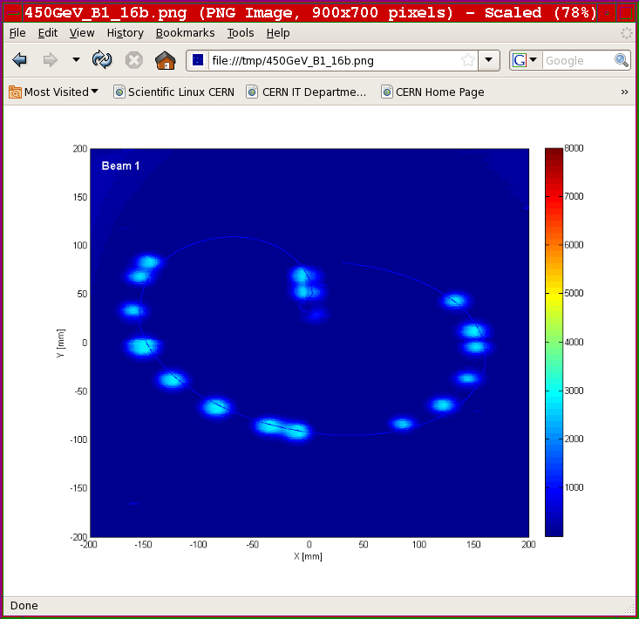
Machine Protection and Operation for LHC
USPAS – Machine Protection & Beam Loss
Rohnert Park
January 2017
Jörg Wenninger
CERN Beams Department
Operation group – LHC section
Acknowledgements: R. Schmidt, V. Kain, B. Salvachua, S. Redaelli, B. Todd, M. Zerlauth, D. Wollmann,
J. Uythoven, B. Puccio, B. Dehning, T. Bär, A. Lechner, A. Appolinio, K. Fuchsberger, W. Fischer, D. Mirarchi

Slide 2
Introduction to LHC
Beam interlock system
Commissioning
Intensity ramp up
Beam losses
Machine protection diagnostics & software
Conclusions

Slide 3
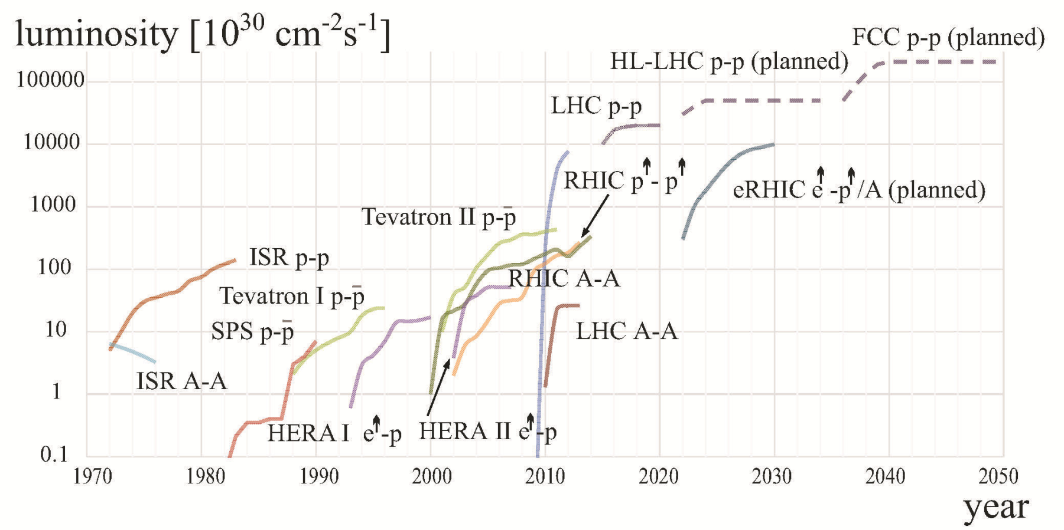
Hadron colliders
The LHC is the latest in the series of the large hadron colliders after the ISR, SPS, Tevatron, HERA and RHIC.
The LHC pushes the luminosity frontier by a factor ~25 and the energy frontier by a factor ~7 (almost !).
  The luminosity gain is mainly achieved with very high beam intensity.
LHC 2016
W. Fischer

Slide 4
Collider Luminosity
The key parameter for the experiments is the event rate dN/dt. For a physics process with cross-section σ it is proprotional to the collider Luminosity L:
unit of L :
1/(surface × time)
Population N₁
Population N₂
area A
N1 × N2
Collision rate ∝
σ ×
× encounters/second
A
L
To maximize L we have to squeeze as many particles as possible into the smallest possible volume !

Slide 5
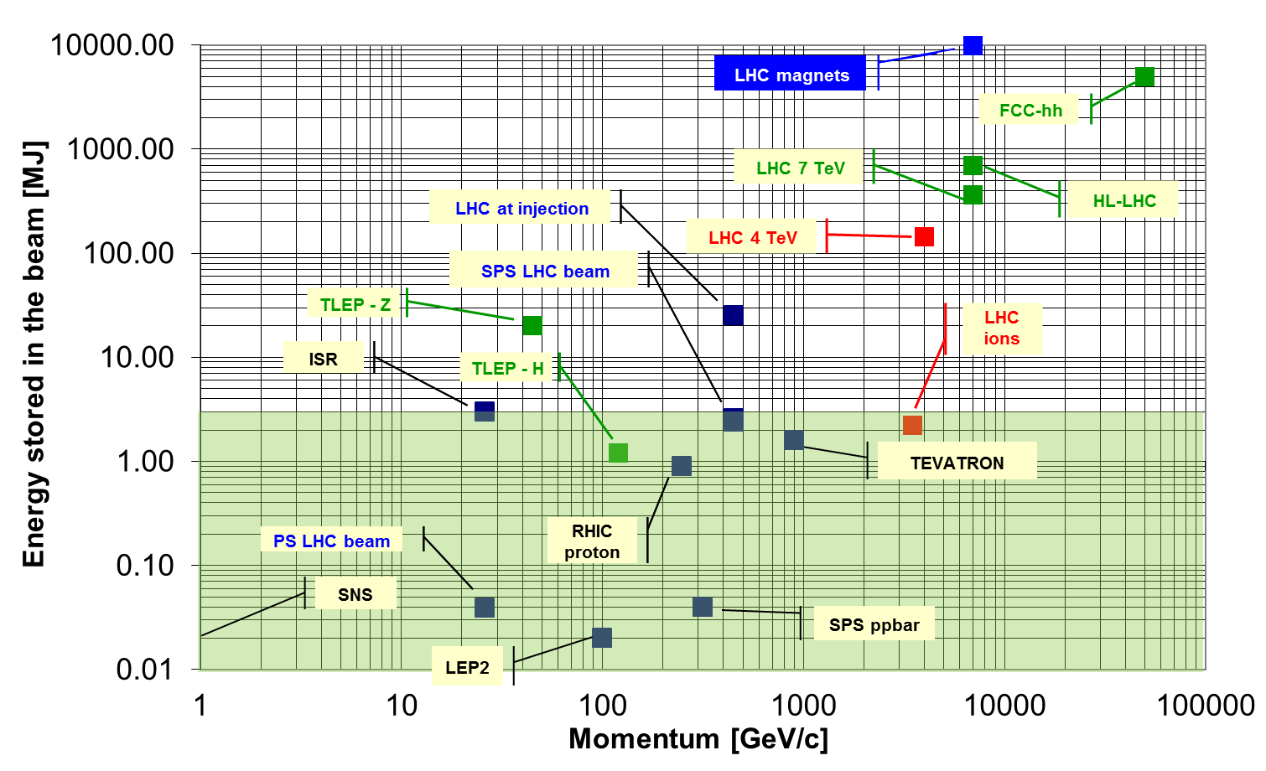
Stored energy: past – present – future
LHC pushed the stored energy from few MJ to > 100 MJ
2050++ ?
2026
Pre-LHC state-of-the-art

Slide 6
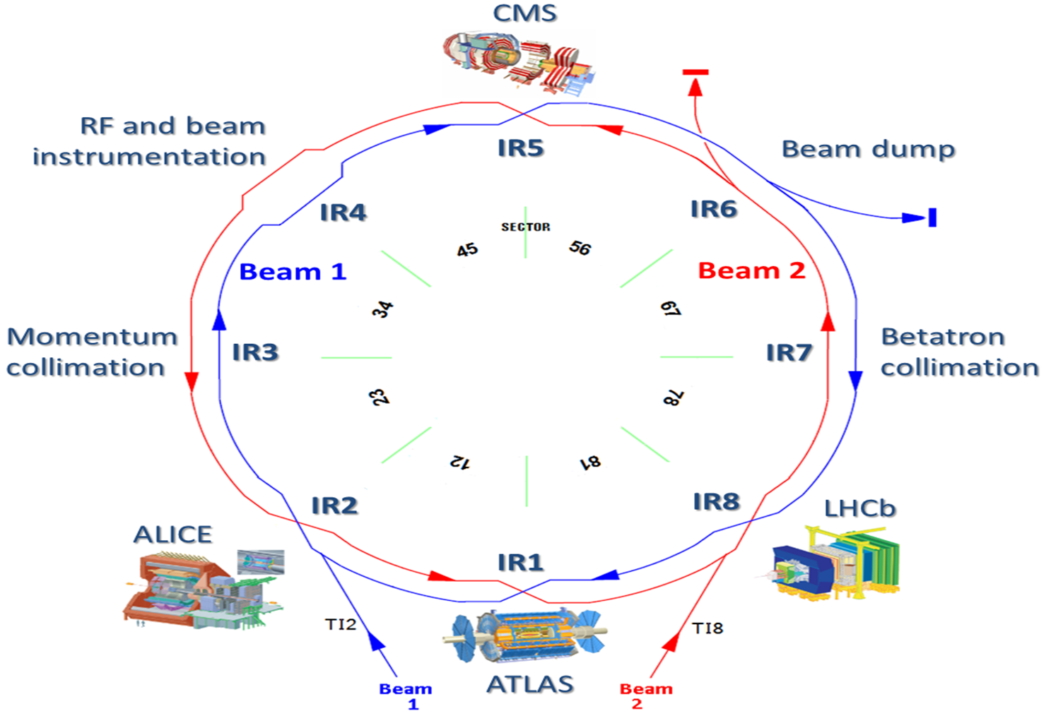
LHC overview
Total length 26.66 km, in the former LEP tunnel.
8 arcs (sectors), ~3 km each.
8 straight sections of 700 m.
beams cross in 4 points.
2-in-1 magnet design with separate vacuum chambers.
2 COUPLED rings.
Injection at 450 GeV, operation at 6.5 TeV since 2015.
The beam intensity (number bunches) can be pushed a lot thanks to the double ring layout – modern ‘factory’ design.
The LHC can be operated with protons and ions (so far Pb₂₀₈)

Slide 7

LHC layout
Installed in 26.7 km LEP tunnel
Depth of 50-170 m
Lake of Geneva
LHC ring
Control Room
SPS ring

Slide 8


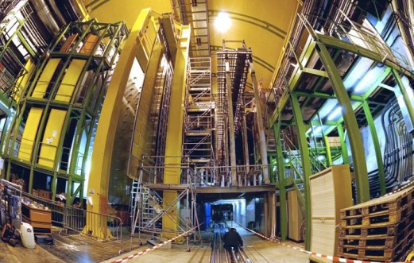
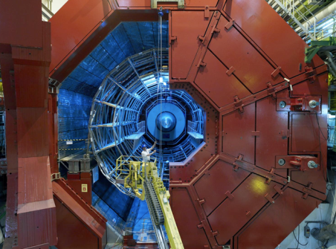


LHC layout
Installed in 26.7 km LEP tunnel
Depth of 70-140 m
Lake of Geneva
CMS
LHC ring
LHCb
LHC ring
Control Room
SPS ring
ALICE
ATLAS

Slide 9
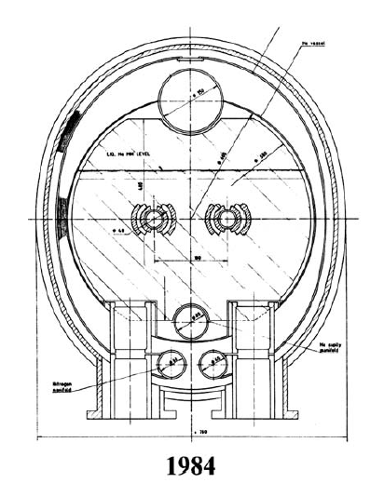
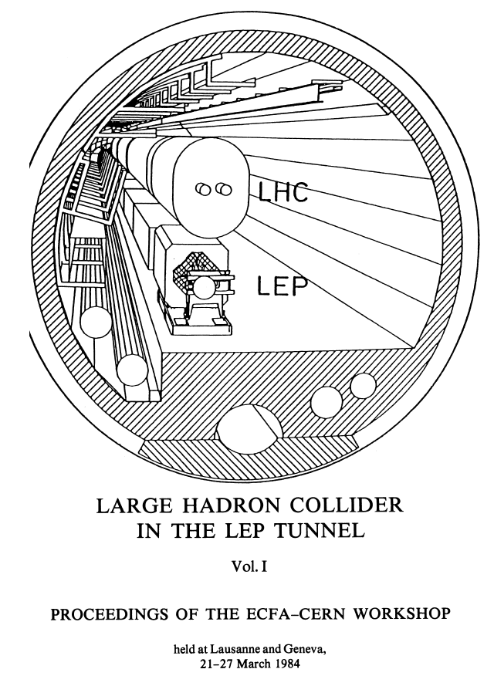
LHC challenges and choices
Initial design choices:
High magnetic fields – 8T,
  ⇒ super-conducting magnets
2 in 1 magnet design,
Superfluid Helium,
Luminosity ~1×10³³ cm⁻²s⁻¹
  ⇔ limit to 4 pp collisions (‘events’) / bunch crossing !
The parameters remained rather stable over time, except for luminosity (and intensity):
Luminosity was pushed to ~1×10³⁴ cm⁻²s⁻¹ to compete with SSC.
  The SSC was cancelled in 1994, but the high luminosity was kept !
  High luminosity → high intensity → MPS !!

Slide 10
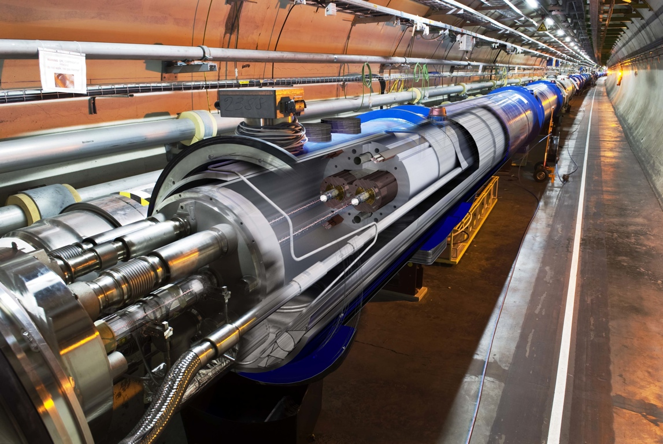
1232 NbTi superconducting dipole magnets – each 15 m long
Magnetic field of 8.3 T (current of 11.8 kA) @ 1.9 K (super-fluid Helium)
Superconducting coil:
quench at ~ 15mJ/cm³
Factor 9.7 x 10 ⁹
Aperture: r = 17/22 mm
Proton beam: 145 MJ
(design: 362 MJ)
LHC 2010-2016: No quench with circulating beam, with stored energies over 100 times above previous state-of-the-art!

Slide 11
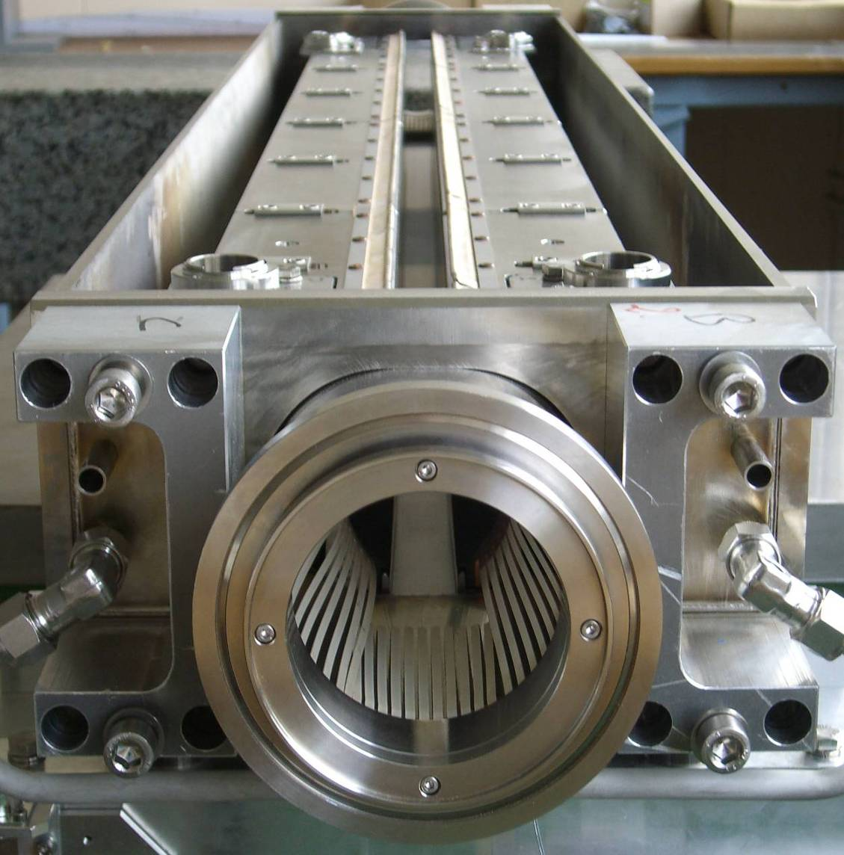
Beam collimation (cleaning)
The LHC requires a complex multi-stage collimation system to operate at high intensity.
  Previous hadron machines used collimators only for experimental background conditions.
see lecture on collimation
Over 100 collimators, mostly made of Carbon and Tungsten, protect the superconducting magnets against energy deposition from the beam
1.2 m
Dual role of collimators:
Halo collimation (cleaning)
Passive protection of the machine
beam

Slide 12
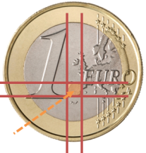
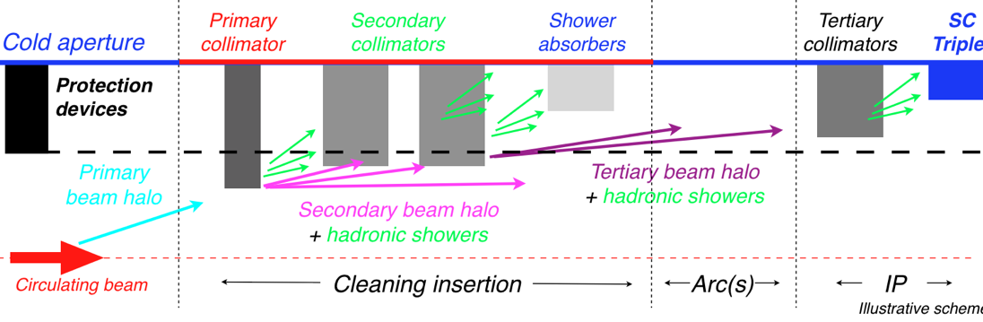
Collimation system
Gap opening
To be able to absorb the energy of the 7 TeV proton, the LHC requires a multi-stage collimation system – primary, secondary, tertiary.
The system worked perfectly so far – thanks to excellent beam stabilization and machine reproducibility – only one full collimation setup / year.
  ~99.99% of the protons that were lost from the beam were intercepted.
  No quench with circulating beam (only during injection or dedicated quench tests).

Slide 13
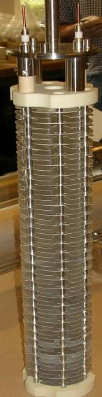
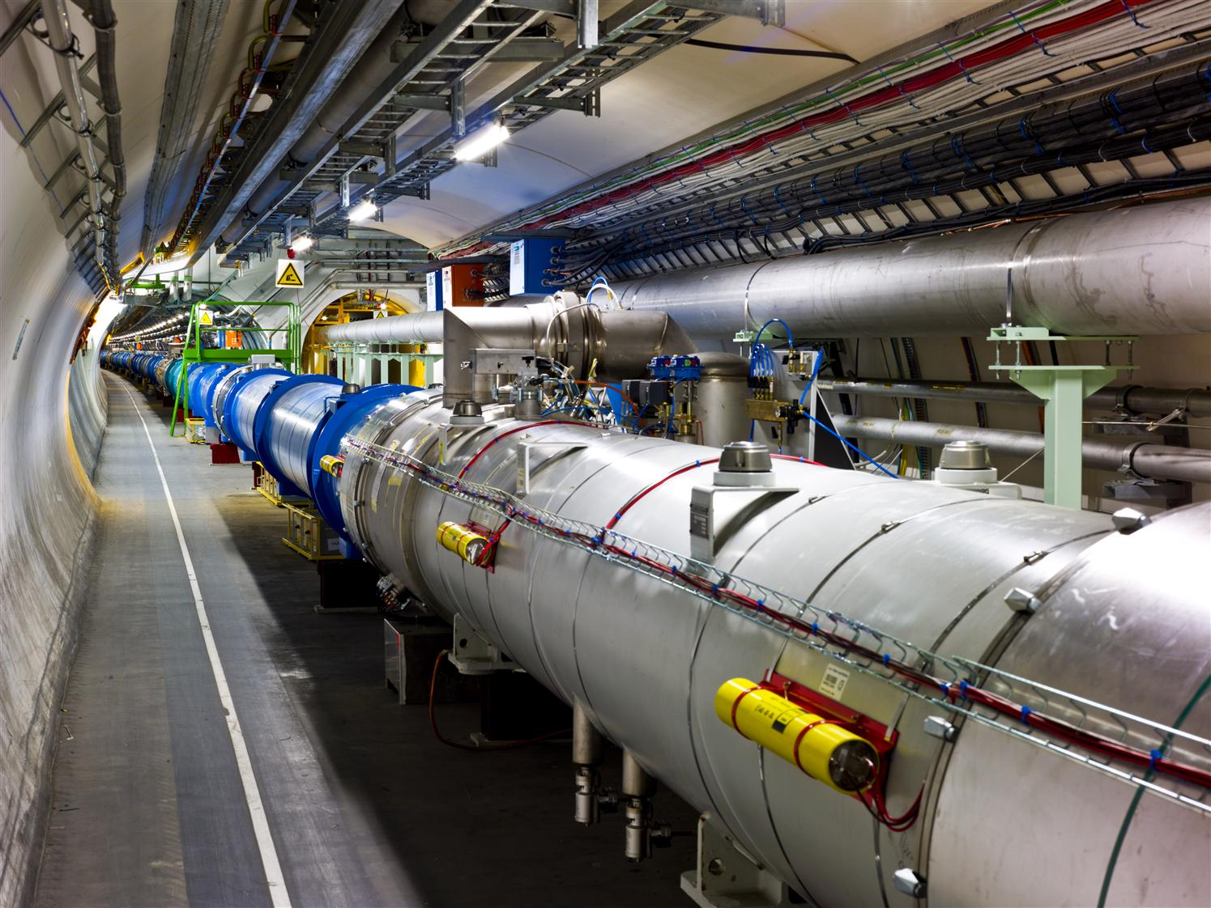
Beam loss monitoring
Ionization chambers are used to detect beam losses at LHC:
  Very fast reaction time ~ ½ turn (40 μs)
  Very large dynamic range (> 10⁶)
~4000 chambers (BLMS) are distributed over the LHC to detect beam losses and trigger a beam abort !
  Each individual monitor can dump the beam.
BLMs are good for almost all failures as long as they last ~ a few turns (few 0.1 ms) or more !
Loss monitors based on diamond detectors are installed in few locations to provide diagnostics with high time resolution.
  Not connected to the MP system.
  With ns time resolution diamonds provide bunch-by-bunch loss diagnostics.
  Very high radiation hardness.

Slide 14
LHC beam dumping system
A complex system, and yet it must be ultra-highly reliable!
Beam 1
15 septum magnets deflect the beam vertically
Q5L
10 kicker magnets dilute the beam
Beam dump block
Q4L
15 fast ‘kicker’ magnets deflect the beam to the outside
≈ 900 m
Q4R
≈ 500 m
Q5R
quadrupoles
Beam 2

Slide 15
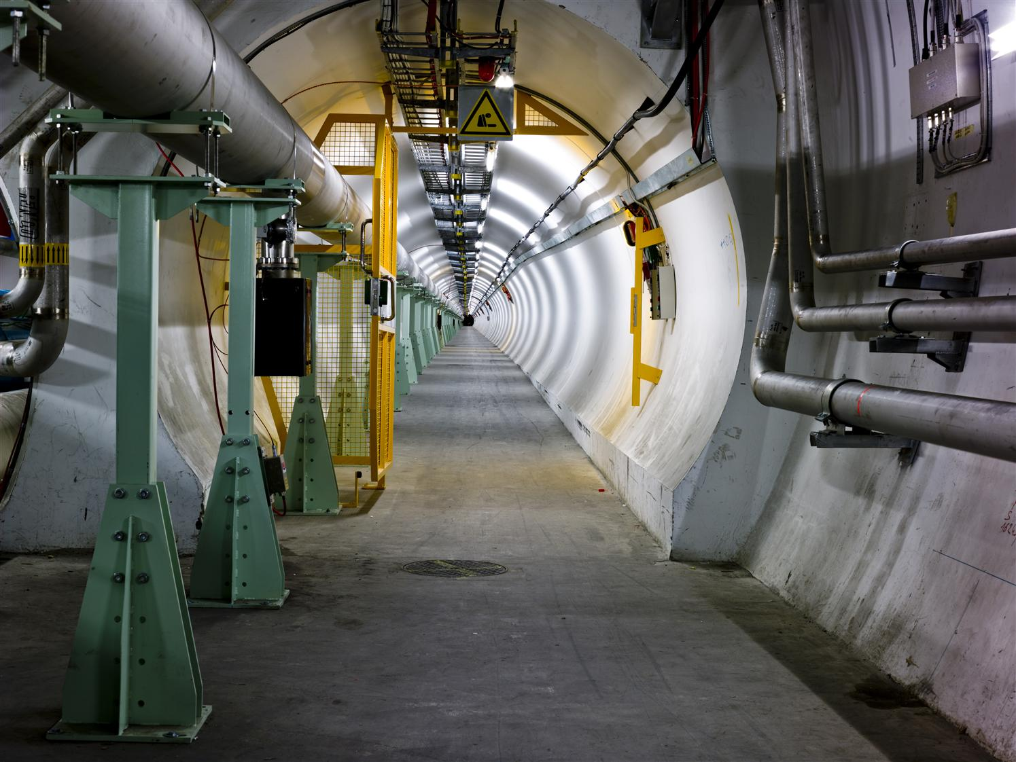
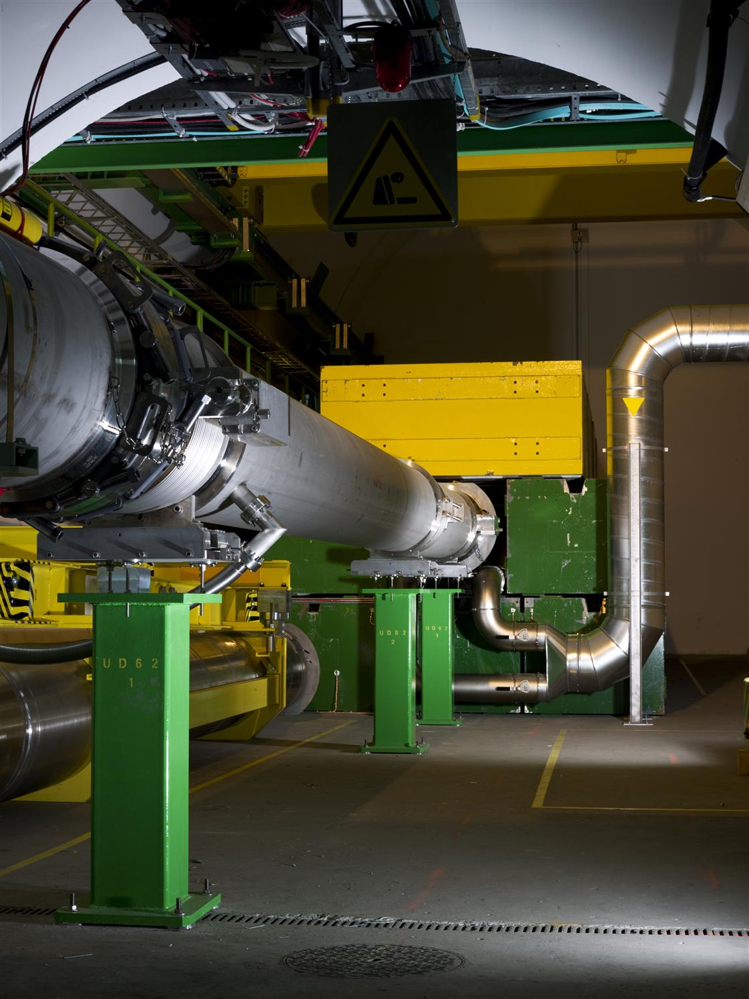
LHC dump line

Slide 16
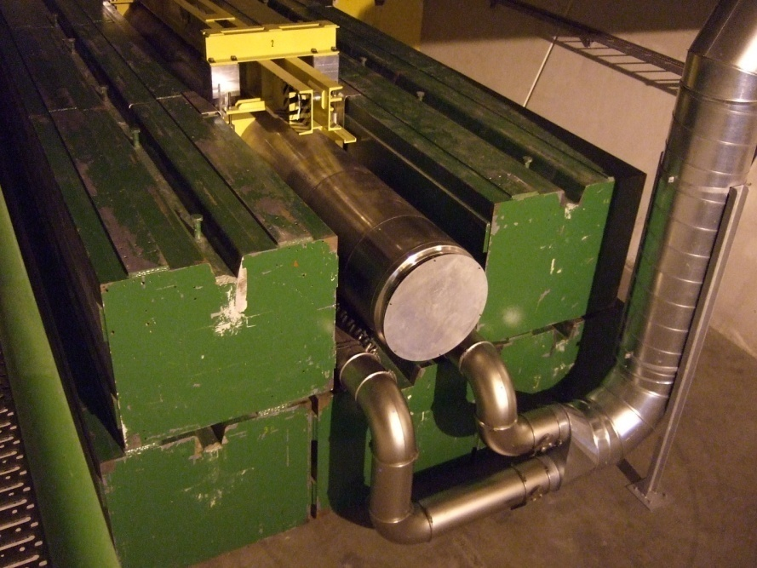
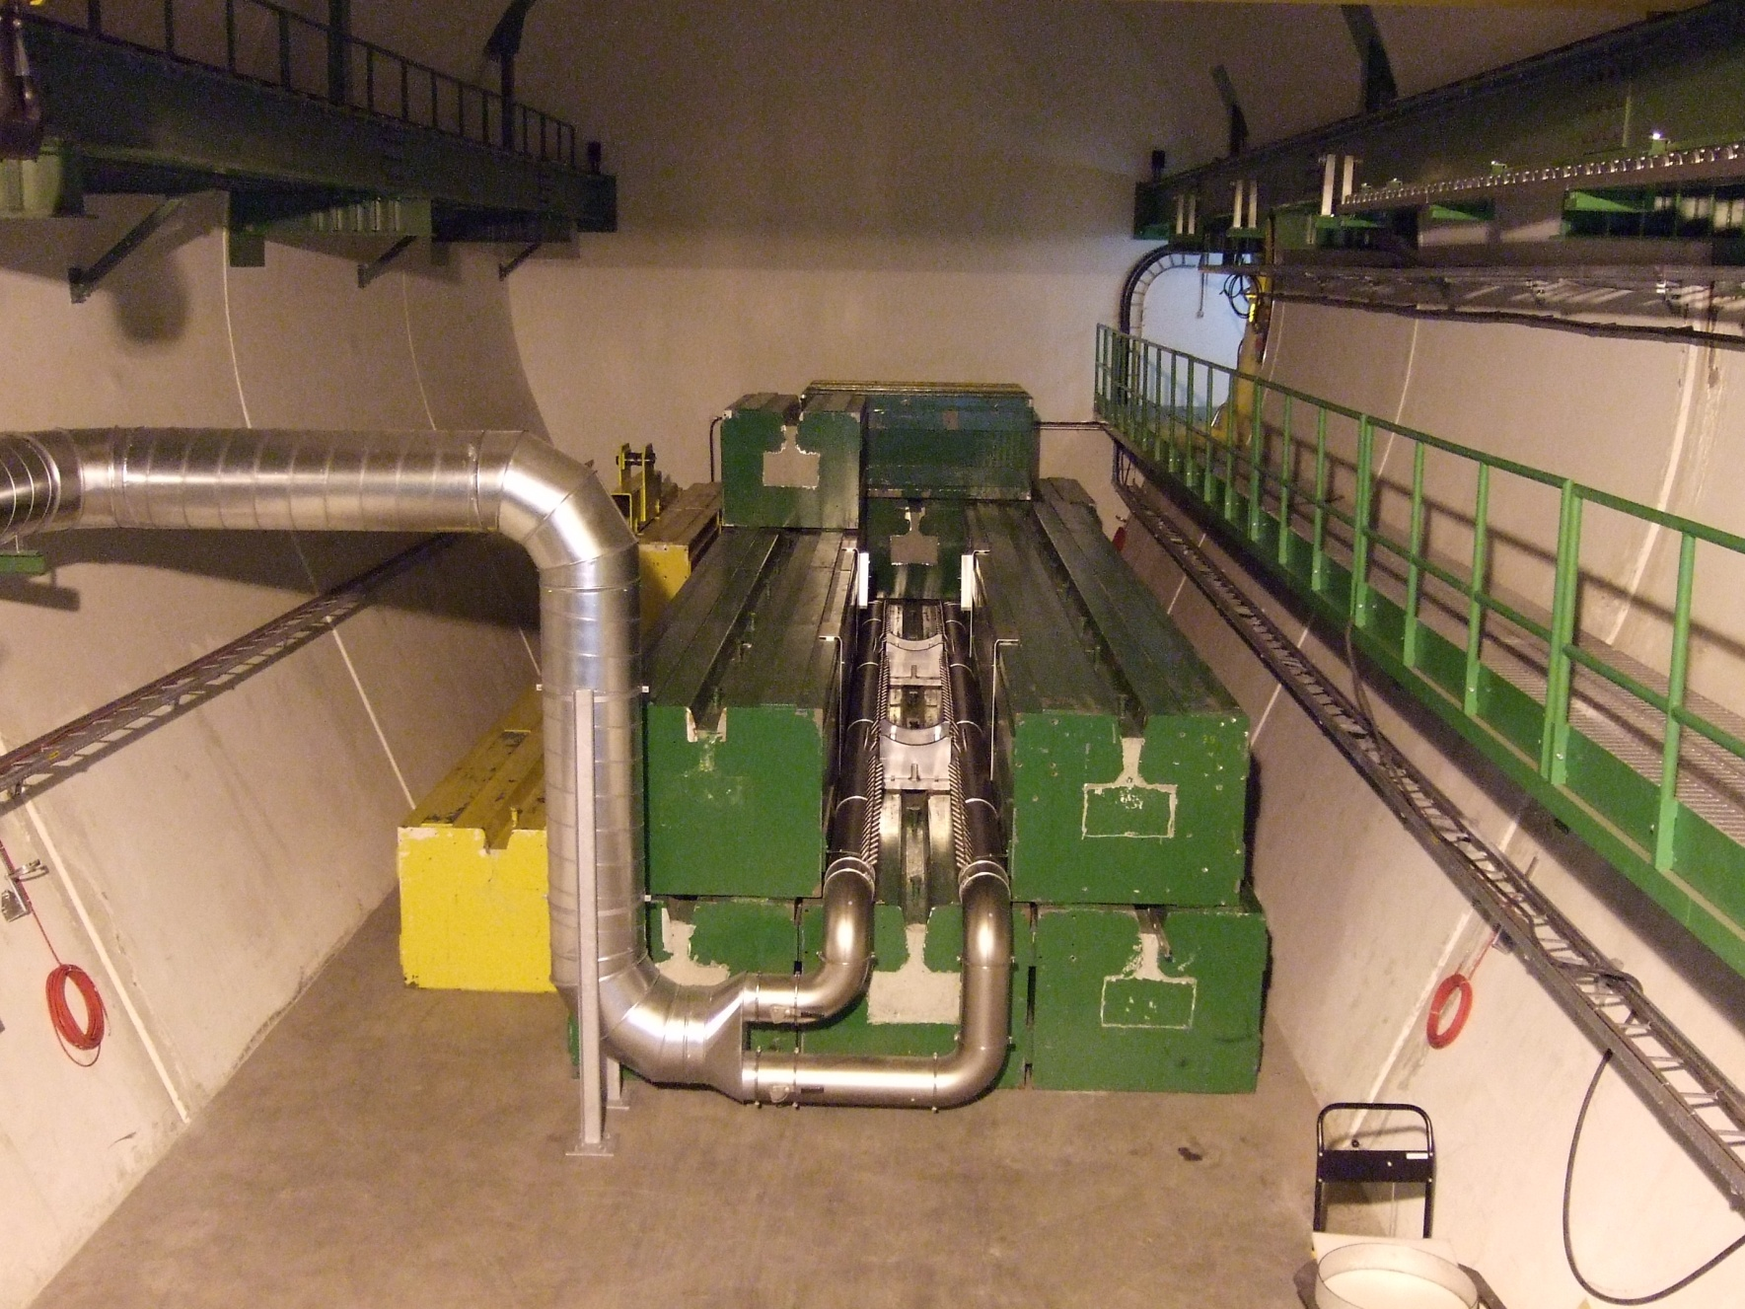
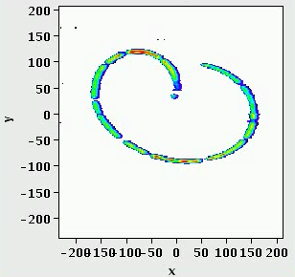
The LHC dump block
The dump block is the only LHC element capable of absorbing the nominal beam.
  The beam is swept over dump surface to lower the power density.
Without the sweep the beam could drill a hole with a depth of a few meters into the block
⇔ Hydro-dynamic tunnelling
CERN visit McEwen
16

Slide 17
LHC incident 19th September 2008

Slide 18
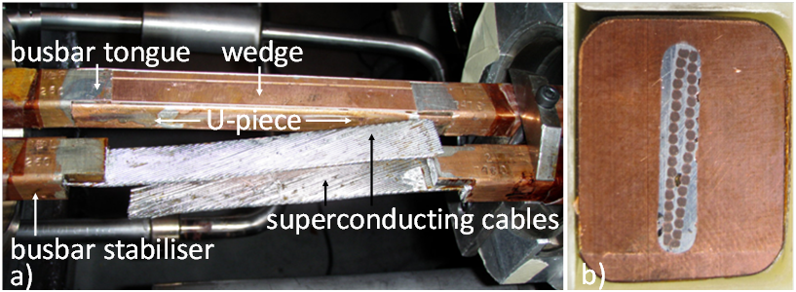
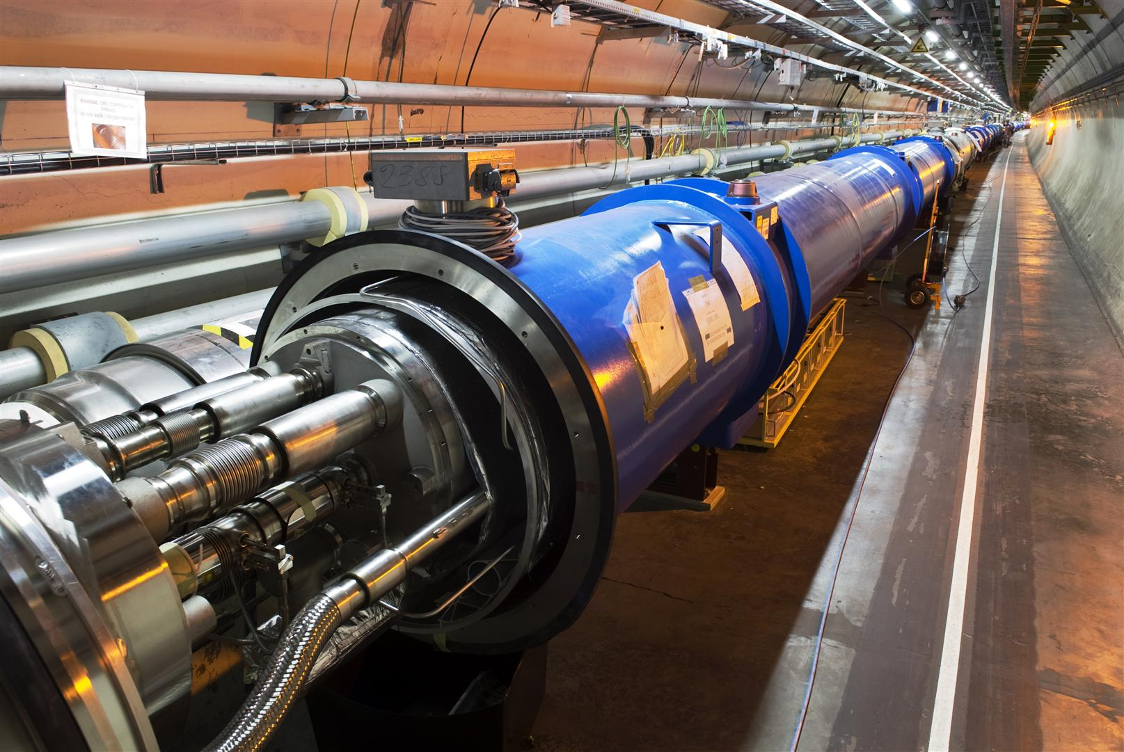
LHC magnet interconnection
On 19th September 2008 , just 9 days after startup, magnet interconnections became a hot topic of the LHC – until today!

Slide 19
The most serious machine incident
LHC incident on September 19th 2008
  Last commissioning step of one out of the 8 main dipole electrical circuit in sector 34 : ramp to 9.3kA (5.5 TeV).
At 8.7kA an electrical fault developed in the dipole bus bar located in the interconnection between quadrupole Q24.R3 and the neighboring dipole.
Later correlated to a local resistance of ~220 nΩ – nominal value 0.35 nΩ.
An electrical arc developed which punctured the helium enclosure.
Secondary arcs developed along the arc.
Around 400 MJ from a total of 600 MJ stored in the circuit were dissipated in the cold-mass and in electrical arcs.
Large amounts of Helium were released into the insulating vacuum.
In total 6 tons of He were released.
This incident involved magnet powering, but no beam!

Slide 20
Helium pressure wave
Pressure wave propagates along the magnets inside the insulating vacuum enclosure.
Rapid pressure rise :
  Self actuating relief valves could not handle the pressure.
  designed for 2 kg He/s, incident ~ 20 kg/s.
  Large forces exerted on the vacuum barriers (every 2 cells).
  designed for a pressure of 1.5 bar, incident ~ 8 bar.
  Several quadrupoles displaced by up to ~50 cm.
  Connections to the cryogenic line damaged in some places.
  Beam vacuum to atmospheric pressure.

Slide 21
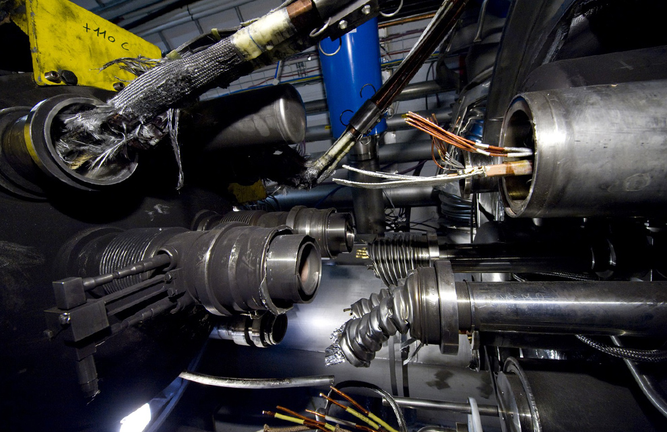
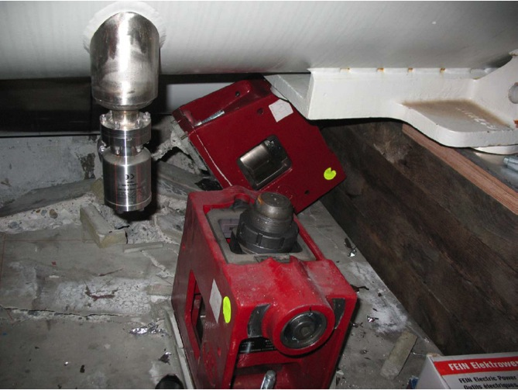
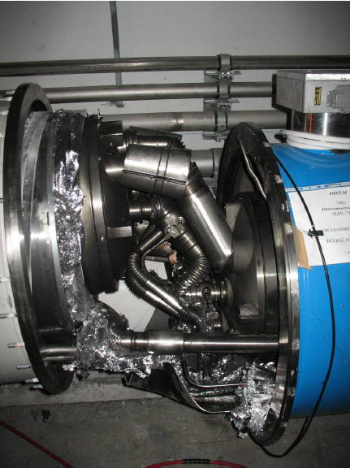
Release of 600 MJ at LHC
The Helium pressure wave damaged ~600 m of LHC, polluting the beam vacuum over more than 2 km.
Arcing in the interconnection
Magnet displacement
53 magnets had to be repaired
Over-pressure

Slide 22
Collateral damage : beam vacuum
Beam vacuum affected over entire 2.7 km length of the arc.
Beam screen with clean Copper surface.
Beam screen contaminated with multi-layer magnet insulation debris.
Beam screen contaminated with sooth.
≈ 60% of the chambers
≈ 20% of the chambers

Slide 23

Consequences
Machine down for more than 1 year for repair and re-commissioning,
Major upgrades to protection system of the magnets (surveillance of the bus-bars),
Major upgrades to pressure release systems and magnet anchoring,
Limitation of the machine energy to 3.5 (later 4) TeV instead of 7 TeV,
Almost 2 years long shutdown (2013-2014) to repair all magnet interconnections.

Slide 24
Dipole training campaign
The LHC dipole magnets suffer from ‘de-training’ after warm up – in particular the magnets of one of the three firms – cause not understood.
The 1232 main dipole magnets had to be trained for 6.5 TeV operation. 2-3 training quenches could be performed for each sector in 24 hours, limited by the recovery time of the cryogenic system.
Just over150 training quenches were required to bring the LHC to 6.5 + ε TeV.
  The large spread in number of quenches between the eight sectors (arcs) is due to the mixture of magnets from the 3 producers.

Slide 25
LHC energy evolution
Energy (TeV)
Consolidation of all interconnections
7 TeV
Design
6.5 TeV
Magnet de-training after installation
Energy increase ⇔ no quench at 3.5 TeV
5 TeV
4 TeV
Joint problems,
incident
Operation
Long Shutdown 1 (LS1)
3.5 TeV
3.5 TeV
Operation
Consolidation delays
1.18 TeV
2007
2008
2009
2010
2011
2012
2013
2014
2015

Slide 26
Introduction to LHC
Beam interlock system
Commissioning
Intensity ramp up
Beam losses
Machine protection diagnostics & software
Conclusions

Slide 27
LHC MPS design
To design the LHC MPS we used ‘intuitively’ a systems approach:
  Break up the LHC into logical systems, identify failure modes,
  Estimate failure properties (time constants, beam loss rates etc) and identify protective measures,
  Establish a classification of failure types and of the most critical failures,
  Ensure that for critical failures there is more than one protection level.
We did not immediate build long failure trees for every element – too much effort and time.
  This was only done for a limited number of critical systems like beam loss monitoring , beam interlock and beam dumping systems to design internal redundancy, monitoring needs etc.
Such a system level approach to safety is now becoming much more common for complex systems – ‘STPA’.
R. Schmidt et al., New J. Phys. 8 (2006) 290. http://dx.doi.org/10.1088/1367-2630/8/11/290

Slide 28
MPS inputs
The LHC beam interlock system (BIS) has ~200 inputs from client systems.
Behind each input there can be many individual tests / interlocks.
  For example the BLM or super-conducting magnet protection systems provide a summary signal for 1/8 of the LHC.
Magnet protection

Slide 29
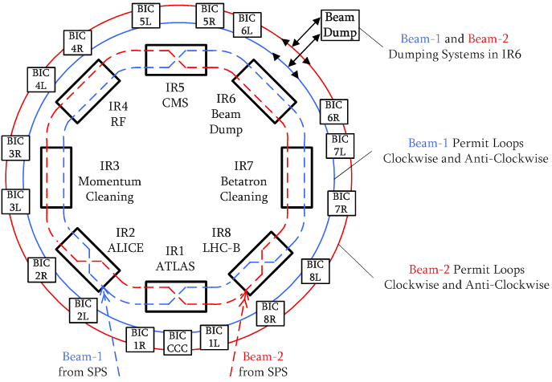
BIS layout
17 Beam Interlock Controller (BIC) units with up to 14 client inputs.
There are 2 BIC units in each LHC access point, plus one unit in the control room.
The BIC units are connected together by optical fibre links – beam permit loops (BPL).
There are 4 independent BPLs, 2 BPLs for each beam.
  The loops of the 2 beams can be coupled together.
For each beam, the loop signals propagate in clockwise and anti-clockwise directions.
  Reduces the time delay to the dump.
Revolution period 89 μs

Slide 30
BIS layout
The BPLs are connected to the LHC beam dumping system: a dump is trigger as soon as the signal of a single BPL is stopped.
The BPLs are also connected to the LHC injection and SPS extraction interlock systems (same hardware design).
At the LHC the dump delay can reach ~3 turns ~300 μs

Slide 31
Masking – the safe beam concept
Already at the design phase of the LHC MPS the need of masking interlocks in certain phases was recognized.
  Flexibility for commissioning and setting up.
To avoid masking interlocks by raising thresholds, opening tolerances for many components (risk of errors during the reversal), the concept of Setup Beam (= almost safe, low risk) was introduced.
  A setup beam should not be able (have low risk) to damage accelerator components.
  The corresponding intensity limit depends on the beam energy (and emittance). It also depends on the material !
    But a Setup Beam may quench magnets!
    The Setup Beam must be defined for a reference material: Copper is used for the LHC.

Slide 32
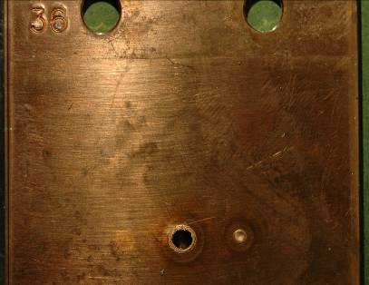
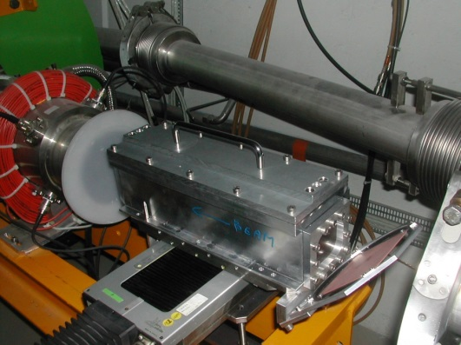
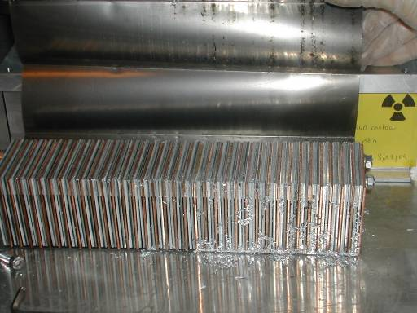
SPS experiment : damage at 450 GeV
Controlled SPS experiment / protons.
Energy 450 GeV,
Beam area σ_{x} x σ_{y} = 1.1 x 0.6 mm²,
Damage limit for copper at 2×10¹² p.
No damage to stainless steel.
Shot | Intensity / p+
A | 1.2×10¹²
B | 2.4×10¹²
C | 4.8×10¹²
D | 7.2×10¹²
A B D C
Special target (sandwich of Tin, Steel, Copper plates)
6 cm
Damage onset is ~200 kJ, < 0.1 % of a nominal LHC beam.
Impact D: ≈ 1/3 of a nominal LHC injection.
25 cm
Notes:
32

Slide 33
Setup Beam Flag for LHC
The simulations predicted the scaling law with beam energy E:
  Larger energy deposition → scaling ~ 1/E,
  Smaller emittance → beam area ~ 1/E,
  Longer showers (~ log E) → some dilution.
This equation was implemented in a dedicated Safe Machine System (SMP). The SMP system is connected to reliable BCTs and energy sources (based on the dipole fields – 4-fold redundancy).
  Generates the SBF (Setup Beam Flag) → distributed to the BIS.
    SBF true = setup beam → ‘maskable’ channels can be masked.
    SBF false = unsafe beam → no channel may be masked.
The beam interlock system is configured to allow masking certain classes of interlocks (maskable) when the SBF is true.

Slide 34
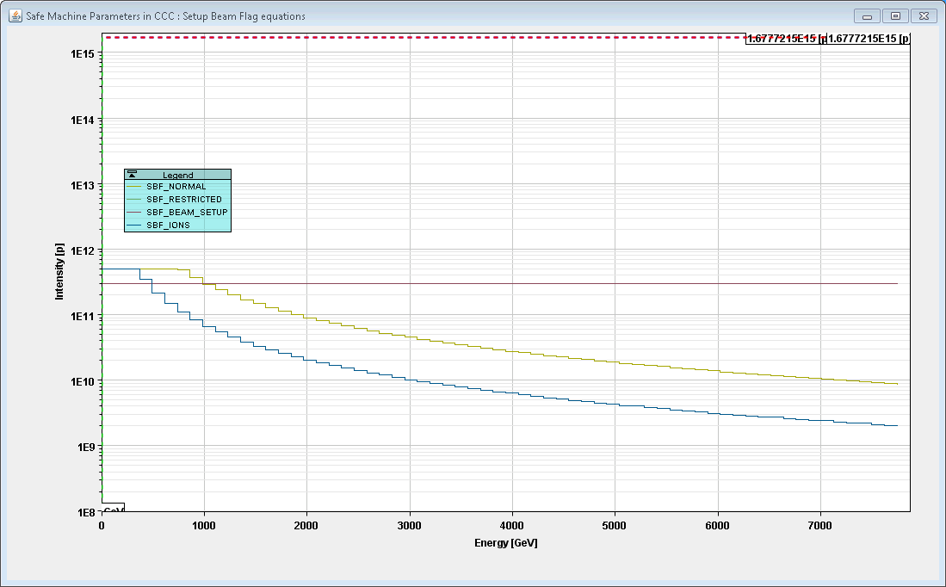
And then operation starts…
When LHC operation started, it was realized setting up the machine accurately required bunches with nominal intensities N ~ 10¹¹ p/b – the low intensity probe bunches induce systematic errors that are not desired for collimator setup.
  Quality of the BPM measurements – beam instrumentation !
Since the SBF limit was below that value in the range 3 TeV - 7 TeV, we had to be able to relax the limit in some cases.
  Defined a relaxed limit (another equation), but with restricted usage.
  Accepted a limited increase of the risk in order to improve setup quality.

Slide 35
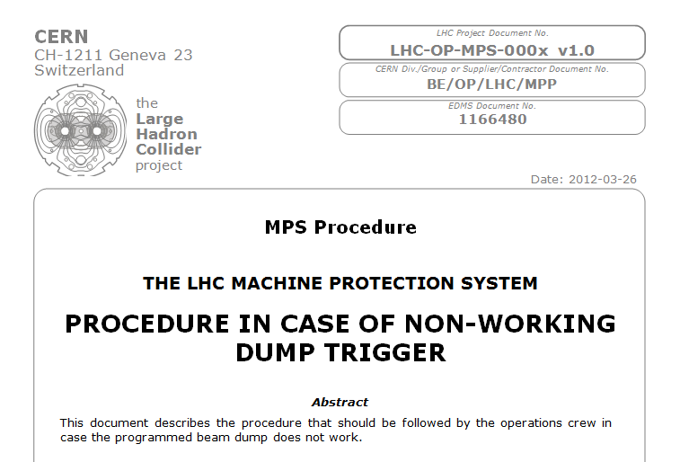
If it does not work
In case the operator request a beam dump trigger and it does not work…. Nobody wants to be on that shift !
  We have foreseen emergency actions (depends on why it did not work).
  Only for dumps that are initiated by the operation crew !

Slide 36
Introduction to LHC
Beam interlock system
Commissioning
Intensity ramp up
Beam losses
Machine protection diagnostics & software
Conclusions

Slide 37
Organization at LHC
The MPS activities of the LHC were organized since 2000 inside a Machine Protection Working Group (later changed to Machine Protection Panel - MPP).
  Design and follow up of implementation, issues and performance,
  Collaboration of all groups concerned by MPS.
With the startup approaching an executive body was created, the restricted MPP (rMPP) with representatives of the core MPS system.
The rMPP takes decisions related to MPS (example : BLM threshold changes), steers the intensity ramp up of the machine, reviews and authorizes beam experiments. The rMPP also follows up on non-conformities (for example degraded operation).
    Recommendations are submitted to the CERN management.
    In general the recommendations are accepted.

Slide 38
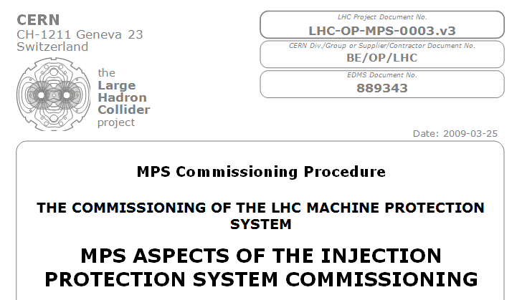
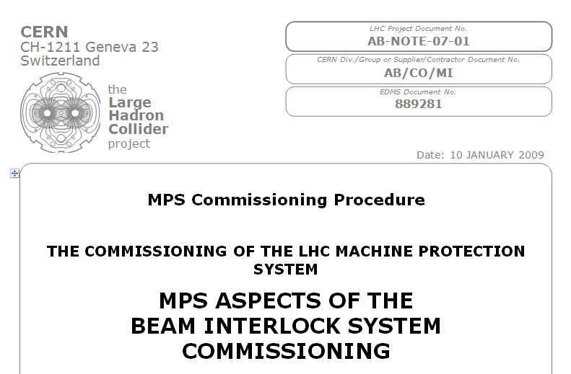
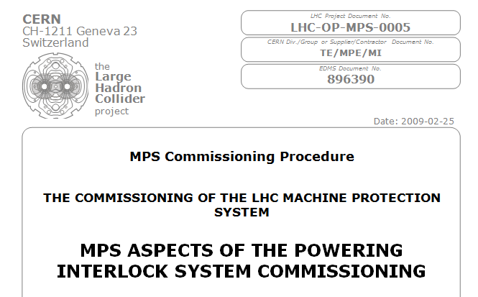
Commissioning - procedures
Before the machine startup, procedures were developed for the commissioning of the machine protection sub-systems.
  Update regularly to reflect changes in the systems or new tests.
The procedures contain test descriptions and frequency of tests.
The procedures were translated into a series of individual tests to be performed on the machine:
  Without beam,
  With beam – if required for different intensity steps.

Slide 39
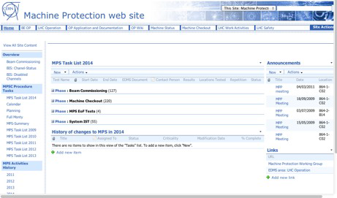
Tracking
The tests are documented and tracked partly on WEB pages, partly by an automated system (next slide).
One MPS expert is in charge of checking that all tests required for a certain machine phase are have been executed by the experts.
  Note that it is generally the system expert that executes the tests for his system – no independence.
During the commissioning the experts involved in rMPP update and approve checklists to track the situation and document non-conformities.

Slide 40
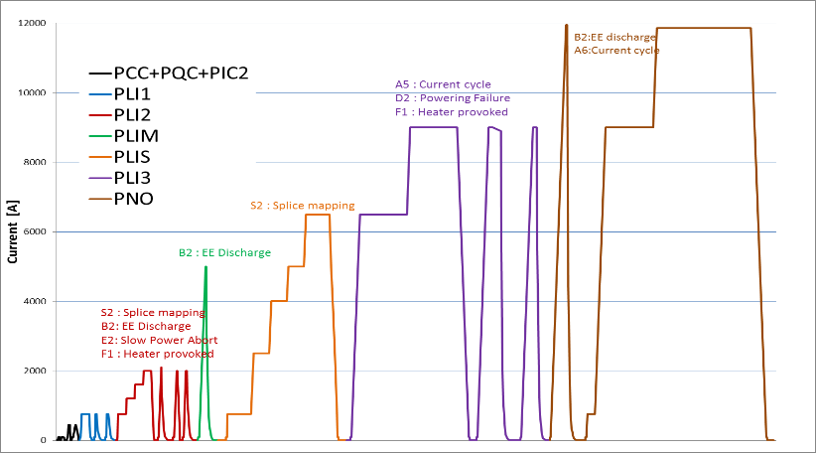
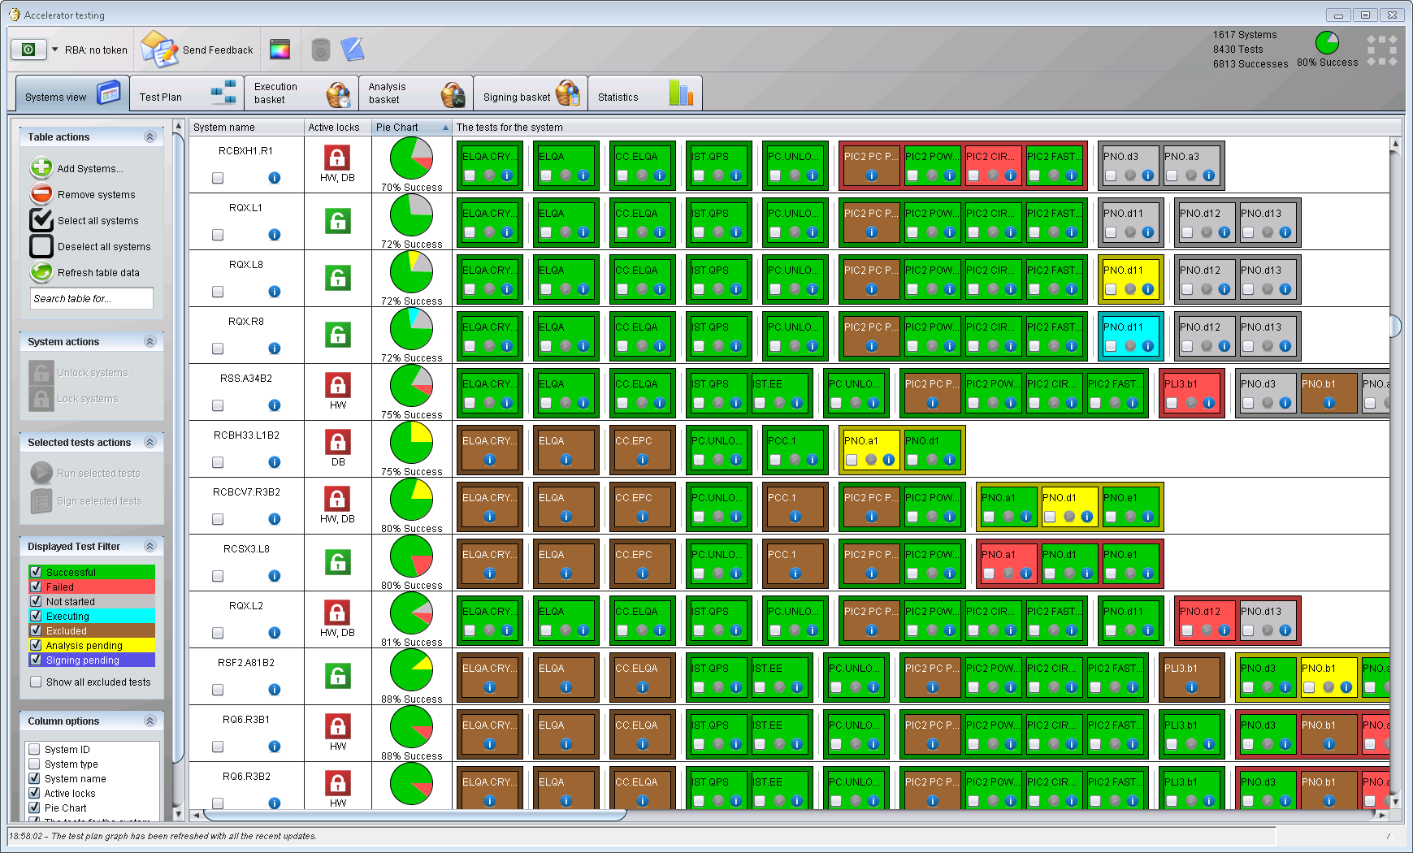
Automated testing
The powering tests that are used to commission the LHC super-conducting magnet system are a good example of how to track and automate test.
  Predefined and agreed test sequences,
  Automated execution of the tests that are ready,
  Test sequence blocked until tests are signed,
  Tracking of results – one cannot forget a step!
Test order
encoding in a test sequence
1 block = 1 test

Slide 41
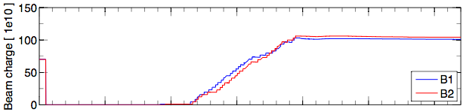
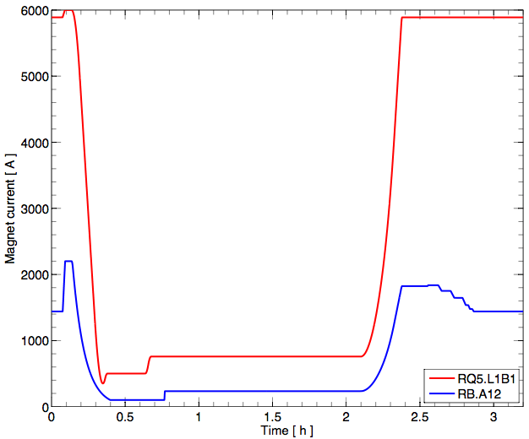
LHC operational cycle
Beam charge
Magnet currents
Typical time ~3-4 hours
Precycle and setup (no beam)
STABLE BEAMS
(physics!)
Injection
Energy ramp
Squeeze and
collision setup
(Simplified) beam “modes”

Slide 42
Beam commissioning sequence
Injection
Ring collimation
Beam dump
First turn, CO, capture
Transfer line setup
Collimation 450 GeV
Setup 450 GeV
450 GeV
Injection steering
Ramp settings
Setup 6.5 TeV
Ramp
Injection protection
Collimation 6.5 TeV
Dump protection
Squeeze & collisions
Transfer line collimation
Collimator setup squeeze & collisions
Dump protection validation
Optics corrections
MPS commissioning
Injection protection
validation
Loss maps
Injection setup & validation
Machine protection activities are an integral part of LHC beam commissioning:
  Commissioning after a long shutdown takes ~2 months, after an end of year stop 2-3 weeks.
  The commissioning is made with a max of 3 bunches (2800 bunches for a nominal filling).
Collimation setup & validation
Stable collisions and intensity ramp up

Slide 43
Setup quality assurance
Protecting the aperture passively with collimators and absorbers is a key ingredient for operating the LHC safely at high intensity.
  All failures affecting the machine on a global scale (global orbit, optics, emittance etc perturbation) should be intercepted by a protection device.
  Dual role of collimators for beam cleaning (→ performance and quench prevention) and MP (passive protection).
A proper LHC machine setting up involves:
  A well corrected orbit,
  A well corrected optics (betatron functions),
  A good knowledge of the aperture bottlenecks (after orbit and optics correction).
    Measurement of the global aperture,
    Measurement of critical local apertures (for example around the experiments).
All along the machine cycle – from injection to collisions

Slide 44
Beam dump synchronization
The beam dump must be accurately synchronized to the beam abort gap to avoid spreading beam across the aperture during the kicker rise-time.
The 3 μs long beam abort gap must be … free of beam !
Possible failure modes:
  The abort gap fills with beams (RF fault, debunching, injection error),
  The kicker synchronization fails,
  A kicker fires spontaneously (not synchronized).
}
Asynchronous dump failure
Abort
gap
Batch of bunches
The LHC can be filled with up to 2800 bunches
see lecture on beam transfer

Slide 45
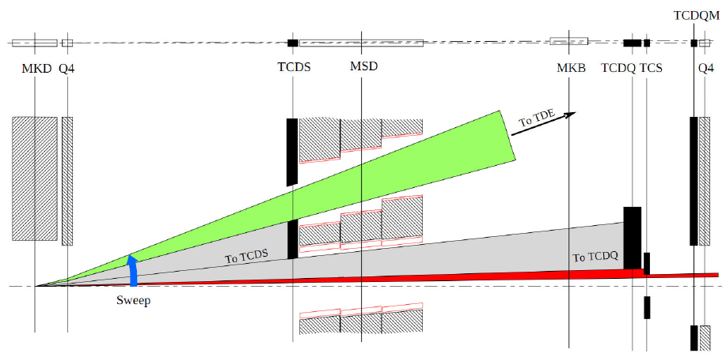

Asynchronous dump: passive protection
Two large absorbers in front of the extraction septum (TCDS) and in front of the first SC magnet (TCDQ) protect the LHC against damage / quench from asynchronous dumps & beam in the abort gap.
to dump
Dump kickers
Septum
Septum
9 m long absorber (TCDQ)

Slide 46
MPS Quality Assurance
During machine setting up collimators and absorbers are aligned around the closed orbit with appropriate retractions.
  The orbit must be reproducible at the level of ~50 μm (⇔ 1/4 σ).
The machine setup (orbit, optics, aperture, protection devices) is then validated by a campaign of loss maps and simulated asynchronous beam dump tests.
  Loss map: the beam emittance is blown up in a controlled way with a transverse feedback (noise) until losses are observed. The loss distributions provides a validation of the collimator alignment & hierarchy.
  Simulated asynchronous dump test: a low intensity is debunched (switch off RF) and a beam dump is triggered. The beam present in the region of the abort gap mimics the effect of an asynchronous dump. The loss distribution along the ring provides a validation of the dump protection alignment.
Those tests are repeated every 6-8 weeks to track the stability of the machine. In general this coincides with a short (5 days) technical stop.

Slide 47
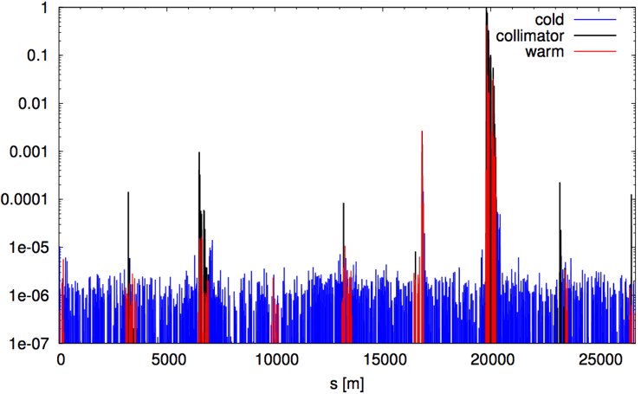
Loss map example
Beam 1
TCT = tertiary
collimator
Betatron collimation
Beam
dump
Off-momentum
collimation
TCTs
Cleaning inefficiency [BLM/BLMtcp]
1/10000
TCTs
0.00001
TCTs
TCTs
0.000001
B. Salvachua
see lecture on collimation
Note: not all collimator hierarchy issues can be identified in this loss map !

Slide 48
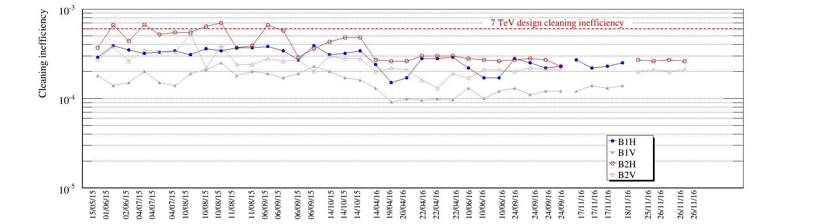
Stability of the beam cleaning
With a single collimator alignment at the beginning of each year, the efficiency of the collimation system is maintained thanks to a very reproducible operation.
  Orbit stabilization with an orbit feedback (unusual in a proton machine).
  Highly reproducible collimator positions.
The improved efficiency in 2016 is obtained with tighter collimator settings
Collimation inefficiency at 6.5 TeV/c
p-p
p-Pb
Pb-p
2015
2016
With only 1 alignment per year!
courtesy D. Mirarchi

Slide 49
Asynchronous dump: active protection
The asynchronous dump is the ‘ultimate’ unavoidable failure at the LHC – must to protect the machine PASSIVELY.
Dump kicker powering, synchronization and triggering are designed to exclude out-of-synch triggers with high reliability.
  A spontaneous trigger of a switch expected at a rate ~ 1 / year.
  So far none has been observed during high intensity operation (1 with low intensity beam).
  But a few failures have started to appear on the dilution kicker system in 2016 → trigger immediate beam dump. Suspected issue due to DUST.
Injection kicker synchronization → no injection into the abort gap.
  Link between dump and injection system.
Abort gap monitoring (using synchrotron light) and abort gap cleaning.
  Cleaning with transverse feedback system (excitation of the bunch positions corresponding to the abort gap → collimators).

Slide 50
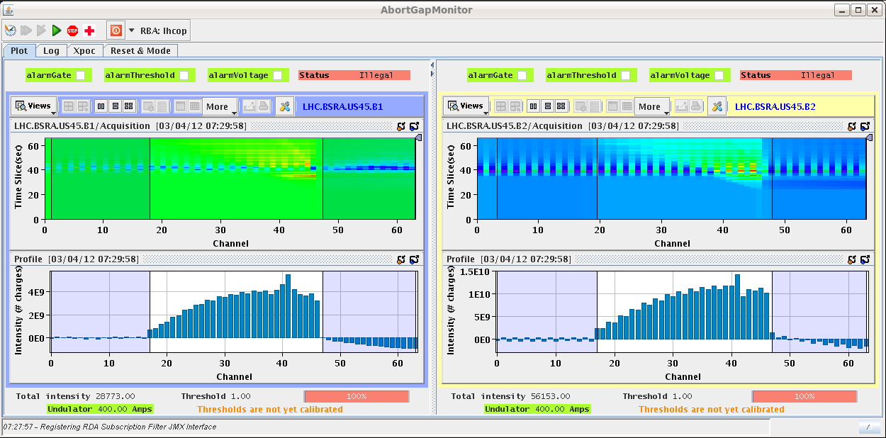
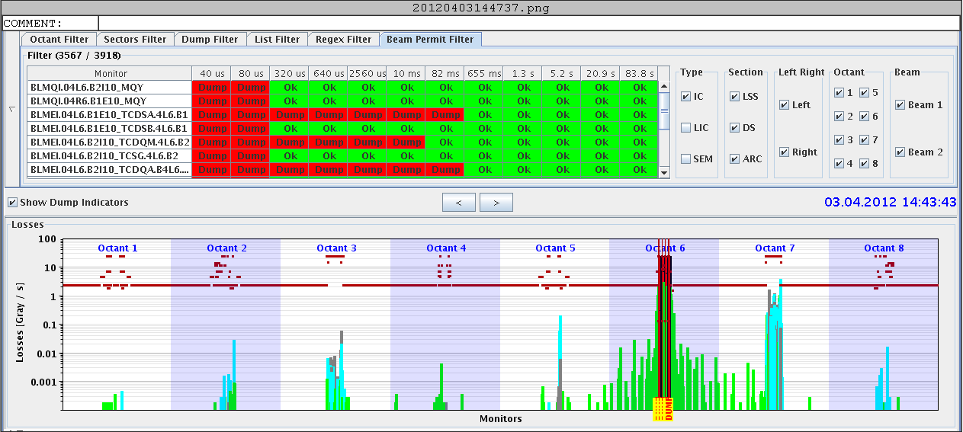
Asynchronous beam dump test
For the asynchronous beam dump test the particle population in the abort gap is observed with synchrotron light, gated on the abort gap.
Abort gap population
BLM signal
Particles leaking out of the dump protection devices
Beam dump
s

Slide 51
Introduction to LHC
Beam interlock system
Commissioning
Intensity ramp up
Beam losses
Machine protection diagnostics & software
Conclusions

Slide 52
Increasing the energy
The LHC is always setup with low intensity beams, max. of 3 bunches (out of ~2800 max).
  Setup with ~ 1/1000 of the nominal intensity! Challenge for instrumentation!
The intensity increase is steered through a restricted Machine Protection Panel (rMPP).
  Defines the intensity steps and the requirements (checklists) to proceed with more bunches.
The plan for the first learning year in 2010 foresaw 3 phases:
  Low intensity for commissioning and early experience.
  Ramp up to 1-2 MJ followed by a period of ~4 weeks at 1-2 MJ.
    Corresponded to state-of-the-art at the time !
  Move into 10’s of MJ regime – new World record at that time !!.

Slide 53
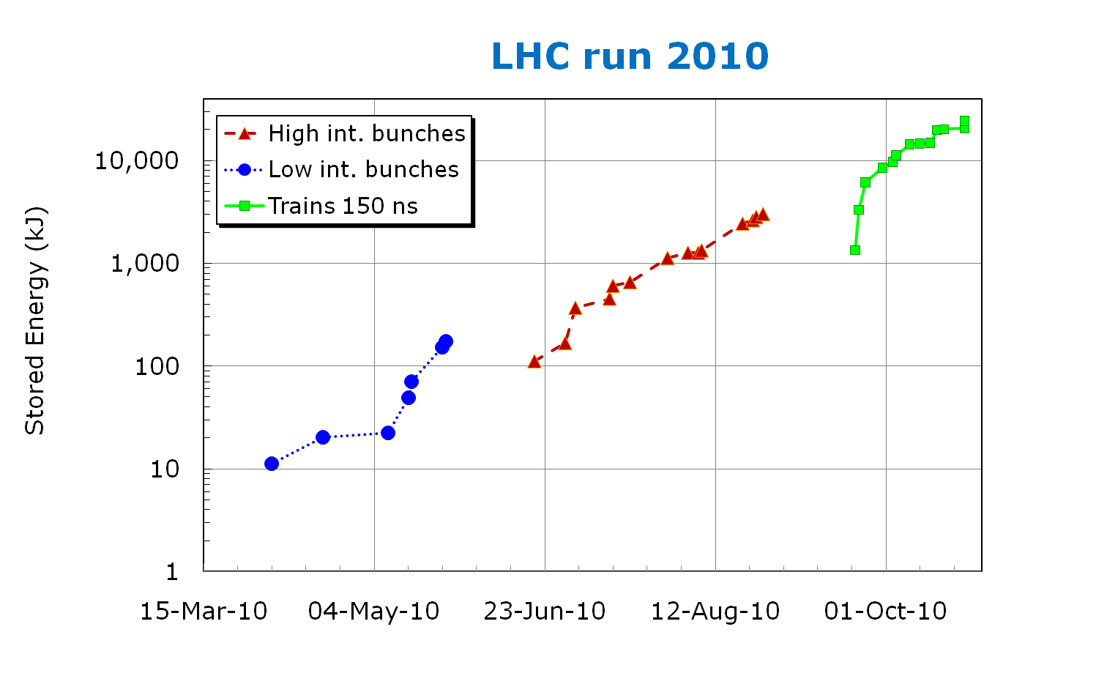
LHC stored energy – the first year
Low bunch intensity operation, first operational exp. with MPS
Ramping up to 1 MJ, stability run at 1-2 MJ
Breaking the records !
External MPS review
Internal MPS review
Two reviews of the MPS performance and issues !

Slide 54
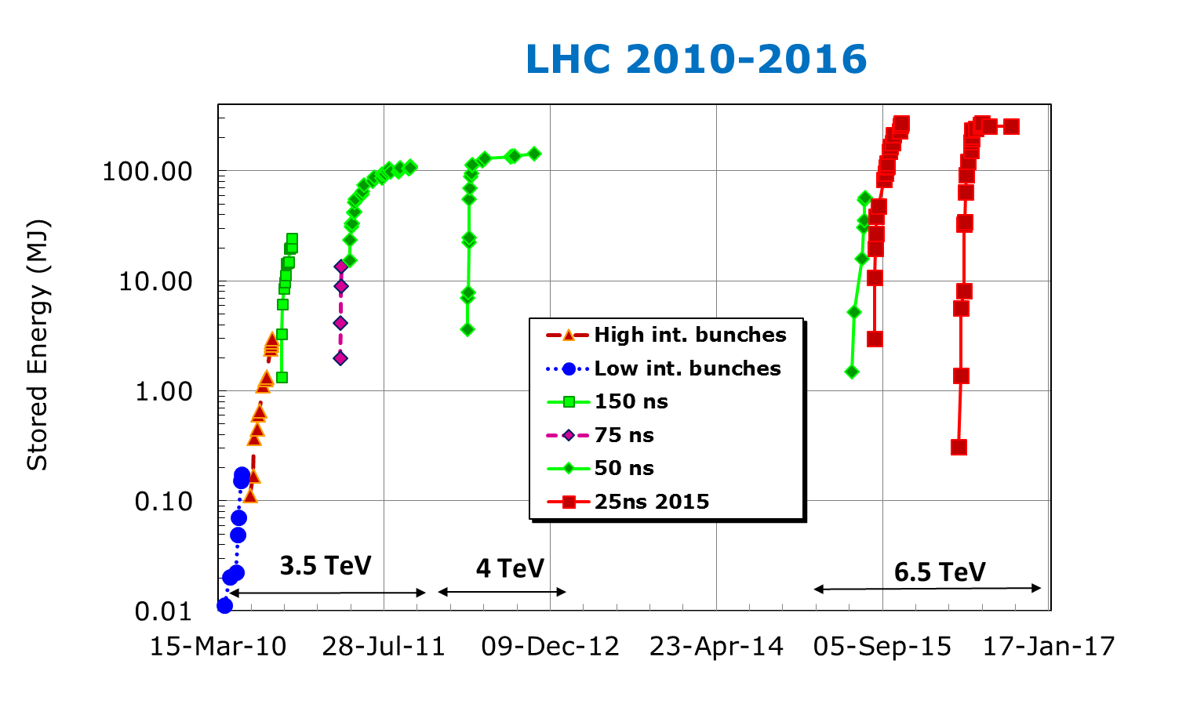
LHC progress 2010-2016
Stored energy and speed of commissioning evolved with experience and improving beam control.

Slide 55
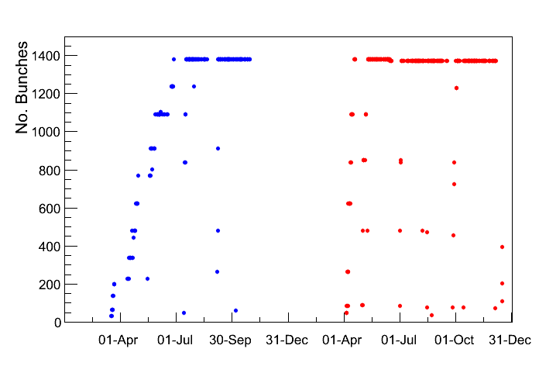
Example of intensity ramp up
2011 intensity ramp up took ~9 effective weeks – 11 intensity steps – rate dictated by operational (and not MP) issues from ~600 bunches.
  Losses & BLM thresholds (increase needed @ collimators), heating by the beam, beam stability etc.
2012 intensity ramp up took 2 weeks – 7 intensity steps – experience !
Ramp up
2011
2012

Slide 56
LHC 2016 versus Design
2016
6.5+6.5 TeV
25
2220
1.1-1.2×10¹¹
2.1
11
0.42 A
260 MJ
1.4×10³⁴
Collision energy: | 7+7 TeV
Bunch spacing (ns): | 25
Number of bunches k: | 2808
Number of particles per bunch N: | 1.15×10¹¹
Beam emittance ε (μm): | 3.75
Beam size at ATLAS/CMS (μm): | 16
Circulating beam current: | 0.58 A
Stored energy per beam: | 360 MJ
Peak luminosity (cm⁻²s⁻¹): | 10³⁴
We have exceeded design luminosity in 2016 – except for the energy (6.5 TeV and not 7 TeV – magnet training).

Slide 57
Introduction to LHC
Beam interlock system
Commissioning
Intensity ramp up
Beam losses
Machine protection diagnostics & software
Conclusions

Slide 58
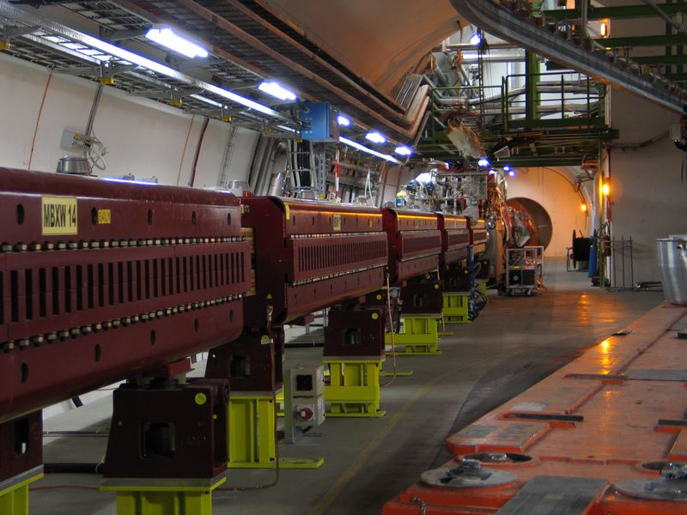
Ultra-fast failures at the LHC
The analysis of the potential failures at the LHC quickly revealed that the normal conducting magnet circuits are the most critical elements.
Those magnets are used to re-combine the 2 LHC beams near an experiment (from two to a single vacuum chamber).
LHC room temperature (normal conducting) separation/recombination dipoles (‘D1’) around ATLAS and CMS.
Those magnets are very strong (large deflections) and they are fast –> most critical powering failure !

Slide 59
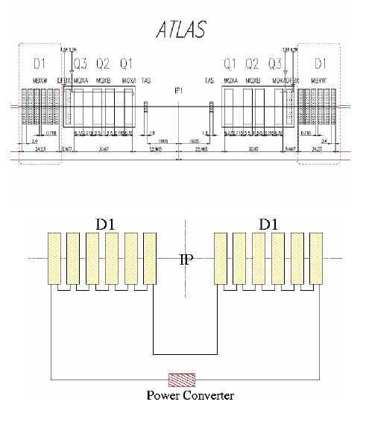
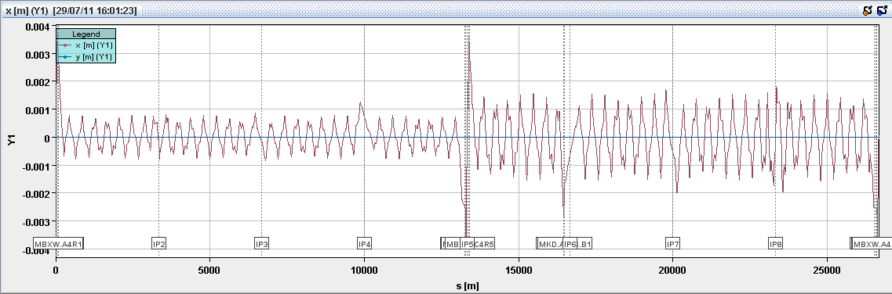

Ultra-fast failures at the LHC (2)
Failure simulation.
  12 magnets are powered in series.
  Large betatron function when squeezed (β > 2000 m) → large orbit changes.
  Short time constant τ = 2.5 seconds (B is the magnetic field):
Simulated orbit change along the LHC ring a few milliseconds after failure.
LHC collimator opening
±2 mm

Slide 60
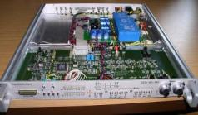

Ultra-fast failures at the LHC (3)
The failure simulations indicated an absence of redundancy (only beam loss monitors) and the need for very short reaction times for BLMs → we wanted an extra-layer (redundancy) of protection at the equipment level.
This triggered the development of so-called FMCMs (Fast Magnet Current change Monitor) that provide protection against fast magnet current changes after powering failures - CERN - DESY collaboration.
Fast
Magnet
Current
change
Monitor
Beam Interlock System
Power Converter
Voltage Divider
& Isolation Amplifier
D1
Very fast detection (< 1 ms) of voltage changes on the circuit. Tolerances of ~ 10⁻⁴ on ΔI/I are achievable.

Slide 61


Ultra-fast failures at the LHC (4)
Test failure of PC and FMCM reaction – NO BEAM.
  Switch off D1 PC – simulated failure.
Failure trigger
I (A)
1 A
FMCM trigger
ΔI/I < 10⁻⁴
10 seconds

Slide 62
Failure timescales @ LHC high energy
Time
Failures and protection
10000 turns
= 0.89 s
Operational
‘mistakes’
1000 turns
100 turns
Quench
protection
Quenches
Power converter
interlocks
Transverse
feedback
10 turns
NC magnet
powering failures
FMCM*
1 turn
= 89 μs
Kicker
magnets
BPMs
BLMs
Absorbers
* FMCM: Fast Magnet Current change Monitor for fast detection of powering failures

Slide 63
Setting thresholds - BLMs
Threshold definition for BLMs installed in the LHC:
  On superconducting elements: prevent quenches,
  On room temperature elements: prevent damage.
  In both cases some safety margin is desired.
Initial thresholds were set before LHC operation started based on rather coarse quench level estimates, GEANT, FLUKA and MARS simulations.
Ever since LHC started beam operation the thresholds were progressively adapted (many were increased) based on experience, on beam intensity and on beam energy.
  Some thresholds had to be ‘corrected’ by factors 10-100 during the early operation phase, in almost all cases the thresholds were increased – set to conservatively !

Slide 64
Beam loss monitor thresholds
To determine quench levels in terms of BLM signals requires extensive simulations including loss scenarios, shower development and material properties.
  Relate a BLM signal on the outside of a cryostat to the energy deposition deep in the magnet.
Minimum Quench Energy Density
The quench levels are delicate to determine theoretically due to the complex environment of the magnets.
  The quench levels depend on the loss time scale:
    10⁻³ s : temperature margin of the cable,
    10⁻¹ s : cooling by helium inside the magnet,
    Steady state : cooling power of cryogenic system.
The quench levels were eventually verified and tuned with dedicated beam experiments (mainly at 4 TeV) and with a few real beam induced quenches.
Beam tests

Slide 65
Beam loss monitor thresholds
To cope with the loss scenarios, the energy and time scale dependence of damage and quench levels each LHC BLM has a threshold table with:
  32 energy levels,
  12 integration times (‘running sums’) from 40 μs (= ½ LHC turn) to 83 seconds.
  ➔ 384 threshold values for each BLM channel.
Since the BLM system is absolutely essential for safe operation, the system and its settings (thresholds) are checked at every injection (and at least once per 24 hour period).

Slide 66
Beam as witness
During injection even a synchrotron is a linac: injection of an intense beam may pose a serious risk or require a very important monitoring efforts (all power converters etc).
  ⇒ concept of ‘witness’ beam / bunch
The LHC with nominal injection of 3 MJ (>> damage threshold) uses the beam presence concept.
  Only a probe bunch (typically 10¹⁰ protons, max 10¹¹) may be injected into an EMPTY ring.
  High intensity injection requires a minimum beam intensity to be circulating.
  Based on a highly reliable and redundant intensity measurement: a flag indicating beam present (true/false) is transmitted to the extraction interlock system of the SPS injector where it is combined with a flag indicating that the SPS beam is a probe intensity (max 10¹¹ p).
see lecture on beam transfer

Slide 67

Injection into LHC
Every injection phase of the LHC starts with the injection of a probe bunch (max 10¹¹ p) into the empty ring.
When a probe intensity is circulating, an intermediate intensity beam can be injected (max 2×10¹² p).
  It is possible to over-inject on the probe bunch (which is kicked onto an injection protection device at the same time as the new beam is injected).
When the intermediate intensity is circulating, it is possible to inject a full intensity batch (up to 288 bunches of 1.3×10¹¹ p/b).
If the beam is dumped during the filling process → back to the beginning
6 or 12 bunch intermediate injection
Beam abort
gap (3 μs)
Intermediate intensity
LHC circumference
Example for a LHC bunch pattern
Filling sequence

Slide 68

LHC example: stored - transfer
Despite storing up to 260 MJ at 6.5 TeV, not a single superconducting magnet was quenched at the LHC with circulating beam – threshold ~ few 10’s of mJ.
Many magnets were however quenched at injection, mainly due to (expected) injection kicker failures.
  The beam (~2 MJ) is safely absorbed in injection dump blocks, but the shower leakage quenches magnets over ~1 km.
Collimation
Injection point
BLM signal
BLM dump
threshold
BLM saturation !
3.3 km

Slide 69

Beam losses through the cycle
Characteristic beam losses are observed in the various phases. They are part of regular operation and must be tolerated, even if one tries to minimize them.
  Injection losses (tails from injections, injection oscillations, de-bunched beam),
  Start of ramp losses (uncaptured beam loss),
  Scraping on collimators (gap changes, orbit and tune shifts),
  Loss of the beam halo when beams start to collide (beam-beam effect),
  Losses due to the beam burn-off – proportional to luminosity and performance.
Beam lifetime, measured by loss rate at primary collimators
Courtesy B. Salvachua, S. Redaelli

Slide 70
Peak power losses at 6.5 TeV
Highest power losses occur when beams are brought into collision.
  Switching on the beam-beam interaction at the collision point has a strong impact on the beam halo particle lifetime (beam-beam force has strong non-linearities).
Collimator system is operated safely below the system design power limit of 500 kW.
Collimator limit 500 kW
Courtesy B. Salvachua

Slide 71

Continuous beam losses at LHC
The BLM signals near the experiments are almost as high at the collimators (steady losses) due to the luminosity.
  At the experiments the BLM record collision debris – in fact the physics at small angles not covered by the experiments !!
Collision points
Collimation and absorbers
Loss rate
S

Slide 72
Beam loss and electronics
Electronics installed in or close to the tunnel can be ‘disturbed’ or damaged by the shower particles (fast neutrons) – Single Event Upset / Errors (SUE/SEE).
The impact can be mitigated by:
  Design of the electronics,
  Relocation (longer cables and single paths),
  Careful selection and radiation tests of electronic components,
  Redundant or self-correcting algorithms (checksums …).
Despite relatively early warnings, many issues were discovered during early operation, and it took ~5-6 years of crash program to cure the issues by relocation and redesign of electronics.
  For the first years of LHC, the higher the luminosity (performance) to higher the failure rates !

Slide 73

Continuous beam losses with collisions
ATLAS experiment
ALICE experiment
Momentumcleaning
RF and
BI
CMS experiment
Beam
dump
Betatron cleaning
LHCb experiment
73

Slide 74

An object falls into the beam

Slide 75
Continuous beam losses with collisions
ATLAS experiment
ALICE experiment
Momentumcleaning
RF and
BI
CMS experiment
Beam
dump
Betatron cleaning
LHCb experiment
75

Slide 76

Accidental beam losses with collisions
ATLAS experiment
ALICE experiment
Momentumcleaning
RF and
BI
CMS experiment
Beam
dump
Betatron cleaning
LHCb experiment
76

Slide 77

Accidental beam loss
Time evolution of the loss
At the LHC each individual BLM can dump the beam!
1 ms

Slide 78


Surprise, surprise !
Very fast beam loss events (~ ms) mainly in supercondcting regions have been THE SURPRISE of LHC operation – nicknamed UFOs*.
  ~20 dumps by such UFO-type events every year up to ~2015.
The signals are consistent with small (10’s μm diameter) dust particles ‘entering’ the beam.
In some cases the UFOs are so fast that the BLMs cannot dump in time before the event is over or before a quench !
  Quench threshold exceeded on the time scale of 1-2 turns !
Time evolution of a UFO-type loss
*:Unidentified Falling Object, acronym borrowed from nuclear fusion community

Slide 79




UFO monitoring
The vast majority of events lead to losses below dump threshold.
For LHC injection kickers UFOs could be traced to Al oxide dust → cleaning campaign during the long shutdown.
There is conditioning with beam:
  The (non-dumping) UFO-rate drops from ~10/hour to < 2/hour over a year.
In the injection kickers UFOs were traced to Al oxide particles.
100µm
10µm

Slide 80




BLM relocation for UFOs
To improve the sensitivity of the BLMs to UFO events, 30% of the arc BLMs were relocated in 2014 from the arc quadrupoles to the dipoles
  Initial failure analysis: all faults are best observed at quadrupoles → in the arcs the BLMs were all installed around the quadrupoles.
→ 2013:
MB = dipoles
2015+
MQ = quadrupole
LHC half-cell

Slide 81

BLM relocation for UFOs
BLMs at the quadrupoles (blue and orange) are not sensitive to UFOs originating in 2 of the 3 dipoles (MB.Axx and MB.Bxx). The relocated BLMs cover the gap.
  This was an important and essential change for operation at 6.5 TeV.
Beam direction

Slide 82
Timescales @ LHC
Time
Some ultra fast UFOs are beyond the MPS reaction time !
10000 turns
= 0.89 s
Operational
‘mistakes’
1000 turns
100 turns
Quench
protection
Quenches
Power converter
interlocks
UFO
Transverse
feedback
10 turns
NC magnet
powering
FMCM
1 turn
= 89 μs
Kicker
magnets
BPMs
BLMs
Absorbers

Slide 83

Unexpected failure modes
The UFOs…
Firing of the superconducting magnet quench heaters generates orbit kicks that are significant at injection (~ 1 beam size equivalent) before the beam dump trigger is fired (‘propagation delay’).
  Nobody paid attention to the fact that the current in the quench heaters generates a magnetic field.
  Can be mitigated by proper design (compensation of the fields).
Dumping a single beam ‘instantaneously’ switches off a strong field that affects the opposing beam near the collision points – similar to a fast kicker magnet.
  Just at the edge of acceptable perturbation (~ 1 beam size equivalent).

Slide 84
Introduction to LHC
Beam interlock system
Commissioning
Intensity ramp up
Beam losses
Machine protection diagnostics & software
Conclusions

Slide 85
Modern Machine Protection System : P³
Protect the machine
  Highest priority is to avoid damage of the accelerator.
Protect the beam
  Complex protection systems reduce the availability of the accelerator, the number of “false” interlocks stopping operation must be minimized.
  Trade-off between protection and operation.
Provide the evidence
  Clear (post-mortem) diagnostics must be provided when:
    the protection systems stop operation,
    something goes wrong (failure, damage, but also ‘near miss’).

Slide 86
Pre and Post-mission checks
Automated checks of the MPS components as pre- or post-flight checks can ensure that the MPS functionality is not degraded.
For colliders with long cycle times there are 2 types of checks that fit well into the cycle:
  Pre-flight checks before injection,
  Post-flight checks on data collected during a fill/store or during the beam dump (Post-Mortem data).
Such tests can come in multiple forms:
  Test of MPS related settings, for example BLM thresholds.
  Configuration checks of the beam interlock systems (all clients present and alive?).
  Automated analysis of the faults and MPS reaction chain – mainly for the simplest and very frequent cases.
  Automated analysis of the dump system action.

Slide 87

Pre-flight checks
Pre-flight checks and validations (after stops, interventions, before filling) are important to asses the good state of MPS elements.
  Interlock settings (actual settings versus DB reference).
LHC example: all LHC BLMs are tested between 2 fills.
  Signal/cable integrity by HV modulation,
  Threshold consistency with respect to reference DB.

Slide 88
Post-mission checks
At the LHC the MPS is so critical that for every beam dump Post Operation Checks (POCs) are performed for the beam dump system based on Post-Mortem data (equipment and beam signals).
  Automatically triggered based on PM data.
  Asses that all signals are correct, no loss of redundancy.
    → system is ‘as good as new’.
  Machine operation is stopped if the beam dumping system POCs fail → expert check required to restart.
The concept was so successful that it was extended to injection: automated check of each injection quality, interruption in case of losses, large trajectory excursions etc.

Slide 89
MPS diagnostics – post-mortem
From the design of the LHC MPS post-mortem diagnostics was viewed as a key component in order to identify the root causes of beam dumps.
  All key systems implement a circular PM data buffer that is frozen and read-out when a beam dump is triggered.
  Sampling frequencies range from μs – turn level to 10’s of milliseconds.
  Synchronization is critical to make sense of the data and define what came first !
After a LHC beam dump, injection is blocked until the PM data is collected, pre-analyzed (automatic) and signed.
  If the automated analysis identifies a critical problem, injection can only be released by a MPS expert.
  The shift crews must sign the PM.
  MPS experts re-analyse all PM events within a few days – independent view, long term trends.

Slide 90





Post-mortem GUI
The LHC PM server and GUIs are JAVA provided standard plots of with analyzed data.

Slide 91
MPS settings (changes)
Depending on its size, complexity and energy range an accelerator will have a large volume of MPS settings.
  BLM thresholds, current references and tolerances etc
Obviously someone has to set / introduce the values. Once there are in place there are two issues:
  Who can change them, when and how?
  How to make sure that the settings have not changed?
There are various solutions that can be mixed:
  ‘Continuous’ verification of the MPS settings.
    For example before new injection phase.
  Protection of the settings - only authorized experts can change them.
    Access restrictions – at CERN: Role Based Access Control (RBAC)
    (Digital) signatures.

Slide 92


Critical settings
To protect MPS settings the concept of Management of Critical Settings (MCS) was developed for the LHC and its injection lines.
  Fully embedded in the control middleware and settings management.
A settings that is defined as critical has an associated digital signature.
  The digital signature is generated at the moment when a setting is changed.
  The setting and its digital signature are transmitted to the front end computer – a critical setting is only accepted with its valid digital signature.
  Only a user that has to appropriate RBAC role (MPS expert, BLM expert etc) is able to generate the digital signature.

Slide 93
Software interlocks
The LHC MPS has inputs from may system that operate independently. There is no (or very limited – timing system) information exchange between those systems.
To implement interlocks on a global machine scale with correlation of data between any LHC system, a Software Interlock System was developed – interfaces to the BIS.
  Global scale analysis and correlations among systems,
  Correlation of injector data with LHC for injection,
  Fast implementation for protection against unexpected issues.
The SIS is by design rather slow (~ second) but it is able to detect anomalies that could lead to problems in the ‘near’ future, or prevent unnecessary beam dumps at injection.
  ‘Soft’ machine protection: prevent activation of the MPS.
    For example: interlocking of the orbit (2000 readings), the steering magnets (~1000), soon to be expanded to all magnets.

Slide 94



Machine experiments
Machine experiments can be very exciting, but also risky periods for a machine – the machine may operate at some distance from standard conditions.
  Collimator settings, orbit and optics may be changed etc
At the LHC every experiment is categorized according to the foreseen changes to the machine and to intensity.
A procedure must be written for every machine experiment.
  Includes details on changes to the MPS.
  Improve the efficiency of the experiment by spotting ‘impossible’ things.
  This encourages experimenters to think about options with smaller MP footprint – for example lower intensity – very efficient !

Slide 95




Summary : anything damaged?
Wire-scanner damage during quench test – ‘deliberate’ action.
Carbon wire Ø reduction from 30 to 17 μm over a length ~ beam size.
Beam induced heating – lack of temperature monitoring – edge at MPS
Damaged RF fingers
Damaged beam screen in a collimator for injection protection
Collimator jaw
Damaged mirror of the synchrotron light telescope
So far we were successful in protecting the machine !

Slide 96
Summary
Despite its record stored energy and its complexity, the LHC was operated very successfully and with high intensity at 6.5 TeV.
No component was damaged by a failure leading to beam loss – so far the MPS fulfilled its job!
When you come now to the LHC control room, everything looks ‘so simple’ and high intensity beams are injection, ramped and put into collisions in an incredibly efficient way.
When we started to look at LHC MP around the year 2000 it was by no means evident that the protection of the machine would work so well and be so efficient – this also includes the LHC collimation system.
  The result of long and hard work, but also of efficient inter-disciplinary collaboration among many groups at CERN !

Slide 98


Beautiful technology
1232 NbTi superconducting dipole magnets – each 15 m long
Magnetic field of 8.3 T (current of 11.8 kA) @ 1.9 K (super-fluid Helium).
  But they do not like beam loss – quench with few mJ/cm³.

Slide 99

Hydrodynamic tunneling
The criticality of sweeping the beam over the dump surface is due to an effect called hydrodynamic tunneling.
For high intensity beams made of long bunch trains hydrodynamic tunneling significantly increases the damage range in a material.
  Leading bunches melt the material and create a plasma, the following bunches see less material and penetrate deeper etc.
  The nominal LHC beam can perforate a ~20 m long Carbon target.
Simulation of the LHC beam impacting a carbon target
(no sweep !)
25 cm/μs of beam
Penetration of ~20 m
see lecture by A. Bertarelli

Slide 100

Local aperture measurement
The primary collimator is used to define a clear edge of the beam (4σ).
The beam is scanned until losses appear locally.
Nominal orbit + 4σ envelope from corrector settings and optics (wrt ref. orbit) at max. excursion
Collimator
Quadrupole
Dipole
Measured orbit at BPMs.
Line is the ref. orbit.
Example of the injection aperture around the ATLAS (IR1) experiment.
Peak BLM signal

Slide 101

LHC filling and kicker synchronization
Kickers magnets have to rise their field in the gaps between the circulating beam.
The trigger and reference frequencies are generated by the RF system.
LHC filling scheme
6 or 12 bunch intermediate injection
Abort gap – 3 μs
1 PS batch
(36 bunches)
1 SPS batch
(144 bunches)
LHC injection kicker gap
SPS injection kicker gap

Slide 102

Ultra-fast failures at the LHC (5)
Test with real beam – FMCM interlocks masked out.
  Low intensity (‘safe’) test beam.
  Switch off D1 PC – simulated failure.
  Beams dumped by the LHC BLMs when beams hit the collimators.
Beam dump !
Orbit change in mm
2 mm
200 turns
LHC turn number
Data from the LHC Post-Morten system

Slide 103

Ultra-fast failures at the LHC (6)
Test with real beam – with FMCM active
  Low intensity (‘safe’) test beam.
  Switch off D1 PC – simulated failure.
  Beam dumped by FMCM.
Beam dump !
Orbit change in mm
No measurable orbit change
LHC turn number
Data from the LHC Post-Morten system → Essential

Slide 104
SIS architecture
Trigger (timing system)
sis-core
Export
Beam interlock system
Alarms
Timing system
period = 2 s
JAVA core server.
Large data buffer (~2500 devices and settings groups).
  Access to entire device space.
  Timeout and no-data policies.
Many tests (> 5000).
Tests can be defined as simple value comparisons or complex JAVA logic.
  Evaluated every 2 seconds.
Tests are organized in trees → top result is exported.
Processing
data buffer
Acquisition
Controls middleware
Front-end A
Front-end B
Front-end C
Settings DB

