Slide 1
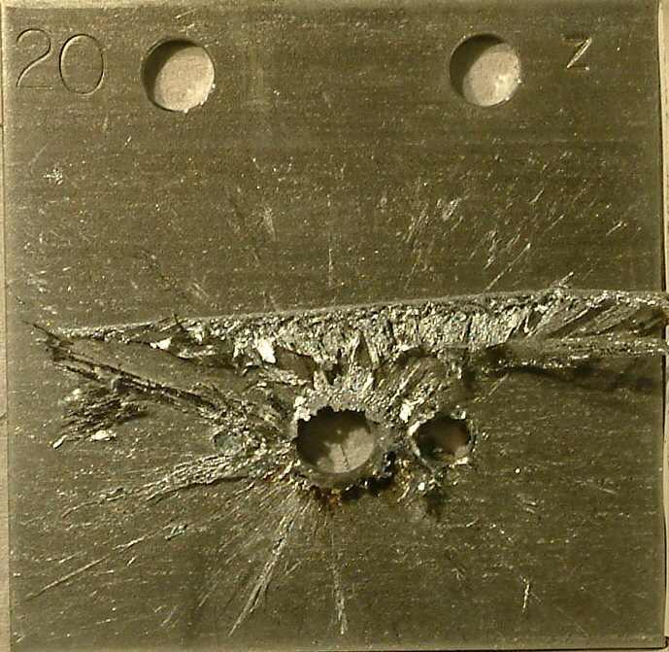

Beam Loss and Machine Protection
Introduction
Rüdiger Schmidt, CERN
U.S. Particle Accelerator School
January 2017

Slide 2
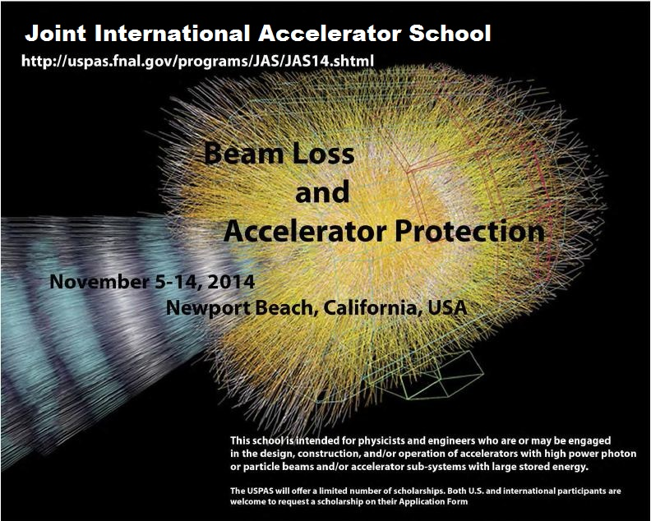

Slide 3
Protection is required if there are risks

Slide 4
Risk from Energy and Power
Risks come from Energy stored in a system (Joule), and Power when operating a system (Watt)
  “Very powerful accelerator” … the power flow needs to be controlled
An uncontrolled release of the energy, or an uncontrolled power flow can lead to unwanted consequences
  Damage of equipment and loss of time for operation
  For particle beams, activation of equipment
In particular relevant for complex particle accelerators
  For equipment, such as RF system, power converters, magnet system …
  For particle beams
Particle accelerators use large amount of power (few MW to many MW)
Where does the power go in case of failure?

Slide 5
Risks in many areas of an accelerator complex
Risks for personnel
  Electrical, Cryogenics, Radiation, Transport and Handling, …
Risks for the environment
  Radiation, release of (toxic) gases, fluids (e.g. oil spill), …
Typical risks as for technical installations, some examples:
  Normal conducting magnets (overheating, electrical risks)
  Power converter (overheating, electrical risks)
  RF (power flow not as desired)
  Transport of magnets (several ten tons)
  ……….
Risks related to the operation with particle beams
The lectures address risks when operating with particle beams, one lecture addresses risks related to superconducting magnets

Slide 6
Risks related to accelerator systems
Normal conducting magnets
  (Water) cooling required, and interlocks to monitor if it works correctly
RF systems (modulator, klystrons, waveguides, cavities): high voltages, arcs can damage the structure
  Requires complex and fast interlock systems
  For high beam intensity: in case of transition from beam on => beam off, RF system has to cope with such transients
High Voltage systems (e.g. kicker magnets) - risk of arcing
Powering systems (power converters, power distribution, electrical network)
These risks are not discussed here
  see Joint International Accelerator School on "Beam Loss and Accelerator Protection“ http://uspas.fnal.gov/programs/JAS/JAS14.shtml

Slide 7
Programme for the school
What can go wrong?
What are the consequences?
How to prevent accidents?
How to control and operate a particle accelerators in presence of risks?

Slide 8
Lecture Programme
Monday | 1 | Introduction to Machine Protection | Rüdiger Schmidt
Monday | 2 | Review of Accelerator Concepts | Jeff Eldred
Monday | 3 | Beam dynamics and beam losses (circular and linear accelerators) | Rüdiger Schmidt / Doug Curry
Monday | 4 | Beam material interaction, heating, activation | Bill Barletta
Monday | 5 | Beam Transfer and fast kicker magnets | Jörg Wenninger
Tuesday | 6 | Beam loss induced damage mechanisms and their calculation | Rüdiger Schmidt
Tuesday | 7 | Detection of failures | Doug Curry
Tuesday | 8 | Beam Cleaning, collimation and beam absorbers | Jörg Wenninger
Wednesday | 9 | Indirect damage due to high intensity beams | John Seemann
Wednesday | 10 | Protection of superconducting magnets | Maxim Marchevsky
Wednesday | 11 | Reliability and availability | Rüdiger Schmidt
Thursday | 12 | Controls and Interlocks | Doug Curry
Thursday | 13 | Case studies in machine protection: SNS and LHC | Doug Curry / Jörg Wenninger
Thursday | 14 | Machine protection and operation | Jörg Wenninger / Doug Curry

Slide 9
Hazards and Risks

Slide 10
Hazard and Risk for accelerators
Hazard: a situation that poses a level of threat to the accelerator. Hazards are dormant or potential, with only a theoretical risk of damage. Once a hazard becomes "active“: incident / accident. Consequences and Probability of a hazard interact together to create RISK, can be quantified:
RISK = Consequences ∙ Probability
Related to accelerators
Consequences of a failure in a hardware systems or uncontrolled beam loss (in $, downtime, radiation dose to people, reputation)
Probability of such event
The higher the RISK, the more Protection needs to be considered
Notes:
10

Slide 11
Hazards related to particle beams
Regular beam losses during operation
  To be considered since losses leas to activation of equipment and possibly quenches of superconducting magnets
  Radiation induced effects in electronics (Single Event Effects)
Accidental beam losses due to failures: understand hazards, e.g. mechanisms for accidental beam losses
  Hazards becomes accidents due to a failure, machine protection systems mitigate the consequences
Understand effects from electromagnetic fields and synchrotron radiation that potentially lead to damage of equipment
Understand interaction of particle beams with the environment
  Heating, activation, mechanical damage,…
Understand mechanisms for damage of components

Slide 12
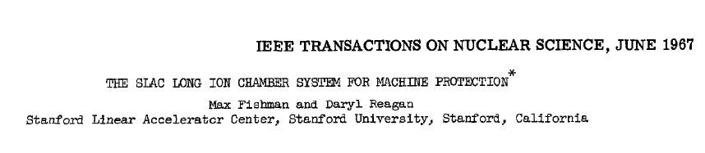
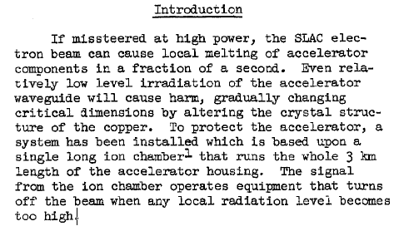
Machine protection 50 years ago

Slide 13
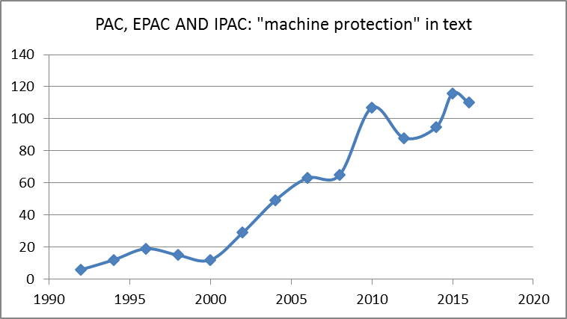
Machine protection during last 25 years
Machine protection has been on the agenda since a long time
Only in the last decade it became significant in conferences
  Due to new expensive machines with increased stored energy / power

Slide 14
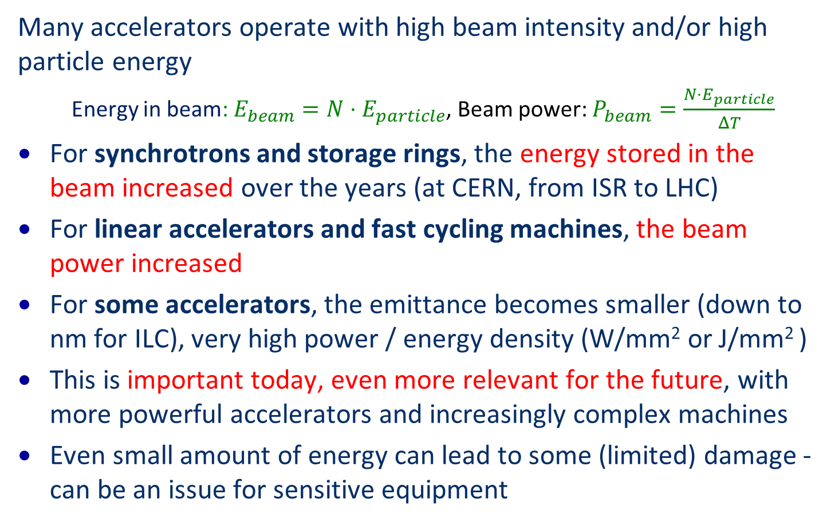
Energy and Power for particle beams
Many accelerators operate with high beam intensity and/or high particle energy
  Energy in beam: $E_{beam}=N⋅E_{particle}$, Beam power: $P_{beam}=\frac{N⋅E_{particle}}{ΔT}$
For synchrotrons and storage rings, the energy stored in the beam increased over the years (at CERN, from ISR to LHC)
For linear accelerators and fast cycling machines, the beam power increased
For some accelerators, the emittance becomes smaller (down to nm for ILC), very high power / energy density (W/mm² or J/mm² )
This is important today, even more relevant for the future, with more powerful accelerators and increasingly complex machines
Even small amount of energy can lead to some (limited) damage - can be an issue for sensitive equipment

Slide 15
Parameters for damage from beam losses
Energy stored in the beam
Beam power
For accelerators with large stored energy or large power => significant hazard
Hazard needs a failure to become active
Activation of equipment to be considered
Hadrons (no issues for synchrotron radiation)
Particle energy
Particle type
Leptons (minor issues for activation of equipment)
Possibly issue during regular operation
Leptons => possibly large synchrotron radiation power
Small beam size
Leptons, but also hadrons
Risk of damage
Risk for equipment in beam pipe due to electromagnetic fields from beam related to impedance
Possibly issue during regular operation
Beam / Bunch current + Time structure

Slide 16
Circular accelerators
Particle colliders
Accelerators for fixed target operation (e.g. neutrino factories)
Synchrotron light sources
Cyclotrons

Slide 17
Circular accelerator: re-use accelerating structure
Accelerating structure
Accelerating beams to high energy in a synchrotron
Beam are injected into the accelerator
The particles make many turns
The magnetic field is slowly increased, and particles are accelerated when travelling through the accelerating structure
The beams are stored for many hours at top energy, bunches collide each turn
Major limitations: emission of synchrotron radiation (leptons) and strength of the magnetic field (hadrons)
Magnets around the accelerator to bring the beam back to the accelerating structure
Today achieved c.m energy of 13 TeV at LHC
Experiment

Slide 18
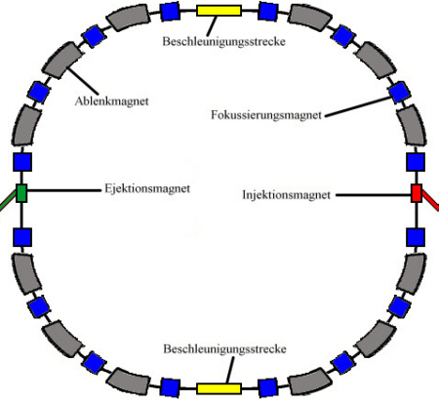
Components of a synchrotron
Components of a synchrotron:
deflection magnets
magnets to focus beams and other magnets
RF cavities
RF system
vacuum system
injection magnets (pulsed)
extraction magnets (pulsed)
beam instrumentation
experiments
control system
power converter
RF cavities
Deflecting magnets
Focusing magnets
Extraction
magnets
Injection
magnets
RF cavities

Slide 19
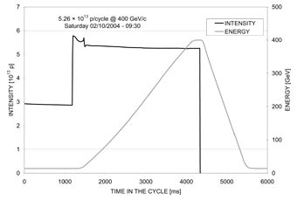
Synchrotrons and storage rings
Magnetic field
Beam intensity
450 GeV
Extraction
Example: CERN-SPS
Protonsynchrotron
14 GeV
Injection
Injection
Extraction
Time
14 sec
cycle
From synchrotron to storage ring: “simply” extend the length of the extraction plateau to many hours
Colliders use two beams, either in one or in two vacuum chambers

Slide 20
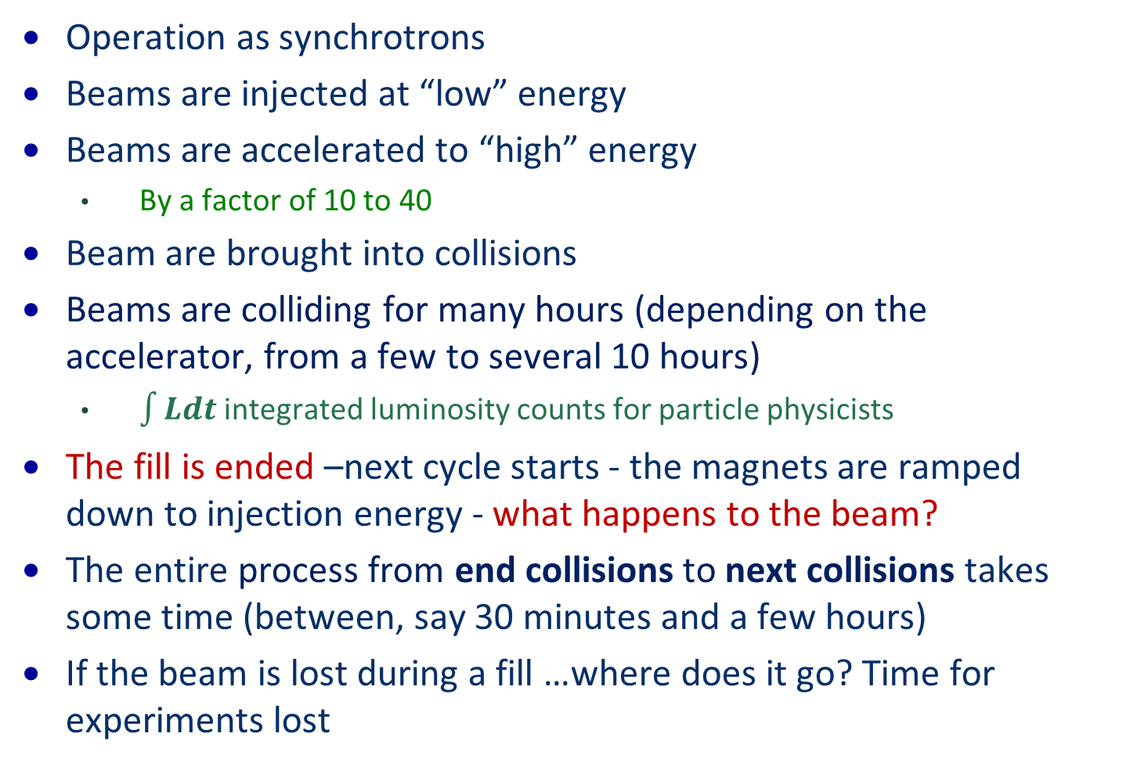
Circular colliders for highest energy….
Operation as synchrotrons
Beams are injected at “low” energy
Beams are accelerated to “high” energy
  By a factor of 10 to 40
Beam are brought into collisions
Beams are colliding for many hours (depending on the accelerator, from a few to several 10 hours)
  $\int{Ldt}$ integrated luminosity counts for particle physicists
The fill is ended –next cycle starts - the magnets are ramped down to injection energy - what happens to the beam?
The entire process from end collisions to next collisions takes some time (between, say 30 minutes and a few hours)
If the beam is lost during a fill …where does it go? Time for experiments lost

Slide 21
Energy stored in beam and magnets
10000.00
LHC
energy in
magnets
1000.00
LHC top
energy
100.00
LHC injection
(12 SPS batches)
Factor
~200
10.00
SPS fixed
Energy stored in the beam [MJ]
ISR
target, CNGS
HERA
TEVATRON
1.00
RHIC
0.10
LEP2
proton
SNS
SPS
ppbar
0.01
1
10
100
1000
10000
Momentum [GeV/c]
based on graph from R.Assmann

Slide 22
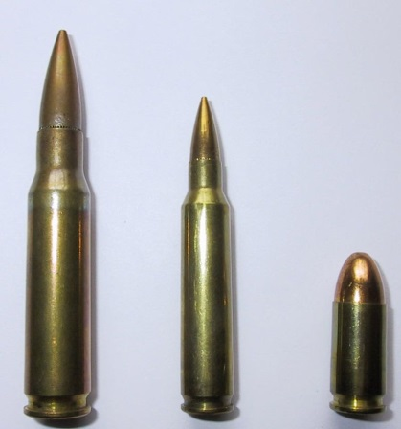
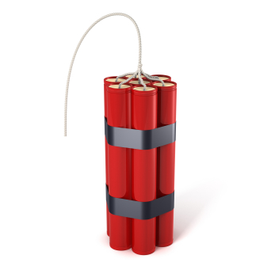

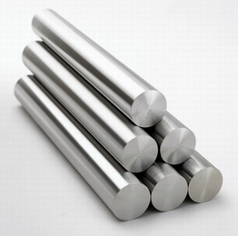
What does it mean ……… Joule, kJ and MJ?
The energy of pistol bullet: about 500 J
The energy of 1 kg TNT: about 4 MJ
The energy of 1 l gas: about 36 MJ
To melt 1 kg of steel (copper is similar): about 800 KJ

Slide 23
LHC collider
LHC: Nominal energy of 7 TeV / beam
Very high luminosity
Superconducting magnets

Slide 24
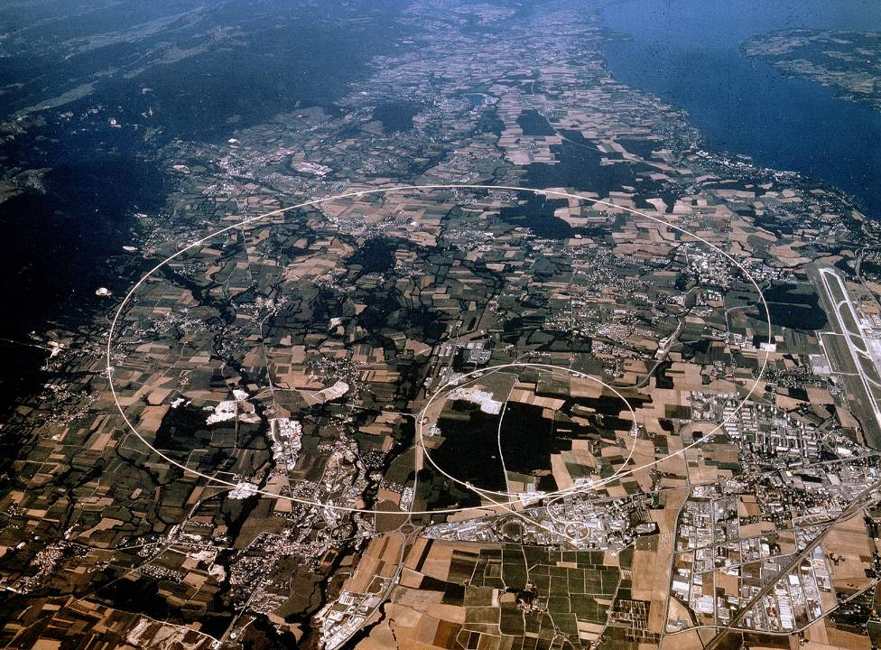
Proton collider LHC – 362 MJ stored in one beam
CERN
Switzerland
Lake Geneva
LHC Accelerator
(100 m down)
LHCb
CMS, TOTEM
ALICE
SPS Accelerator
ATLAS
LHC pp and ions
7 TeV/c – up to now 4 TeV/c
26.8 km circumference
Energy stored in one beam 362 MJ

Slide 25
LHC Large Hadron Collider
Two ring collider (two different bending fields and vacuum chambers)
Superconducting magnets
  Protection of superconducting magnets needs to be addressed during the magnet development
It is not tolerable to lose the beam in an uncontrolled way = > needs to be extracted from the machine
A performant protection system is required, to protect from both, uncontrolled release of beam energy and uncontrolled release of magnet energy
What triggers the extraction? Managing of interlocks is required.
Task assigned to a team in 2000: Machine Protection Working Group

Slide 26
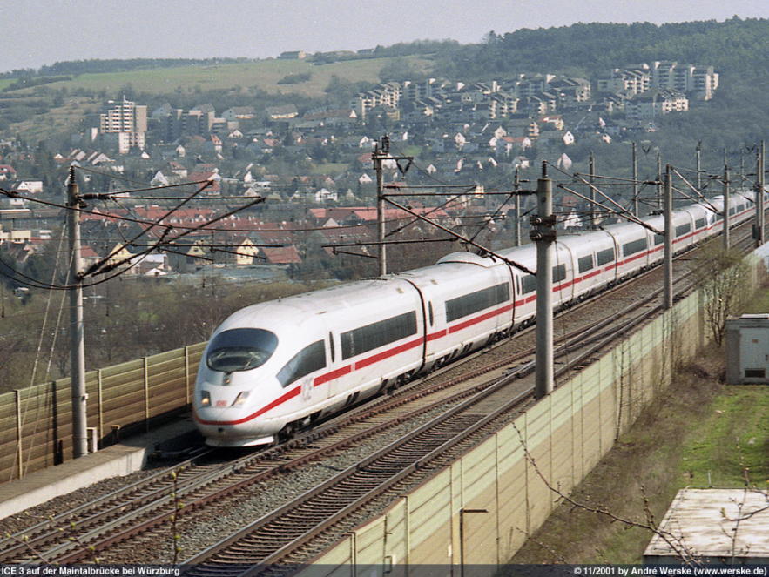
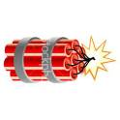

……the LHC
The energy of an 200 m long fast train at 155 km/hour corresponds to the energy of 360 MJ stored in one LHC beam.
360 MJ: the energy stored in one LHC beam corresponds approximately to…
90 kg of TNT
8 litres of gasoline
15 kg of chocolate
It matters most how easy and fast the energy is released !!

Slide 27
Proton collider LHC – 362 MJ stored in one beam
If something goes wrong, the beam energy has to be safely deposited
CERN
Switzerland
Lake Geneva
LHC Accelerator
(100 m down)
LHCb
CMS, TOTEM
ALICE
SPS Accelerator
ATLAS
LHC pp and ions
7 TeV/c – up to now 4 TeV/c
26.8 km Circumference
Energy stored in one beam 362 MJ

Slide 28
Linear accelerators
High power hadron accelerators
Spallation sources
Proton accelerators for neutrino production
Accelerator Driven Spallation
Rare Isotope Beams Production (e.g. FRIB folded linac to accelerate ions)
Linear colliders
ILC and CLIC
FEL Linear accelerators
XFEL (DESY) and LCLS / LCLS II (SLAC)

Slide 29
ESS Lund / Sweden – 5 MW beam power
~ 500 m
352.21 MHz
704.42 MHz
2.4 m
4.0 m
3.6 m
32.4 m
58.5 m
113.9 m
227.9 m
Target
Source
LEBT
RFQ
MEBT
DTL
Spokes
Medium β
High β
HEBT & Upgrade
75 keV
3 MeV
90MeV
220MeV
570MeV
2000 MeV
Low energy beam transport
RFQ
352.2 MHz
Medium energy beam transport
Drift tube linac with
4 tanks
Super-conducting cavities
High energy beam transport
Power of
5000 kW
Operating with protons
Operation with beam pulses at a frequency of 14 Hz
Pulse length of 2.86 ms
Average beam power of 5 MW
Peak power of 125 MW
Power per pulse 360 kJ
ESS as an example for a high intensity linear accelerator (similar to SNS and J-PARC)

Slide 30
ESS Lund / Sweden – 5 MW beam power
If something goes wrong, injection has to be stopped
~ 500 m
352.21 MHz
704.42 MHz
2.4 m
4.0 m
3.6 m
32.4 m
58.5 m
113.9 m
227.9 m
Target
Source
LEBT
RFQ
MEBT
DTL
Spokes
Medium β
High β
HEBT & Upgrade
75 keV
3 MeV
78 MeV
200 MeV
628 MeV
2500 MeV
Low energy beam transport
RFQ
352.2 MHz
Medium energy beam transport
Drift tube linac with
4 tanks
Super-conducting cavities
High energy beam transport
Power of
5000 kW
Operating with protons
Operation with beam pulses at a frequency of 14 Hz
Pulse length of 2.86 ms
Average power of 5 MW
Peak power of 125 MW
As an example for a high intensity linear accelerator (similar to SNS and J-PARC)

Slide 31

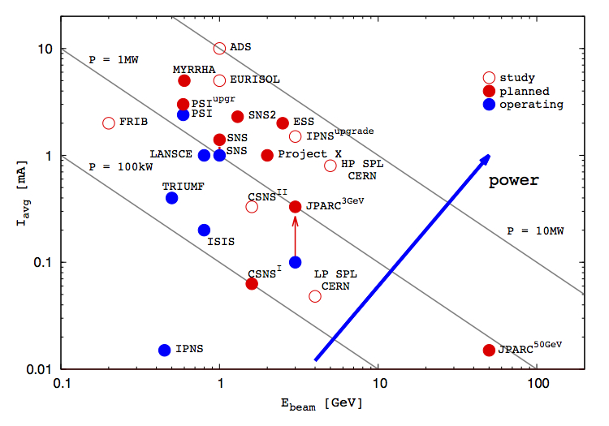
High intensity proton accelerators
10²⁰
SNS
ESS
MTR
NRU
HFIR
ILL
ISIS
J-PARC
10¹⁵
NRX
HFBR
IPNS
X-10
KENS
FRM-II
SINQ
10¹⁰
WNR
CP-2
Effective thermal neutron flux n/cm²-s
ZING-P/
CP-1
Berkeley 37-inch cyclotron
10⁵
Steady State Sources
350 mCi Ra-Be source
Pulsed Sources
1
1930
1940
1950
1960
1970
1980
1990
2000
2010
2020
(Updated from Neutron Scattering, K. Skold and D. L. Price, eds., Academic Press, 1986)

Slide 32
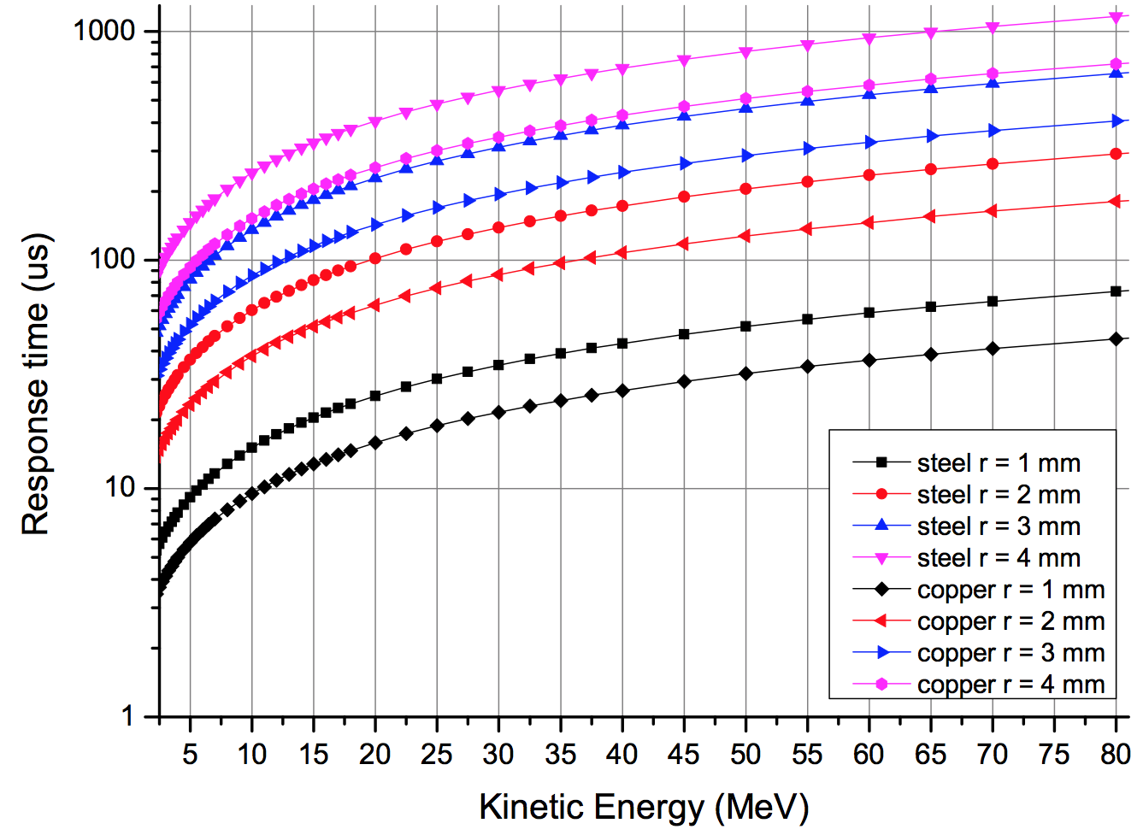
Example for ESS
Example:
After the DTL normal conducting linac, the proton energy is 78 MeV. In case of a beam size of 2 mm radius, melting would start after about 200 µs.
Inhibiting beam should be in about 10% of this time.
Time to melting point
L.Tchelidze
inhibit beam interlock signal
source
dT = dT_detect failure + dT_transmit signal + dT_inhibit source + dT_beam off

Slide 33
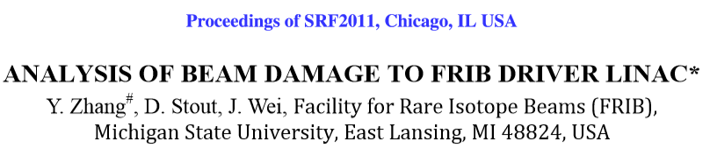
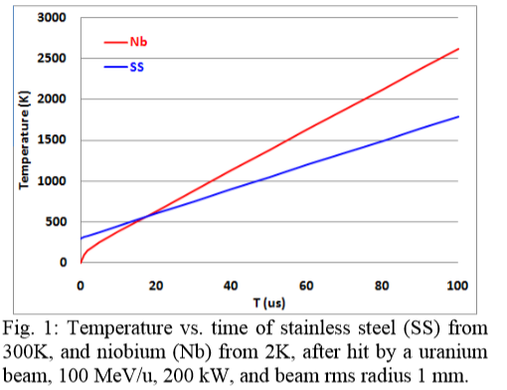
Example for FRIB at MSU for uranium beams

Slide 34
Linear collider: use accelerating structure once
Accelerating beams to high energy in a linear collider
The beams are accelerated during one passage and the bunches are colliding only once at the center of the experiment
Accelerating structures
Experiment
Accelerating structures
  Acceleration of particles with time-varying electrical field
    Limit 30-40 MeV/m with superconducting cavities
    Limit about 100 MeV/m with other technologies, not yet used (CLIC)
    Some 100 MeV … ~TeV conceivable for e+e- colliders
    Reaching an energy of 14 TeV c.m. (such as LHC) would require an accelerator with a length > 400 km (with 40 MV/m)
    Long-term: acceleration in a plasma … not ready for a HEP collider
    Challenge: operation with extremely small beams (few nm)

Slide 35
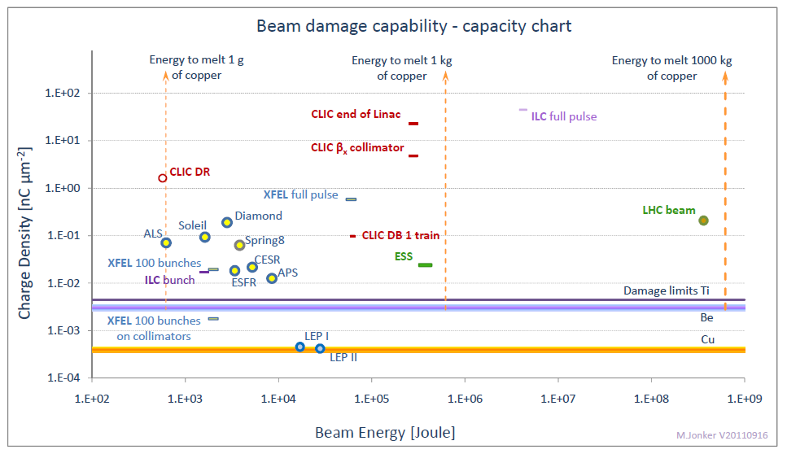
Beam damage capabilities
M.Jonker

Slide 36
Parameters for a few accelerators…..
I
e+e-
protons
For hadron colliders, the energy stored in the beams can be very high (LHC is very critical)
For linacs, the power of the beam can be very high

Slide 37
Observations at various accelerators

Slide 38
Accidents at accelerators in the past
Accident: An unfortunate incident that happens unexpectedly and unintentionally, typically resulting in damage or injury.
SLAC: Damage Test 1971
SPS proton antiproton collider 1986: Damage of UA2
Tevatron proton antiproton collider 2003: Damage of collimator
SPS synchrotron 2004: Damage of transfer line TT40
SPS – TT40 Damage Test 2004
LHC magnet powering: Severe damage of magnet system
LINAC 4 (2013) at very low energy: Beam hit a bellow and a vacuum leak developed
JPARC 2013: Damage of target – release of radioactive material

Slide 39
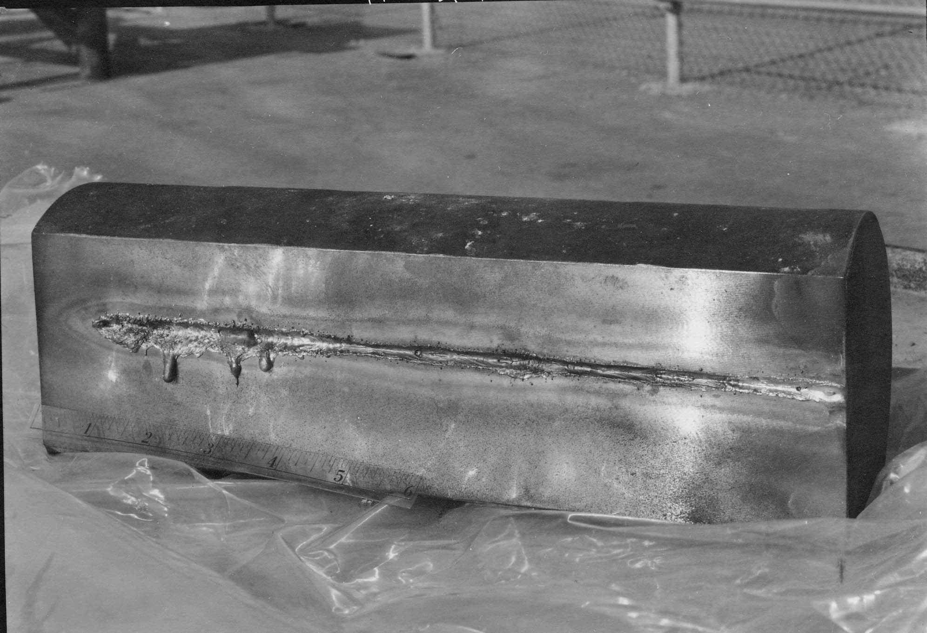
Damage test of a 30 cm long Copper Block (SLAC – 1971)
A ~2-mm 500 kW Beam enters a few mm from the edge.
It took about 1.3 sec to melt through the block (slow accident).
30 cm
500 kW beam
(0.65 MJ in 1.3 sec)
L. Keller et al (SLAC)

Slide 40
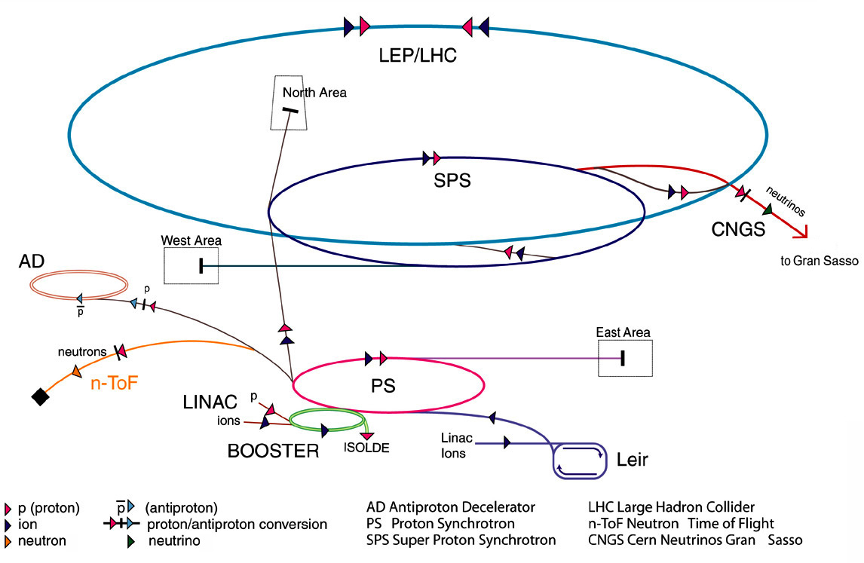
CERN-SPS Proton Antiproton Collider
Build as proton synchrotron to accelerate protons to 450 GeV and direct beam on a target for Fixed Target Experiments starting in 1978
  Normal conducting magnets, no ultrahigh vacuum required
Transformed the SPS accelerator from a Fixed Target Synchrotron into a Proton Antiproton collider in 1980 … 1982
Operating as Proton Antiproton Collider until 1990
Once, injected beam went for 10 min into the UA2 experiment … not appreciated: do not forget the protection of the experiments
Antiprotons are very rare, takes a long time to produce them
Sometime the beams were lost …….. many hours to produce a new stack of antiprotons
Lessons from SPS Proton Antiproton Collider:
  Protect the experiments
  Protect the beam

Slide 41
CRN-SPS Proton Synchrotron
Very different parameters from Proton Antiproton Collider
  Cycle time in the order of some seconds to some ten seconds, high intensity beams
  Used for fixed target physics, neutrino production and as injector for LHC
  Requirements for the vacuum system are moderate
If the beam is lost … no big issue, wait for next cycle
  …. however, beam losses should not lead to damage
Beam current constantly being increased over the years
Operating in different modes with different extraction lines
Several (minor) accidents during the history of the SPS by beam induced damage
  Damage, e.g. replacing a magnet, can be fixed in a short time (< one day)
Lesson from SPS Proton Synchrotron: Protect the machine from uncontrolled beam losses

Slide 42
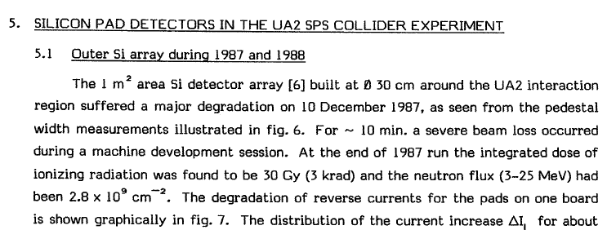
Damage to silicon detector in UA2 at SPS
Damage to the silicon detector in the UA2 experiment at the Proton Antiproton Collider
The beam was injected for about 10 minutes
The electrostatic separators, normally used to create an orbit bump at the experiment, were still set to high energy
The bump directed the beam directly into UA2

Slide 43
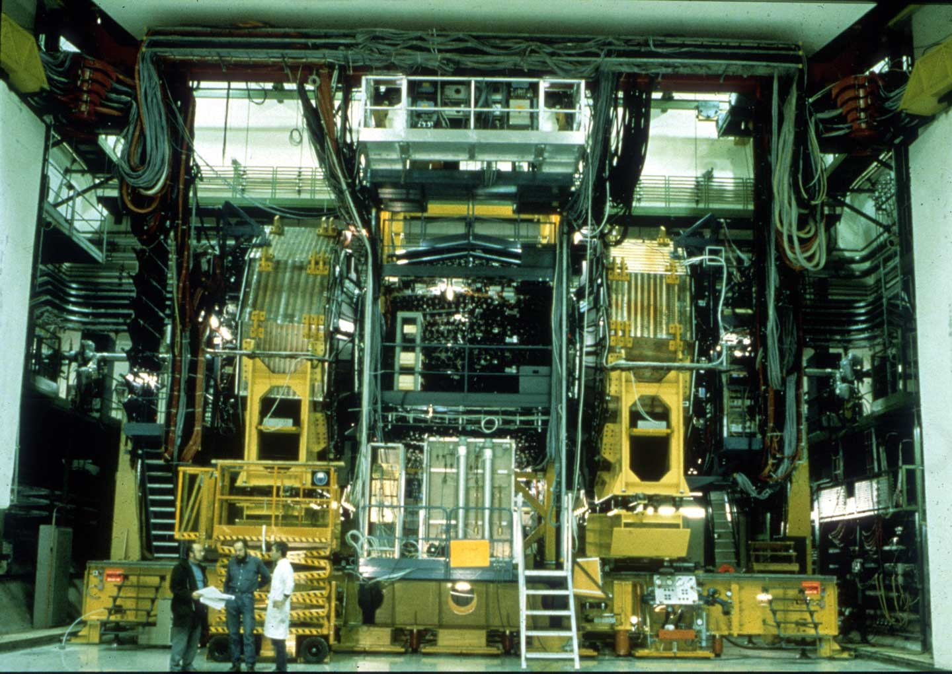
Colliding beams in UA2
UA2 Experiment
Protons
Pbar
several m

Slide 44
Separation bump
UA2 Experiment
Electrostatic separators
Electrostatic separators
Protons
Pbar
The beam needed to be separated at injection energy of 26 GeV and during the energy ramp to 315 GeV
This was done with electrostatic separators that were also ramped

Slide 45
….try to inject beam
UA2 Experiment
Electrostatic separators
Electrostatic separators
Protons
Pbar
One day, for injection at 26 GeV, the separators were left at the setting for 315 GeV – much too large angle, and operation was surprised to see not circulating beam - using UA2 as a beam dump

Slide 46
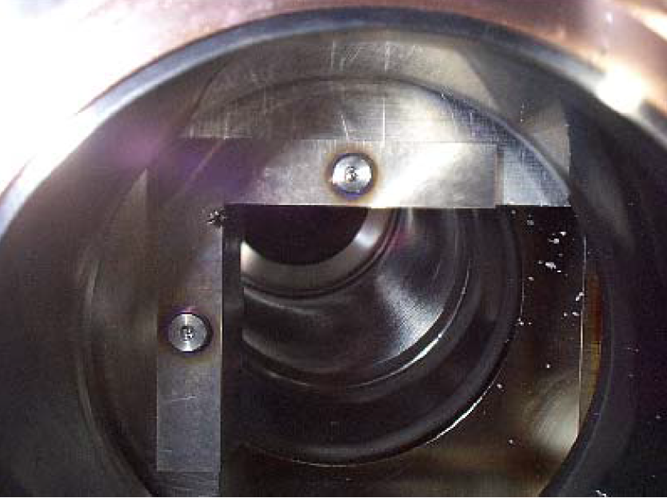
Tevatron accident
December 5, 2003, 16 house quench during the end of a proton-antiproton colliding beam store followed by the damage of two collimators used for halo reduction at the CDF and DØ interaction points. A cryogenic spool piece that houses correction elements was also damaged as a result of helium evaporation and pressure rise during the quench, requiring 10 days of Tevatron downtime for repairs.
A Roman pot (movable device) moved into the beam
Particle showers from the Roman pot quenched superconducting magnets
The beam moved by 0.005 mm/turn, and touched a collimator jaw surface after about 300 turns
The entire beam was lost, mostly on the collimator
BLMs switched off during ramp

Slide 47
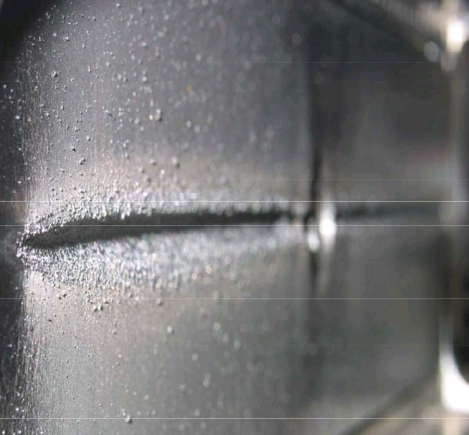
HERA proton collimator in 2003
HERA collimators – 5 mm grove, never noticed during operation, only when machine was opened
https://espace.cern.ch/acc-tec-sector/Chamonix/Chamx2009/talks/bjh_6_06_talk.pdf

Slide 48
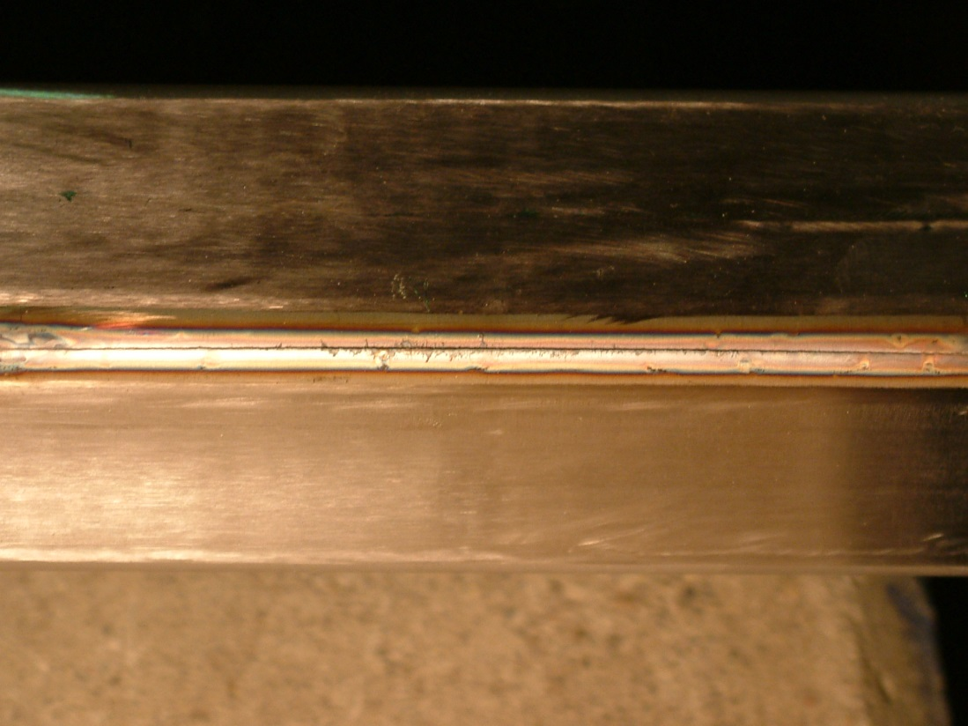
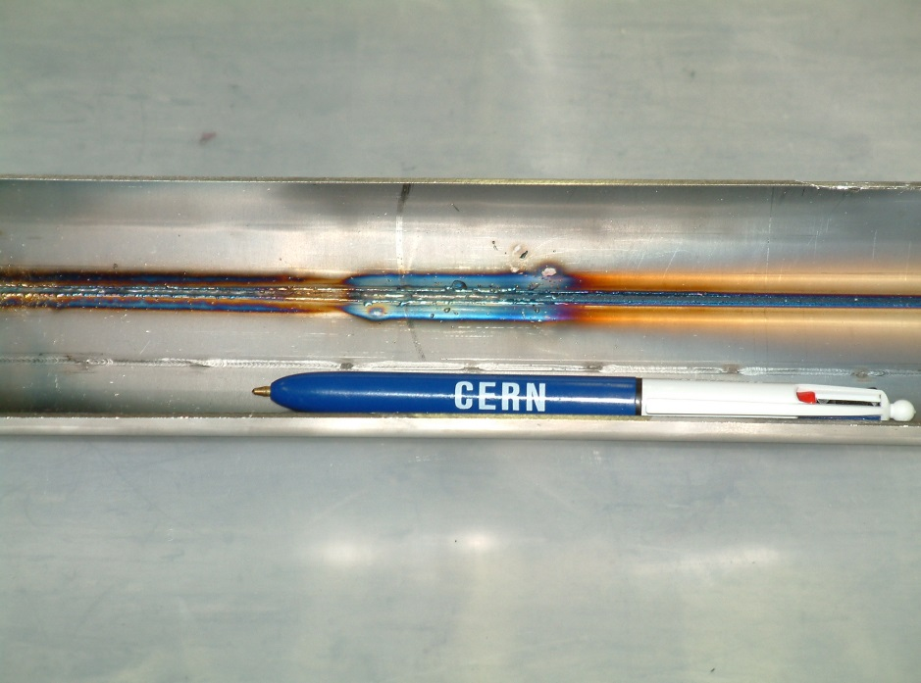
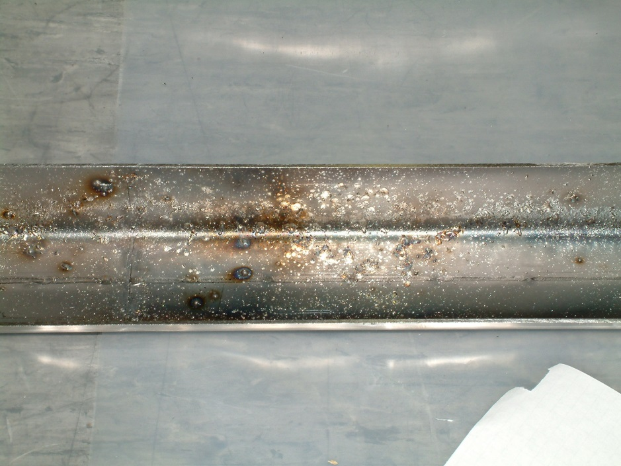
Vacuum chamber in SPS extraction line incident
450 GeV protons, 2 MJ beam in 2004
Failure of a septum magnet
Cut of 25 cm length, groove of 70 cm
Condensed drops of steel on other side of the vacuum chamber
Vacuum chamber and magnet replaced

Slide 49
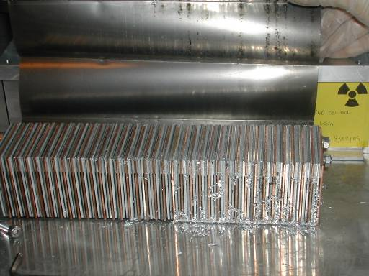
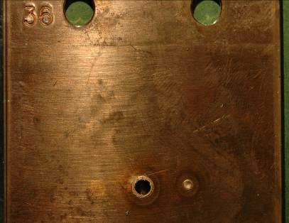
SPS experiment: Beam damage with 450 GeV protons
Controlled SPS experiment
8⋅10¹² protons clear damage
beam size σ_{x/y} = 1.1mm/0.6mm
above damage limit for copper
stainless steel no damage
2⋅10¹² protons
below damage limit for copper
25 cm
6 cm
0.1 % of the full LHC 7 TeV beams
factor of three below the energy in a bunch train injected into LHC
damage limit ~200 kJoule
A B D C
V.Kain et al
Notes:
49

Slide 50
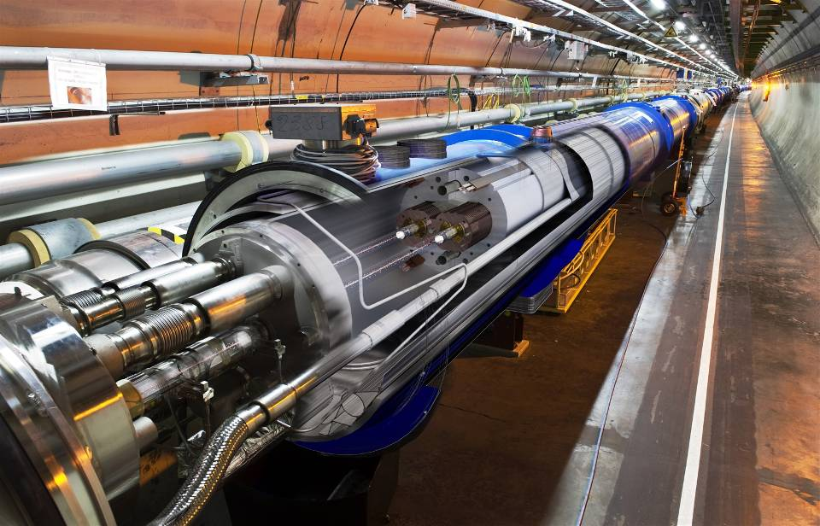
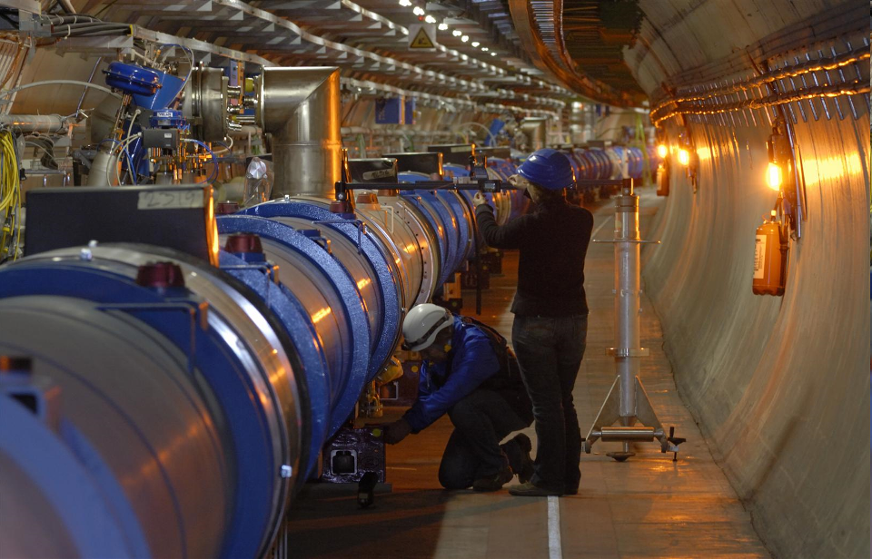
LHC tunnel with dipole magnets
If something goes wrong, the energy stored in the magnet has to be safely discharged
beam tubes
  1232 superconducing dipole magnets
Looking into the arc
Notes:
50

Slide 51
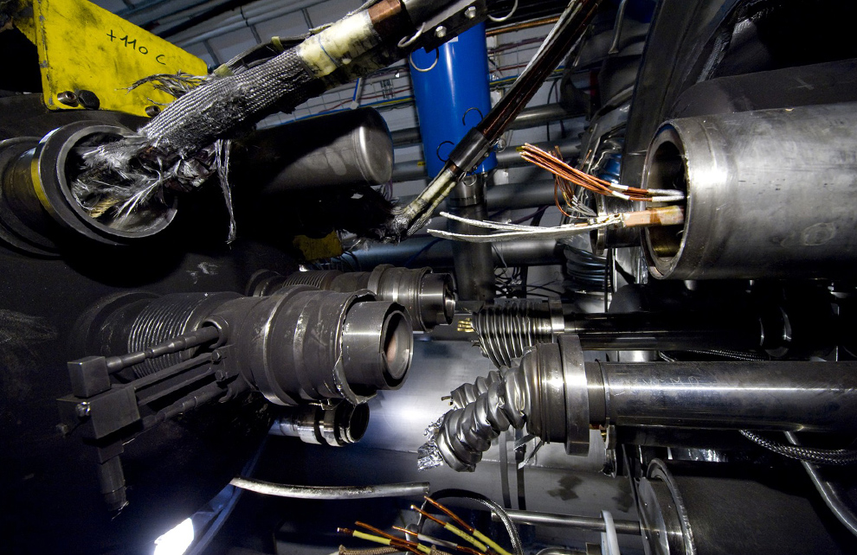
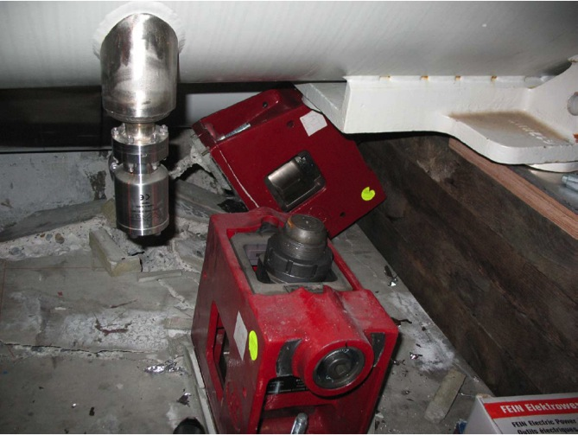
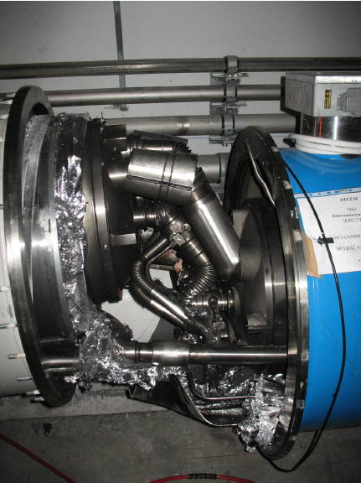
Consequences of a release of 600 MJ at LHC
The 2008 LHC accident happened during test runs without beam.
A magnet interconnect was defect and the circuit opened. An electrical arc provoked a He pressure wave damaging ~600 m of LHC, polluting the beam vacuum over more than 2 km.
Arcing in the interconnection
Magnet displacement
53 magnets had to be repaired
Over-pressure

Slide 52
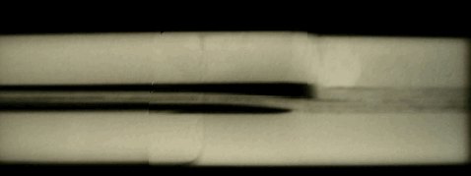
Problems on the joints between magnets
The copper stabilizes the bus bar in the event of a cable quench (=bypass for the current while the energy is extracted from the circuit).
Protection system in place in 2008 not sufficiently sensitive.
A copper bus bar with reduced continuity coupled to a badly soldered superconducting cable can lead to a serious incident.
Solder
No solder
wedge
bus
U-profile
bus
X-ray
During repair work, inspection of the joints revealed systematic voids caused by the welding procedure.
Energy limitation for run 1 !!

Slide 53
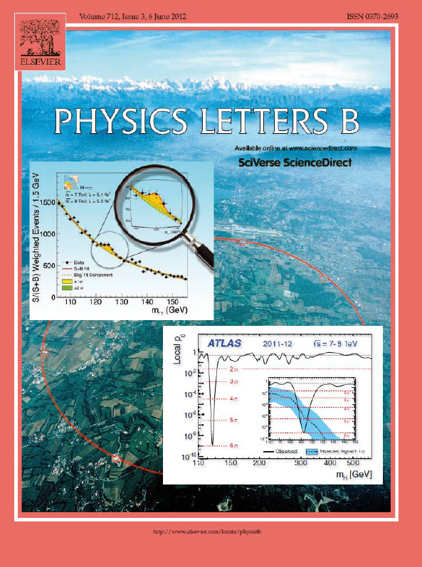
Recovery from the accident
Damage has a large impact on the availability of an accelerator
For the LHC, it took a long time (about one year) to repair the magnets
A new layer of protection system for the superconducting magnets and bus-bars was installed
Energy was limited to 3.5 TeV, later to 4 TeV
Re-start up about one year later
Performance was excellent
During a two years shut-down from 2013-2014 the interconnects were finally repaired, then operation at 6.5 TeV

Slide 54
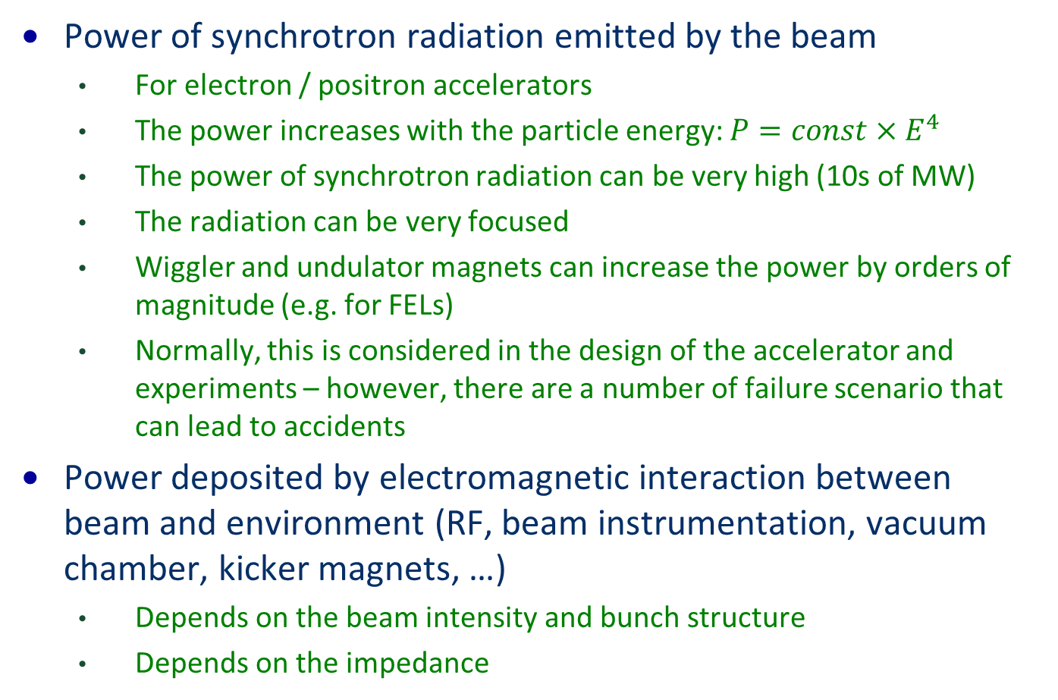
Indirect energy transfer from beam to equipment
Power of synchrotron radiation emitted by the beam
  For electron / positron accelerators
  The power increases with the particle energy: $P=const×E^{4}$
  The power of synchrotron radiation can be very high (10s of MW)
  The radiation can be very focused
  Wiggler and undulator magnets can increase the power by orders of magnitude (e.g. for FELs)
  Normally, this is considered in the design of the accelerator and experiments – however, there are a number of failure scenario that can lead to accidents
Power deposited by electromagnetic interaction between beam and environment (RF, beam instrumentation, vacuum chamber, kicker magnets, …)
  Depends on the beam intensity and bunch structure
  Depends on the impedance

Slide 55
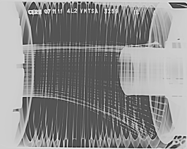
LHC interconnects
The metallic coating on the fingers had melted, temperature had reached more than 800 ⁰C.
B.Salvant

Slide 56
CERN-LINAC 4 during commissioning at 3 MeV
On 12 December 2013 a vacuum leak on a below developed in the MEBT line.
Beam has been hitting bellow during special measurements (very small beams in vertical, large in horizontal), ~16% of the beam lost for about 14 minutes and damaged the bellow. The consequences were minor since LINAC4 was not yet in the CERN injector chain.
Happened with very low power beam (few W).
A.Lombardi

Slide 57
J-PARC radioactive material leak accident
A radioactive material leak accident occurred at the Hadron Experimental Facility on May 23, 2013.
The accident was triggered by a malfunction of the slow extraction system of the Main Ring synchrotron (MR). May 2013, one of the spill feedback quadrupole magnets, Extraction Quadrupole (EQ), malfunctioned.
A beam consisting of 2x10¹³ protons was extracted within a very short time of 5 ms and delivered to the gold target in the HD facility, normally a total of 3x10¹³ protons were extracted for 2 s. The gold target was instantaneously heated up to an extraordinarily high temperature and partially damaged. The radioactive material dispersed from the gold target and leaked into the primary beam-line room, because the target container was not hermetically sealed.
After seven-month long shutdown due to the accident, beam operation of the linac was restarted in December 2013.

Slide 58
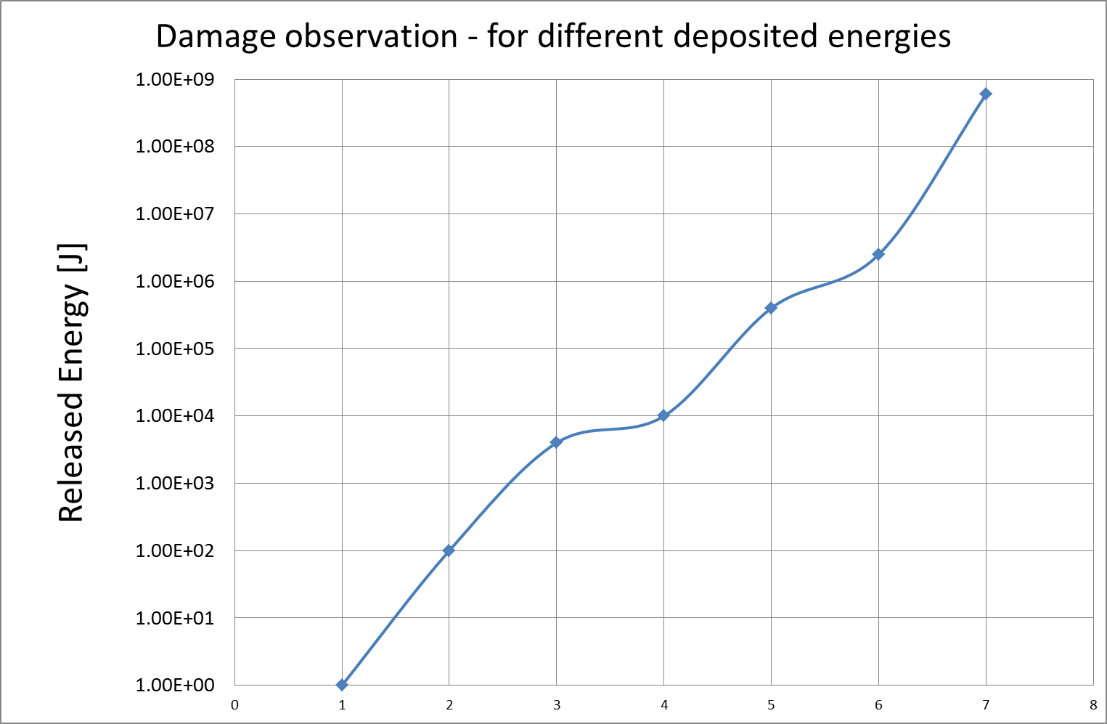
Observed damage for deposited energy
Damage sensitive vacuum equipment (bellow) – long exposure CERN-LINAC4
Major damage to magnet system (LHC powering accident)
Damage of experimental detectors (UA2)
Damage of vacuum chamber with grazing beam incident – short exposure SPS-TT40 accident
Damage of metal plates – short exposure SPS-TT40 material test
Magnet quenches
Problems with superconducting cavities

Slide 59
Machine Protection
Accidental beam losses time scale
Active protection
Passive protection

Slide 60
Accidental beam losses
Single-passage beam loss in the accelerator complex (ns - μs)
  transfer lines between accelerators or from an accelerator to a target station (target for secondary particle production, beam dump block)
  failures of kicker magnets (injection, extraction, special kicker magnets, for example for diagnostics)
  failures in linear accelerators, in particular due to RF systems
  too small beam size at a target station
Very fast beam loss (ms)
  e.g. multi turn beam losses in circular accelerators
  due to a large number of possible failures, mostly in the magnet powering system, with a typical time constant of ~1 ms to many seconds
Fast beam loss (some 10 ms to seconds)
Slow beam loss (many seconds)
Notes:
60

Slide 61




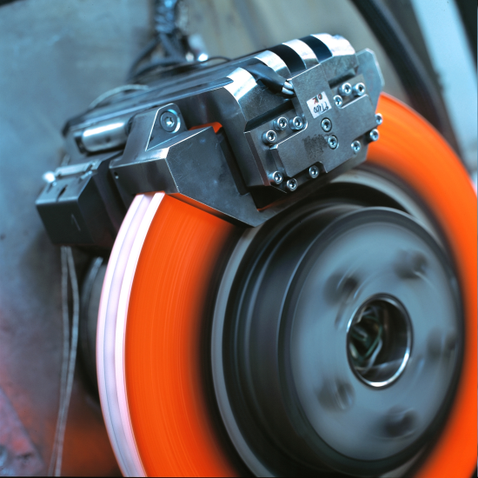
Example for Active Protection - Traffic
A monitor detects a dangerous situation
An action is triggered
The energy stored in the system is safely dissipated

Slide 62
Active protection
A system is monitored, the monitor delivers some values (e.g. beam loss monitors measuring beam losses)
The acceptable range of values is predefined (e.g. maximum beam losses within a time interval)
If a value is out of the predefined range (e.g. after an equipment failure): take action (dump circulating beam, stop injection, ….)
The information has to travel from the monitor to the activator (extraction system, injection inhibit, …) => interlock system
There is some reaction time required for the response (depending on the system this can range between some ns and many seconds)

Slide 63

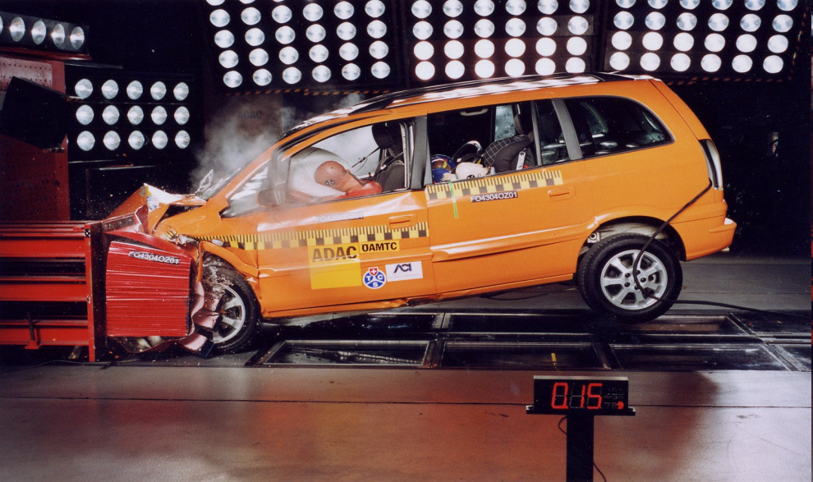
Example for Passive Protection - Traffic
The monitor fails to detect a dangerous situation
The reaction time is too short
Active protection not possible – passive protection by bumper, air bag, safety belts

Slide 64
Passive protection
Is always necessary when the time required for the response is too short (…remember the limitation of the speed of light)
Might simplify the protection system
One example is the fast extraction of a high intensity beam from an synchrotron
  The extraction is performed with a fast kicker magnet
  It cannot be guaranteed that there is not kicker failure leading to a wrong deflection angle of the beam
  The range of plausible failures (=deflection angles) needs to be defined
  If the beam could damage hardware, protection absorbers are required
  For movable absorbers: need to be made sure that they are at the correct position

Slide 65
Some observations
Several accidents happened during injection and extraction of beams (SPS-proton-antiproton collider, SPS fixed target-TT40, J-PARC)
An accident happened when operating with circulating beams (Tevatron)
An accident happened during beam commissioning at very low energy (CERN-Linac4)
A very serious accident happened at LHC during superconducting magnet commissioning (no beam operation)
On several occasions it was observed that accelerator components were heating up and deforming due to the interaction of high intensity beam with the environment (beam instruments, bellows, …)

Slide 66
This school: Overview
Beam dynamics and beam losses (circular and linear accelerators)
Beam material interaction, heating, activation
Beam Transfer and fast kicker magnets
Beam loss induced damage mechanisms and their calculation
Detection of failures
Beam Cleaning, collimation and beam absorbers
Indirect damage due to high intensity beams
Protection of superconducting magnets
Reliability and availability
Controls and Interlocks
Case studies in machine protection: SNS and LHC
Machine protection and operation

Slide 67

Thanks and have fun !

Slide 68
References: Early paper on machine protection
M.Fishman, THE SLAC LONG ON CHAMBER SYSTEM FOR MACHINE PROTECTION http://accelconf.web.cern.ch/AccelConf/p67/PDF/PAC1967_1096.PDF
R.F.Koontz, Multiple Beam Pulse of the SLAC Injector, IEEE TRANSACTIONS ON NUCLEAR SCIENCE, 1967, http://ieeexplore.ieee.org/stamp/stamp.jsp?tp=&arnumber=4324532
A FAST PROTECTION SYSTEM FOR LlNEAR ACCELERATOR (LAMPF) http://accelconf.web.cern.ch/AccelConf/p69/PDF/PAC1969_0579.PDF
G.S.Levine, THE AGS BEAM LOSS MONITORING SYSTEM http://accelconf.web.cern.ch/AccelConf/p75/PDF/PAC1975_1069.PDF
D.F.Sutter and R. H. Flora, ELECTRICAL PROTECTION OF SUPERCONDUCTING MAGNET SYSTEMS (TEVATRON) http://accelconf.web.cern.ch/AccelConf/p75/PDF/PAC1975_1160.PDF
A.Maaskant, A FAST BEAM PROTECTION SYSTEM (NIKEEF) http://accelconf.web.cern.ch/AccelConf/p81/PDF/PAC1981_2367.PDF
M.C. Ross, Machine Protection Schemes for the SLC http://accelconf.web.cern.ch/AccelConf/p91/PDF/PAC1991_1502.PDF

Slide 69
References: High Intensity Proton Accelerators
M-H. Moscatello, MACHINE PROTECTION SYSTEM FOR THE SPIRAL2 FACILITY http://accelconf.web.cern.ch/AccelConf/IPAC2012/papers/weppd044.pdf
M. Tomizawa, MALFUNCTION, CAUSE AND RECURRENCE PREVENTION MEASURES OF J-PARC SLOW EXTRACTION http://accelconf.web.cern.ch/AccelConf/IPAC2014/papers/thpme060.pdf
T. Koseki, PRESENT STATUS OF J-PARC -AFTER THE SHUTDOWN DUE TO THE RADIOACTIVE MATERIAL LEAK ACCIDENT http://accelconf.web.cern.ch/AccelConf/IPAC2014/papers/thpme061.pdf
C.Sibley, The SNS Machine Protection System: Early Commissioning Results and Future Plans, PAC 2005, http://accelconf.web.cern.ch/AccelConf/P05/PAPERS/RPPE021.PDF
L.Tchelidze, In how long the ESS beam pulse would start melting steel/copper accelerating components? ESS AD Technical Note, ESS/AD/0031, 2012, http://eval.esss.lu.se/DocDB/0001/000168/001/Time_Response_Requirements_BLM.pdf
Y.Zhang, ANALYSIS OF BEAM DAMAGE TO FRIB DRIVER LINAC https://accelconf.web.cern.ch/accelconf/SRF2011/papers/mopo058.pdf
A.C.Mezger, Control and protection aspects of the megawatt proton accelerator at PSI, HB2010, https://accelconf.web.cern.ch/accelconf/HB2010/papers/tuo1a04.pdf

Slide 70
References: High Intensity Proton Accelerators
Y.Zhang, D.Stout, J.Wei, ANALYSIS OF BEAM DAMAGE TO FRIB DRIVER LINAC, SRF 2012, https://accelconf.web.cern.ch/accelconf/SRF2011/papers/mopo058.pdf
S.Henderson, Status of the Spallation Neutron Source: Machine and Science, PAC 2007, http://accelconf.web.cern.ch/AccelConf/p07/PAPERS/MOXKI03.PDF
H.Yoshikawa et al., Current Status of the Control System for J-PARC Accelerator Complex, ICALEPCS 2007, https://accelconf.web.cern.ch/accelconf/ica07/PAPERS/TOAB02.PDF

Slide 71
References: Reports on losses and damage
E.Beuville, Measurement of degradation of silicon detectors and electronics in various radiation environment http://cds.cern.ch/record/197457/files/CERN-EF-89-4.pdf
B.Goddard, TT40 DAMAGE DURING 2004 HIGH INTENSITY SPS EXTRACTION http://cds.cern.ch/record/825806/files/ab-note-2005-014.pdf?version=1
N.Mokhov, Beam-Induced Damage to the Tevatron Components and What Has Been Done About it http://accelconf.web.cern.ch/AccelConf/abdwhb06/PAPERS/WEAZ04.PDF
M.Werner and K.Wittenburg, Very fast Beam Losses at HERA, and what has been done about it, HB2006, http://accelconf.web.cern.ch/AccelConf/abdwhb06/PAPERS/WEAZ05.PDF
P. Vagin, RADIATION DAMAGE OF UNDULATORS AT PETRA III http://accelconf.web.cern.ch/AccelConf/IPAC2014/papers/wepro035.pdf
N.Tahir, First experimental evidence of hydrodynamic tunneling of ultra–relativistic protons in extended solid copper target at the CERN HiRadMat facility http://scitation.aip.org/content/aip/journal/pop/21/8/10.1063/1.4892960?showFTTab=true&containerItemId=content/aip/journal/pop

Slide 72
References: DESY
R.Bacher et al., The HERA Quench Protection System, a Status Report, EPAC 1996, https://accelconf.web.cern.ch/AccelConf/e96/PAPERS/MOPG/MOP039G.PDF
M.Werner, A Fast Magnet Current Change Monitor for Machine Protection in HERA and the LHC http://adweb.desy.de/mdi/downloads/P3_042.pdf
A.Piwinski, Dependence of the Luminosity on Various Machine Parameters and Their Optimization at PETRA http://accelconf.web.cern.ch/AccelConf/p83/PDF/PAC1983_2378.PDF
L.Froehlich, Machine Protection for FLASH and the European XFEL, DESY PhD Thesis 2009, http://www.physnet.uni-hamburg.de/services/fachinfo/___Volltexte/Lars___Froehlich/Lars___Froehlich.pdf
L.Froehlich et al., First Experience with the Machine Protection System of FLASH, FEL 2006, https://accelconf.web.cern.ch/accelconf/f06/PAPERS/THPPH016.PDF

Slide 73
References: Linear Colliders
C.Adolphsen et al., The Next Linear Collider Machine Protection System, PAC 1999, http://www.slac.stanford.edu/cgi-wrap/getdoc/slac-pub-8130.pdf
M.C.Ross et al., Single Pulse Damage in Copper, LINAC 2000, http://slac.stanford.edu/pubs/slacpubs/8500/slac-pub-8605.pdf
S.R.Buckley and R.J.Smith, Monitoring and Machine Protection Designs for the Daresbury Laboratory Energy Recovery Linac Prototype, EPAC 2006, https://accelconf.web.cern.ch/accelconf/e06/PAPERS/TUPCH038.PDF
M. Jonker, Machine Protection Issues and Solutions for Linear Accelerator Complexes, http://accelconf.web.cern.ch/AccelConf/LINAC2012/papers/thpb091.pdf

Slide 74
References: CERN and LHC
R.Bailey, Synchrotron radiation effects at LEP http://cds.cern.ch/record/360833/files/sl-98-046.pdf
R.B.Appleby et. al., Beam-related machine protection for the CERN Large Hadron Collider experiments, Phys. Rev. ST Accel. Beams 13, 061002 (2010)
R.Schmidt et al., Protection of the CERN Large Hadron Collider, New Journal of Physics 8 (2006) 290
R.Schmidt, Machine Protection, CERN CAS 2008 Dourdan on Beam Diagnostics
N.Tahir et al., Simulations of the Full Impact of the LHC Beam on Solid Copper and Graphite Targets, IPAC 2010, Kyoto, Japan, 23 - 28 May 2010, http://accelconf.web.cern.ch/AccelConf/IPAC10/papers/tupea022.pdf
E. Carlier, The LEP Beam Dumping System https://accelconf.web.cern.ch/accelconf/e94/PDF/EPAC1994_2429.PDF

Slide 75
References: CERN Theses
Verena Kain, Machine Protection and Beam Quality during the LHC Injection Process, CERN-THESIS-2005-047
G.Guaglio, Reliability of the Beam Loss Monitors System for the Large Hadron Collider at CERN /, CERN-THESIS-2006-012 PCCF-T-0509
Benjamin Todd, A Beam Interlock System for CERN High Energy Accelerators, CERN-THESIS-2007-019
Redundancy of the LHC machine protection systems in case of magnet failures, Gomez Alonso, A, CERN-THESIS-2009-023 - Geneva : CERN, 2009. http://cds.cern.ch/record/1171279/files/CERN-THESIS-2009-023.pdf
Sigrid Wagner, LHC Machine Protection System: Method for Balancing Machine Safety and Beam Availability, CERN-THESIS-2010-215
Roderik Bruce, Beam loss mechanisms in relativistic heavy-ion colliders, CERN-THESIS-2010-030
M.Kwiatkowski, Methods for the application of programmable logic devices in electronic protection systems for high energy particle accelerators , CERN-THESIS-2014-048 http://cds.cern.ch/record/1705521?ln=en

Slide 76
References: General papers
V. Shiltsev, ACHIEVEMENTS AND LESSONS FROM TEVATRON http://accelconf.web.cern.ch/AccelConf/IPAC2011/papers/tuya01.pdf
C. Sibley, Machine Protection Strategies for High Power Accelerators http://accelconf.web.cern.ch/AccelConf/p03/PAPERS/ROPB001.PDF
Accelerator and Target Technology for Accelerator Driven Transmutation and Energy Production http://science.energy.gov/~/media/hep/pdf/files/pdfs/ADS_White_Paper_final.pdf
A. Lüdeke, A COMMON OPERATION METRICS FOR 3RD GENERATION LIGHTSOURCES http://accelconf.web.cern.ch/AccelConf/IPAC2014/papers/moocb02.pdf

Slide 77
References: Literature on particle accelerators
The Physics of Particle Accelerators: An Introduction, Klaus Wille, Oxford University Press (9. March 2000))
Helmut Wiedemann, Particle Accelerator Physics
Edmund Wilson, An Introduction to Particle Accelerators
Proceedings of CERN ACCELERATOR SCHOOL (CAS), Yellow Reports, for many topics in accelerator physics and technology: General Accelerator Physics, and topical schools on Vacuum, Superconductivity, Synchrotron Radiation, Cyclotrons, and others… http://schools.web.cern.ch/Schools/CAS/CAS_Proceedings.html
5th General CERN Accelerator School, CERN 94-01, 26 January 1994, 2 Volumes, edited by S.Turner
Superconducting Accelerator Magnets, K.H.Mess, P.Schmüser, S.Wolff, WorldScientific 1996
Handbook of Accelerator Physics and Engineering, A.W.Chao and M.Tigner, World Scientific, 1998
A.Sessler, E.Wilson: Engines of Discovery, World Scientific, Singapur 2007
Conferences and Workshops on accelerator physics (EPAC, PAC, IPAC, …): http://www.jacow.org/

