Slide 1
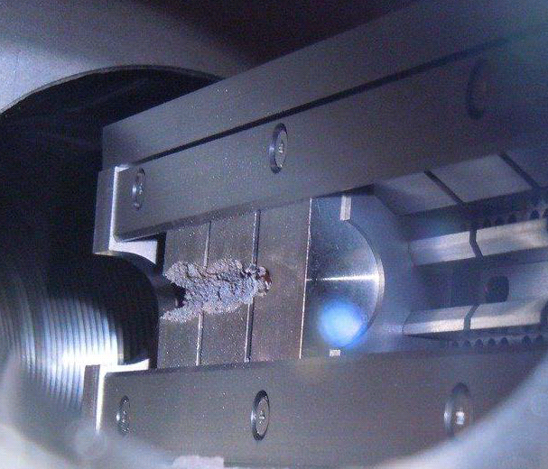
Reliability and availability of machine protection systems
Rüdiger Schmidt, CERN
U.S. Particle Accelerator School January 2017
Input from A.Apollonio, J.Thomas and F.Willeke

Slide 2
Programme for the school
What can go wrong?
What are the consequences?
Mitigation
  Are the protection systems efficient and reliable?
Controls and operation

Slide 3
Basic Definitions
Reliability is the probability that a system does not fail during a defined period of time under given functional and environmental conditions =>
  E.g. probability that Beam Loss Monitoring System does not fail during 20 years of accelerator operation
Availability is the probability that a system is in a functional state at given point in time =>
  Simply put, availability is the proportion of time the accelerator is in a functioning condition
MTBF: Mean-Time-Between-Failures is the average time until a failure occurs (in case of random failures)
What are the factors that determine reliability and availability?
How can these factors be quantified?

Slide 4
Exercise 1

Slide 5
Accelerator and Machine Protection Systems
Interlock system
Injection / Extraction
RF system
If the accelerator operates with beam below damage limit
No beam protection system needed
Power converters
Vacuum system
Magnet system
Beam Instrumen- tation
Access system
Technical services
In case of beam with risk of damage
Beam protection system needed
Controls
Beam loss monitor system
Beam abort system
Collimation + Beam absorbers

Slide 6
Availability and reliability: Accelerator and MPS
If the accelerator operates with beam that is below damage limit
  No protection needed
  Accelerator will operate with a certain availability (A1)
In case of beam above damage limit and operation without protection systems
  In case of failure, equipment will be damaged and availability decreases, possibly dramatically (A2)
  Protection is required to increase availability and to prevent repair cost
In case of operation with beam above damage limit with protection systems
  In case of failure, the protection systems will prevent damage

Slide 7
Failures of the MPS
The protection systems (as all technical systems) will also suffer from failures
Unsafe failures:
Protection system does not correctly respond to a dangerous situation
Not acceptable – need to have very high reliability (about 100% availability)
Safe failures:
Protection system brings machine into a safe state (e.g. beam dump), but reduces availability
The protection system will reduce the availability from A1 to A3

Slide 8
Availability
Accelerator operating with very low intensity beam, no protection system: A1
Accelerator operating with high intensity beam, reliable protection system: A3
Accelerator operating with high intensity beam, no protection system: A2

Slide 9
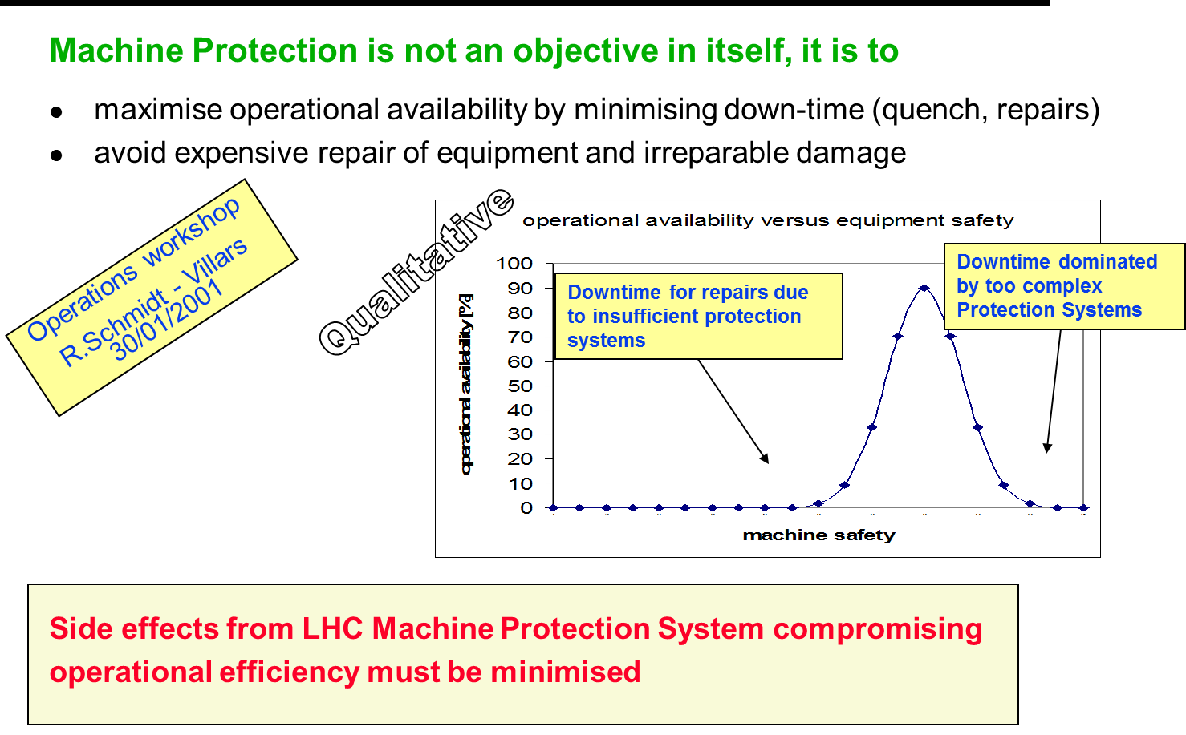
Accelerators need protection systems, but….

Slide 10
Reliability of the MPS
Beam below damage limit: From the failure modes without protection system the availability of the accelerator can be estimated (A1)
Beam above damage limit : Failure modes of the accelerator to be studied (failure catalogue) and to define protection strategy / protection systems
Protection systems are developed and their reliability and availability can be estimated (for safe failures and for unsafe failures)
In this presentation the methods to address the reliability of the protection system are addressed. The methods are very similar to those to address the accelerator availability.

Slide 11
Hazards and Risks

Slide 12
Hazard and Risk for accelerators
Hazard: a situation that poses a level of threat to the accelerator. Hazards are dormant or potential, with only a theoretical risk of damage. Once a hazard becomes "active“: incident / accident. Consequences and Probability of a hazard interact together to create RISK:
RISK = Consequences ∙ Probability
Related to accelerators
Consequences of a failure in accelerator systems or uncontrolled beam loss (in Euro, downtime, radiation dose to people, reputation)
Probability of such event
The higher the RISK, the more Protection needs to be considered
Notes:
12

Slide 13
Example:
Hazard from D1 magnet at LHC

Slide 14
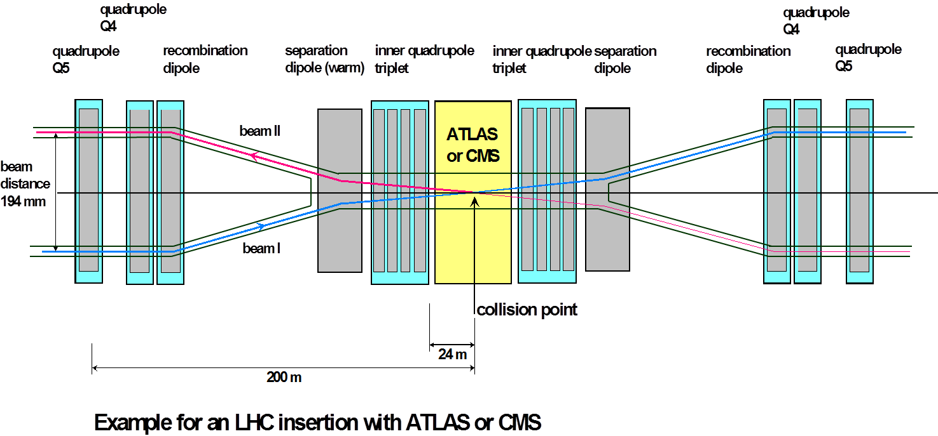
LHC failure of D1 magnet
D1
D1
Failure of the D1 magnet has been identified as fastest failure (except kicker magnet failures)
Used to show how reliability analysis can be performed

Slide 15
MTBF for D1 magnet circuit operation
Assume that the power supply for D1 fails
  Orbit starts to move rather rapidly (1 sigma in about 0.7 ms)
  In 10 ms the beam would move by 14 sigma, outside of the aperture defined by the collimators
  The beams have to be extracted in a very short time
Probability: typical MTBF for (very good) power supply is 100000 hours = 15 years
  Is this realistic? NO
The power supply requires the electrical network
In case of a thunderstorm the electrical network frequently fails – typically several times per year
The MTBF for such failure is in the order of 1000 hours or less

Slide 16
Hazard for failure of D1
LHC beams will be deflected and hit the collimation system within a few ms
The beam energy will damage collimators that risk to lose their protection functionality
Damage of superconducting magnet system expected
LHC could be off for years – damage beyond repair not excluded
Consequences are catastrophic
Probability is rather high
The machine protection system must prevent this accident
It must be demonstrated that the machine protection is adequate to prevent such accident
Notes:
16

Slide 17
Functional diagram for protection from D1 failure
Function 1: provide trigger to dump the beam in case of D1 failure
Beam Interlock system
Beam abort system
D1 current monitor
Provide beam dump trigger if current is outside predefined parameters
D1 magnet circuit

Slide 18
Question: would you rely on this current monitor to protect a 10 B$ accelerator ?

Slide 19
Consequences for machine protection
The risk is very high – is it sufficient?
Detection of the failure by several different systems (diverse redundancy):
Detection of the failure of a wrong magnet current, challenging, since a fast detection of current errors on the level of 10⁻⁴ is required
Beam loss monitors detect losses when the beam touches the aperture (e.g. collimator jaw, but also elsewhere)
FMCM = Fast Magnet Current Monitor designed in collaboration with M.Werner (DESY)

Slide 20
MPS functional diagram for D1 failure
Function 1: provide trigger to dump the beam in case of D1 failure
Beam Interlock system
Beam abort system
D1 current monitor
D1 magnet circuit

Slide 21
Functional diagram with redundant detection
Function 1: provide trigger to dump the beam in case of D1 failure
Beam Interlock system
Beam abort system
D1 current monitor
Beam Loss Monitors
D1 magnet circuit

Slide 22
Functional diagram with redundant interlocks
Function 1: provide trigger to dump the beam in case of D1 failure
Beam Interlock system
Beam abort system
Beam Interlock system B
D1 current monitor
Beam Loss Monitors
D1 magnet circuit

Slide 23
Bit of standards….

Slide 24
‘Standard’ design of safety systems
In the world of industry different standards exist to guide engineers in the design of safety systems (elevators, cars, ….)
  IEC61508, …
Accelerators are very special machines
Safety must be ensured for
  Personnel
  Environment
  Machine
  “Beam”
Common standards are applied to personnel and environmental protection systems
Machine related protection can follow a relatively free approach for the design (still inspired by standards…)
  Watch out for coupling between protection of machine and people

Slide 25
From Safety to Protection
IEC 61508 is an international standard of rules applied in industry, Functional Safety of Electrical/Electronic/Programmable Electronic Safety-related Systems (E/E/PE, or E/E/PES))
Safety standards have been developed over many years for system with risks to humans
Avoid mixing systems in accelerator to protect equipment with systems to protect people
Ideas from Safety Integrity Level (SIL) concept of the IEC 61508 were applied => PIL = Protection Integrity Level
M.Kwiatkowski, Methods for the application of programmable logic devices in electronic protection systems for high energy particle accelerators, CERN-THESIS-2014-048

Slide 26
Unacceptable and acceptable risk
Acceptable’ or ‘Unacceptable’ risk depends on the context!
Different for user-oriented facilities, medical accelerators, fundamental research, …

Slide 27
Classification of unacceptable / acceptable risk
 | Per year | Catastrophic | Major | Moderate | Low | Negligible
Cost [MCHF] |  | > 10 | 5-50 | 0.5-5 | 0.05-0.5 | 0-0.05
Downtime [days] |  | > 300 | 30-300 | 3-30 | 0.3-3 | 0-0.3
Frequent | 1
Probable | 0.1
Occasional | 0.01
Remote | 0.001
Not credible | 0.0001

Slide 28
Example of D1 failure
 | Per year | Catastrophic | Major | Moderate | Low | Negligible
Cost [MCHF] |  | > 10 | 5-50 | 0.5-5 | 0.05-0.5 | 0-0.05
Downtime [days] |  | > 300 | 30-300 | 3-30 | 0.3-3 | 0-0.3
Frequent | 1
Probable | 0.1
Occasional | 0.01
Remote | 0.001
Not credible | 0.0001
D1 failure
Risk for D1 Hazard far above acceptable level
=> Protection required

Slide 29
Risk reduction by protection system
 | Per year | Catastrophic | Major | Moderate | Low | Negligible
Cost [MCHF] |  | > 10 | 5-50 | 0.5-5 | 0.05-0.5 | 0-0.05
Downtime [days] |  | > 300 | 30-300 | 3-30 | 0.3-3 | 0-0.3
Frequent | 1
Probable | 0.1
Occasional | 0.01
Remote | 0.001
Not credible | 0.0001
D1 failure
Risk reduction for D1 Hazard to acceptable level

Slide 30
Protection Integrity Level
 | Per year | Catastrophic | Major | Moderate | Low | Negligible
Cost [MCHF] |  | > 10 | 5-50 | 0.5-5 | 0.05-0.5 | 0-0.05
Downtime [days] |  | > 300 | 30-300 | 3-30 | 0.3-3 | 0-0.3
Frequent | 1 | 4 | 3 | 2 | 1 | 0
Probable | 0.1 | 3 | 2 | 1 | 0 | 0
Occasional | 0.01 | 2 | 1 | 0 | 0 | 0
Remote | 0.001 | 1 | 0 | 0 | 0 | 0
Not credible | 0.0001 | 0 | 0 | 0 | 0 | 0
D1 failure
Protection integrity level

Slide 31
Steps for building a protection system….
Understand hazards (example: failure of D1)
Estimation of risk and required Protection Integrity Level for the system
(From other lectures) Definition of the concept of the protection system(s) (Fast current monitor, beam loss monitors, beam interlock system, beam dumping system)
Development of the protection systems
Fabrication of the system
Extensive tests
Commissioning
Monitoring during operation
Reliability analysis / monitoring
Demonstrate reliability

Slide 32
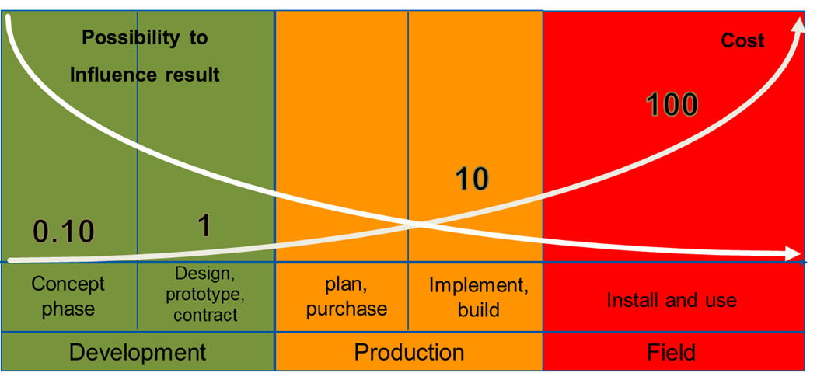
Importance of Reliability Analyses
The earlier reliability constraints are included in the design, the more effective the resulting measures will be
Prof. Dr. B. Bertsche, Dr. P. Zeiler, T. Herzig, IMA, Universität Stuttgart, CERN Reliability Training, 2016

Slide 33
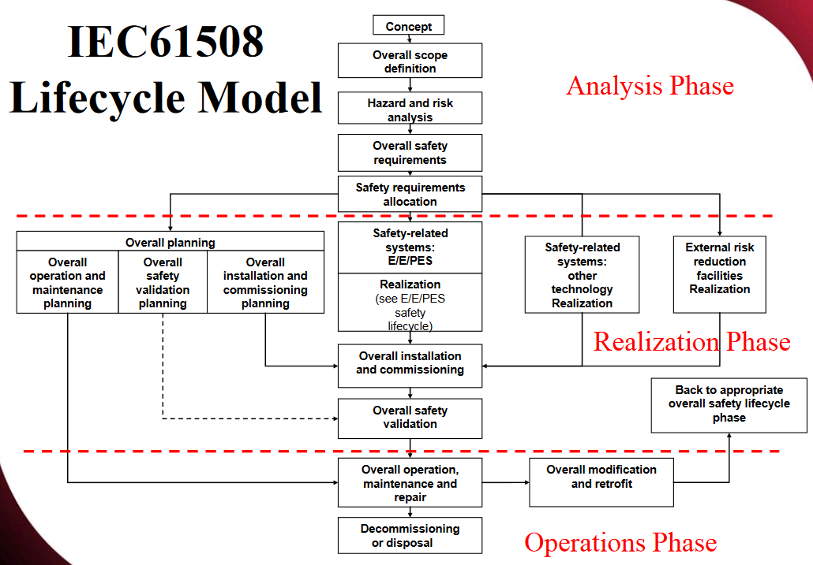

Slide 34
From D1 hazard to general LHC hazards

Slide 35
A few questions ….
Are all relevant hazards considered or are there hazards that are not addressed?
Are the requirements for a particular protection system correctly specified?
  Example: fast current monitor for D1
Does a particular protection system work (… the fast current monitor) as specified?
Is the specification for a particular protection system adequate?
Will the protection systems work for the lifetime of the accelerator?
The methods to address these questions are different…..

Slide 36
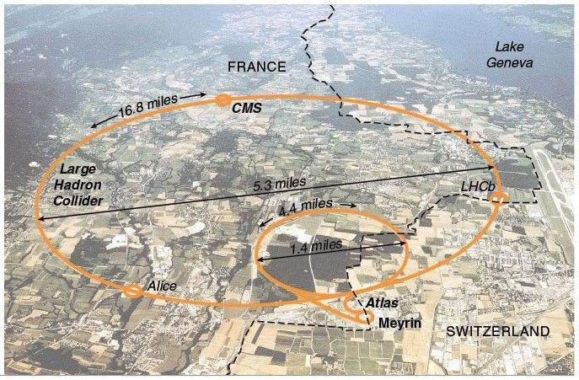
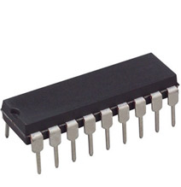
From accelerator components to the entire accelerator …. and back

Slide 37
TOP – DOWN approach
BOTTOM – UP approach

Slide 38
Top down Bottom up (example)
Identify hazards
The beam hits equipment (beam deflection towards the vacuum chamber or instrument moving into beam)
In what phase of operation?
By what equipment?
What failures can lead to such situation (HW failure, controls, operation, beam dynamics?)
How are the hazards addressed?
Who feels responsible for protection?
Is there a safety culture in the organisation?
Includes technical system, operation, management
Example: reliability of the beam abort system
What components (subsystems) are used?
What are the failure modes of the components?
What is the effect of a component failure on the functioning of the system?
What are the consequences of failures?
How to demonstrate adequate reliability of the beam dumping system?
How to commission the system?
How to ensure keeping high reliability along the years?

Slide 39
Classification of Reliability Methods
Qualitative methods
Employ methodical, systematic procedures to determine possible faults/failures and their effects
Provide evaluation by way of estimation and classification (not by calculation)
Aim: (qualitative) understanding and ranking of weak points
Methods
FMEA (FMECA)
Fault tree analysis
Event tree analysis
STPA
Reliability block diagram
Check lists / Design review
Quantitative methods
Make use of terms and processes from statistics and probability theory
Provide (quantitative) probability values for reliability by way of calculation
Aim: Prediction of system reliability
Methods
Fault tree analysis
Boolean system theory
Markov's theory
Monte-Carlo method

Slide 40
Illustration of some methods

Slide 41
Functional diagram with redundant interlocks
Function 1: provide trigger to dump the beam in case of D1 failure
Beam Interlock system
Beam abort system
Beam Interlock system B
D1 current monitor
Beam Loss Monitors
D1 magnet circuit

Slide 42
Reliability Block Diagram
What is the minimum set of components that allows fulfilling the system functionality to dump the beam in case of D1 failure?
D1 current monitor
Beam Interlock system A
D1 magnet circuit
failure
Beam abort system
BEAM DUMPED
Beam Interlock system B
Beam Loss Monitors

Slide 43
What are the combinations of failures that lead to a system failure?
Boolean Algebra allows calculating system reliability from component reliability
BEAM NOT DUMPED
Fault Tree
or
Missed failure detection
Beam abort failure
and
Channel A failure
Channel B
failure
or
or
No detection D1 failure
Beam Interlock A failure
Beam Interlock failure
No detection D1 failure
and
and
D1 magnet circuit failure
D1 current monitor failure
BLM failure
D1 magnet circuit failure
D1 current monitor failure
BLM failure

Slide 44
Other functions

Slide 45
Functional diagram for protection from D1 failure
Function 1: provide trigger to dump the beam in case of D1 failure
Function 2: ?????????????
Beam Interlock system A
Beam abort system
Beam Interlock system B
D1 current monitor
Beam Loss Monitors
D1 magnet circuit

Slide 46
Functional diagram for protection from D1 failure
Function 1: provide trigger to dump the beam in case of D1 failure
Function 2: do not trigger a beam abort if D1 magnet circuit is ok
Beam Interlock system A
Beam abort system
Beam Interlock system B
D1 current monitor
Beam Loss Monitors
D1 magnet circuit

Slide 47
Function 2
Function 1: provide trigger to dump the beam in case of D1 failure
Function 2: do not trigger a beam abort if D1 magnet circuit is ok
In case of failure of the D1 current monitor without prior D1 magnet circuit failure (false positive, false alarm or false beam abort)
  Beams will be dumped
  Downtime of a few hours
If this happens rarely it is acceptable … but for a large accelerator there are several thousand interlock channels that could lead to a false beam dump
Every single channel should consider the risk of “False Beam Aborts” and minimise the probability

Slide 48
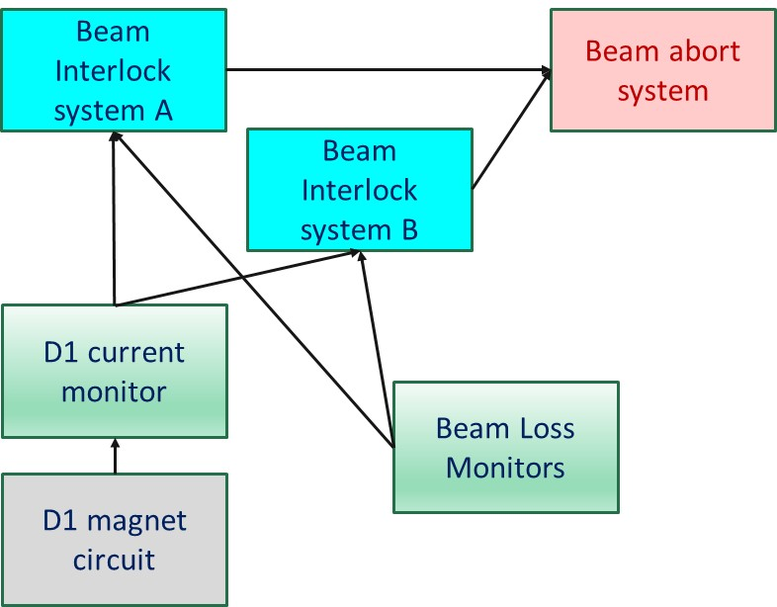
Functional diagram for protection from D1 failure
Function 1: provide trigger to dump the beam in case of D1 failure
Function 2: do not trigger a beam dump if the D1 magnet circuit is ok
Function 3: ?????????????
Assume that the beam is suddenly dumped
…. what to do then?

Slide 49

Functional diagram for protection from D1 failure
Function 1: provide trigger to dump the beam in case of D1 failure
Function 2: do not trigger a beam dump if the D1 magnet circuit is ok
Function 3: provide data that allows to understand what happened
Post Mortem analysis using transient recording across the systems

Slide 50
P3 of machine protection
Protect the Equipment
Protect the Beam
Provide the Evidence

Slide 51
Novel approach in safety
Nancy Leveson
John Thomas

Slide 52
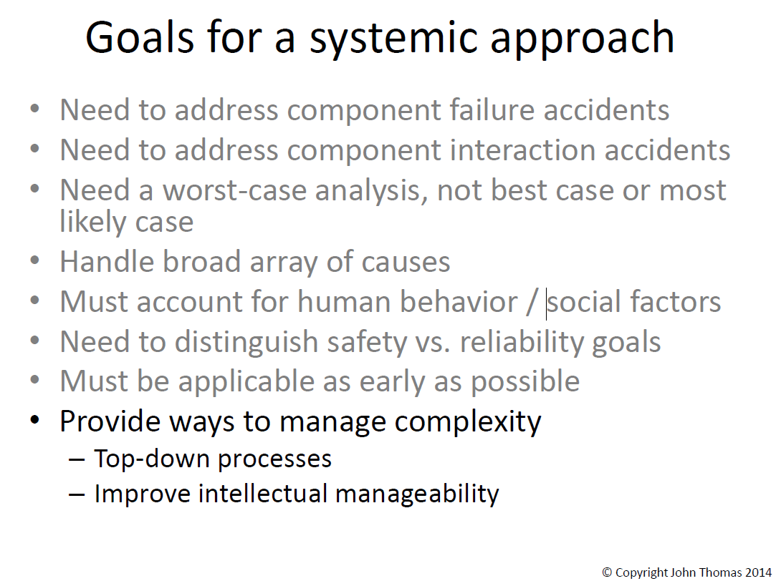
System approach to safety engineering

Slide 53
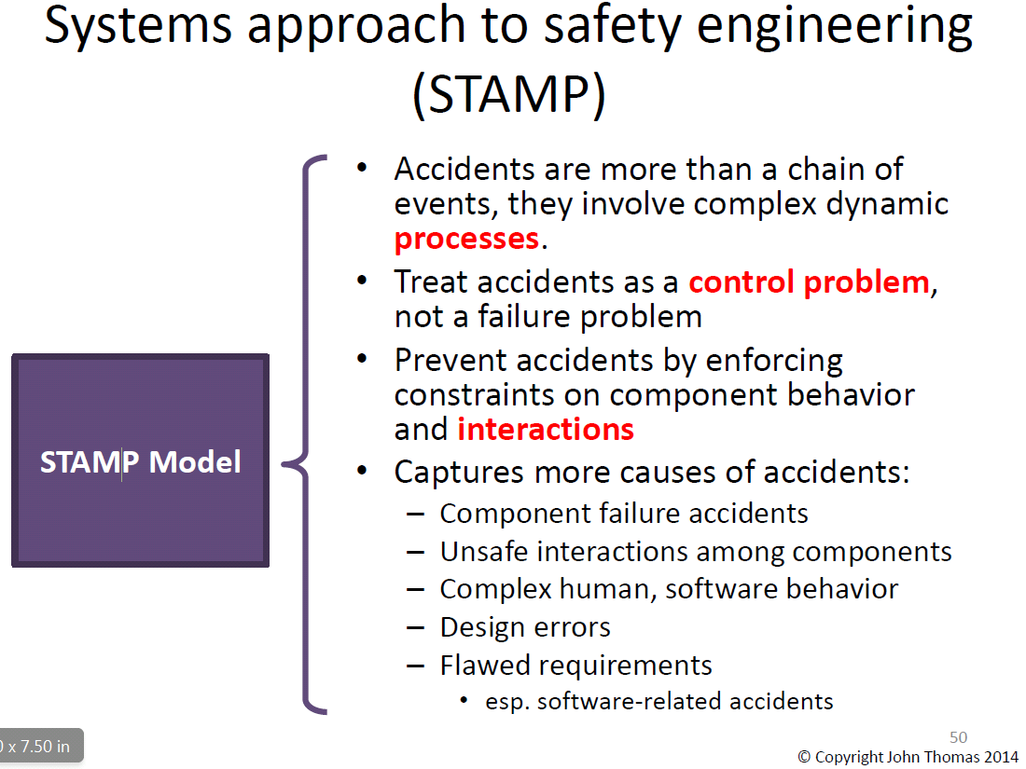
STAMP and STPA

Slide 54

Comments
Traditional methods do not sufficiently address the role of humans, of the organisation, and of the safety culture in the organisation
Traditional methods have difficulties to address hazards related to software
STAMP / STPA offer a different view to safety in complex systems … and can detect additional failure mechanisms
In my view, traditional methods and this novel method are complementary

Slide 55
Design for highly reliable protection systems

Slide 56
Example: Beam Loss Monitors at LHC
In total, there are about 4000 Beam Loss Monitors installed around the LHC accelerator, plus the electronics and read out systems
If one single monitor measures too high beam loss - > beam dump
If part of the hardware of one single monitor fails…..
  Redundancy in the electronics ensures that many failures do not have an effect on the operation of the monitor
  If a monitor completely fails (…is not capable to detect unacceptable beam losses) => beam dump => repair
  During the repair time, the LHC is not operating. The Mean Time To Repair (MTTR) can be determined.
  Loss of availability depends on MTTF and MTTR

Slide 57
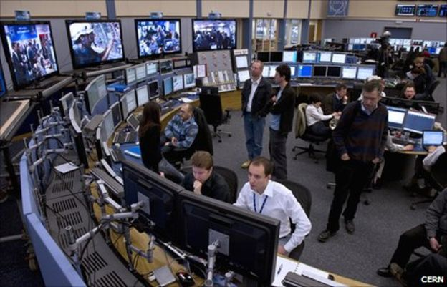


Time to repair
Failure Duration
Identification
Diagnostics
Logistics
Repair
Mean Time to Repair (MTTR): the average time required to repair a failed component or device.

Slide 58
Exercise 2

Slide 59
Some recommendations (from my experience)

Slide 60
General architecture of protection system
Controlled removal of beams in case of failures:
  Circular accelerators (e.g. LHC): Beam dump (100 μs – 1 ms)
  Linear accelerators (Linac4, ESS): Beam stop (1-10 μs)
Choosing a suitable MPS interlock architecture
Rule based process
Sensor 1
Actuator 1
R
T
O
N
T
E
Signal
transmission
A
M
M
Local electronics
R
A
E
P
E
Sensor 2
Actuator 2
L
I
E
U
B
C
Q
C
E
A
Sensor N
Actuator N
LHC: Several 10 thousand sensors → complex Several km → distributed

Slide 61
Some recommendations…
X
Failsafe design
  Avoid single point of failure
  Detect internal faults
Detection of internal MPS failures leads to preventive accelerator shutdown (‘false’ beam aborts)
  MPS preserve availability by preventing damage to equipment
  MPS affect availability due to possible internal failures, in particular for slow cycling accelerators (takes time to restart operation)
Finding a good balance between protection and availability is challenging, but crucial for efficient operation
  Can be significant overhead
X

Slide 62
…during design and development
Consider the operational phase of the accelerator during the design ….
  maintenance and operability to be considered from early design phases
  system architectures can strongly influence maintainability
  modular design helps optimizing maintenance tasks and commissioning
Avoid (unnecessary) complexity for protection systems
Calculate safety / availability / reliability
  use established methods to analyse systems and predict failure rate
  reliability analyses provide the means for spare part management
Comprehensive diagnostics to identify root causes of failure
Critical processes not by software (no operating system)
  No remote changes of most critical parameters
Review of the system with outside experts

Slide 63
…from development to operation
Test benches for electronic systems should be part of the system development
  careful testing in conditions similar to real operation
  our experience: most failures are due to power supplies, mechanical parts and connectors
The accurate execution of each protection function must be explicitly tested during commissioning
Reliable protection does not end with the development phase
  Documentation for installation, maintenance and operation of the protection systems is required
Requirements are established for test intervals of each function
Monitor system during operation
  for every beam abort, understand if system worked correctly, e.g. if redundant signal path worked)
Learn from near misses

Slide 64
Comments on failures

Slide 65
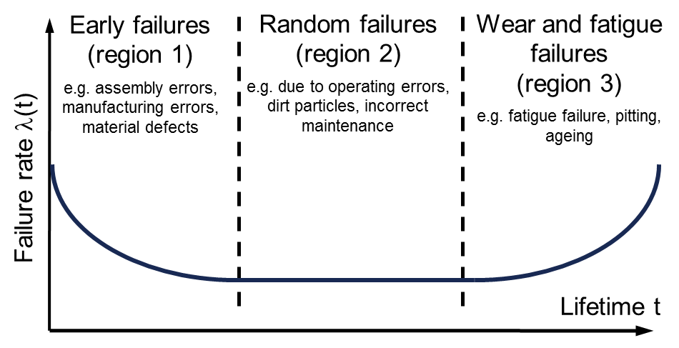
Failure Rate and Bathtub Curve
In practice, it is often assumed that failures occur randomly, i.e. they are described by an exponential density function → constant failure rate λ
Only in the latter case Mean Time Between Failures (MTBF) = 1/λ
Clearly a simplification in some cases, in particular for aging……
Prof. Dr. B. Bertsche, Dr. P. Zeiler, T. Herzig, IMA, Universität Stuttgart, CERN Reliability Training, 2016

Slide 66
Failure Rate Estimates
Tests of components
  Large number of samples to be tested / long time for testing
  May be impractical in some cases
  Accelerated lifetime tests (if applicable)
Experts’ estimates
  Large uncertainties on boundary conditions
  Good approximation for known technologies
  Good for preliminary estimates
Using Standards (Military Handbooks)
  Very systematic approach
  Uncertainties on boundary conditions can be addressed
  Difficult to follow technology advancements (e.g. electronics)
IMPORTANT: The power of these methods is not in the accuracy of failure rate estimates, but in the possibility to compare architectures and show the sensitivity of system performance on reliability figures

Slide 67
Example for using redundancy

Slide 68
Powering critical equipment
PS1
SYSTEM X

Slide 69
Powering critical equipment
PS1
SYSTEM X
MTBF = 20 years
Time for operation = 20 years
Probability of failure = 58%

Slide 70
Redundant Powering
PS1
PS2
SYSTEM X

Slide 71
Redundant Powering
PS1
PS2
SYSTEM X

Slide 72
Redundant Powering
PS1
PS2
SYSTEM X

Slide 73
Redundant Powering
PS1
PS2
SYSTEM X
MTBF = 20 years
Time for operation = 20 years
Probability of failure = 66%

Slide 74
Redundant Powering: detect and repair
PS1
PS2
SYSTEM X

Slide 75
Redundant Powering: detect and repair
PS1
PS2
SYSTEM X
Detect the failure and repair the unit

Slide 76
Redundant Powering: detect and repair
PS1
PS2
SYSTEM X
MTBF = 20 years
Time for operation = 20 years
Detect and repair interval = 1 months
Probability of failure = 98%

Slide 77
Dependability of Machine Protections Systems
Dependability: new challenge for accelerator laboratories
Requires different approach in engineering, operation and management
Safety culture: has been developed over the last, say, 10 years
  Largely helped by the accident in 2008
Excellent experience at LHC beam operation: no damage
Availability and Safety are in trade-off relationship - given safety is met, the goal is to make the system as available as possible for experiments
  Avoid ‘false beam dumps’ + minimize downtime
  Room for improvements
Lessons to be learned for future accelerators to ensure safe operation with high availability (e.g. Accelerator Driven Spallation)

Slide 78


