Slide 1
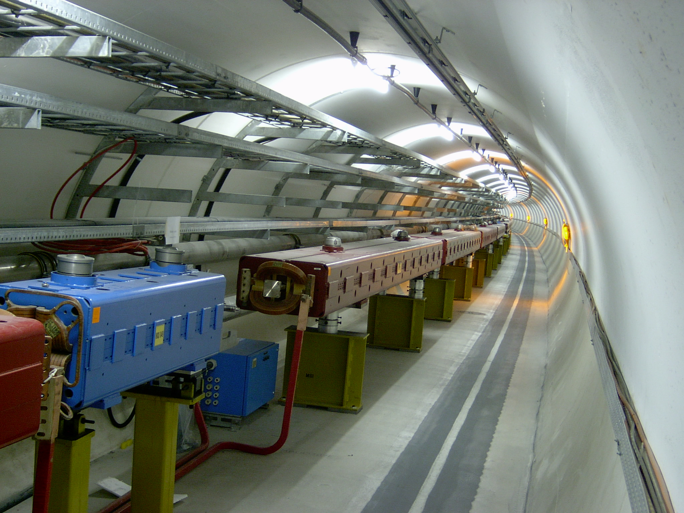
Beam transfer and fast kicker magnets
Jörg Wenninger
CERN Beams Department
Operation group – LHC section
USPAS
Machine Protection & Beam Loss
Rohnert Park, January 2017
Acknowledgements: V. Kain, B. Goddard, M. Barnes, J. Uythoven, W. Bartmann, C. Bracco

Slide 2
Introduction to injection, extraction and beam transfer
Septum and kicker magnet
Protection of transfer lines
Collimation for transfer lines

Slide 3
Beam transfer
The purpose of a beam transfer (line) is to transport a beam from a source (accelerator) to a destination (accelerator).
The source may be a particle source or an accelerator.
The target may be an accelerator, a particle dump or a target.
Source
Transfer
s
Destination
There are many similarities between a linear accelerator and a beam transfer. A beam transfer however does not accelerate the beam – no change of energy, no radio-frequency acceleration (RF) systems.
  Note that both linacs and transfers may have bending elements.

Slide 4
Injection - extraction
A the entrance of a transfer line there is in general an extraction region to take the beam out of the source and ‘inject’ into the transfer line.
Source
Extraction
Transfer
s
Destination
Injection
A the end of a transfer line there is in general an injection region to guide the beam into the destination accelerator.
  Absent if the destination is a beam dump or a beam target.

Slide 5
Injection - extraction
For injection (extraction) the beam must be deflected out of (into) the destination (source) accelerator.
These processes involve fast pulsing elements or elements to paint or shave off the beam.
  Fast pulsed injection and extraction can be seen as ‘time-reversed’ processes.
Fast pulsed injection or extraction
Kick
Slow beam shaving
Shaver

Slide 6
Transfer line twiss parameters
A transfer matrix M_{1→2} transforms the transverse particle coordinates at the entrance into the coordinates at the end of the transfer.
The optical (Twiss) beam parameters are propagated from the beginning to the end of line.
At any point in line the optical functions α(s), β(s) are functions of the initial conditions α₁ , β₁.

Slide 7
Linking source and ddestination
Linking the beam optics between source and destination implies:
The parameters of the source have to be propagated to match the parameters of the destination at the end of the line.
  8 variables (α_{x} β_{x} D_{x} D’_{x} and α_{y} β_{y} D_{y} D’_{y}) must be matched.
Maximum β and dispersion (D) are generally imposed by magnet apertures in the transfer.
Other constraints can exist:
  phase conditions for collimators,
  insertions for special equipment like stripping foils,
  …
The design generally relies on matching with computer codes and a mixture of theory, experience, intuition, trial and error, …

Slide 8
Optics propagation
Source
Extraction
α_{1x}, β_{1x} , α_{1y}, β_{1y}
Transfer
α_{x}(s), β_{x}(s) , α_{y}(s), β_{y}(s)
s
Destination
Injection
α_{2x}, β_{2x} , α_{2y}, β_{2y}
The Twiss parameters can be propagated when the transfer matrix M is known

Slide 9
Transfer line
Maps single particle coordinates at entrance and exit.
An Infinite number of source phase space ellipses are transported to an infinite number of final ellipses.
x’
x’
α₁, β₁
α₂, β₂
α∗₁, β∗₁
x
Transfer Line
x
Entrance
Exit
α∗₂, β∗₂

Slide 10
Transfer line optics
The optical functions (and therefore beam sizes, divergences etc) depend on the initial conditions at the entrance point.
The transfer line is matched to given initial (defined by the source) and final conditions (defined by the destination).
  If the optics of the source accelerator is changed, then the beam properties in the TL are affected, and the beam at the exit may no longer match the destination → possible cause of machine protection issues.
- Design betatron functions β_{x} in a transfer line
− β_{x} functions with different initial conditions
Example of a 450 GeV prpton TL from the CERN Super Proton Synchrotron (SPS) to the Large Hadron Collider (LHC)

Slide 11
Transfer line perturbation
A change of an element in a TL affects only the downstream optics properties, beam position etc – causality !
- Unperturbed β_{x} functions in a transfer line
− β_{x} functions with modification of one quadrupole strength
10% change a quadrupole strength

Slide 12
Injection
There are different injection techniques:
Single-turn injection for hadrons
  Boxcar stacking: transfer between machines in an accelerator chain.
Multi-turn injection for hadrons
  Phase space painting to increase intensity.
  H- injection allows injection into same phase space area.
Lepton injection
  Radiation damping helps damp out injection transients.
  Less concerned about injection precision and matching.
  Over-inject on circulating bunches: stacking and top-up.

Slide 13
Injection and extraction elements
A combination of septa and kicker magnets are frequently used – both are needed.
Septa have two vacuum chambers, while kicker magnets have a single vacuum chamber.
  A septum is characterised by a field free region (circulating beam of source or destination) and a homogenous field region that is used to deflect the beam that is transferred.
  Septa can be electrostatic or magnetic.
Magnetic septa provide slower field rise/fall times (possibly DC), but strong field.
Kicker magnets provide fast field rise/fall times, but relatively weak fields.
  Firing the kicker magnet generally initiates the beam transfer.

Slide 14
Injection concept
‘boxcar’ stacking
Injected beam
intensity
injected
beam
Septum magnet
Homogeneous septum field
kicker field
t
Circulating beam
field “free” region of septum
Kicker magnet
F-quad
D-quad
The septum deflects the beam onto the closed orbit at the kicker.
The kicker compensates for the remaining angle.

Slide 15
Charge exchange H⁻ injection
The incoming H⁻ beam (from a LINAC) is stripped to produce H⁺/protons that are deflected into the ring.
  For example Spallation Neutron Source (SNS) at Oak Ridge NL.
  Residual unstripped and neutral H0 beam must be handled – dump.
H- beam
Stripping foil
Start of
injection process
H-
H₀
p+
Circulating p+
Displaced orbit
Injection chicane dipoles

Slide 16
Charge exchange H⁻ injection
During accumulation the circulating beam is slowly moved away from the injection point to make room for more beam.
End of
injection process
H- beam
Stripping foil
H-
H₀
p+
Circulating p+
Injection chicane

Slide 17
Betatron injection for e⁺/e⁻
Septum magnet
Closed orbit bumpers or kickers
The beam is injected with an angle to the circulating beam (on top of existing bunches – accumulation).
The circulating beam is bumped towards the injected beam to reduce the amplitude of the injection angle.
The injected beam performs damped oscillations around the circulating beam until it merges into it.

Slide 18
Extraction
Different extraction techniques exist, for example:
Slow extraction
  Experimental facilities frequently use slow extracted beam. An optimum slow extracted beam has a smooth, uniform spill. The spill duration can reach a few seconds.
Fast single-turn extraction
  This technique is used in the transfer of beam from one acceleration stage to another.
  Fast extractions are also used for neutrino facilities where a large number of particles should reach a target in a short time.
Usually extraction occurs at higher energy than injection, it therefore requires stronger elements (larger EM fields):
  At high energies many kicker and septum modules may be required.
  To reduce kicker and septum strength, the beam can be moved close to the septum by an orbit bump (applies to injection too).

Slide 19
Fast single turn extraction
Septum magnet
    The beam is kicked into the septum gap and extracted
Kicker magnet
Closed orbit bumpers
The kicker deflects the beam into the septum in a single turn.
  Bumping the beam towards the septum reduces the required kicker deflection strength.
The septum deflects the beam into the transfer line.

Slide 20
Non-resonant multi-turn extraction
    Beam bumped to septum; part of beam ‘shaved’ off each turn.
Extracted beam
Septum
Bumped circulating beam
Closed orbit bumpers
The beam is moved close to the septum.
The beam extracted over a time interval ranging from a turns to a seconds.
Intrinsically a lossy process (on septum blade) – thin septum essential.

Slide 21
Transfer quality
Transfer of a beam to a dump or a target in general does not require an outstanding quality unless there are for example constrains on the beam size (not too large or too small) – the main objective is that beam reaches its destination without losses.
For a transfer from one accelerator to another, the beam quality in the destination machine is generally a key aspect, in particular for hadrons where radiation damping is not present.
Beam quality degradation may occur due to the process of filamentation:
  Non-linear fields (e.g. magnetic field multipoles ) in the destination accelerator introduce amplitude dependence into the particle motion.
  Over many turns, a phase-space oscillation is transformed into an emittance increase.
  Any residual transverse oscillation will lead to an emittance blow-up through filamentation
    “Transverse damper (feedback)” systems are used to damp injection oscillations - bunch position measured by a pick-up, which is linked to a kicker.

Slide 22
Mismatch at injection
Due to filamentation the beam fills a larger volume in phase space – corresponds to a growth of its emittance – quality degradation !
Turn 0
Time
Turn N
x’
x

Slide 23
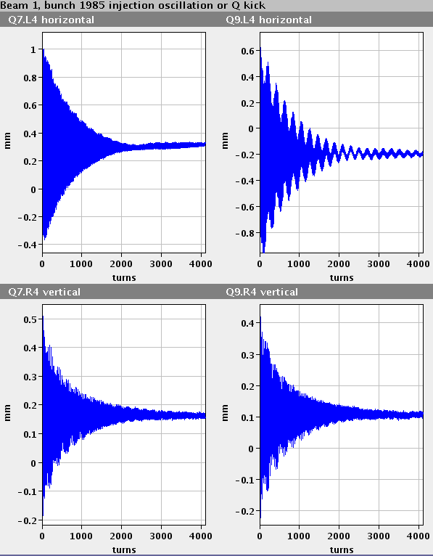
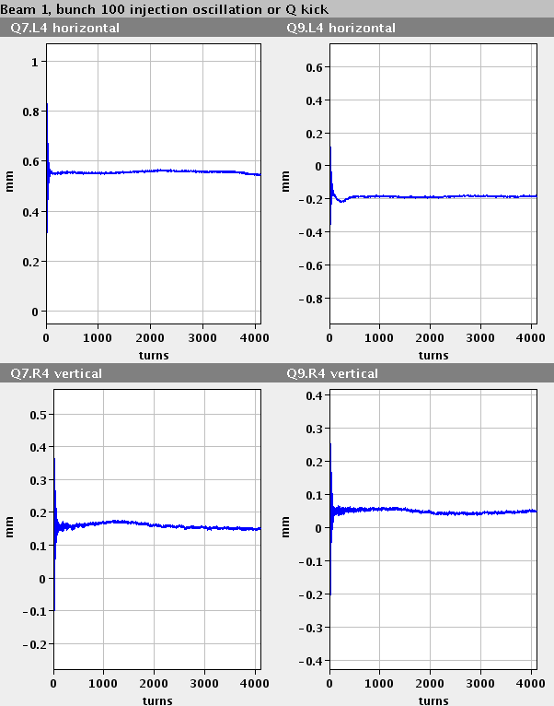
Transfer feedback & filamentation
A transverse feedback systems that damps the injection oscillations of a beam on a time scale shorter than the filamentation time is an effective means to reduce the sensitivity to injection errors.
Oscillation amplitude (mm)
Example for injection into LHC
No transverse feedback
With transverse feedback
Turn number

Slide 24
Introduction to injection, extraction and beam transfer
Septum and kicker magnet
Protection of transfer lines
Collimation for transfer lines

Slide 25
Kicker system
PFL = Pulse Forming Line (coaxial cable);
PFN = Pulse Forming Network (lumped elements);
RCPS = Resonant Charging Power Supply;
Typical circuit operation:
A Pulse Forming Network (Line) PFN/PFL is charged to a voltage V_{p} by a charging power supply (RCPS).
The main switch closes and a pulse of magnitude (V_{p}/2) is launched, through the transmission line, towards the magnet.
When the current pulse reaches the (matched) terminating resistor full-field has been established in the kicker magnet.
The length of the pulse in the magnet can be controlled in length, between 0 and 2τ_{p}, by adjusting the timing of the dump switch relative to the main switch.

Slide 26
Pulse forming network
Schematic for an LHC Injection PFN – length 4.4 m
PFN Line #1
PFN Line #2
“Cell”
System Parameters:
Field flat top duration ≤ 7.86μs;
Field flat top ripple < ±0.5%;
Field rise-time 0.5% to 99.5% = 0.9μs;
Kick strength per magnet = 0.325 T∙m;
Nominal PFN Voltage = 54kV;
Nominal Magnet Current = 5.4kA.

Slide 27
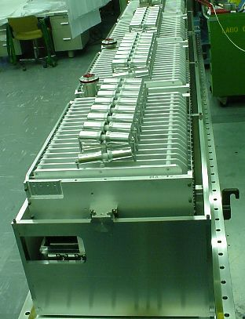
Kicker magnet
Pulsed magnet with very fast rise time
(100ns – few μs)
w
Ferrite
g
B
I
B = μ₀I / g
L = μ₀wl / g (magnet length l)
dI/dt = V/L
Typically 3 kA in 1 μs rise time

Slide 28
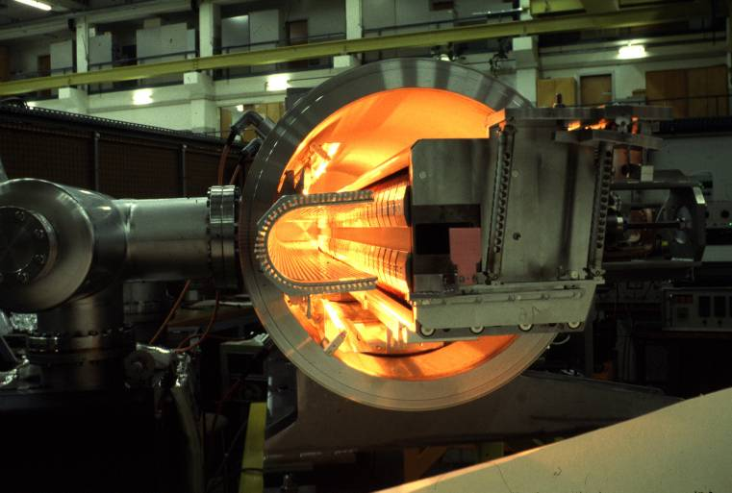
Magnetic septum
Pulsed or DC magnet with thin (2-20mm)
septum between zero field and high field region
I
B
Current Density
is very high in
Septum Blade
Septum coil
Beam
screen
Beam “monitor”
I
Remote positioning system
B_{o} = μ₀I / g
Typically Ι 5-25 kA
Circulating beam
Extracted beam

Slide 29
Lambertson septum principle
Conductors are enclosed in steel yoke, “well away” from beam;
Thin steel yoke between Aperture and circulating beam – however extra steel required to avoid saturation;
Extraction septum as shown:
  A kicker deflects the beam horizontally into aperture;
  The Lambertson deflects the beam vertically (orthogonal to kicker deflection).
Steel yoke
Coil
Steel to avoid saturation
x
I
Circulating
beam
Thin septum
•
I
Aperture

Slide 30
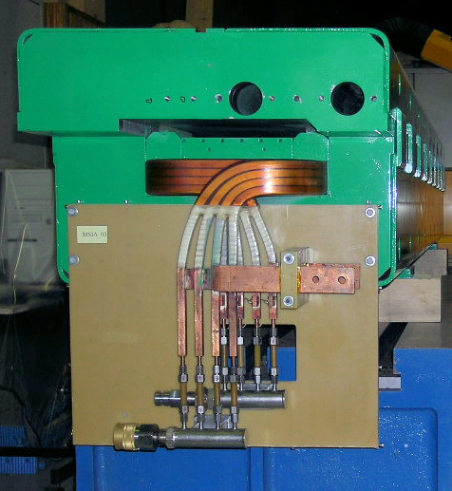
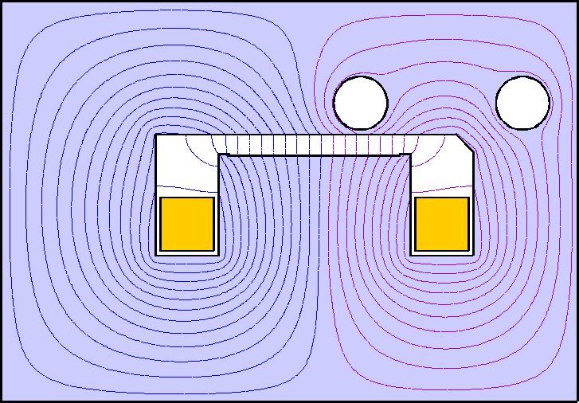
LHC Injection – Lambertson Septum
Coil
Beam Injected into LHC
Transfer line from SPS
Counter-rotating LHC Beam
Coil
The septum deflects the beam horizontally to the right.
The kicker deflects the beam vertically onto the orbit.
Notes:
Photo includes two NON-magnetic pieces above coil (to clamp coil).
Note: Top steel overhangs coils and aperture to minimize fringe field leakage into beam pipes.

Slide 31
Septum for multi-turn extraction
    The beam is positioned close to a thin septum, part of beam ‘shaved’ off each turn:
Beam
E_{A}=0
Septum Blade
E_{B}≠0
The septum blade must be very thin (e.g. <0.1mm) to limit the magnitude of beam losses: an electrostatic septum is generally used.

Slide 32
Electrostatic septum
Thin septum ‘foil’ gives small interaction with beam.
Orbiting beam passes through hollow support of ‘septum foil’ (field free region).
Extracted beam passes on the other side of the septum (homogeneous field region).
Electrostatic septa generally use vacuum as an insulator, between septum and electrode, and are therefore normally in a vacuum tank.
Circulating Beam
g
Support
Septum Foil
V
Electrode
Extracted
Beam
y
z
E
x
E = V / g
Typically V = 200 kV
E = 100 kV/cm
To allow precise matching of the septum position with the circulation beam trajectory, the magnet is often fitted with a displacement system, which allows parallel and angular movement with respect to the circulating beam.

Slide 33
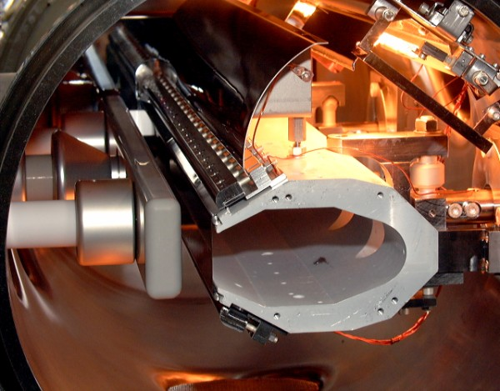
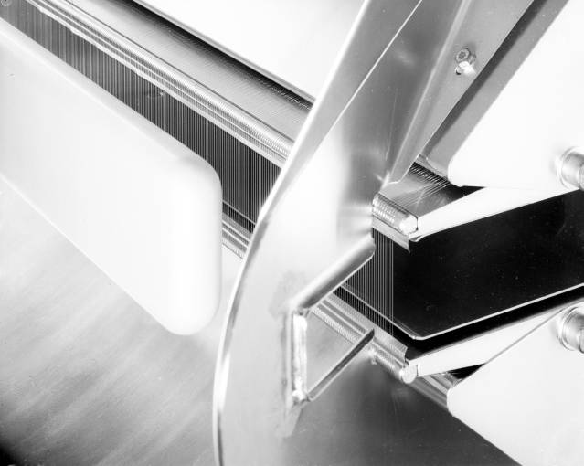
Electrostatic septum
DC electrostatic devices with very thin (~0.1mm) septum wires or foil between zero field and high field region.
Deflector
Foil Tensioners
Septum wires
Hollow earth
electrode
Beam Screen
Electrode
Foil
High Voltage
Electrode

Slide 34
Introduction to injection, extraction and beam transfer
Septum and kicker magnet
Protection of transfer lines
Collimation for transfer lines

Slide 35
Beam transfer and machine protection
The failure mechanisms and protection issues associated to a beam transfer can be classified into two categories:
  Failures and protection associated to kickers (fast extraction) or to other extraction / injection elements or ingredients,
  Failures and protection associated to the transfer (line) elements.
The machine protection system may have to rely on active protection by interlocks (surveillance) and on passive protection by absorbers, dumps and collimators (beam interception).
  Some active protection can be performed BEFORE the beam is transferred.
    For example a check that all magnet currents are within tolerance.
  Some active protection may only be applied AFTER the beam was transferred to block further transfers.
    For example beam loss and trajectories that can only be know after the beam passed through the TL.
Depending on the stored energy of the transferred beam, a partial or total loss of one or more shots may be acceptable or not.

Slide 36
Safe injection and extraction basics
Ensure correct element settings & configuration:
  Kicker voltage, beam energy, magnet currents,
  Vacuum valve and other interceptive device positions (out !),
  Position of passive protection devices,
  …
Ensure correct synchronization:
  Particle free gaps for kicker field rise,
  Synchronization to RF systems (frequencies),
  Protection again over-injection (where beam is already present),
  …
Protect against unavoidable failures with passive protection in the form of collimators and absorbers.
  Cover time interval between surveillance and actual extraction firing,
  Fast kicker failures,
  …
To define the required interlocks, a risk analysis (failure modes, frequencies and consequences) must be performed for each element involved in the transfer from source to target.

Slide 37
Failures of kicker systems
The kicker magnet system involves high voltages and the switching devices must:
  withstand high voltages (up several 10’s of kV),
  switch high currents with short rise times (several 10 kA in < 1 μs).
Failure modes of kickers:
  incorrect deflection (voltage).
    Interlock the setting /measurement of charging and PFN voltage.
  erratic turn-on: the kicker fires before it is triggered.
    Charge kicker PFN at the last moment (~ ms before the trigger).
  missing pulse: the switch does not fire or the trigger does not arrive.
  asynchronous pulse: the trigger arrives at the wrong moment.
  flash-over (discharge): a discharge occurs between kicker electrodes while the kicker has high field, which results in a reduced or increased kick strength.

Slide 38
Consequences of kicker failures
The consequences depend on the case.
Injection:
  For the injected beam: large injection oscillations, or no deflection.
  For an already circulating beam: a large deflection if the pulse is de-synchronized and hits the beam.
Extraction:
  In case of extraction into a transfer line to another accelerator a missing kick does not harm, but a wrong kick again results in large trajectory oscillations in the beam transfer line.
  In case of extraction to the beam dump: the beam is not dumped but probably lost in the source accelerator.

Slide 39
Extraction kicker and particle free gaps
The aim of the kicker magnet is to provide a deflection that kicks the beam out of the source accelerator into the extraction channel.
A partial kick will lead to large oscillations of particles in the source accelerator or losses at septa etc ⇒ failure !
One or more particle free gaps must exist in the beam to provide sufficient time to turn on the kicker magnet.
  Particles kicked during the kicker turn-on (risetime) are swept across all amplitudes (0 to max).
Intensity
Kicker
field
Kick

Slide 40
Example beam gap and kicker pulse
The SPS ring is filled with 2 batches of beam, with a short (<1 μs) inter-batch spacing that is ideally particle-free.
The extraction kicker is pulsed twice at ~50 ms interval to extract the first and second batch of beam.
To achieve a clean extraction, the kicker rise must be precisely synchronized to the particle free gap.
Particle free gap
Particle free gap

Slide 41
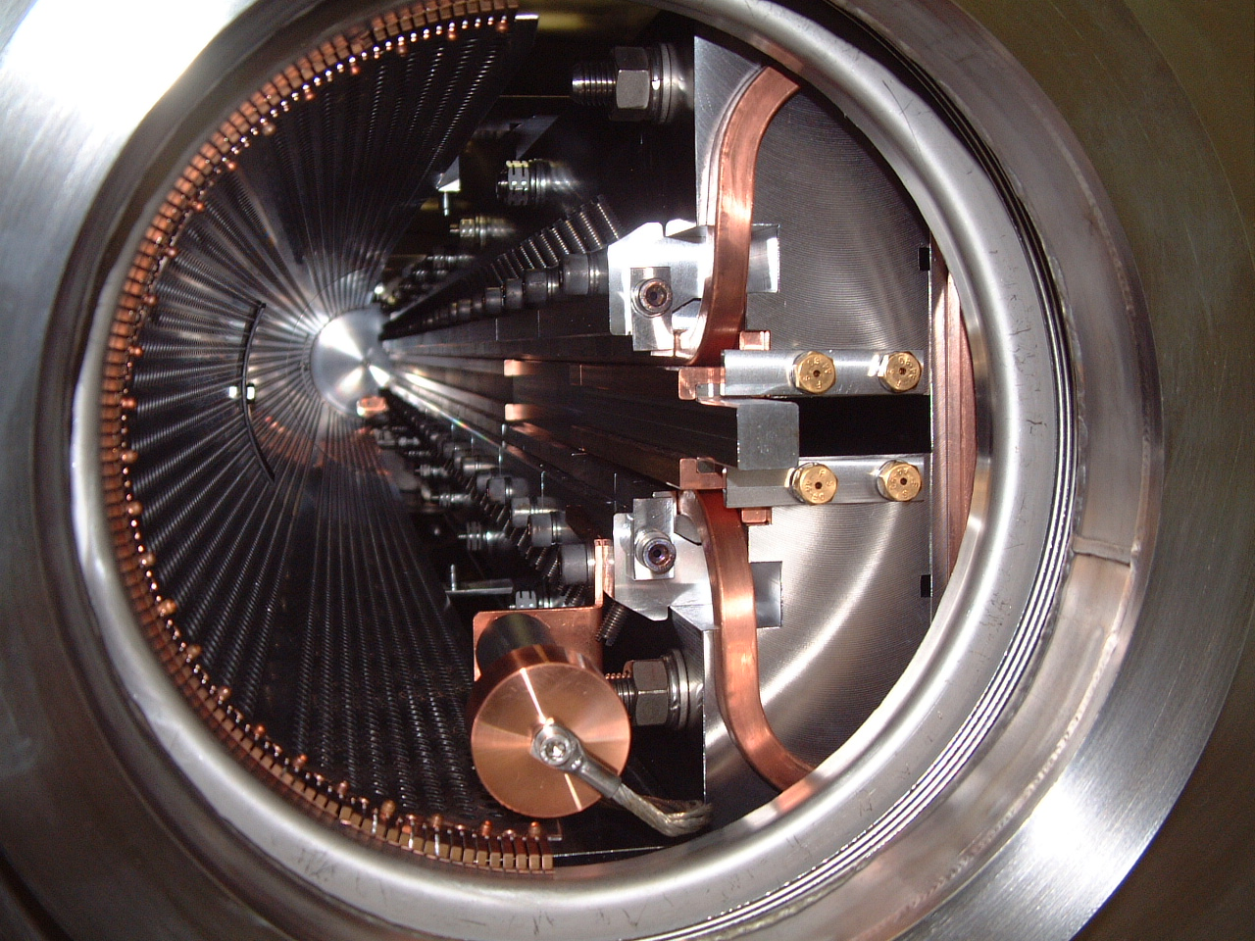
Passive protection at extraction
A classical failure at extraction is a de-synchronized kicker pulse or the presence of beam in the particle free gap.
  An absorber (mask) may be required to protected downstream extraction elements, for example the septum.
mask
coil
Septum magnet
beam gap
Septum mask
Kicker magnet

Slide 42
Passive protection at injection
A classical failure at injection is a de-synchronized or missing injection kicker pulse. In that case the beam is either not or only partially kicked into the destination machine.
  A dump should be installed to absorb the beam in such a case.
  Such a concept is also important for charge exchange injection to intercept unstripped H⁻ and partially stripped H⁰ beams.
Septum magnet
Circulating beam is kicked by accident
Injection dump
Circulating beam
Injection dump
Kicker magnet
Injected beam is not (sufficiently) kicked

Slide 43
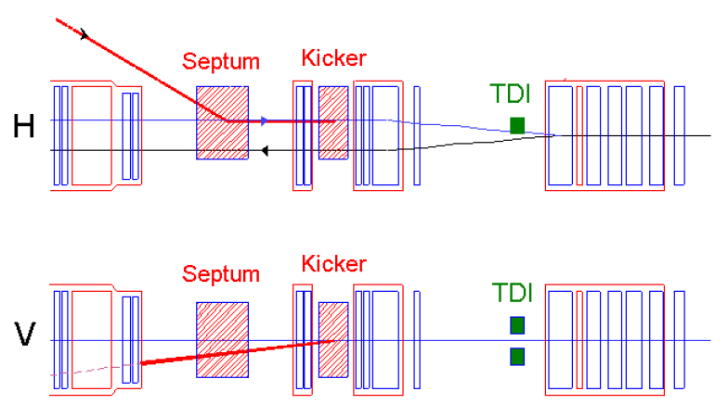
Example: LHC injection dump
If the injection kick is too small (no / partial kick), the injected beam is absorbed by the upper injection dump (TDI) jaw.
12 mrad
0.8 mrad
Kicker off

Slide 44
Example: LHC injection dump
If the circulating beam is accidentally kicked (synchronization error etc), it is absorbed by the lower injection dump (TDI) jaw.
12 mrad
0.8 mrad
Over-injection

Slide 45
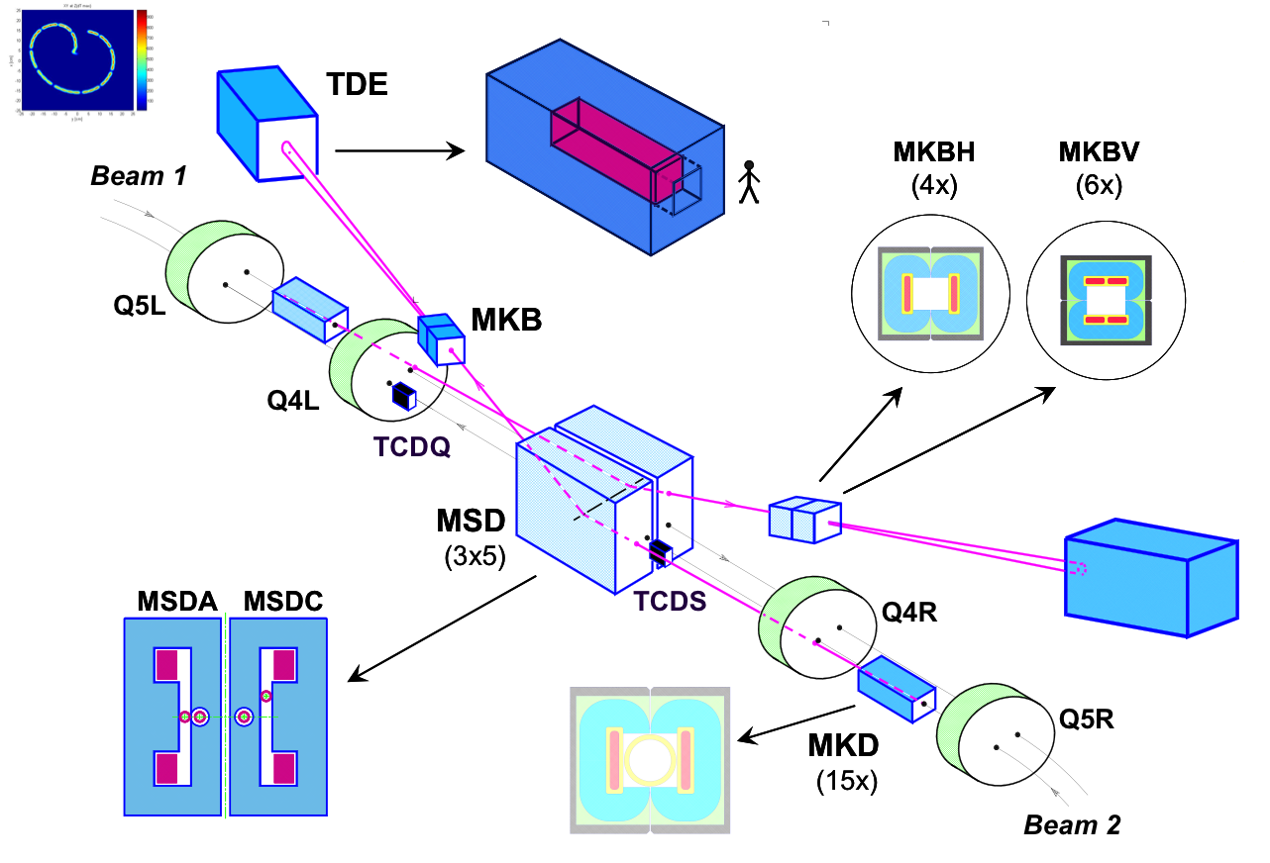
The extreme system – LHC beam dump
The LHC beam dump is installed in an external cavern.
The beam with up to 360 MJ of stored energy is extracted horizontally by a system of 15 kicker magnets (MKD) that are fired synchronously.
15 Lambertson septum magnets deflect the beam vertically into the beam dump transfer line.

Slide 46
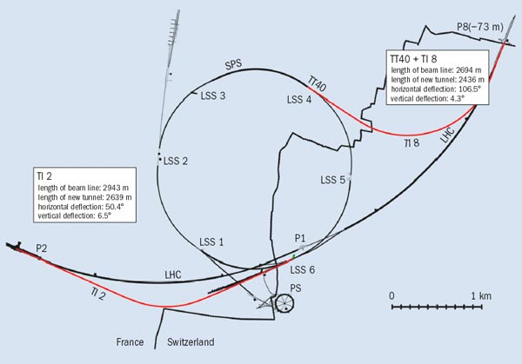
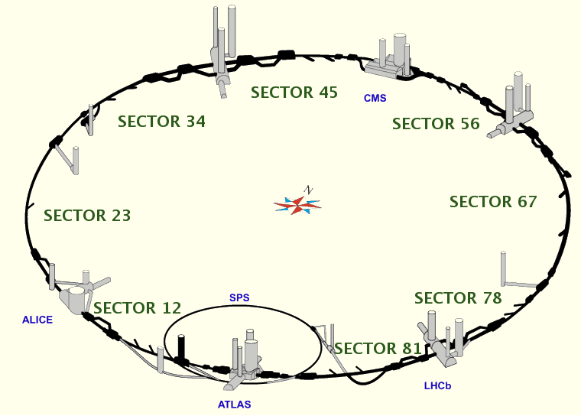
SPS - LHC transfer example
Transfer from the SPS to the LHC: two 3 km long transfer lines.
Energy 450 GeV
Peak intensity: 288 bunches of 1.7 × 10¹¹ p+ ⇒ 2.4 MJ
Damage limit ~ 100 J/cc which is reached with 5% of the peak intensity

Slide 47
Interlock (groups)
In general a large number of individual interlocks may feed into the protection of a transfer.
  The individual interlocks are combined with appropriate logic, the resulting interlock status (OK/Not OK, true/false) will be defined as the permit.
When all conditions are OK (true) the transfer is initiated by pulsing the transfer elements.
In case the conditions are NOT OK (false) the transfer must be inhibited or stopped by dumping / stopping the beam in the source accelerator and / or by inhibiting the transfer of the beam.
  The beam should be inhibited as far upstream as possible.
  Applying multiple protective actions may be possible in some cases.

Slide 48
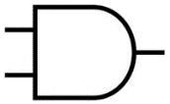

Permit concept
We define a PERMIT as the result of the evaluation of a group of interlocks.
The permit may be true (green, all OK) or false (red, not OK).
The permit can be associated to an accelerator zone (geographical grouping) or to a beam action like a transfer.
  Injection permit, extraction permit, beam permit (circulating beam).
Interlock signal 1
Interlock signal 2
Interlock signal 3
Interlock signal 4
Interlock signal 5
Interlock signal 6
Interlock signal 7
Permit
Interlock signal 8
Interlock signal n-1
Interlock signal n
Interlock signal n+1

Slide 49
Permit concept
The permit is eventually connected to a kicker or trigger system, for injection and extraction it authorizes (state = true) to transfer the beam, i.e. enables the kicker pulse.
  Extraction permit → extraction kicker,
  Injection permit → injection kicker & extraction permit (source).
Transfer of 450 GeV beam from SPS to LHC
Extraction permit
Injection permit
SPS extraction
Transfer
LHC Injection

Slide 50
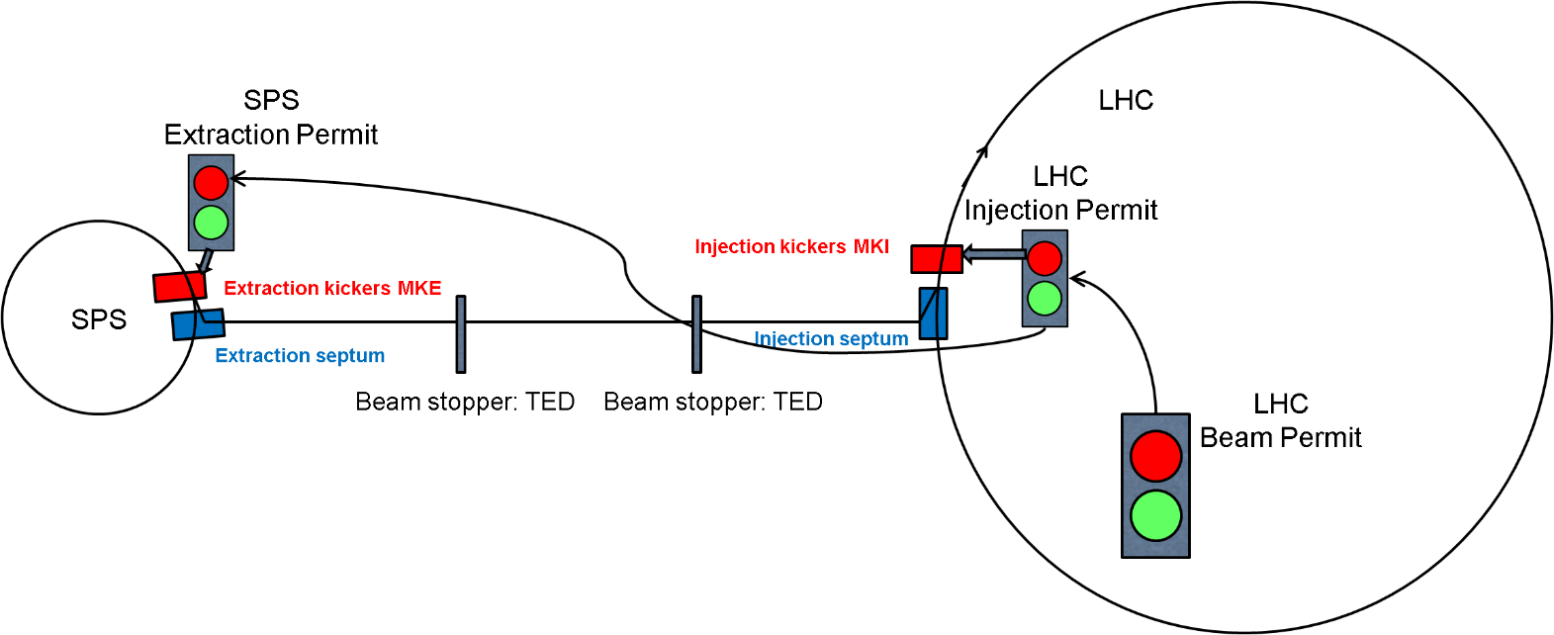
Example for SPS-LHC transfer permits
The permit chain:
LHC circulating beam permit = beam allowed to circulate in the LHC
LHC Injection permit = beam is allowed to be injected into the LHC (≠ beam permit)
  Elements relevant for protection at injection may add extra conditions.
SPS Extraction permit = beam is allowed to be extracted into the transfer line
LHC beam permit ⇒ LHC injection permit ⇒ SPS extraction permit

Slide 51

Interlocked systems and signals
Possible list of interlocks – risk analysis defines which ones are required:
Extraction orbit + power supplies of source accelerator.
Extraction elements: septum state and current, kicker state and strength.
All transfer line magnet power supplies – state and current.
Position of all interceptive devices: vacuum valves, observation screens.
Settings of passive protection devices.
Beam losses – to inhibit the next transfer.
Beam trajectory – to inhibit the next transfer.
Through injection permit: injection equipment and destination accelerator interlocks.

Slide 52
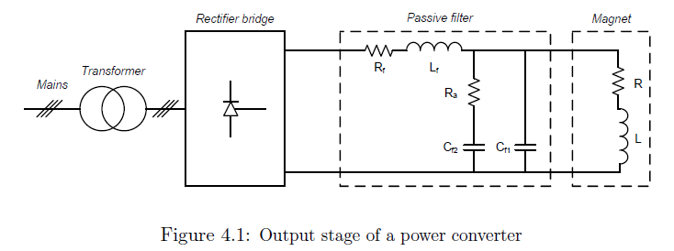
Example for SPS-LHC transfer
To set interlock windows on power converters, the maximum beam excursion in case of failure must be estimated. One has to take into account:
  the magnet circuit parameters in case of failure,
  the delay between the last possible measurement and the transfer.
The ‘naïve’ circuit time constant τ = L/R can be modified by the presence of filters in the PC output stage !
Example for a transfer line from SPS to LHC:
The extraction septum (MSE) is particularly fast:
  Moves beam by 40 σ in 1 ms
Aperture of the transfer line ~ 10 σ
Notes:
Most dangerous are the dipoles

Slide 53
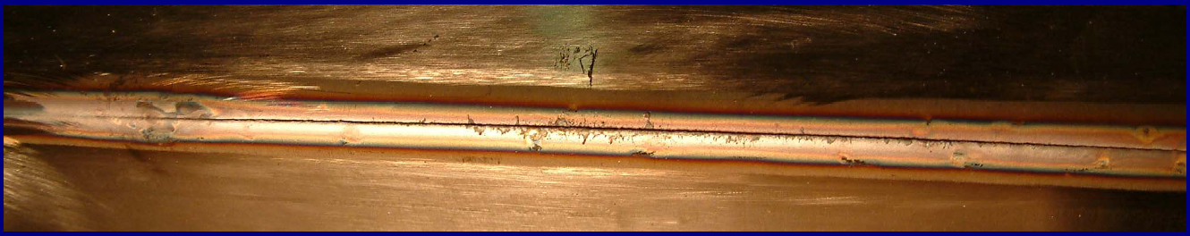
Example: fast extraction failure SPS-LHC
Failure in SPS during setting-up of LHC beam (25/10/2004).
Extraction septum power supply failed due to EMC from the beam.
  Beam induced signals made their way into the protection PLC through temperature monitoring cables !
  In 11 milliseconds the field dropped by 5%.
3.4×10¹³ p+ @ 450GeV (~2 MJ) were hit the vacuum chamber aperture of the TL.
Vacuum chamber and quadrupole magnet were damaged and had to be replaced.
Screenshot captured mis-steered beam at 23:47:36
Beam horizontally off by 10.8mm
Reconstructed H trajectory (±3 σ envelope)
~25cm long hole in chamber
10 cm
Inside, damage visible over ~1m (melted steel)

Slide 54
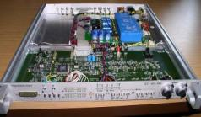
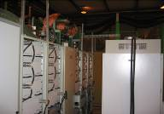
Failure follow up
The failure revealed a weakness with the protection against failure in magnet circuits with very fast decay times.
Similar issues arose at the same time at DESY (for the HERA machine) and for the LHC normal conducting circuits.
This triggered the development of so-called FMCMs (Fast Magnet Current change Monitor) that provide nowadays protection against fast magnet current changes after powering failures - CERN - DESY collaboration.
Fast
Magnet
Current
change
Monitor
Beam Interlock System
Power Converter
Voltage Divider
& Isolation Amplifier
Magnet
Power converter
Very fast detection (< 1 ms) of voltage changes on the circuit. Tolerances of ~ 10⁻⁴ on ΔI/I are achievable.

Slide 55
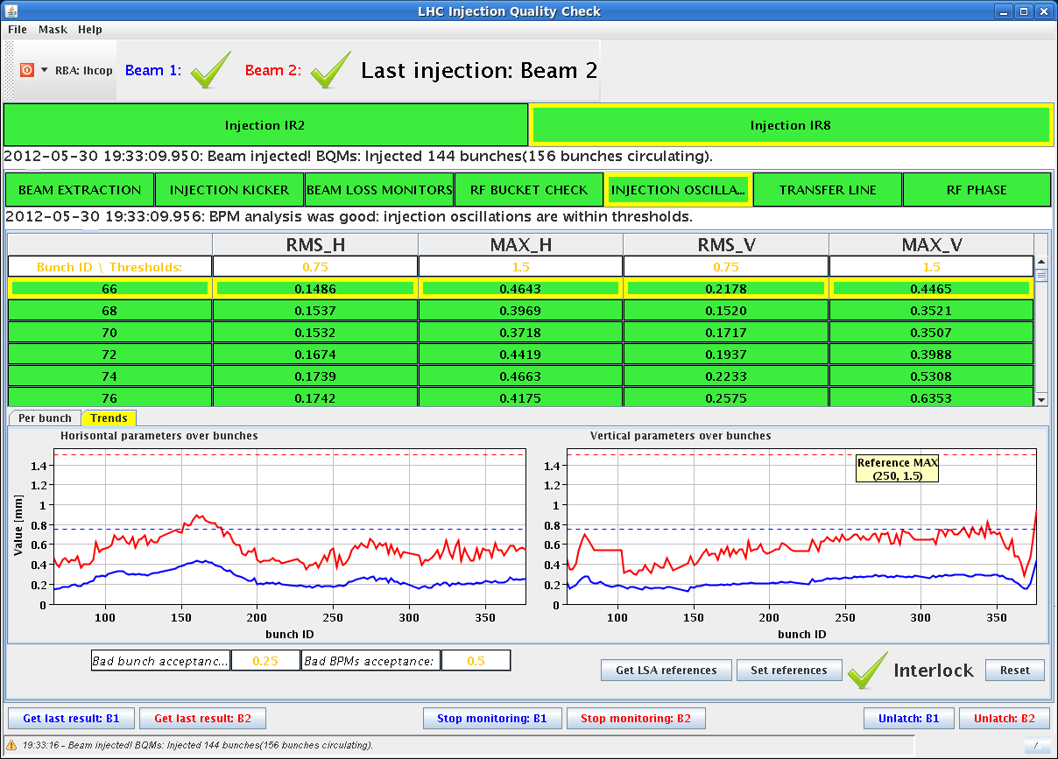
Post operational checks
In some cases it may be desirable to monitor data collected during a transfer to inhibit future transfers (e.g. beam loss too high) or to detect detrimental long term trends or parameter drifts.
Automatic post operational check software.
Automatic analysis with respect to reference shot + tolerance.
If outside tolerance ➔ extraction is blocked.
LHC Injection Quality Check (IQC)

Slide 56
Commissioning and masking
During early commissioning, it may not be possible to set all interlocks with correct settings as they may depend on the outcome of the commissioning.
Operating with the full interlock chain active may render life ‘impossible’ to the commissioning team.
In such situations the possibility to “disable" certain interlock inputs (“mask”) is extremely valuable.
To avoid the situation where interlock remain masked ‘accidentally’ after commissioning or when the intensity is unsafe, an automatic re-activation depending on intensity or energy can be valuable.
  Example: for the SPS-LHC transfer masking is only allowed for a “setup beam intensity” – above that intensity masks are automatically reactivated.
  The setup intensity is derived from beam current transformer measurements and distributed across the interlock system in the form of a “setup intensity flag” which is true when the intensity is below a pre-defined limit, false if it is above.
  Interlock masking is then conditioned by the flag: when false, masks applied in the interlock system are ignored !

Slide 57
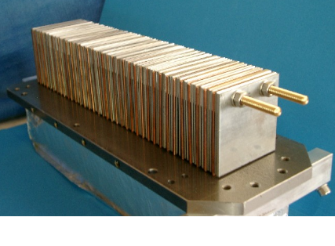
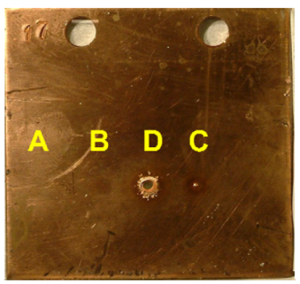
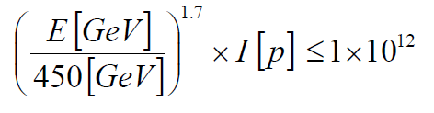
Example of “setup intensity” – SPS-LHC
The setup intensity must be reasonably high to be able to test under representative beam conditions.
The setup intensity should be below damage limit.
  It turns out that it is not possible to prevent magnet quenches as the limit would be too low (factor ~100 between quench and onset of damage).
The knowledge of the accelerator equipment damage limit is of importance. Test result at 450 GeV with LHC beam:
Intensity | # protons | Comments
A | 1.2e12 | No effect
B | 2.4e12 | Decolouration
C | 4.8e12 | Melting
D | 7.2e12 | Fragment ejection
Definition of LHC Setup Beam Flag
Notes:
In reality it is a bit more complicated as the beam size enters as well…we can talk about this offline.

Slide 58
Going further: beam presence
In some situation it may be extremely difficult to monitor all equipment at an adequate level to ensure a safe transfer – for example when the destination is a larger collider.
  For example the 27km long LHC.
Instead trying to interlock a vast number of elements, one can use the fact that the presence of a circulating beam is the best sign of ‘health’.
Before sending a high intensity beam, one ensures that a low intensity beam is circulating.
  This concept was implemented successfully within the LHC interlock system.
    A very sensitive and very robust device detects the presence of circulating beam (threshold ~ 2 x 10⁹ charges per bunch).
    The presence of beam is converted into a logical flag (beam presence flag) that is distributed to the SPS-LHC transfer interlock system.
    High intensity from the SPS is only transferred if beam is present in the LHC.
Notes:
Is everything correct that one can inject high intensity beam.

Slide 59
Introduction to injection, extraction and beam transfer
Septum and kicker magnet
Protection of transfer lines
Collimation for transfer lines

Slide 60
Passive protection
There are many options to ensure the correct settings of the magnets during beam transfer, before beam transfer occurs. The beam transfer can be inhibited in the very last moment in case of failures.
But certain extraction element failures, kicker magnets or electrostatic devices (sparking), are an exception as not all failures can be avoided.
Dealing with such mis-guided beam has to be designed into the protection system and requires passive protection by absorbers and collimators.
Notes:
Also for redundancy…

Slide 61
Passive protection devices
When designing a passive protection system, the following questions have to be answered:
  Protection against which failure?
  Where to install the protection?
  What is the damage/quench/allowed radiation level of downstream equipment?
    This defines the required attenuation → material and length of device
  What is the maximum particle density that can impact the protection devices? At which repetition rate?
    One may have to balance robustness versus material density. This defines the device length (space requirement) for a given attenuation
  What is the aperture to be protected?
  Are moveable devices required?
The design of protection devices requires a mixture of accelerator physics and material science.
  Simulations for particle tracking, energy deposition and thermo-mechanical response are required.

Slide 62
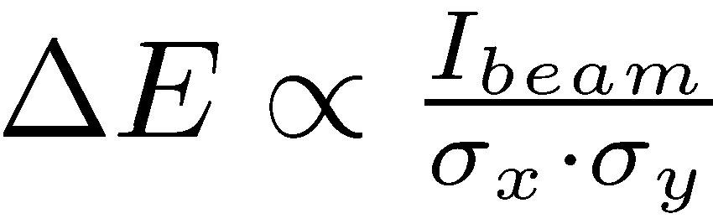
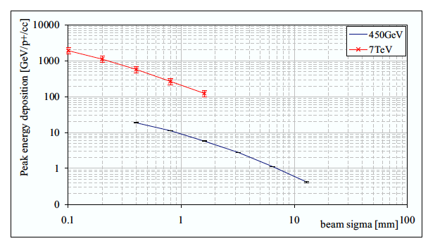
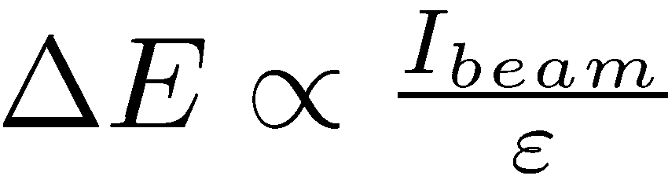
Energy density
The damage potential of a beam does not only depend on the total intensity and on the beam energy (penetration), but also on the beam (impact) size σ_{x}×σ_{y}.
Peak energy deposition in Copper
(round beams)
Notes:
I showed you already before the dependence of the energy deposition on energy earlier….with Eˆ1.7….which also takes the shrinking of the emitance into account

Slide 63
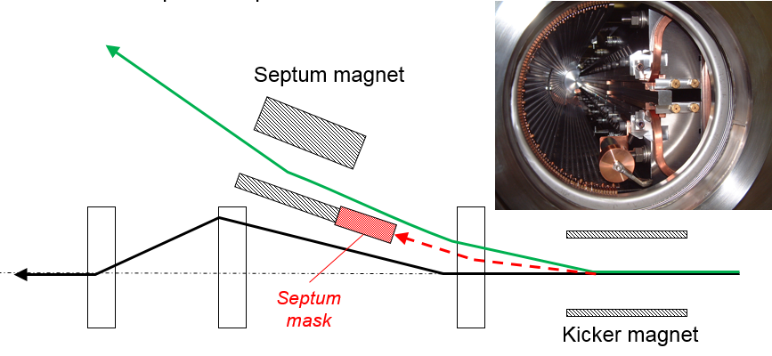
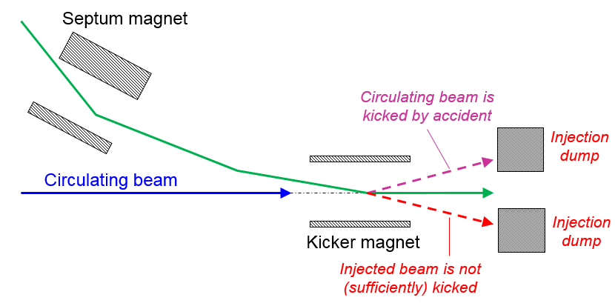
Injection and extraction protection
We already saw the passive protection for injection and extraction…

Slide 64
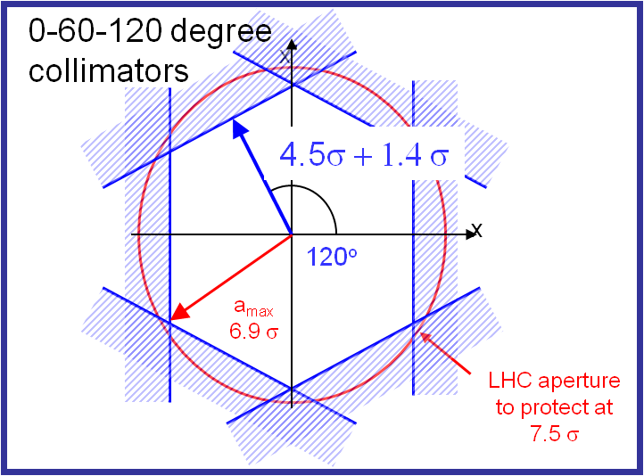
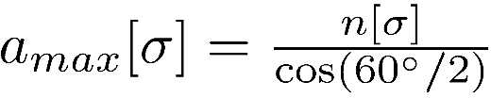
Passive protection in a transfer line
To protect against ANY failure during extraction, transfer, a generic passive protection system should have a full phase-space coverage.
In single pass for a generic protection/collimation system:
  Collimators at several phase locations are required.
  A good solution is made of 3 collimators with 60 degrees betatron phase advance between them.
In case of very high intensity and risk of absorber damage, select as much as possible locations with large beam sizes !
For 3 collimators per plane the maximum amplitudes for setting n:
7.5σ aperture to protect

Slide 65
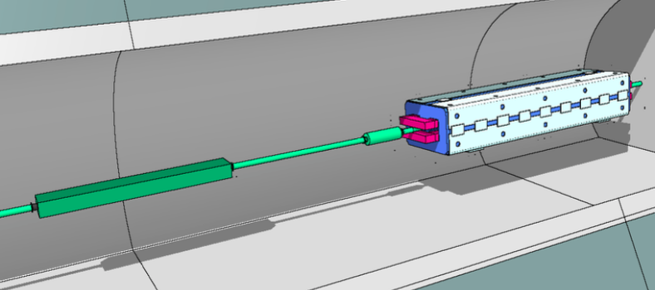
Passive protection example
SPS to LHC passive protection is based on 3 collimators in each plane separated by 60º in phase.
To provide best protection of the LHC superconducting magnets, the collimators are placed at the end of the line.
  Note that the line itself, made of room temperature magnets, is not passively protected !
TCDIMOM
TCDIH/V
SPS
TT40/60
TI 8/2
LHC
MKE
TED
TED
MKI
TDI
1.2 m long moveable graphite collimators complemented by iron masks.
Provide a factor ~ 20 attenuation.

Slide 66
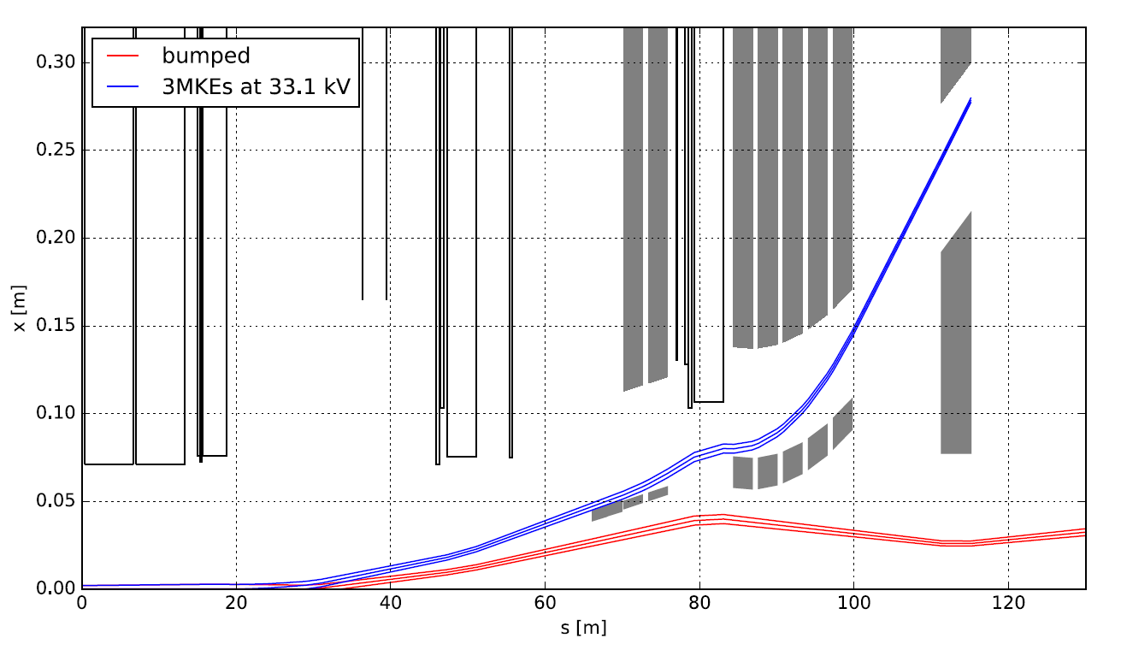
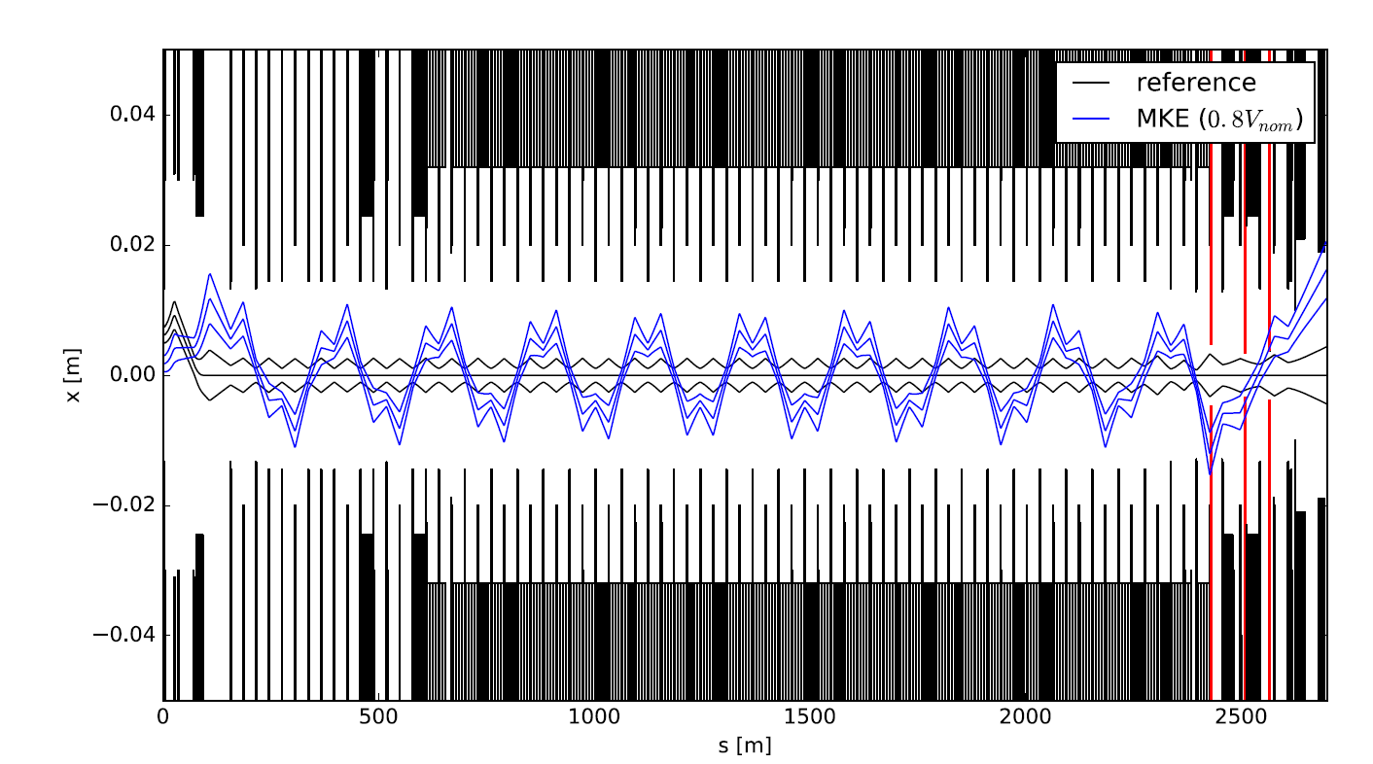
Extraction kicker failure case
Simulated beam path for 80% of nominal extraction kicker pulse: protected by the collimators.
Perturbed beam envelope
Collimators
Nominal beam envelope

Slide 67
Operation with moveable protection devices
Moveable protection devices have to be set up with beam.
Beam loss monitors need to be installed close by. Absorber jaws should be centered around beam.
The absorbers can only be set up when the optics is corrected and reference trajectory/orbit established.
Interlock thresholds for jaw position measurement systems are then defined and applied.
  Injection/extraction not allowed if the jaws are not at the correct location.
System qualification tests have to be carried out. E.g. simulate failure case and verify phase space coverage.
  Can be done with low intensity beam, swept across the aperture with steering elements to ensure that there are no losses at undesired locations.
Before qualification finished operation with high intensity is not allowed.

Slide 68
Summary
Protection of a beam transfer – which bears similarities to a linac – differs from a ring protection by that fact that the beam passes only once through the transfer.
  One cannot profit from the fact that the effect on a beam of a failure builds up one turn after the other.
It is in general not possible to abort a beam during a transfer, all machine elements should therefore have correct settings before the transfer is launched.
  The stored energy of the beam that is transferred and the available passive protection will define what type of loss is acceptable and for how many consecutive shots.
  For large stored energy or high average power transfer, the reaction times may be very short.
The fast pulsing magnets that are involved in extraction and injection of beam may require a dedicated risk analysis.
  Passive protection may have to be provided to cope with failures.

Slide 70
Synchrotron lepton injection
Inject an off-momentum beam
p = p₀ + Δp
Septum magnet
Injected beam
p = p₀
x_{s}
Bumped circulating beam
x_{s} = D_{x} Δp/p₀
Closed orbit bumpers or kickers
Beam is injected parallel to the circulating beam, onto dispersion orbit of a particle having the same momentum offset Dp/p.
The injected beam performs damped synchrotron oscillations and finally damps longitudinally into the circulating beam.

Slide 71
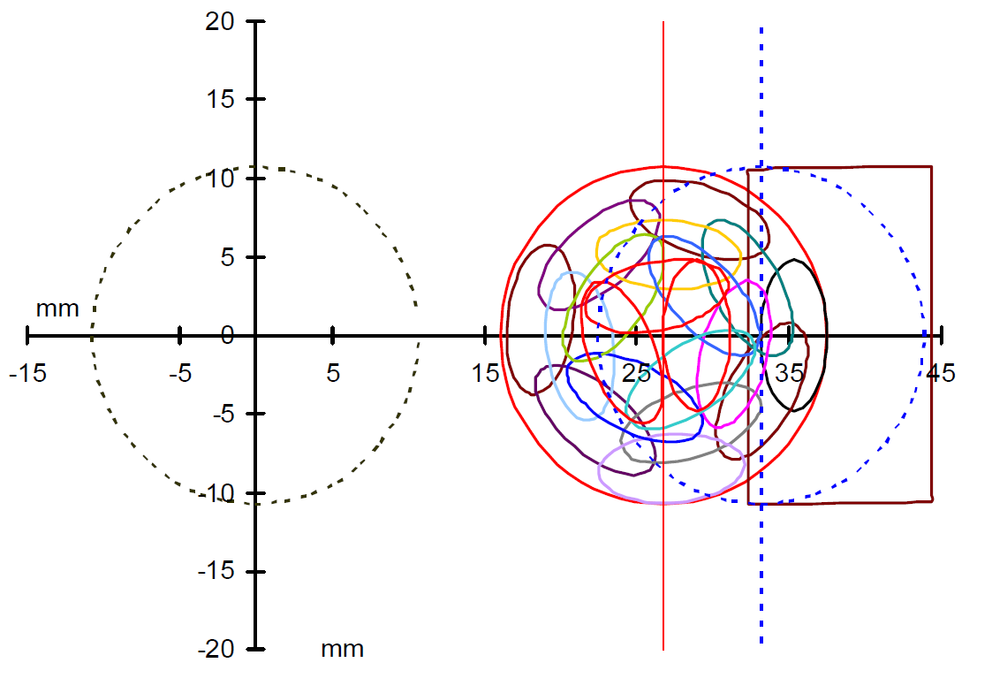
Charge exchange injection PSB
Charge exchange injection into the CERN PS Booster
M. Martini et al, Proc. of EPAC04 (2004)

Slide 72
Direct Drive Pulsed Magnetic Septum (1)
Rear Conductor
Powered with a half sine wave current with a half period time of typically 3 ms.
Coil is generally constructed as a single turn, so as to minimize magnet self-inductance.
A transformer is used between power supply and magnet to allow use of standard 2kV capacitors for the supply.
To allow precise matching of the septum position with the circulating beam trajectory, the magnet is also often fitted with a remote displacement system.
Often under vacuum to minimize distance between circulating and extracted beam.
Yoke
Septum
Conductor
x
Circulating
Beam
B
Extracted
Beam
0
x
y
z
x
Notes:
Example: J to 300A/mm^2 peak

Slide 73
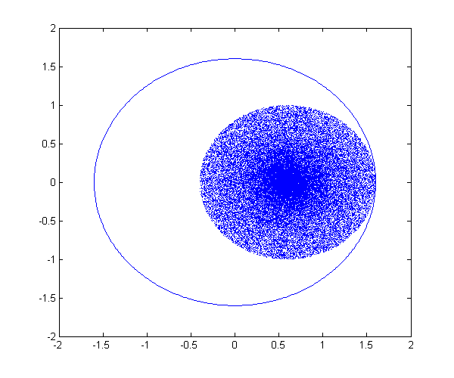
Filamentation

Slide 74
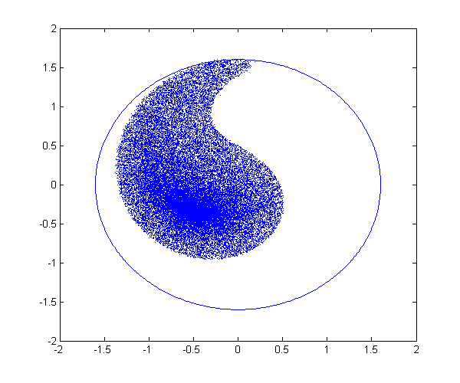
Filamentation

Slide 75
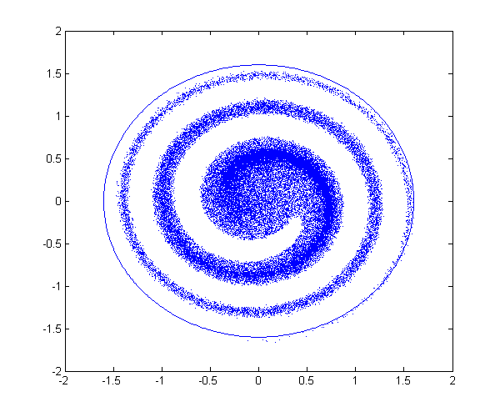
Filamentation

Slide 76
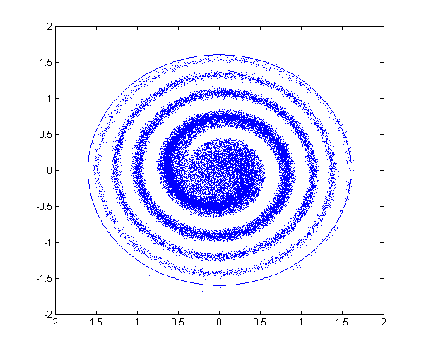
Filamentation

Slide 77
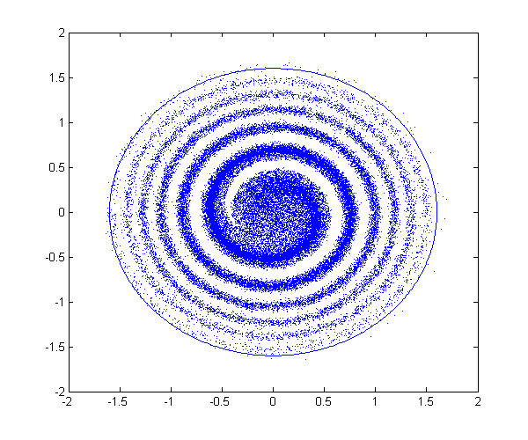
Filamentation

Slide 78
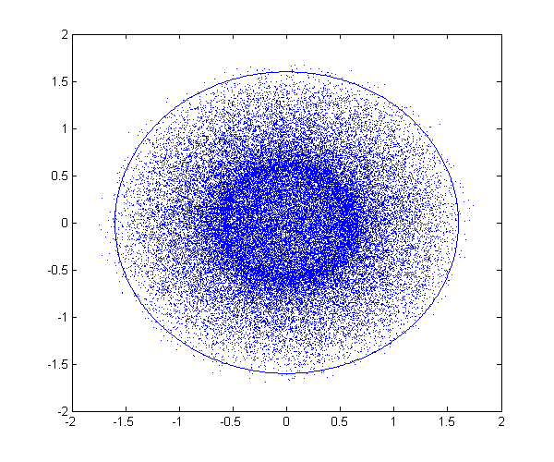
Filamentation

Slide 79
Single-turn injection
Normalised phase space at centre of idealised septum
Large deflection by septum
θ septum

Slide 80
Single-turn injection
π/2 phase advance to kicker location

Slide 81
Single-turn injection
Normalised phase space at centre of idealised kicker
Kicker deflection places beam on central orbit
θ kicker

Slide 82
Injection Mismatch - Injection oscillations
For imperfect injection the beam oscillates around the central orbit.
kicker θ error

Slide 83
Injection oscillations
For imperfect injection the beam oscillates around the central orbit.

Slide 84
Injection oscillations
For imperfect injection the beam oscillates around the central orbit.

Slide 85
Injection oscillations
For imperfect injection the beam oscillates around the central orbit.

Slide 86
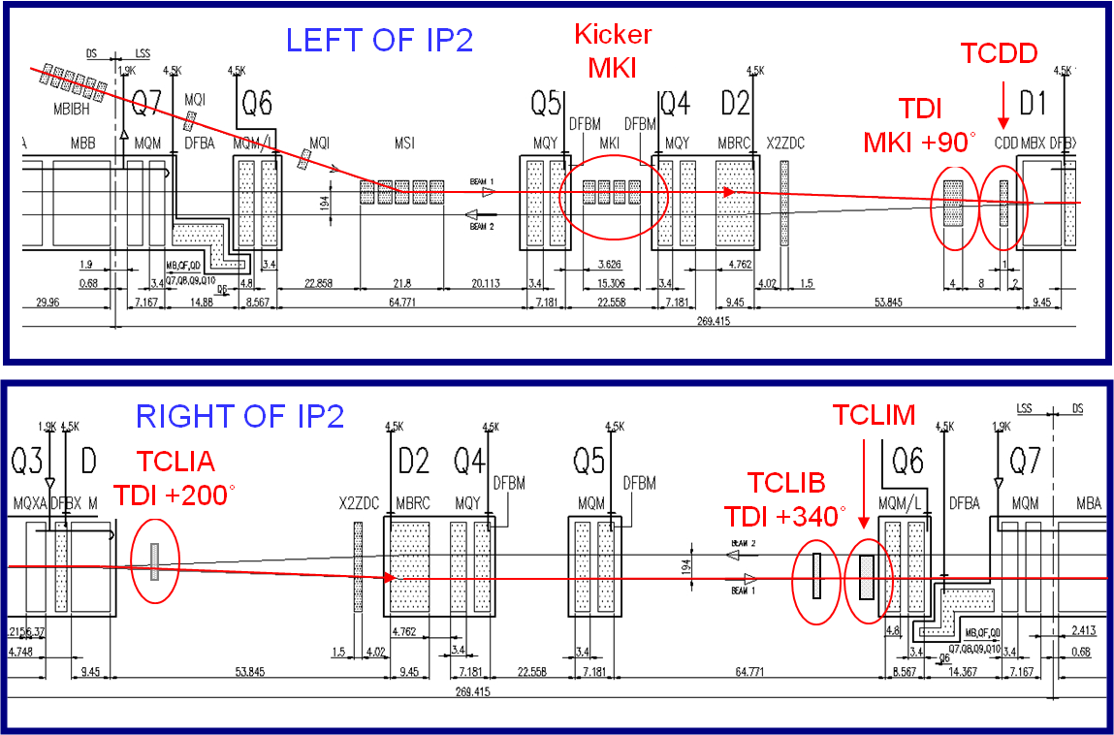
Passive Passive Protection against LHC Injection Kicker Errors – Auxiliary Collimators
sdf
Notes:
They are 1.2 m long, made of graphite CfC. In the horizontal plane. Check whether made of CfC

