Slide 1
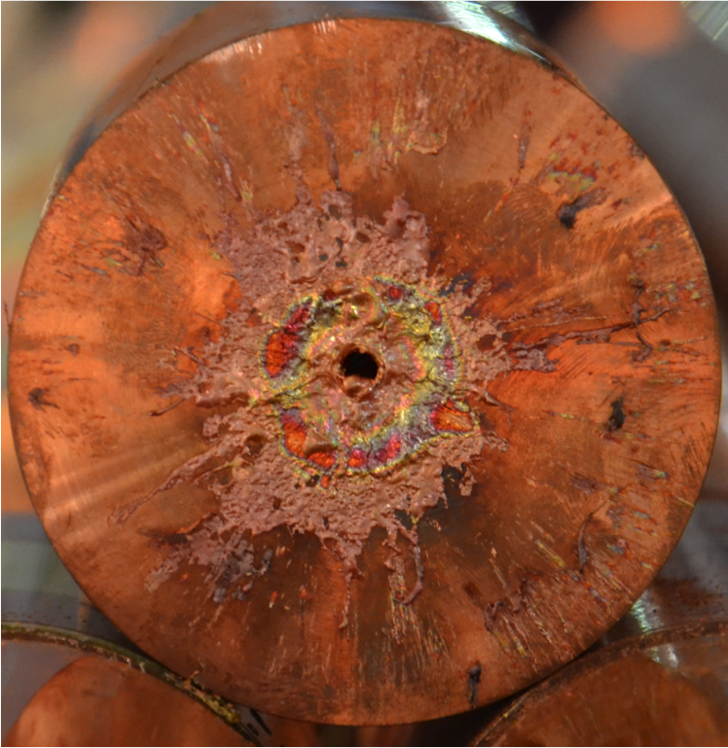

Beam loss induced damage mechanisms and their calculation
Rüdiger Schmidt, CERN
U.S. Particle Accelerator School January 2017
Based on a presentation of Alessandro Bertarelli at the
Joint International Accelerator School 2014

Slide 2
Programme for the school
What can go wrong?
What are the consequences?
Mitigation
  Are the protection systems efficient and reliable?
Controls and operation

Slide 3
Can the beam damage equipment?

Slide 4
Steps to address the question
Can the beam induced damage?
Beam impact on equipment
Heating of equipment
Static deformation
Dynamic deformation
Hydrodynamic tunnelling

Slide 5
Indirect beam impact on equipment
Energy deposition due to high intensity beam
Synchrotron radiation in e+ or e- machines
  In general, heating of the surface, but also deeper inside the material
Electromagnetic interaction of high intensity beam with the environment due to impedance of equipment
Radiation in the accelerator environment
Single ionising particles can lead to Single Event Effects in electronics
  Either cause bit-flip in memory, or damage electronics, e.g. in transistors
  Can lead to secondary damage, e.g. if power converter trips
  The probability for such event is proportional to the radiation dose
High radiation dose will have an effect on any material
  Metals are most robust

Slide 6
Direct beam impact on equipment
Direct beam impact on equipment - by design
  Beam on target
  Beam through vacuum windows
  Beam on protection devices (beam absorber and collimators)
  Beam on beam instrumentation (observation screens, wire scanners, ..)
Direct accidental beam impact on equipment
  Any equipment close to the beam can be hit by particles if lost after a failure (vacuum chamber, magnets, cavities, beam instruments, …)
  Targets, vacuum windows and protection devices hit with wrong beam parameters (beam too small, too high intensity)
During initial commissioning this cannot be avoided…
  For commissioning of an accelerator: what beam intensity during first test?
What is the “safe” beam intensity impacting on equipment?

Slide 7
Relevant parameters
Beam parameters
  Particle type
  Particle energy
  Beam intensity
  Beam size
  Temporal profile of impacting beam / bunch
  Impact parameters of beam onto equipment (orthogonal, grazing, …)
Equipment parameters
  Material
  Mechanical structure
  Sensitivity of equipment
Impact by design, well defined
Accidental impact, ill defined

Slide 8
What can happen to materials / equipment?
Temperature increase
Loss of superconductivity in magnets or cavities
Melting
Vaporisation
Stresses and forces: by temperature differences and/or by shock waves
Change of shape and mechanical properties
Triggering additional release of energy (e.g. superconducting magnets)
Some equipment is very delicate, e.g. the inner tracker of particle physics detectors very close to the beam
Question: Assume that the temperature of the material after beam impact is (far) away from melting: is it safe for the equipment?

Slide 9
Heating by direct beam impact
Beam impact deep into the material can happen very fast, e.g. down to ns.
There are no other known mechanisms to heat deep inside a material block in very short time (e.g. laser beams hit only the surface)
  This is the motivation to use high energy beam impact on materials to address some basic physics questions (High Energy Density Matter and Plasma Physics, to be studied FAIR@GSI and other installations)

Slide 10
Damage mechanisms and their calculation
Calculate beam loss and energy deposition
  Straightforward beam impact by design, on targets, windows and screens
  Can be very difficult for accidental beam losses – worst case scenarios to be assumed (e.g. failure of kicker magnet, beam on a resonance, etc.)
Calculate energy deposition and temperature increase
  Straightforward, but calculation can be very complex in case of complex geometry
Calculate temperature increase and structural / mechanical response
  Does the material change its properties during beam impact, e.g. does it melt or does it get vaporised?
  Can be from straightforward to very difficult
For accidental beam impact, all of these phenomena are a function of time (ranging from ns to many seconds)

Slide 11
Define failure case
Calculate beam loss as function of time
Calculate total energy deposition
Calculate material temperature increase
Iterative Hydrodynamic calculations
Does the material change density?
Iterative calculations
YES
NO
YES
Any effect of cooling during beam impact?
Perform mechanical calculations

Slide 12
Heating of equipment

Slide 13
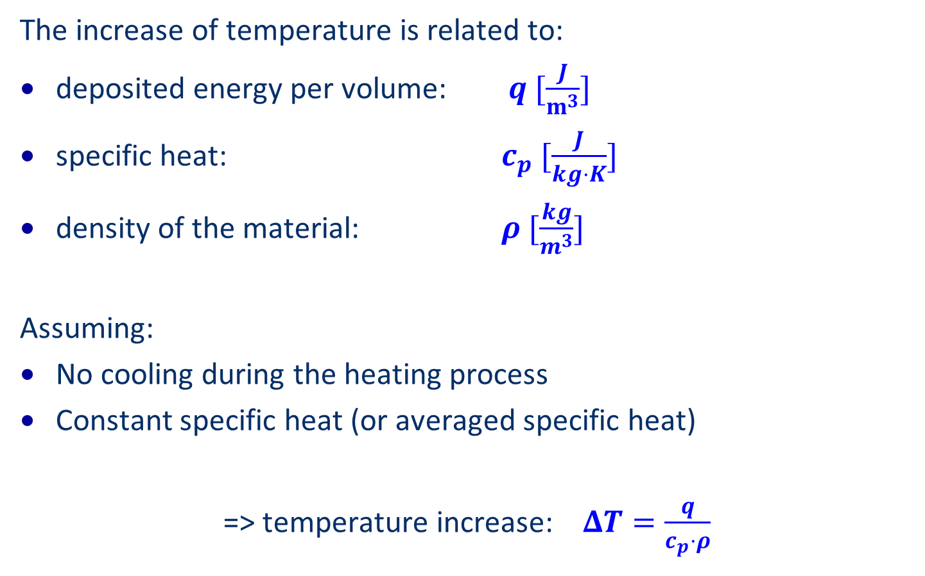
Heating when cooling can be neglected
The increase of temperature is related to:
deposited energy per volume: $q [\frac{J}{m^{3}}]$
specific heat: $c_{p} [\frac{J}{kg⋅K}]$
density of the material: $ρ [\frac{kg}{m^{3}}]$
Assuming:
No cooling during the heating process
Constant specific heat (or averaged specific heat)
=> temperature increase: $ΔT=\frac{q}{c_{p}⋅ρ}$

Slide 14
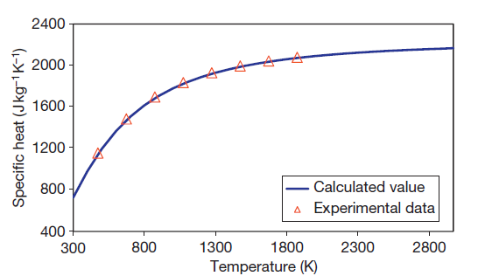
Some complications…
The specific heat is a function of temperature, depending on the material
The cooling needs to be considered if beam impact is “slow”
Cooling can be by heat conduction and by radiation (radiation becomes important for high temperature >> 1000 ⁰C)
Specific Heat of Graphite

Slide 15
Simulation of LHC beam impact on copper target
Fast impact of 200 bunches on copper cylinder with a length of 6 m
Fast heating of material far above melting point in 100 µs
Material changes its phase
Hydrodynamic tunnelling – discussed later

Slide 16
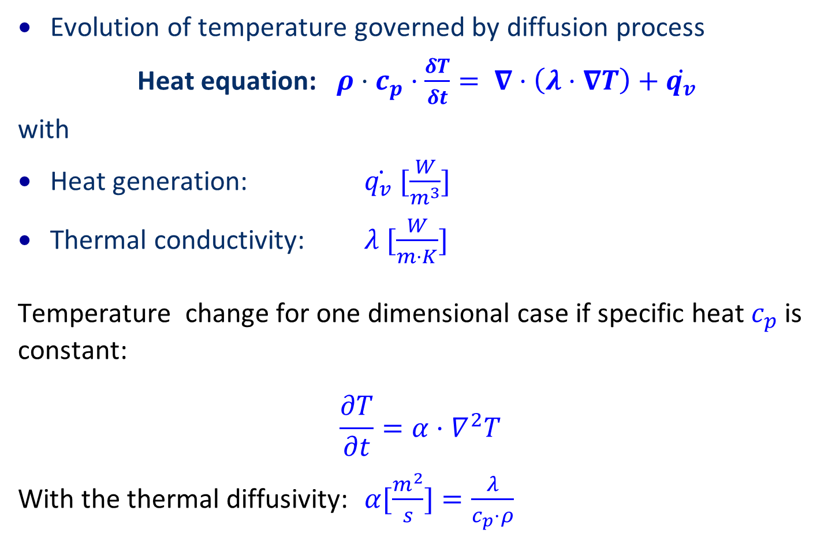
When to consider cooling…
Evolution of temperature governed by diffusion process
Heat equation: $ρ⋅c_{p}⋅\frac{δT}{δt}= ∇⋅\left(λ⋅∇T\right)+\dot{q_{v}}$
with
Heat generation: $\dot{q_{v} }[\frac{W}{m^{3}}]$
Thermal conductivity: $λ [\frac{W}{m⋅K}]$
Temperature change for one dimensional case if specific heat $c_{p}$ is constant:
$$\frac{∂T}{∂t}=α⋅∇^{2}T$$
With the thermal diffusivity: $α[\frac{m^{2}}{s}]=\frac{λ}{c_{p}⋅ρ}$

Slide 17
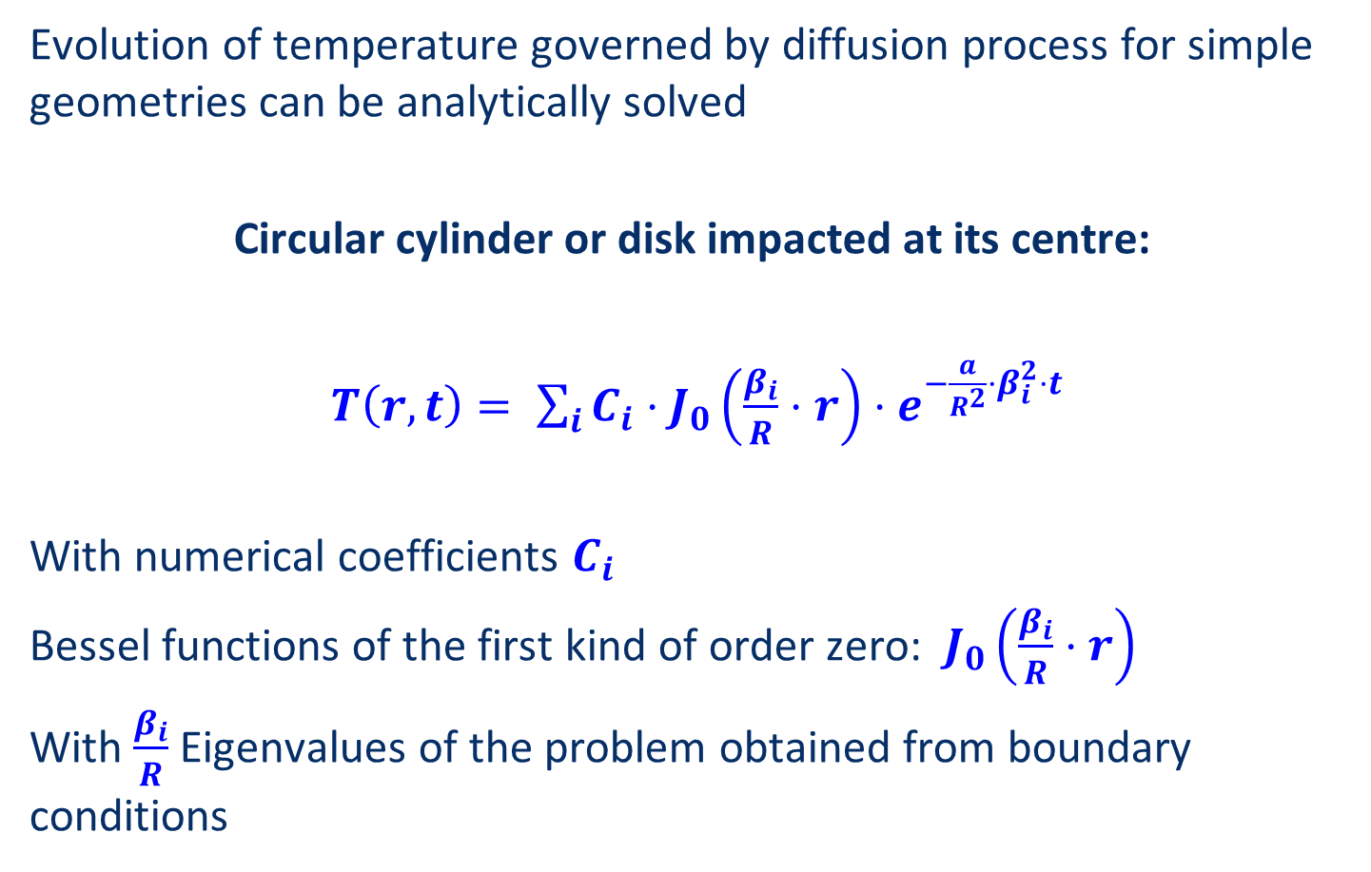
Example when to consider cooling…
Evolution of temperature governed by diffusion process for simple geometries can be analytically solved
Circular cylinder or disk impacted at its centre:
$T\left(r,t\right)= \sum_{i}{C_{i}⋅J_{0}\left(\frac{β_{i}}{R}⋅r\right)⋅e^{−\frac{a}{R^{2}}⋅β_{i}^{2}⋅t}}$
With numerical coefficients $C_{i}$
Bessel functions of the first kind of order zero: $J_{0}\left(\frac{β_{i}}{R}⋅r\right)$
With $\frac{β_{i}}{R}$Eigenvalues of the problem obtained from boundary conditions

Slide 18
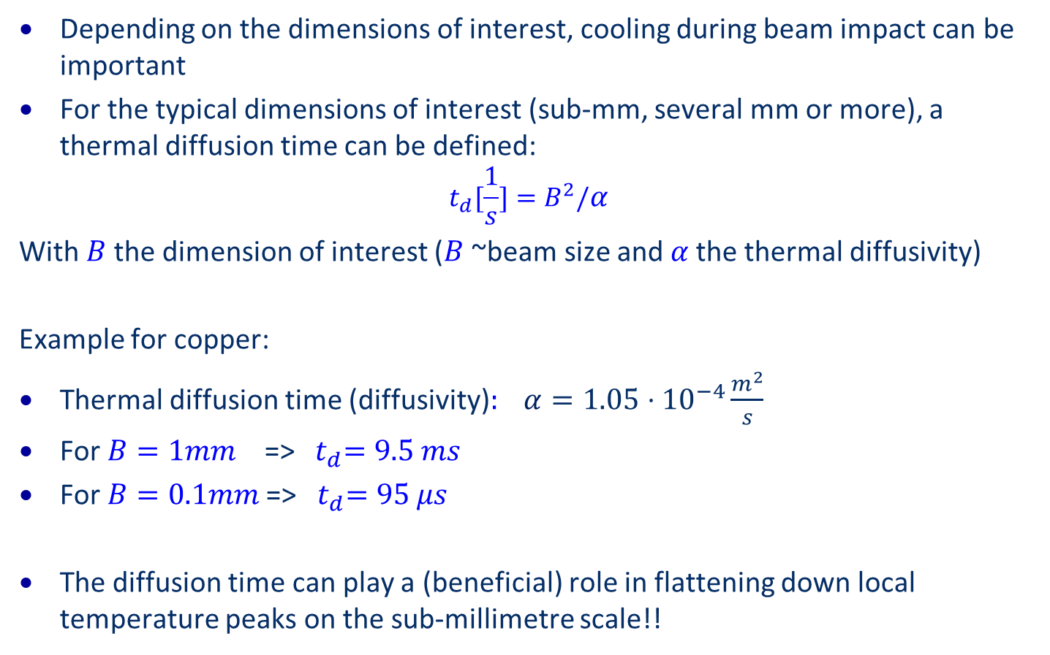
Thermal diffusion time
Depending on the dimensions of interest, cooling during beam impact can be important
For the typical dimensions of interest (sub-mm, several mm or more), a thermal diffusion time can be defined:
$$t_{d}[\frac{1}{s}]=B^{2}/α$$
With $B$the dimension of interest ($B$~beam size and$α$the thermal diffusivity)
Example for copper:
Thermal diffusion time (diffusivity)$: α=1.05⋅{10}^{−4}\frac{m^{2}}{s}$
For $B=1mm$ =>${ t}_{d}=9.5 ms$
For $B=0.1mm$=>${ t}_{d}=95 μs$
The diffusion time can play a (beneficial) role in flattening down local temperature peaks on the sub-millimetre scale!!

Slide 19
Material properties
On the typical dimensions of interest (several mm or more), the thermal diffusion time lasts from several to many milliseconds.
Depending on the beam impacts, the assumption of instantaneous heat deposition looks can be appropriate (in many cases).
 | Properties at Room Temperature |  |  |  | Diffusion Time [ms]
Material | Density [kg/m³] | Specific Heat [J/kg/K] | Thermal Conductivity [W/m/K] | Diffusivity [mm²/s] | L = 0.1 mm | L = 1 mm | L = 1 cm
Copper (Glidcop) | 8900 | 391 | 365 | 104.9 | 0.10 | 9.5 | 953
Tungsten Alloy (Inermet180) | 18000 | 150 | 90.5 | 33.5 | 0.30 | 29.8 | 2983
Molybdenum | 10220 | 251 | 138 | 53.8 | 0.19 | 18.6 | 1859
Titanium Alloy (Ti6Al4V) | 4420 | 560 | 7.2 | 2.9 | 3.44 | 343.8 | 34378
Aluminum Alloy | 2700 | 896 | 170 | 70.3 | 0.14 | 14.2 | 1423
Molybdenum-Graphite | 2500 | 740 | 770 | 416.2 | 0.02 | 2.40 | 240
Graphite | 1850 | 780.0 | 70 | 48.5 | 0.21 | 20.6 | 2061

Slide 20
Example
Beam impact on a (thin) window
Transverse round Gaussian distribution of particles
Energy deposition in a thin window is calculated by Bethe-Bloch equation
Heating is calculated by knowing the specific heat of the window material
What are the relevant parameters?
Relevant parameters
  Beam size
  Particle type
  Number of particles
  Time duration of impact
  Material of window

Slide 21
Proton energy deposition for different energies
Simulations with FLUKA, beam impact on a copper target
Y.Nie et al

Slide 22
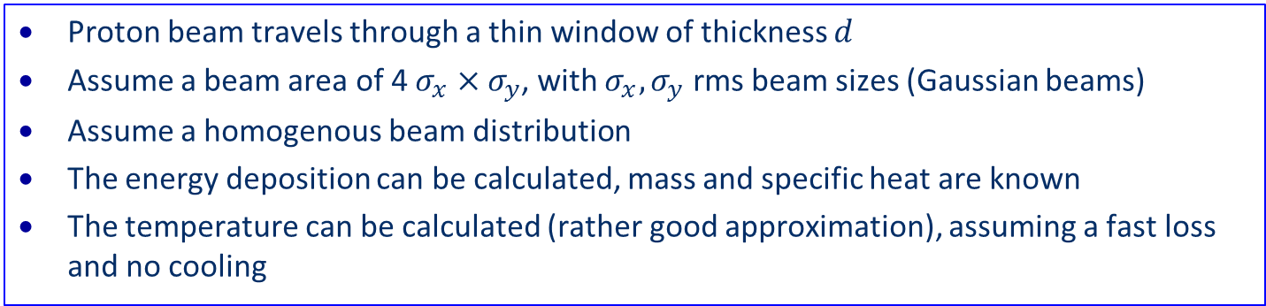
Beam loss and consequences
Proton beam travels through a thin window of thickness $d$
Assume a beam area of 4 $σ_{x}×σ_{y}$, with $σ_{x}, σ_{y}$ rms beam sizes (Gaussian beams)
Assume a homogenous beam distribution
The energy deposition can be calculated, mass and specific heat are known
The temperature can be calculated (rather good approximation), assuming a fast loss and no cooling

Slide 23
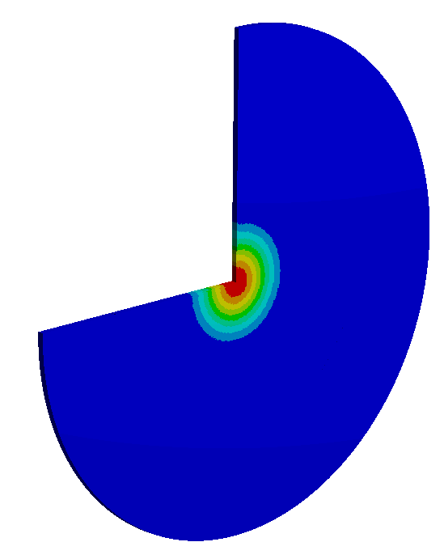
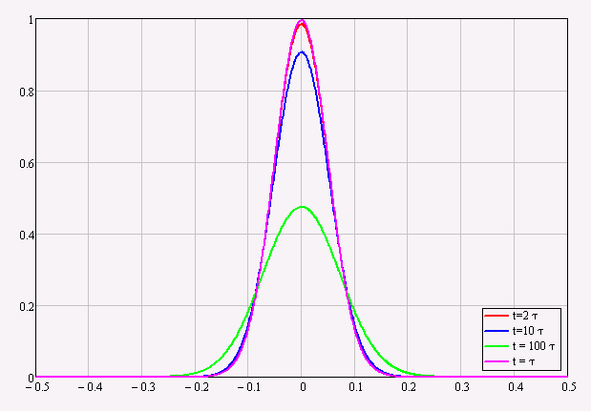
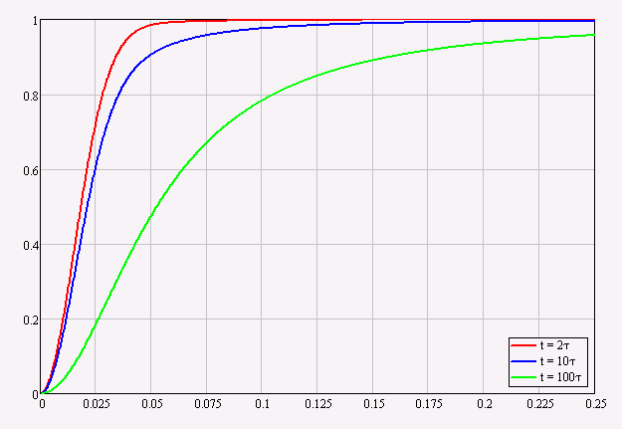
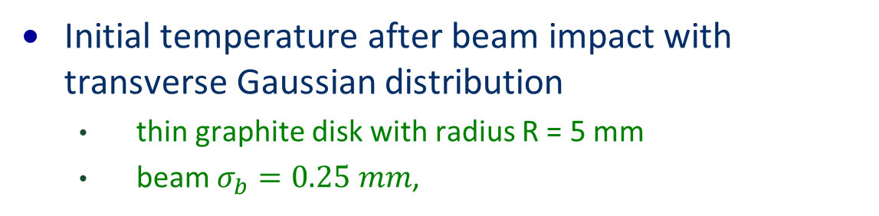
Heating of a disk by Gaussian beam profile
Initial temperature after beam impact with transverse Gaussian distribution
  thin graphite disk with radius R = 5 mm
  beam $σ_{b}=0.25 mm$,
R
σ_{b}
Temperature distribution at various instants for σ_{b} = 0.25 mm
Temperature at disk center as a function of σ_{b}/R

Slide 24
Generalisation
Beam impact on a (thin) window
  => can be a much more complex structure
Transverse round Gaussian distribution of particles
  => beams can have different profile
Energy deposition in a thin window is calculated by Bethe-Bloch equation
  => in general, energy deposition is calculated done with codes such as FLUKA, MARS, GEANT4, …
Heating is calculated by knowing the specific heat of the window material
  => specific heat is in general temperature dependent
In general, energy deposition is calculated using a particle shower code, heating is calculated using ANSYS or similar codes

Slide 25
Static deformation of equipment

Slide 26

Mechanical deformation by applying a force
Cylinder restrained at left side
$$δ$$
Force F applied

Slide 27


Thermal deformation by heating
Cylinder restrained at left side
$$δ$$
Temperature increase dT

Slide 28
Thermal deformation and force
Cylinder restrained at left side
$$δ$$
Force F
Temperature increase dT

Slide 29
Mechanical deformations
To illustrate the principle, a long cylinder is considered (stress only in one direction)
It is possible to generalise these equations using the stress and strain tensors (beyond the scope of this lecture – see Alessandro Bertarelli)
Elastic deformation: stress deforms the object, after releasing the stress the object comes back to the same shape
Plastic deformation: the object shape is permanently modified

Slide 30
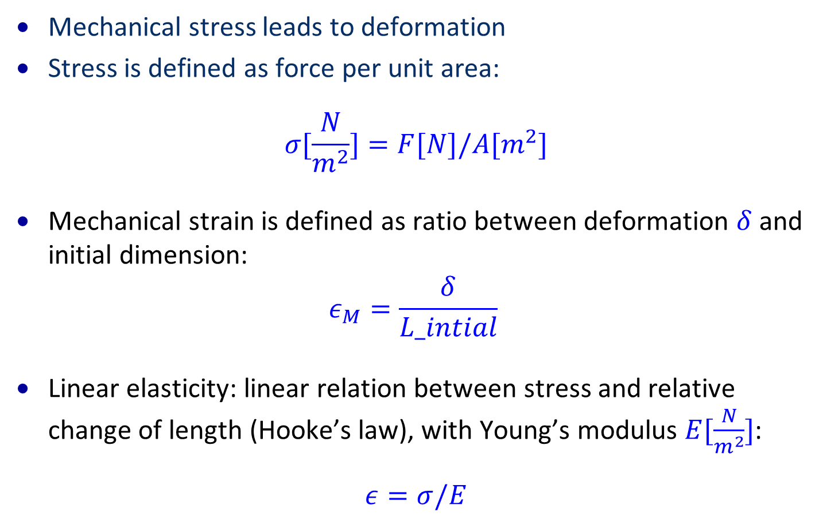
Mechanical deformations
Mechanical stress leads to deformation
Stress is defined as force per unit area:
$$σ[\frac{N}{m^{2}}]=F[N]/A[m^{2}]$$
Mechanical strain is defined as ratio between deformation $δ$and initial dimension:
$$ε_{M}=\frac{δ}{L_intial}$$
Linear elasticity: linear relation between stress and relative change of length (Hooke’s law), with Young’s modulus $E[\frac{N}{m^{2}}]$:
$$ε=σ/E$$

Slide 31
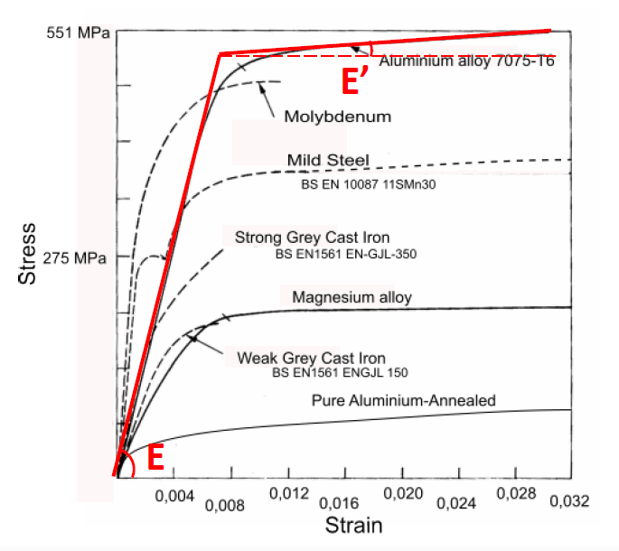
Typical stress–strain curve of some materials
Elastic deformation: stress deforms the object, after releasing the stress the object comes back to the same shape
Plastic deformation: the object shape is permanently modified

Slide 32
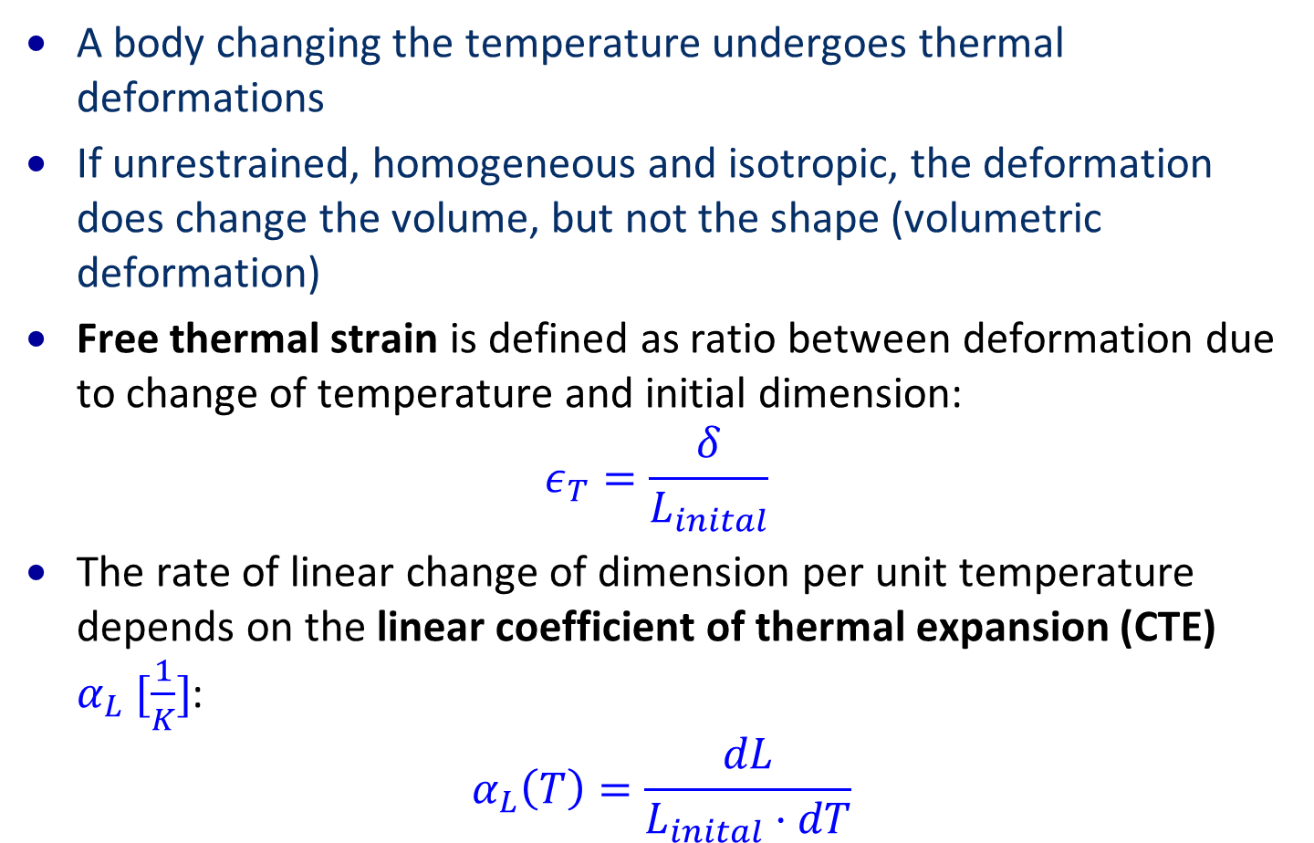
Thermal deformations
A body changing the temperature undergoes thermal deformations
If unrestrained, homogeneous and isotropic, the deformation does change the volume, but not the shape (volumetric deformation)
Free thermal strain is defined as ratio between deformation due to change of temperature and initial dimension:
$$ε_{T}=\frac{δ}{L_{inital}}$$
The rate of linear change of dimension per unit temperature depends on the linear coefficient of thermal expansion (CTE) $α_{L} [\frac{1}{K}]$:
$$α_{L}\left(T\right)=\frac{dL}{L_{inital}⋅dT}$$

Slide 33
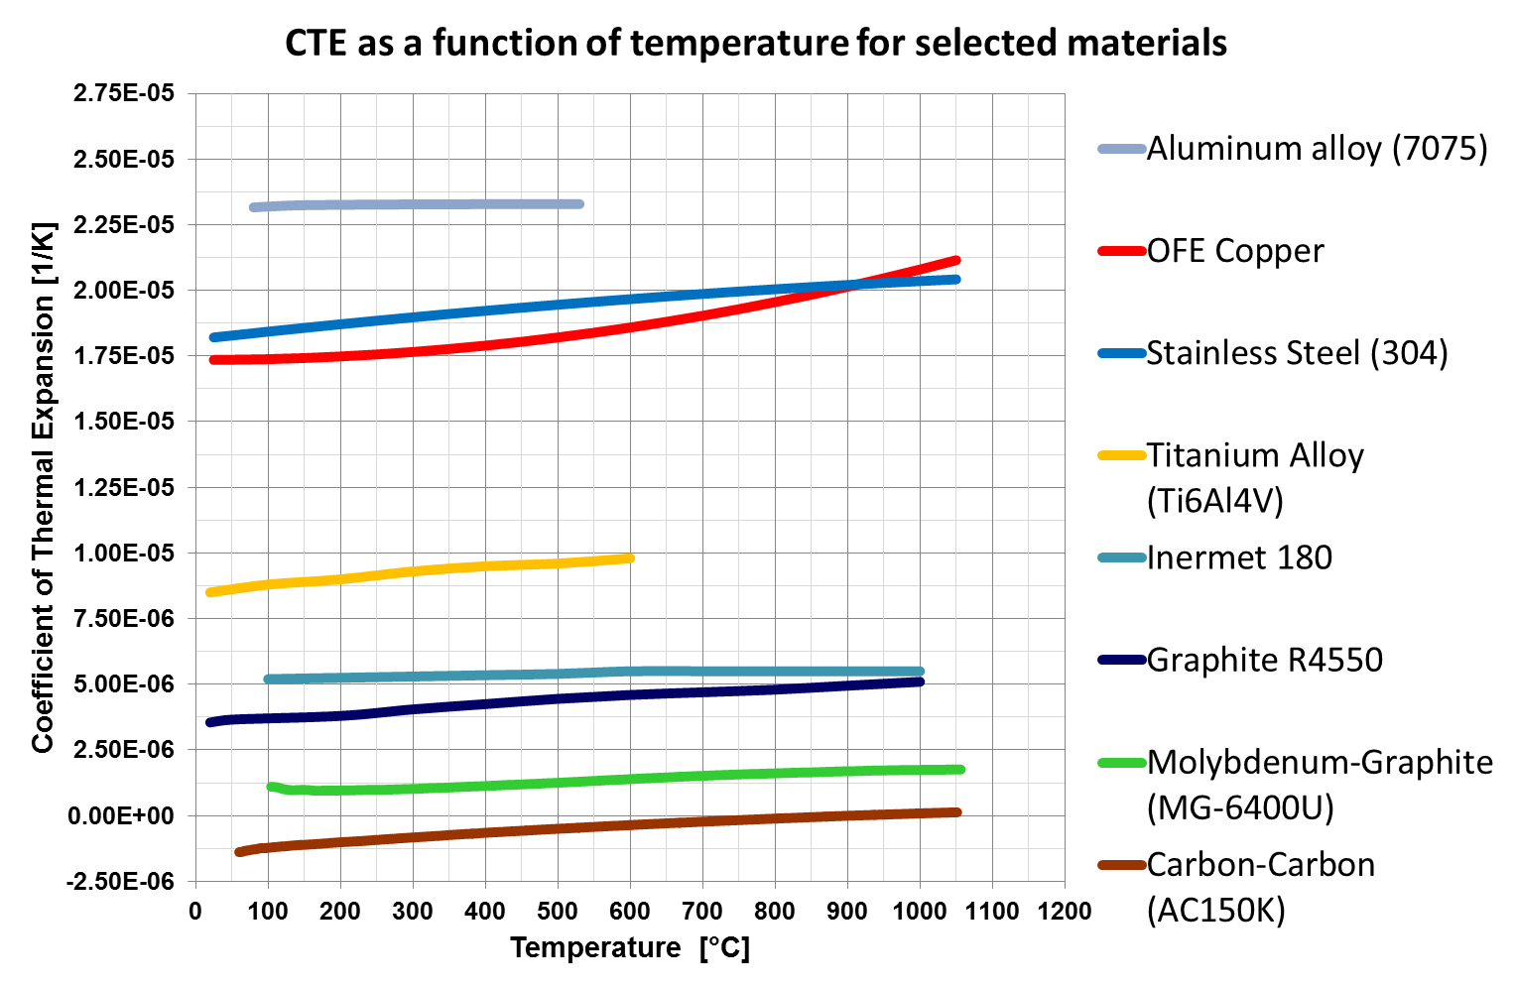
Coefficients of thermal expansion

Slide 34

Thermal and mechanical deformations
The total strain due to thermal and mechanical stresses is given by the sum:
$$ε=\frac{1}{E}⋅σ+ α⋅T$$
The quasi-static total stress is: $σ=E⋅(ε−α⋅T)$

Slide 36
Stress inside cylinder and disk
Heating of inner cylinder
Leads to radial and circumferential (hoop) stresses

Slide 37
Stress inside cylinder and disk
Bunches impacting on a cylinder
Heating of the cylinder after beam impact
Leads to radial and circumferential (hoop) stresses

Slide 38
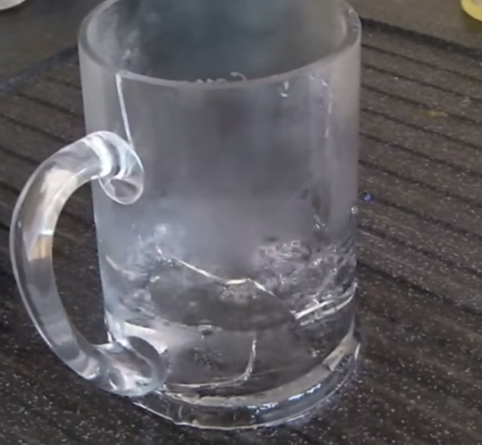
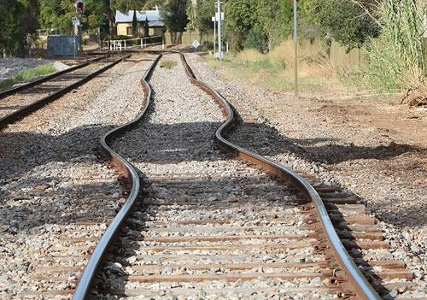
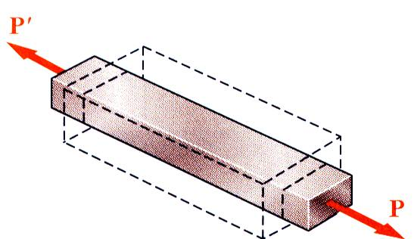
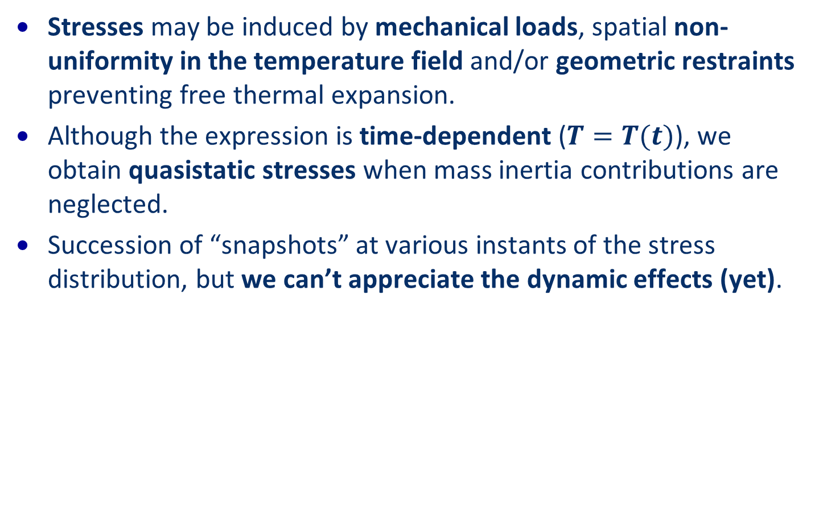
Stresses…
Stresses may be induced by mechanical loads, spatial non-uniformity in the temperature field and/or geometric restraints preventing free thermal expansion.
Although the expression is time-dependent ($T=T(t)$), we obtain quasistatic stresses when mass inertia contributions are neglected.
Succession of “snapshots” at various instants of the stress distribution, but we can’t appreciate the dynamic effects (yet).

Slide 39
Accelerators and mechanical deformations
Accelerator components: usually designed to work in the elastic domain
  Elastic deformation: stress deforms the object, after releasing the stress the object comes back to the same shape
  Plastic deformation: the object shape is permanently modified
In case of highly energetic beam impact, the dynamic response of the structure can largely exceed this regime
  high pressures
  changes of material density
  phase transitions (e.g. melting, sublimation, evaporation)
  intense stress waves
  material fragmentation
  explosions

Slide 40
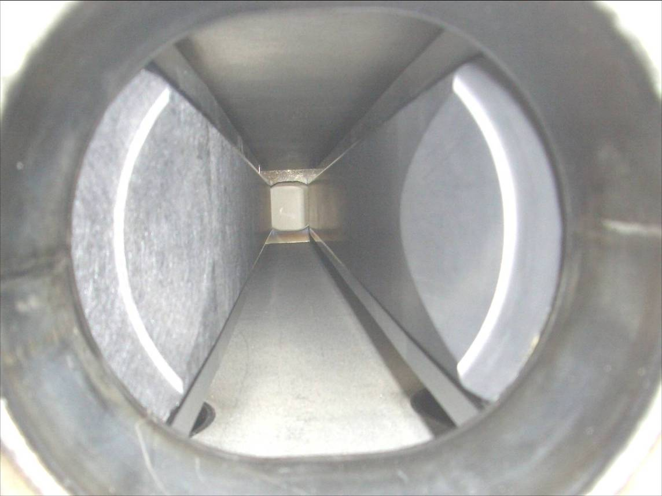
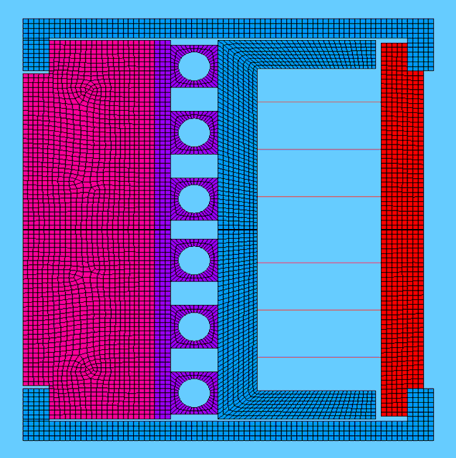
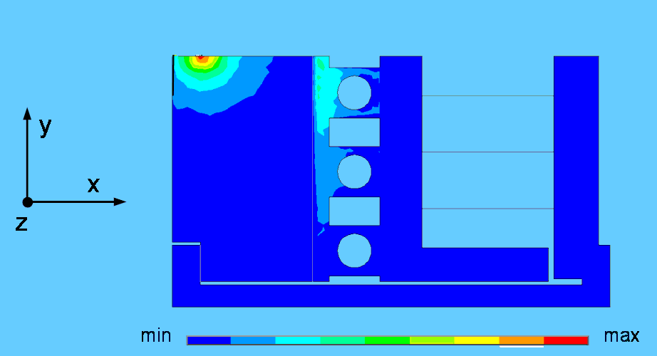
3D Thermo-Mechanical Elastic-Plastic analysis
Robustness test of LHC Collimator in 2004 with 288 x 1.15x10¹¹ p bunches at 450 GeV at the SPS
3D Thermo-Mechanical Elastic-Plastic Analysis of a LHC collimator
Post-mortem analysis confirmed survival of both blocks.
Measurements showed permanent deformation by 400 µm of metal support
The temperature increase of the graphite blocks was only about 70°C
Carbon/ carbon jaw
Carbon/ carbon jaw
5 mm
Graphite jaw
Graphite jaw

Slide 41
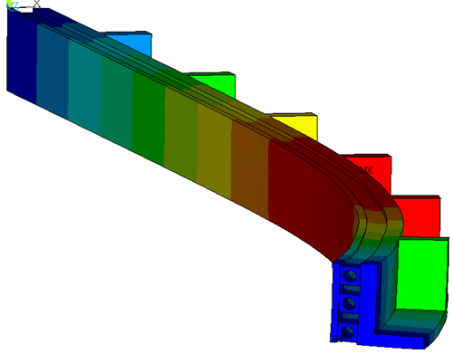
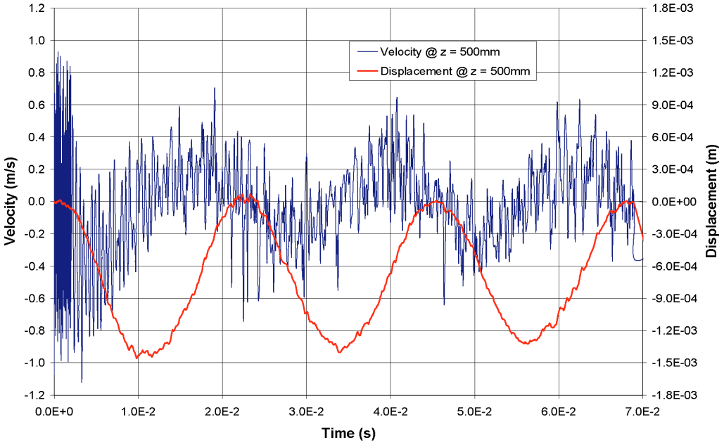
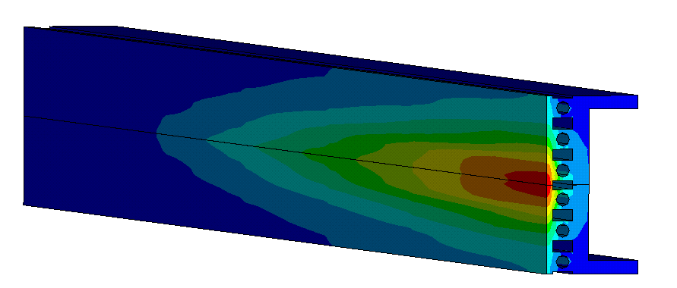

3D Thermo-Mechanical Elastic-Plastic analysis
A moderate T increase (~70°C) on OFE-Cu back-plate was initially ignored
A simple analytical check anticipated what simulation with ANSYS confirmed: In plane stresses of 210 MPa, too large for copper (max. 50-70 MPa)
The design was upgrade from OFE-Copper to Glidcop, and the deformation was reduced from 400 µs to 16 µm
$$δmax ≅350 μm$$
Area of residual plastic strains

Slide 42
Dynamic deformation of equipment

Slide 43
Dynamic stresses
Very slow heating the inner cylinder: the temperature of both cylinders will slowly increase (by heat conduction): no internal stresses
Heating the inner cylinder fast (but not ultra-fast): the temperature of the inner cylinder will increase, the outer cylinder will experience stresses
Heating the inner cylinder ultra-fast (instantly with respect to thermal timescales): the temperature of the inner cylinder will increase instantly
dT

Slide 44
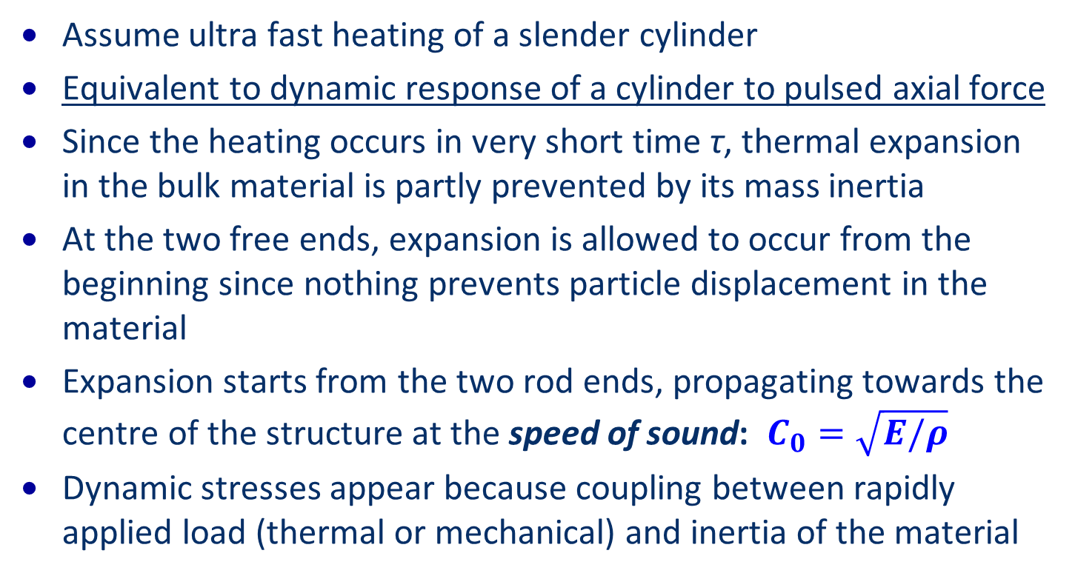
Dynamic stresses
Assume ultra fast heating of a slender cylinder
Equivalent to dynamic response of a cylinder to pulsed axial force
Since the heating occurs in very short time τ, thermal expansion in the bulk material is partly prevented by its mass inertia
At the two free ends, expansion is allowed to occur from the beginning since nothing prevents particle displacement in the material
Expansion starts from the two rod ends, propagating towards the centre of the structure at the speed of sound: $C_{0}=\sqrt{E/ρ}$
Dynamic stresses appear because coupling between rapidly applied load (thermal or mechanical) and inertia of the material
F(t) with rise time τ applied at its ends

Slide 45
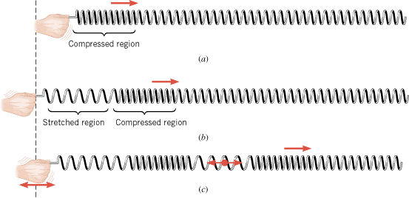
Dynamic stresses - spring
Two elastic stress waves are generated; this is equivalent to an axial spring that is rapidly moved outwards at its end
Since these are expansion waves, dynamic tensile stresses propagate and are superposed on the compressive axial stresses, which are due to the initially ‘clamped’ state
Practically impossible to study with analytics methods
Computer codes are required to assess the material response

Slide 46
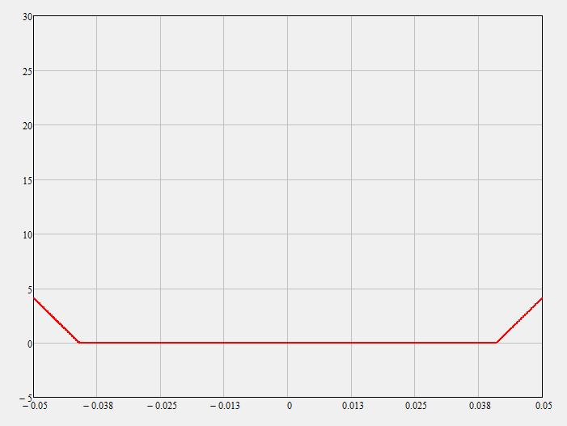
Axial stress along thin rod
Axial stress
t = 0.5 τ
Position

Slide 47
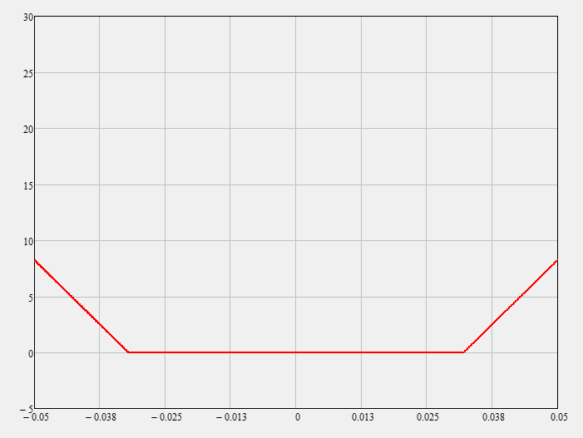
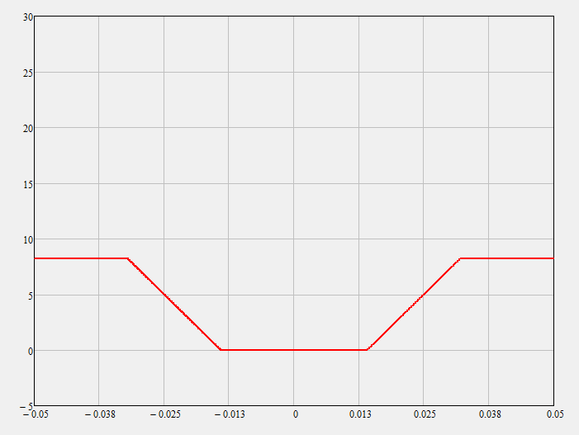
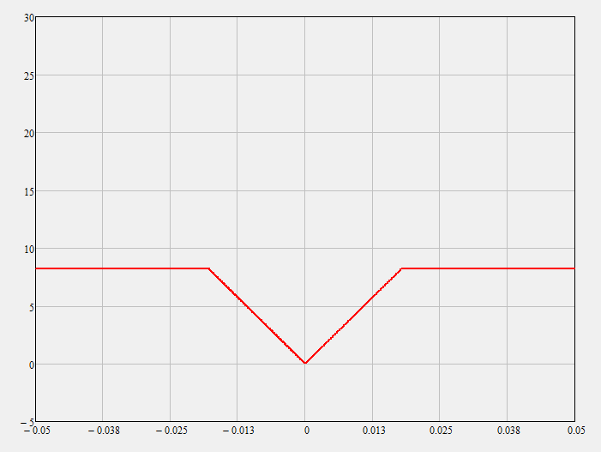
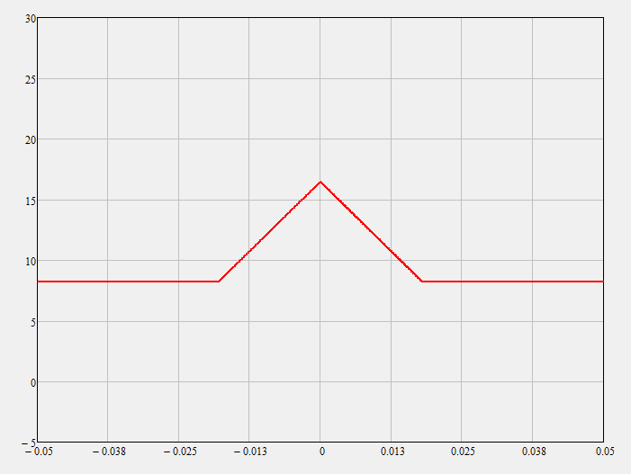
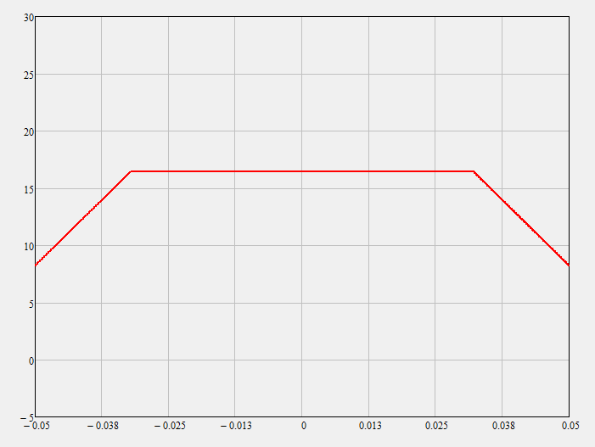
Axial stress along thin rod as function of time
At the beginning, a tensile stress wave starts travelling at the speed of sound 𝒄_𝟎 from both ends while force 𝑭(𝒕) linearly builds up. At 𝒕=𝝉, 𝑭(𝒕) stops growing and so does stress. The axial stress wave reaches the rod center after one quarter of the wave period given by 𝒕_𝑴=𝟐𝑳/𝒄
t = 0.5 τ
t = τ
t = 2τ
t = t_{M}/4
t = t_{M}/4 + τ
t = t_{M}/2

Slide 48
Simulation codes
Energy deposition codes
FLUKA, Geant4 and MARS
Structural mechanical engineering
ANSYS
Hydro-codes are highly nonlinear wave propagation tools, initially developed for high speed mechanical impacts where solids could be approximated by a fluid-like behaviour
LS-Dyna, Autodyn, BIG2
Simulations can be performed using different meshing methods

Slide 49
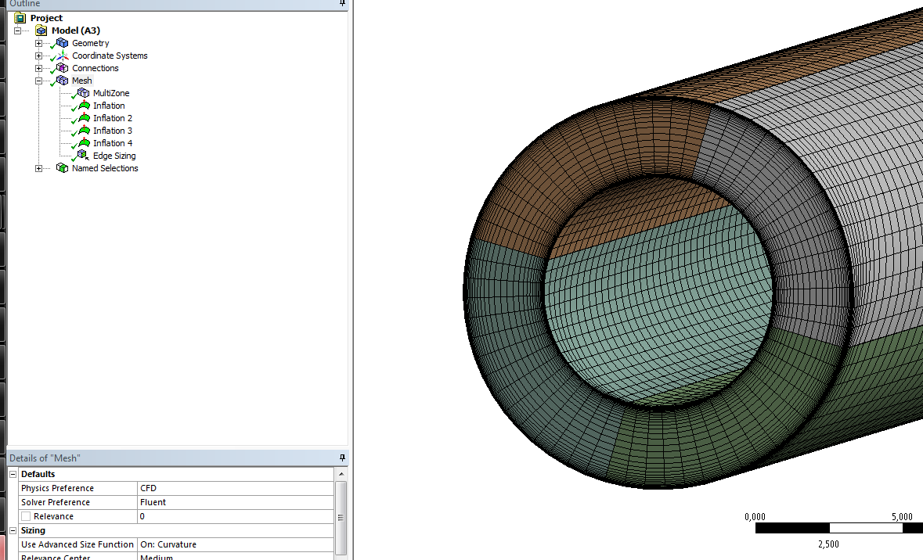
Example mesh for cylinder
A mesh is a discretization of a domain existing in one, two or three dimensions.
Typical uses are for physical simulation such as finite element analysis, computational fluid dynamics and radiation calculations.
Three-dimensional meshes created for finite element analysis can consist of tetrahedra, pyramids, prisms, hexahedra and arbitrary polyhedra.
Those used for finite difference methods usually need to consist of piecewise structured arrays of hexahedra known as multi-block structured meshes.

Slide 50



Principe of numerical codes
Lagrangian mesh: moves and distorts with the material as a result of forces from neighbouring elements.
  The most efficient solution for structures.
  Very slow when an element incurs in large deformations.
Eulerian mesh: fixed mesh, allowing materials to flow from one element to the next.
  Very well suited for problems involving extreme material movement (fluids, gases).
  Computationally intensive and requiring higher element resolution.
SPH (smooth particle hydrodynamic with lattice of discrete elements): mesh-free method suited for certain types of problems with extensive material damage and separation.
  For crack propagation inside a body and the motion of expelled fragments/liquid droplets.
Standard FEM codes and Hydrocodes
Hydrocodes and CFD
Hydrocodes

Slide 51
Dynamic deformation of equipment – shock waves and hydrodynamic tunnelling

Slide 52
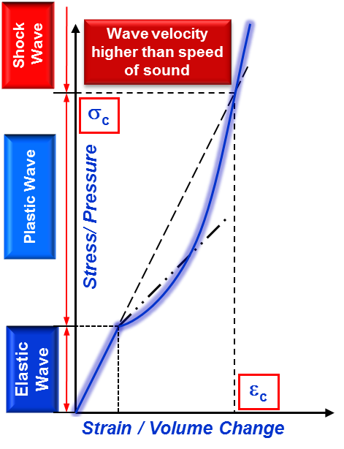
From classical structure dynamics to hydro-codes
When the impact induces large density and phase changes, classical Structure Dynamics approach (analytical or numerical) is no longer viable
In these regimes, materials tend to behave like fluids => Hydrodynamic approach => Hydro-codes
Complex material Constitutive Models are required, i.e. Equations of State, Strength Model and Failure Model

Slide 53
















Criteria for shock waves
$${10}^{6}$$
$${10}^{4}$$
$${10}^{2}$$
$${10}^{0}$$
$${10}^{−2}$$
$${10}^{−4}$$
$${10}^{−6}$$
$${10}^{−8}$$
Characteristic time [s]
$${10}^{−8}$$
$${10}^{−6}$$
$${10}^{−4}$$
$${10}^{−2}$$
$${10}^{0}$$
$${10}^{2}$$
$${10}^{4}$$
$${10}^{6}$$
Strain rate [1/s]
Creep | Quasi-static | Intermediate strain-rate | Bar impact | High velocity plate impact
Constant load | Hydraulic or screw machines | Pneumatic or mechanical machines | Mechanical or explosive impact | Light gas-gun of explosively driven plate impact
 |  | Mechanical resonances | Elastic-Plastic wave propagation | Shock wave propagation
Inertial forces neglected |  | Inertia forces important
Isothermal |  | Adiabatic
Increasing stress level
U.S. Lindholm, Techniques of Metal Research

Slide 54
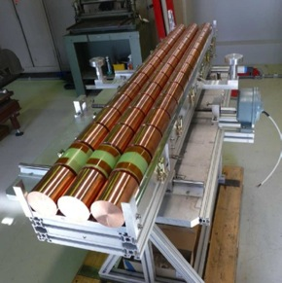
Experiment for damage characterisation
  Damage experiments at LHC not possible → High Radiation to Materials facility at the SPS (450 GeV proton synchrotron).
Demonstrate damage of SPS beam impacting on target.
Getting confidence in hydrodynamic tunneling simulations.
Target | Copper (3x15 cylinder), 1 cm gap
Cylinder size | Length 10 cm, radius 4 cm
Bunch intensity | 1.5E11 p @ 440 GeV/c
Bunch spacing | 50 ns
Target 3
144b
σ = 0.2mm
Target 2
108b
σ = 0.2mm
Target 1
144b
σ = 2mm
F. Burkart, J. Blanco

Slide 55
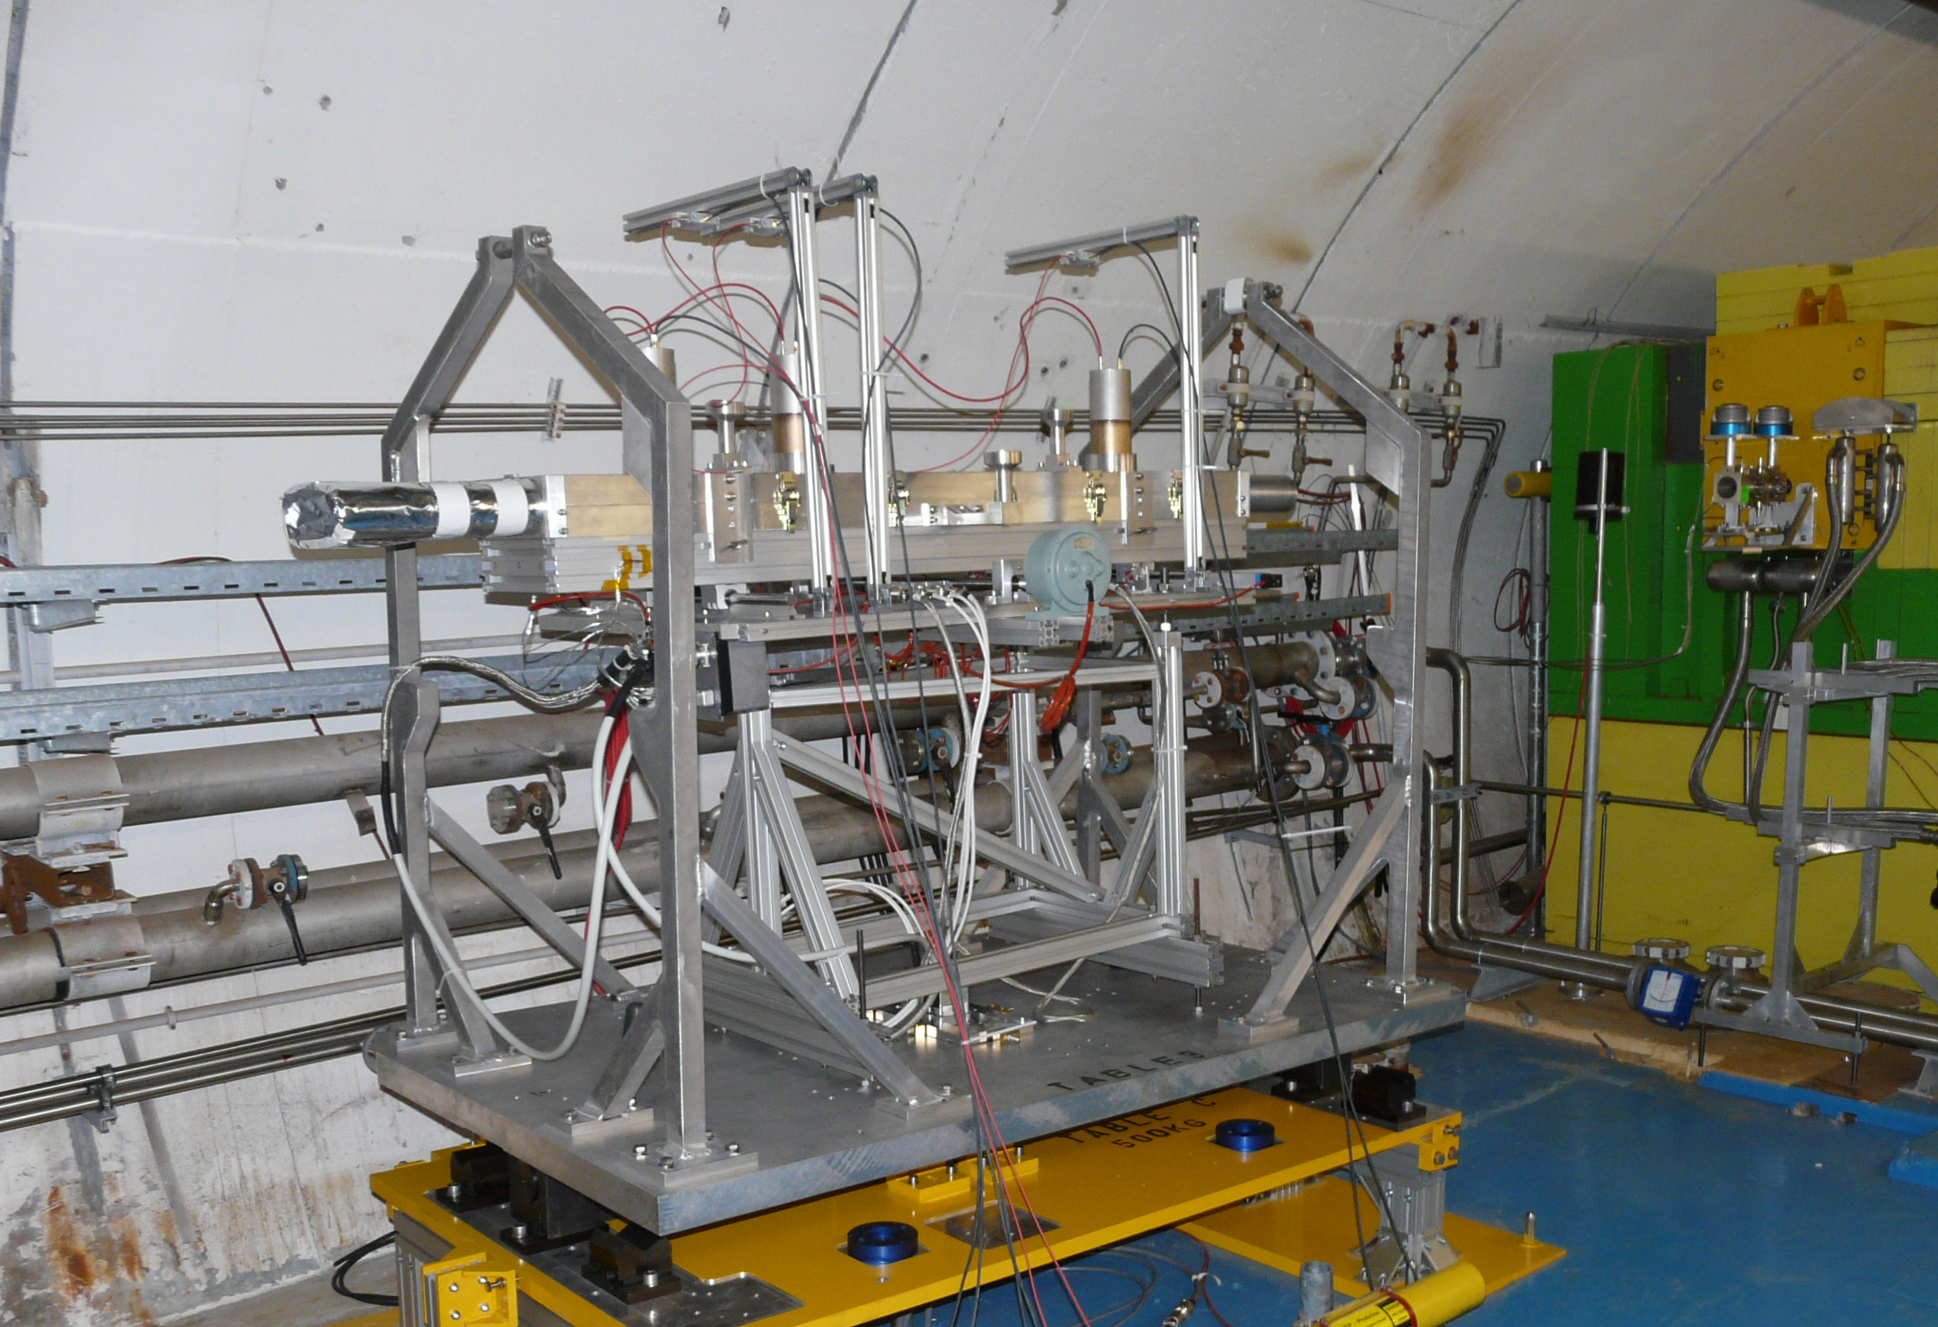
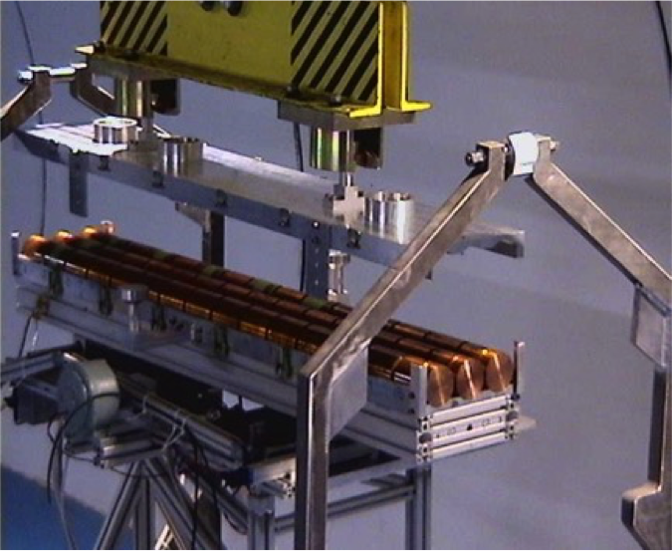

HiRadMat Experiment
Courtesy: D.Deboy

Slide 56
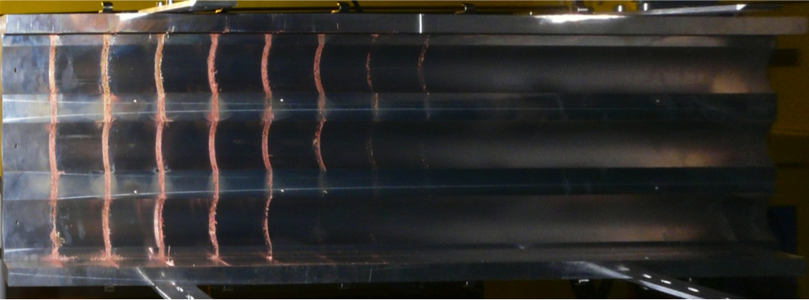
144b, σ = 0.2 mm
1
2
3
4
5
6
7
8
9
80 < penetration depth < 90 cm
7
8
108b, σ = 0.2 mm
70 < penetration depth < 80 cm
144b, σ = 2 mm
5
6
50 < penetration depth < 60 cm
10 cm
beam
F. Burkart, J. Blanco

Slide 57
Simulations of hydrodynamic tunneling
Alternating simulation with FLUKA and BIG2 (N. Tahir, GSI)
    Energy deposition of 440 GeV protons in the target is calculated using FLUKA.
    Energy deposition data is used as input to a two–dimensional hydrodynamic code BIG2, to study the thermodynamic and the hydrodynamic response of the target due to the beam impact.
    Density distribution from BIG2 used as input for next FLUKA iteration.
runs until the density
changed by 15%
FLUKA
Simulation of E_{dep}
E_{dep} map
BIG2
Density change
density map
Notes:
ICH

Slide 58
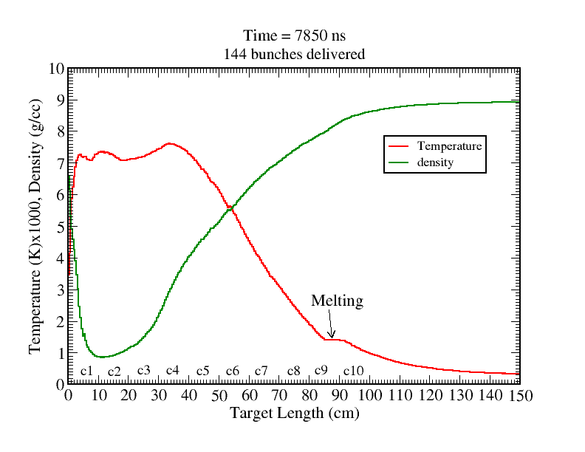
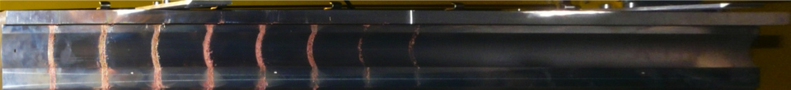
Comparison experimental results / simulations
Third target, after 144 bunches, 7850 ns
T_{max} : 7500 K
Gaseous copper
T_{melt} : 1357 K
Density_{min} : 0.9 g/cc
1
2
3
4
5
6
7
8
9
80 < Hole < 90 cm
F. Burkart, J. Blanco, N. Tahir
144b, σ = 0.2 mm
Notes:
Nur Target 3 – tunneling max
Cu melt : 1360K – boil: 2650K

Slide 59
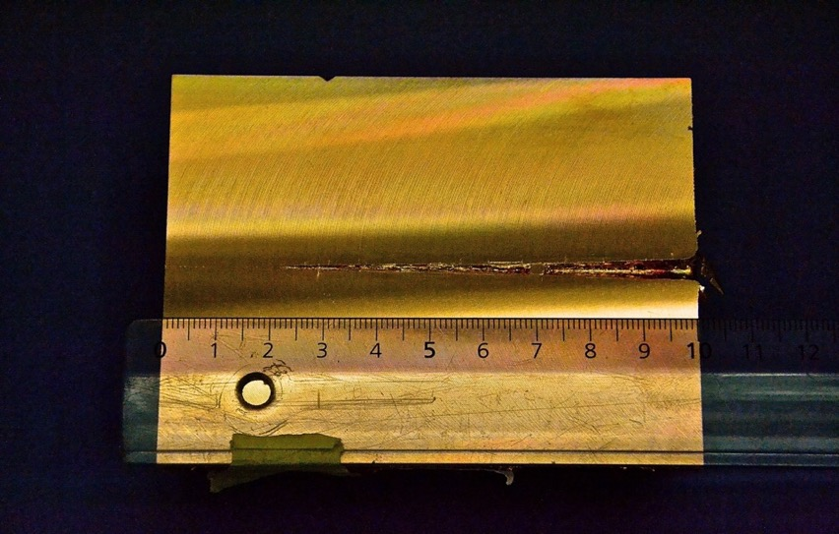
Longitudinal cut – surface picture Target 3, Cylinder 1
F. Burkart, V. Raginel
Notes:
Bild von der Oberfläche , qualitativer vergleich.

Slide 60
Material for beam intercepting devices
(collimators, beam absorbers)

Slide 61
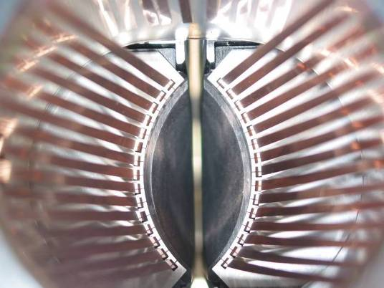
RF contacts for guiding image currents
View of a two sided collimator
about 100 collimators are installed in LHC
2 mm
Beam spot
length about 120 cm
Ralph Assmann, CERN

Slide 62
What material for beam intercepting devices?
The choice of a particular material for a collimators is driven by the material performance under different points of view
Thermomechanical robustness
  Ability of material to withstand impact of short beam pulse
  Melting temperature gives an indication – this is related to the radiation length and material density
Thermal stability
  Under steady-state or slowly transient heat deposition, ability of the material to maintain geometrical stability of the component.
Electrical conductivity
  Components close to the beam must minimize their contributions to RF impedance: highest electrical conductivity for materials close to circulating beams!
Radiation hardness
  To maintain properties with radiation dose

Slide 63
What material for beam intercepting devices?
Maximize Electrical Conductivity to limit RF Impedance
Maximize Thermal Conductivity to maintain geometrical stability under steady-state losses
Minimize Coefficient of Thermal Expansion (CTE) to increase resistance to thermal shock and maintain geometrical stability
Maximize Melting/Degradation Temperature to withstand high temperatures reached in case of beam impacts
Maximize Specific Heat to lower temperature increase during impacts
Maximize Mechanical Strength (particularly strain to failure) to improve thermal shock resistance
Balance Density and Atomic Number to limit peak energy deposition while maintaining adequate interaction efficiency
Minimize Radiation-Induced Damage to improve component lifetime under long term particle irradiation

Slide 64
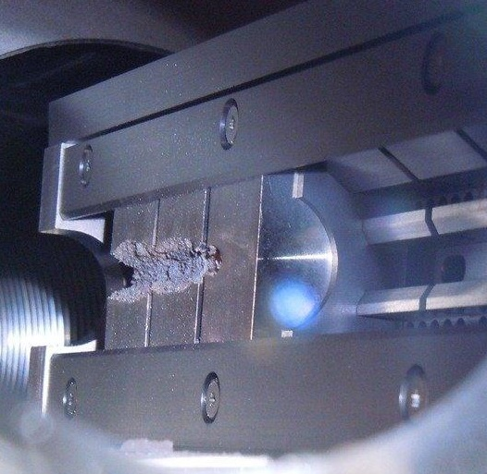
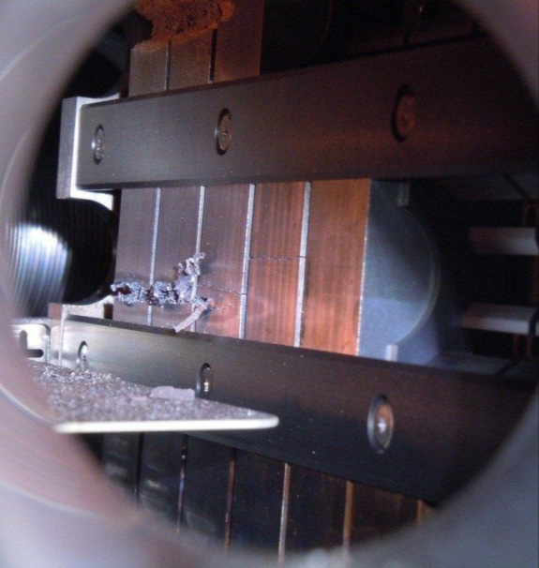
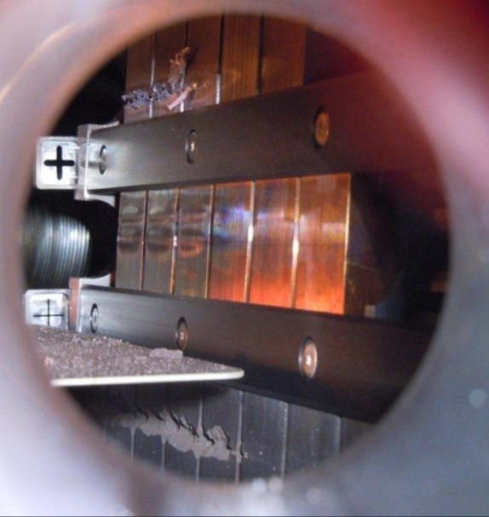
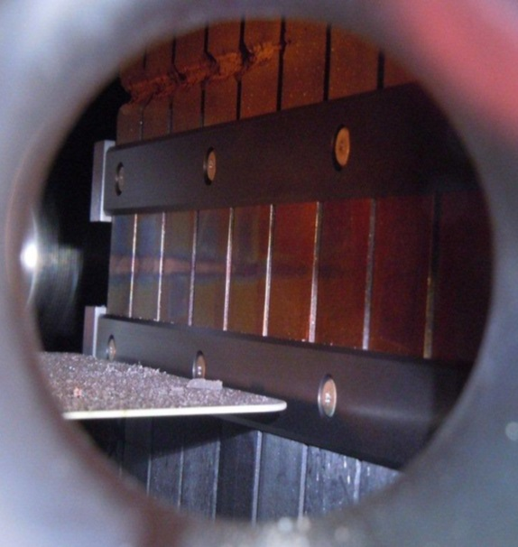
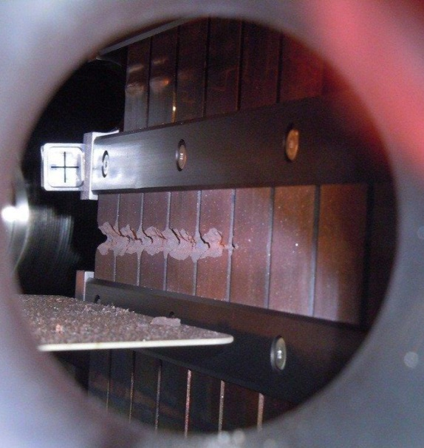
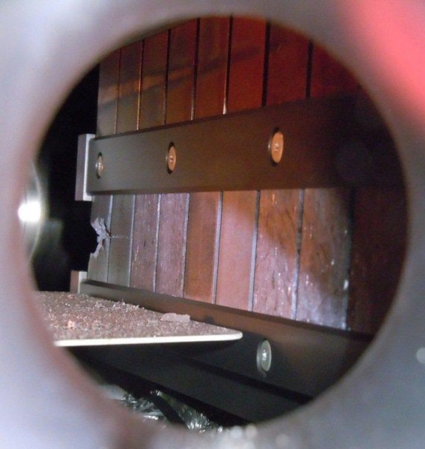
Test of different materials at HiRadMat
    Tungsten Alloy, 72 b
  Molybdenum, 72 & 144 b
  Glidcop, 72 b (2 x)
  Copper-Diamond
  144 b
  Molybdenum-Copper-Diamond 144 b
  Molybdenum-Graphite (3 grades)
  144 b

Slide 65


Collimator test at HiRadMat
Goal: induce severe damage on the collimator (~3 equivalent LHC bunches)
Impressive quantity of tungsten alloy ejected
(partly bonded to the opposite jaw, partly fallen on tank bottom or towards entrance and exit flanges)
Vacuum degraded. Tank contaminated
Groove height ~ 1 cm (consistent with numerical simulations)
Groove height
~ 1 cm
Ejected W fragments
72 bunches 440 GeV
~12 mm
A. Bertarelli

Slide 66
Risk when damaging equipment
Opening of the beam pipe - loss of ultrahigh vacuum
Damage of a normal conducting or superconducting magnet
Collimator scratches at HERA – not a problem
Collimator deformation, can be a problem
Creating dust or particulates – in particular a problem for cavities
Sensitive equipment such as detectors: very little beam loss can lead to damage

Slide 67
Final comments
High energy particle beams have extremely high destructive potential in case of interaction with matter (several 100 MJ can be released in < ms)
The analysis of beam-matter interaction involves several disciplines and requires a multi-physics approach
When interaction phenomena do not lead to extensive changes of density or phase transitions, material response can be analysed with a good degree of approximation by thermo-elasticity principles
Otherwise, advanced nonlinear tools (hydro-codes) must be used
Some criteria can help in the material selection process in the early design phase of systems exposed to beam interaction
No material fits all requirements!
Dedicated, carefully designed experiments can benchmark advanced numerical simulations and provide the final validation for systems
The power of particle beams are not only a threat, but also used for physics studies (HED) and machining in industry

