Slide 1
USPAS Project Discussion
Tom Peterson and John Weisend
January 2017

Slide 2
USPAS Project Statement
A new proton linear accelerator (The Buckytron) is being built to provide high energy protons to a target that produces neutrons via the spallation process. The bulk of the accelerator consists of Niobium superconducting RF cavities operating in saturated helium baths at 1.8 K.
  Six cavities are contained within one cryomodule.
  A total of 40 cryomodules are required.
  In addition to the cavities, each cryomodule also contains a 40 K thermal radiation shield.
  Each cavity has a coaxial coupler to bring the RF energy into the cavity.
  Each coupler has a 20 W load at 40 K and a 1 W load at 1.8 K.

Slide 3
Buckytron description – pg 2
  Each cryomodule is 8 m in length and 0.75 m in diameter.
  Between each cryomodule is a 3 m long warm ( 300 K) section that contains magnets and beam instrumentation.
  When operating, the RF energy deposits 7 W into the 1.8 K space per cryomodule.
  The total deposited by the proton beam into the 1.8 K space is 10 W.
  The linac is contained in a 10 m diameter tunnel located 20 m below the surface.

Slide 4
Project goal
Based on this information, design the cryogenics system for the accelerator. The cryogenic system includes: The cryomodule, the refrigeration plant or plants and the distribution system if needed to tie the refrigeration plant(s) to the cryomodules as needed. Include in this design:
  A list of information you will need from other groups in the accelerator project
  Definition of requirements for both the cryomodule and the cryogenics system

Slide 5
Conceptual design elements
A conceptual design for the cryogenics system should include:
  A conceptual design of the cryomodule including an estimated heat leak
  A high level Piping & Instrumentation Diagram (P&ID) for the cryogenics system
  A conceptual design for any distribution system including pipe sizes, estimated heat leaks, pressure drops and required valves
  Number and size of cryogenic refrigeration plants. These do not have to be designed but will be procured from a commercial vendor

Slide 6
Conceptual design elements – pg2
  Build safety into the conceptual design; include relief valves as needed Consider impact of venting on oxygen deficiency hazards
  Assume that all subsystems associated with the superconducting RF system including the cavity design itself, power supplies, control, and power coupler design are provided by other groups.

Slide 7
Bonus topics
Discuss how the system will handle possible operating modes including cool down and warm up
Consider standby ( cold but no beam or RF energy present), lower heat loads and flow rates
Describe any prototyping or testing you feel would be required
Describe design alternatives considered

Slide 8
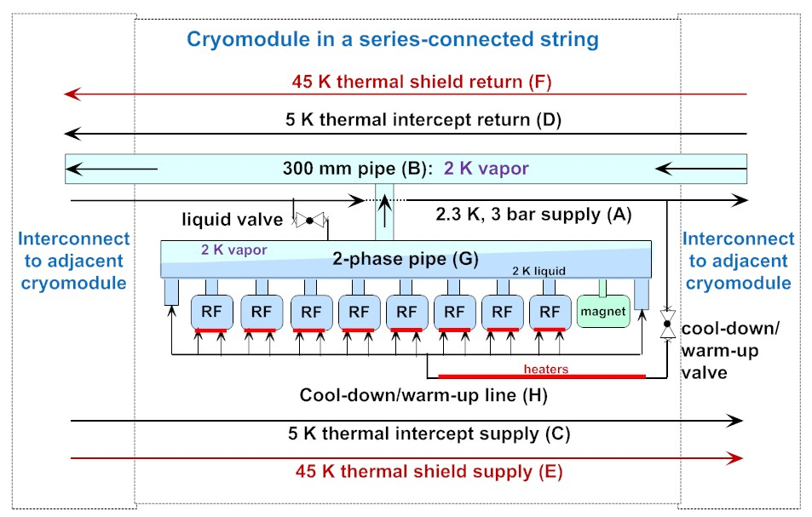
Options, examples

Slide 9
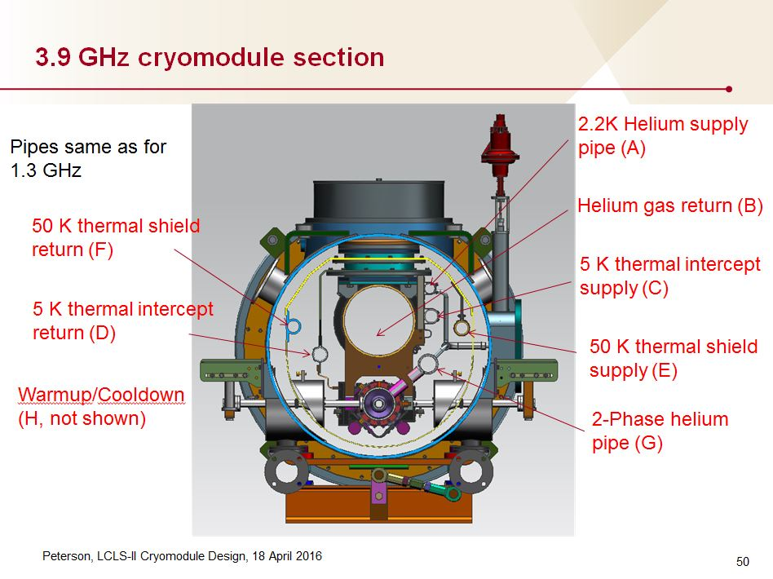

Slide 10
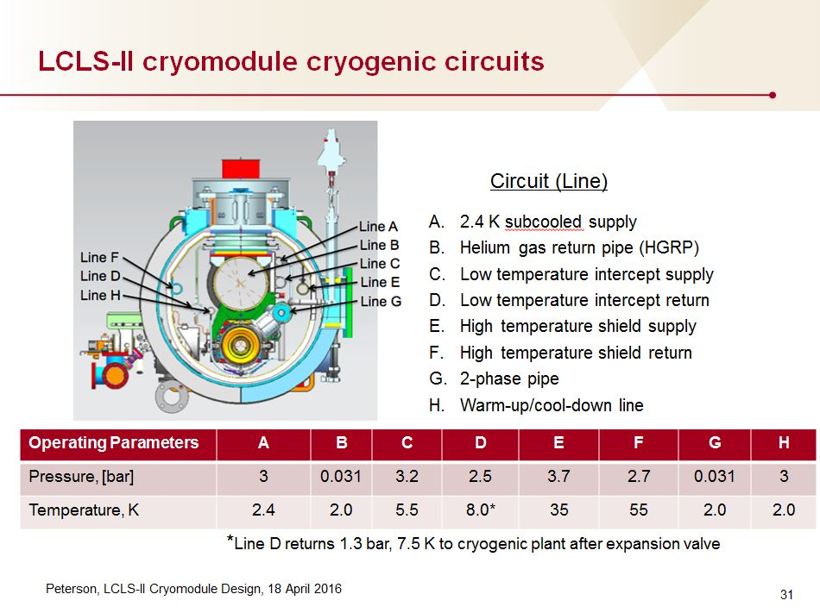

Slide 11
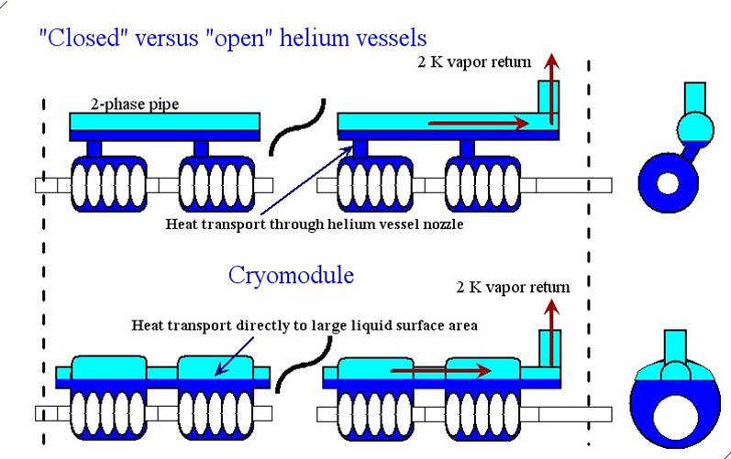
Helium vessel styles

Slide 12
ESS distribution system

Slide 13
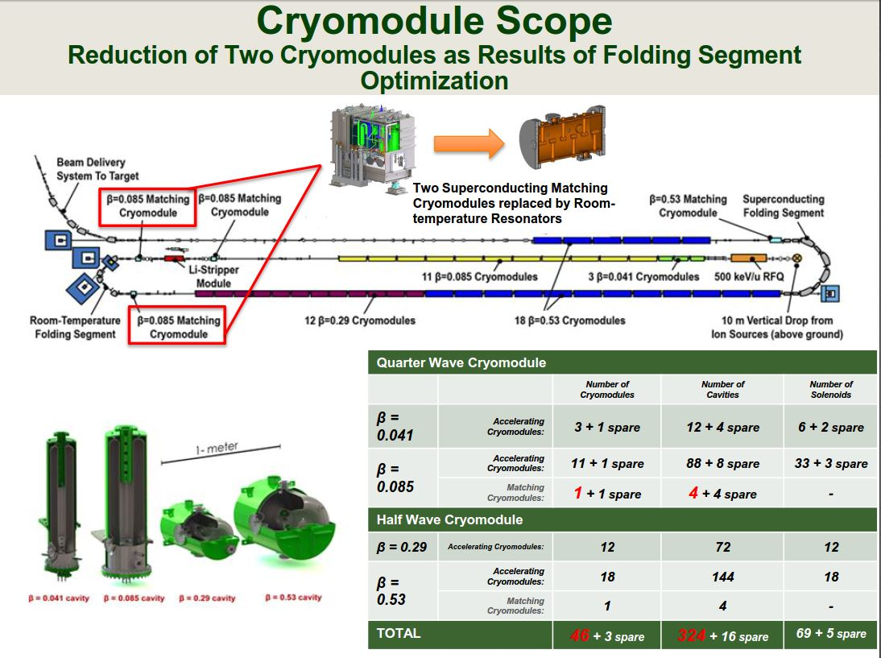
FRIB linac folded layout

Slide 14
Thermal shield example
Assuming a thermal shield with 18 bar helium in and some lower pressure out due to pressure drop, like 16 bar. (Higher pressure gives higher density for less pressure drop and smaller pipes.) However, you may choose otherwise!
  Estimate heat load to 40 K per cryomodule (e.g, 100 W)
  Given a temperature range for helium gas (say for example 40 K to 60 K) determine how much heat is absorbed per gram of helium for each cryomodule
    In this example it would be 106.5 J/g. (It is nearly an ideal gas with Cp = 5.2 J/gK, which you may assume. 20 K x 5.2 J/gK = 106.5 J/g)
  Divide total heat for the cryomodule in W by amount absorbed in J/g to get g/sec flow
    In this example: 100 W / 106.5 J/g = 0.94 g/sec per cryomodule

Slide 15
For example power and flow
See ILCcryoTDP-26June2012.xlsx
Check the tabs “TDS power”
  Input assumptions are pressure and temperature desired for supply and return
  From that we have enthalpy and entropy change
  And then from the heat load we find mass flow rate
  Those provide input for Ideal Power

Slide 16

Evaluating cooling power

Slide 17
Liquefier work
From previous slide and data for 80 K flow returning at 300 K
  915 J/g ideal work is 915 W per gr/sec which at 25% relative to Carnot is 3660 room T Watts per gram/sec
  3660 room T power is equiv to 3660/250 = 15 W at 4.5 K
So each gr/sec taken from 80 K and returned at 300 K is equivalent to 15 W at 4.5 K in terms of room temperature cryogenic plant work
For 4.5 K flow returning at 300 K a similar analysis shows
  6420 J/g ideal work which is 6420 W per gr/sec which at 25%
  relative to Carnot is 25700 room T Watts per gram/sec
  Note that 100 W at 4.5 K x 257 W/W would be 25700 W
  So 4.5 K liquefaction of 1 gr/sec is ~ equiv to 100 W at 4.5 K

