Slide 1
Homework Problem #4
For a helium expander with the following conditions:
  18 bar inlet pressure, 2.0 bar exit pressure, efficiency = 70%
At approximately what inlet temperature would the exhaust become 2-phase?
2 bar exhaust saturated vapor, approx.
  T = 5.025 K. h= 27.5 J/g. s = 6.952 J/gK.
h(18 bar, s=6.952) = 50.2 J/g (about 10.7 K)
delta-h ideal = 50.2 – 27.5 = 22.7 J/g.
70% efficiency implies real delta-h = 0.70 x 22.7 = 15.9 J/g
Real delta-h inlet = 27.5 + 15.9 = 43.4 J/g
Real T in = T(18 bar, 43.4 J/g) = 9.75 K

Slide 2
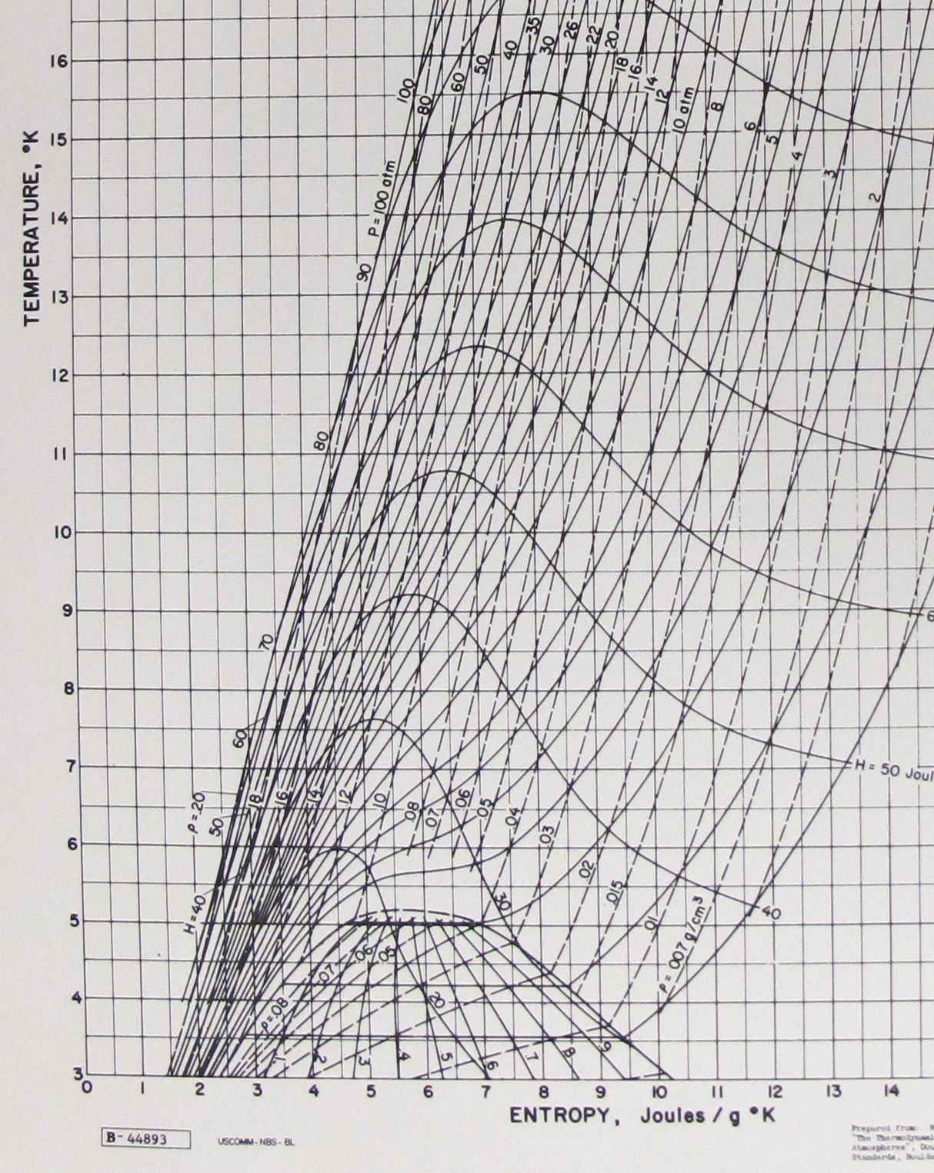
Isentropic
Real
Isenthalpic

Slide 3
Expansion Engine – “Square Wave” Expansion Discussion
Tom Peterson
January 2017

Slide 4
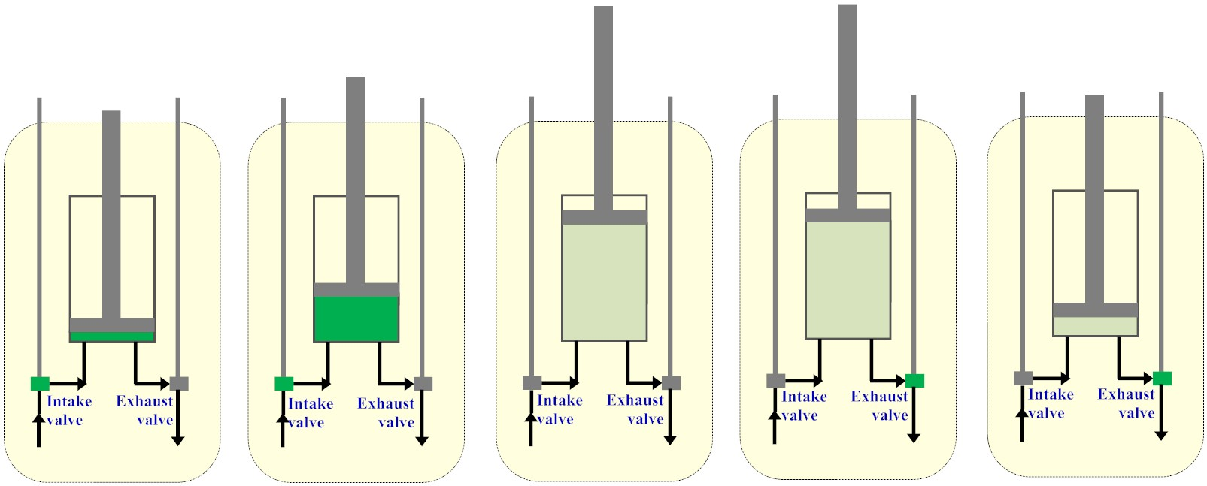
Expansion engine cycle
Work extraction
Work extraction
1
2
3
4
5
Minimal volume,
intake valve
opens
Filling cylinder,
then intake
valve closes
Valves closed,
constant mass
expansion
Maximal volume,
exhaust valve
opens
Cut-off volume,
exhaust valve
closes

Slide 5
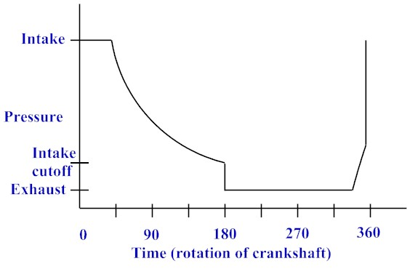
Pressure trace
2
3
1
4
5

Slide 6
Question for discussion tomorrow
“Square wave engine”

Slide 7
Square wave engine illustrates an interesting thermodynamics problem
“Square wave” engine problem
  Suppose intake valve is open for entire 180 degree intake stroke
  No closed-cylinder expansion
  Intake valve closes, then exhaust valve opens, so cylinder contents blow down from intake pressure to discharge pressure

Slide 8
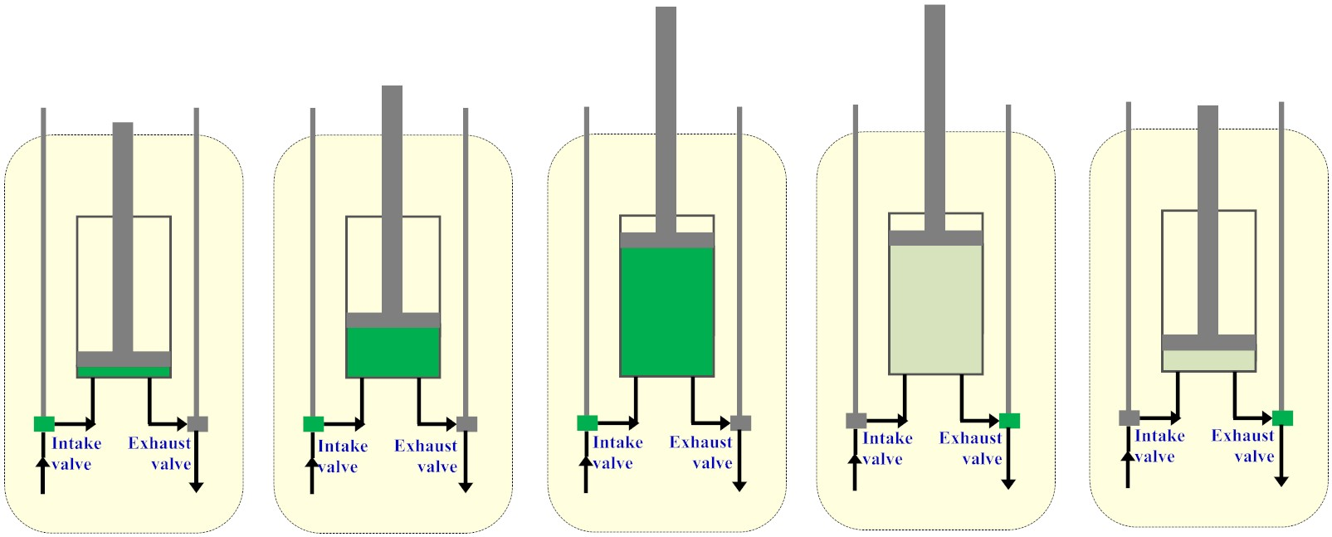
Intake valve open 180 degrees
Fill cylinder with intake valve open, then open exhaust valve

Slide 9
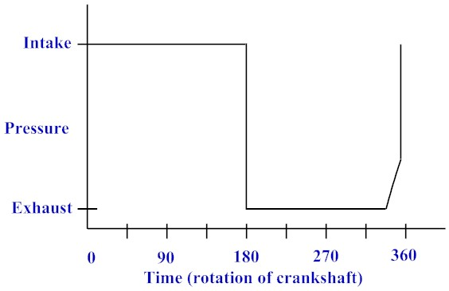
Square wave pressure trace

Slide 10
Square wave problem
Entire intake stroke at higher pressure than entire discharge stroke
Engine clearly does work, generates power
But no isentropic expansion
  No closed-cylinder expansion of any kind
Where does power come from? What gas properties change, and how? We’ll discuss that tomorrow.

Slide 11
Process description
Filling of cylinder at full intake pressure (minus some small pressure drop, in reality)
Intake valve closes
Exhaust valve opens (both not open at the same time, not even for a few msec!)
Exhaust valve opening and discharging contents from higher pressure to lower pressure is called “blowdown” in engines

Slide 12
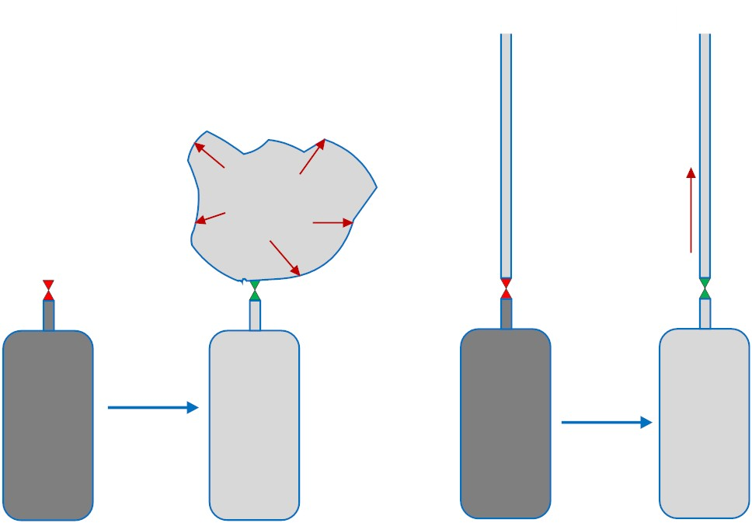
Blowdown – tank discharge
When pressurized gas is released,
it does work against the constant
atmospheric pressure or line pressure
into which it is released

Slide 13
Energy – inlet
Look at the process of filling the cylinder as the piston moves up
  Energy at the end of the fill process is
  E₁ = H₁ – P₁ V₁ = U₁ where P₁ is inlet pressure and V₁ is the displacement of the piston (neglecting dead volume)
  We end up with a closed volume of gas with its internal energy = U₁

Slide 14
Energy – exhaust
Look at the process of blowdown plus displacing the gas in the cylinder
  The gas flows out into pressure P₂, ultimately expanding to the new volume V₂
  After the piston has displaced the remaining gas out to pressure P₂, all the gas has exited with
  E₂ = U₂ +P₂V₂ = H₂

Slide 15
Energy balance
E₁ = E₂ implies U₁ = H₂
So the answer to the “square wave” engine problem regarding how the gas changed state is that the internal energy of the intake gas becomes the enthalpy of the exhaust gas
Mass is constant in this example, so u₁ = h₂

Slide 16
Example
Suppose we had inlet helium at 18 bar, 30 K and discharged to 2.0 bar
u₁ = u_{helium}(18 bar, 30 K) = 103.5 J/g
T₂ = T_{helium} (2 bar, h = 103.5 J/g) = ~ 18 K
  The real expansion would result in a higher temperature due to heat inleaks, valve leaks, dead volume, etc.

Slide 17
Isentropic expansion
Suppose again we had inlet helium at 18 bar, 30 K and discharged to 2.0 bar
s₁ = s_{helium}(18 bar, 30 K) = 13.48 J/gK
T₂ = T_{helium} (2 bar, s = 13.48 J/gK) = ~ 12 K
  The real expansion again would result in a higher temperature due to heat inleaks, valve leaks, dead volume, etc.

Slide 18
Conclusion
The “tank-filling” and “tank-discharge” processes do not depend on Joule-Thomson expansion but provide real warming or cooling as a result of compression or expansion of the gas
The “blow-down” of remaining gas (not the “square wave” cycle but a compromise) at the end of an expansion cycle does not too severely reduce efficiency, and it has the advantage that not requiring full expansion allows the admission of more gas per stroke into the cylinder

