Slide 1
SLC Damping Ring Direct Loop
USPAS LLRF final presentation
J. Yocky
January 20, 2017

Slide 2
System Overview and the Problem
SLC Damping Ring
1.19GeV
Up to 5e10 e-/bunch
Two bunch operation
One 60kW klystron driving two RF accelerating cavities of two cells each for a total of 1MV
Instability threshold
In order to prevent turbulent bunch lengthening, voltage is ramped down mid-store to keep bunch length long until extraction when voltage is ramped back to nominal
The Problem
At low cavity voltage, beam loading instability occurs because cavities tuned for optimum loading angle of 0 when at max voltage
Cavity tuning angle fixed during store due to mechanical tuners not fast enough to compensate

Slide 3
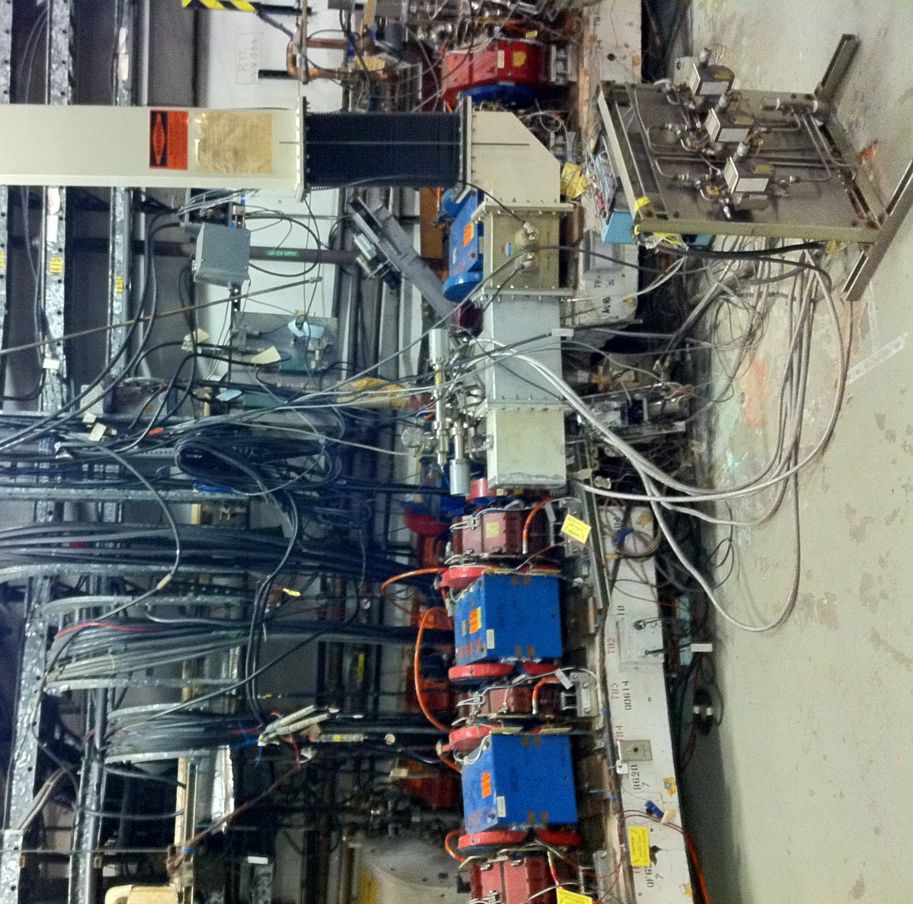
Inside the ring
Klystron in ring to right
Temperature stabilized to 105F

Slide 4
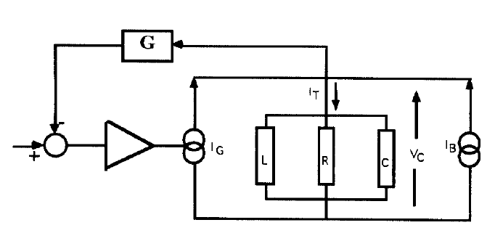
System Representation
Model the system as a resonant cavity driven by two current sources: the klystron and the beam.
I_T=current in cavity
I_B=beam current
I_G=generator current (klystron)
V_c=voltage of cavity
G=RF feedback
V_ref=Klystron Drive Signal
V_ref

Slide 5
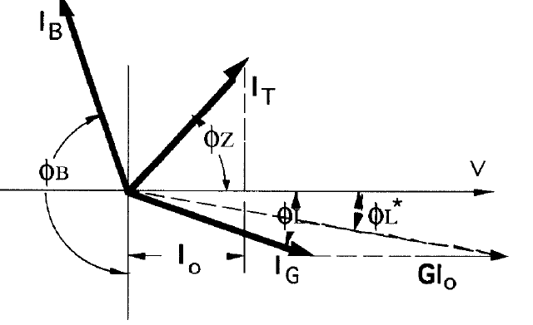
Phasor Representation of Currents
I_O=Real part of total current in cavity
Φ_B=Beam phase—determined by synchronous phase of particle
Φ_Z=Impedance angle—determined by cavity tuning wrt klystron
Φ_L=Loading angle—determined by angle between klystron current and cavity voltage
$$I_{G}=\frac{I_{O}(1+sinφ_{B})}{\cos\left(φ_{L}\right)}$$
$$tanφ_{L}=\frac{tanφ_{Z}−Ycosφ_{B}}{1+Ysinφ_B}$$

Slide 6
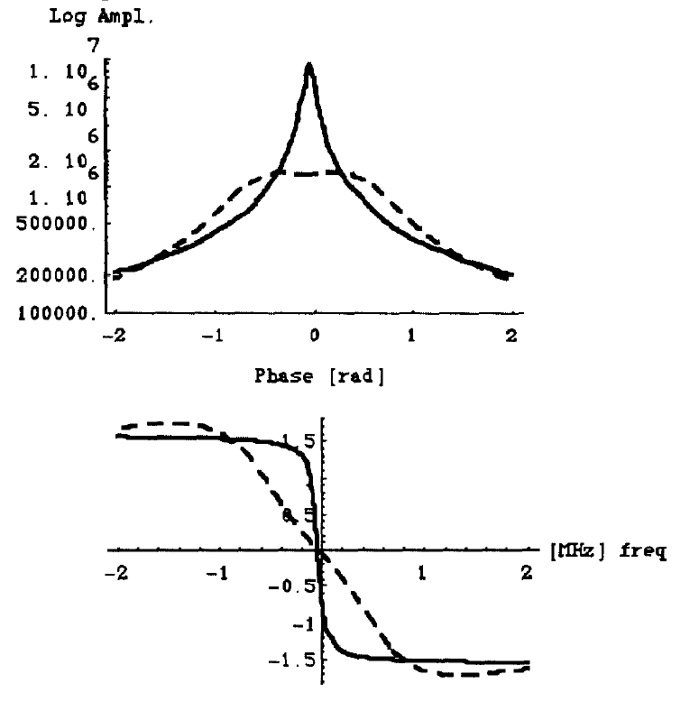
Modeled Behavior
Impedance function for ring parameters
Feedback transfer function where $G_{O}$= gain, $R_{SH}$= cavity shunt impedance, and ΔT=delay
Impedance for cavity plus feedback

Slide 7
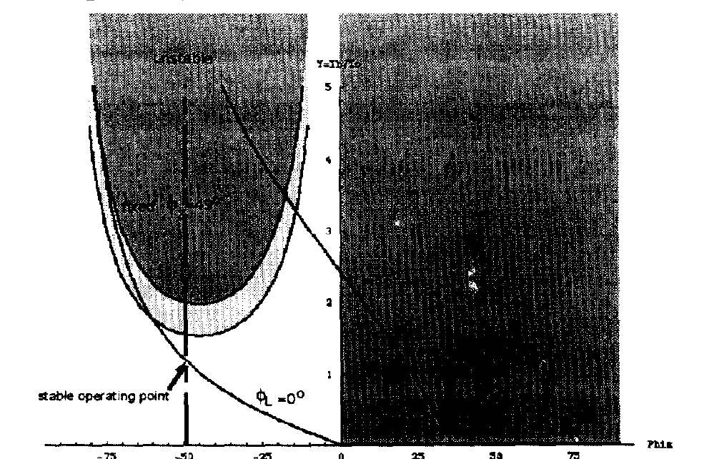
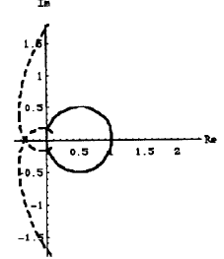
Gain and stability limits
Stability criteria:
Shaded region in plot at positive phase is anti-damping of synchrotron oscillations. Curved region on left is exponential growth. Vertical axis is Y=I_B/I_O.
At cavity frequency, Z=R_SH and G=G_0/R_SH, so effective impedance is reduced as 1/(1+G_0). Real part of cavity current increase by (1+G_0) and raises the shaded region on left by this amount.
Nyquist plot on right shows stability limit with (dashed line) and without feedback.
Phase shifts cause rotation and gain increase push curve to left. Allowing for phase margin limits effective impedance reduction

Slide 8
Direct Loop RF Feedback Implementation
Klystron and cavities are in tunnel, so signal path lengths are short
Two-cell cavities have a non-accelerating 0-mode which is close to the accelerating pi-mode
Probe signals from the cells combined with phase shifters and attenuators to suppress 0-mode
Cavity signals are then combined with phase shift and attenuation
Common phase and attenuation to tune feedback parameters remotely

Slide 9
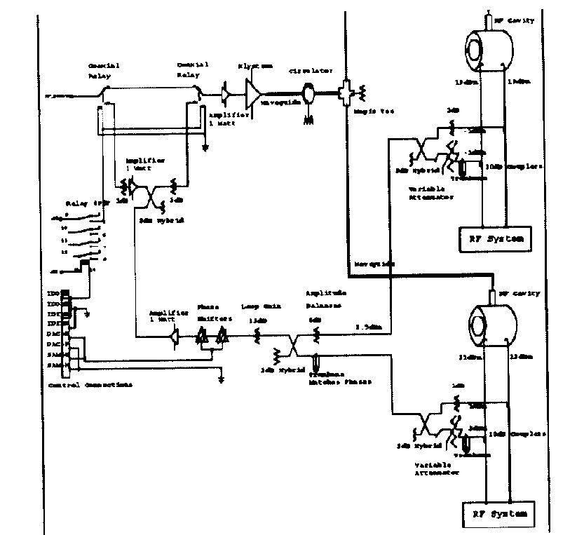
Implementation

Slide 10
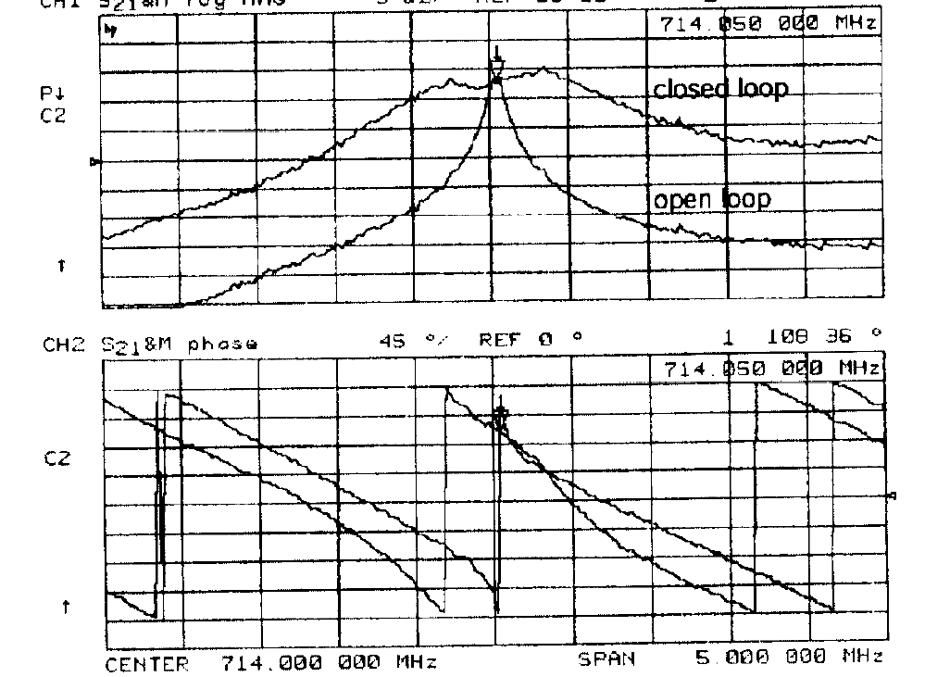
Measured Response

Slide 11
Observations
Direct Loop behaves as predicted from model
Suppresses beam loading instability
Straight forward implementation
Relatively simple design
Robust
Allows for physics parameters to be pushed

